Slide 1
Addressing Drinking Water Vulnerability in Extreme Drought
L’Oreal Stepney, P.E.
Deputy Director, Office of Water, TCEQ

Slide 3
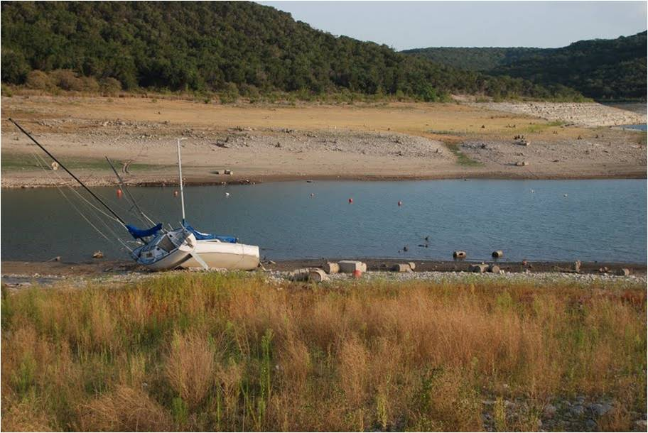
2011 Drought
October 4, 2011
97% of Texas in extreme or exceptional drought
Included all or part of all counties in Texas
February 21, 2012
37% of Texas in extreme or exceptional drought
Includes all or part of 124 counties in Texas

Slide 4
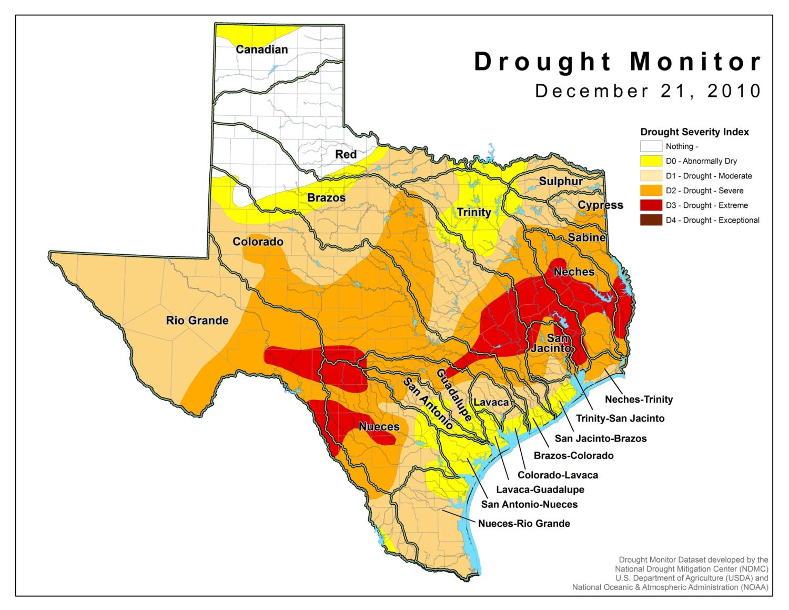

Slide 5
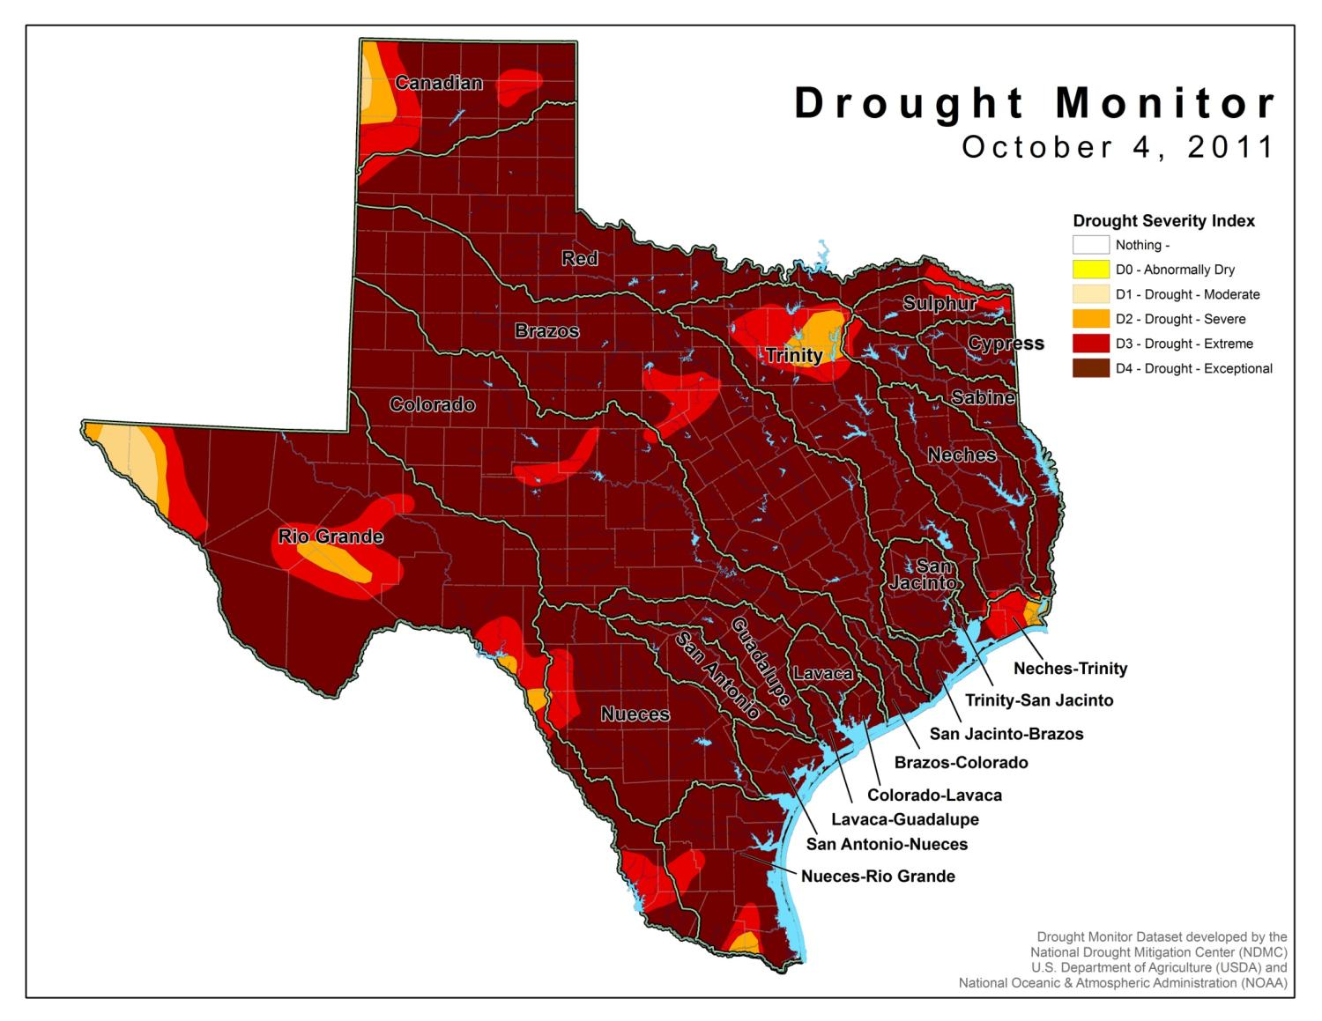
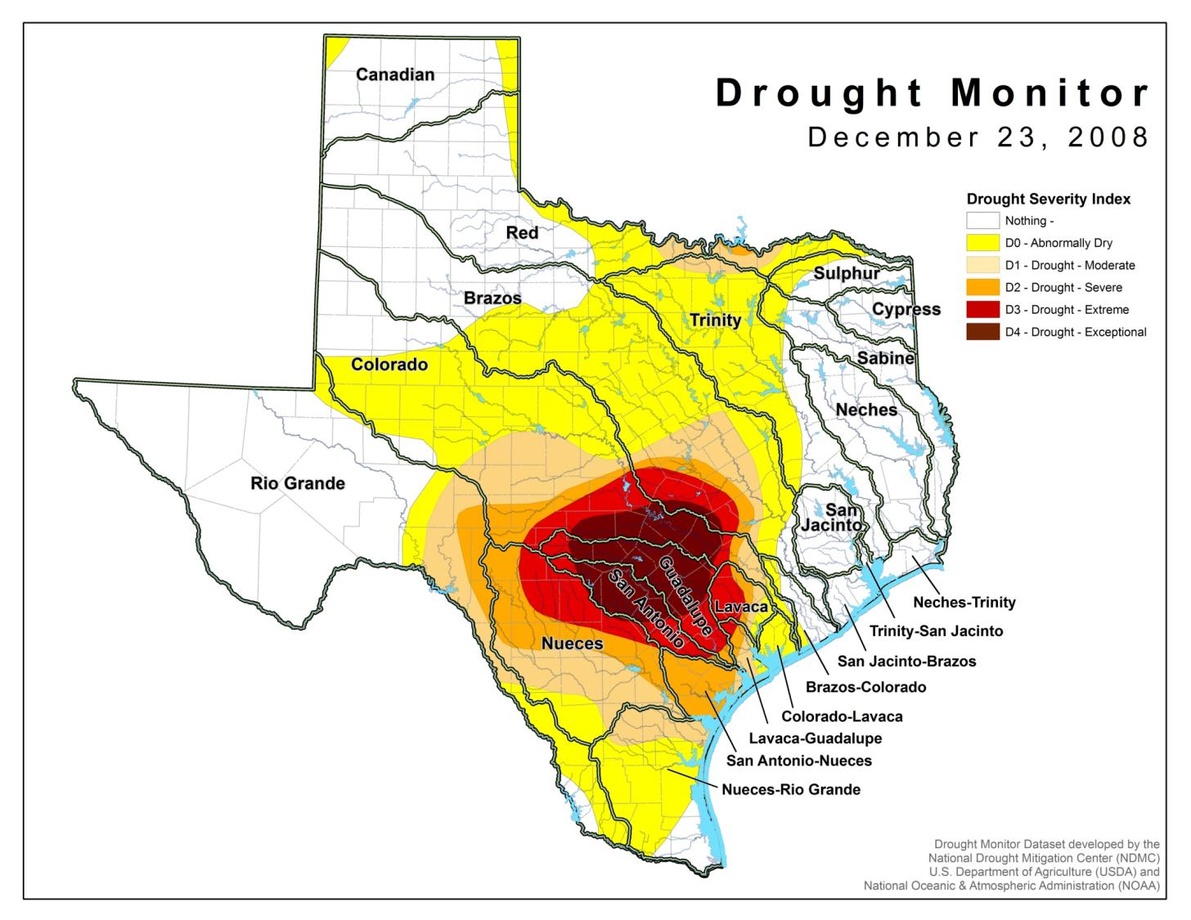

Slide 6
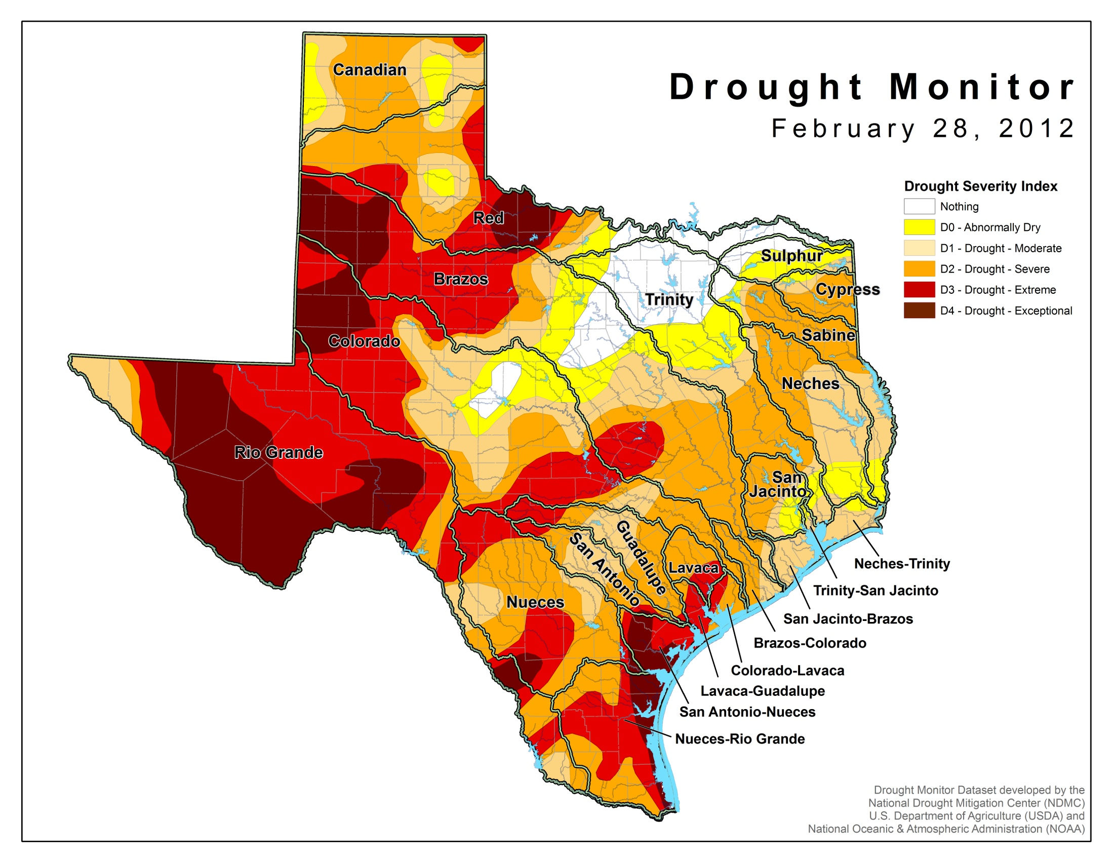

Slide 7
Senior Calls
TCEQ’s actions are guided by the Priority Doctrine
“First in time, first in right”
Superior rights: domestic & livestock uses
15 senior calls resulting in over 1,200 water right holders suspended

Slide 8
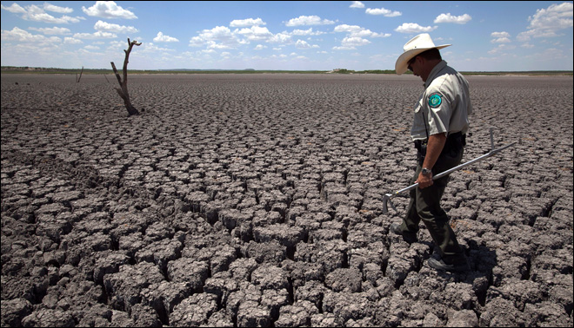
Senior Calls (cont.)
TCEQ stopped issuing temporary water right permits in affected basins
Suspended water rights have not included junior municipal or power generation uses

Slide 9
Senior Calls: New Issues
Governor’s Drought Proclamation
TCEQ managing new types of calls
Working with entities to manage:
Lake levels/temperatures at power plants
Releases from Lake Whitney
Changes to senior calls
Drinking Water Facilities

Slide 10
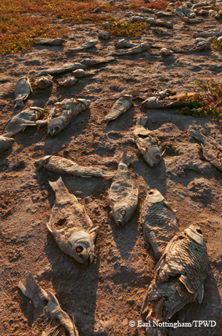

Slide 11
TCEQ Drought Response
TCEQ Drought Team
Weekly Drought Meetings
Drought Contingency & Water Conservation Plans
State-wide notifications
State leadership
Legislative officials
County judges
County extension agents
Water right holders
media

Slide 12
Public Water Systems & Drought
Outreach targeted at public water systems.
Approximately 6,000 public water systems in Texas.
Drought Information Webpage
State-level emergency assistance

Slide 13
Priority Public Water Systems
TCEQ intensively monitors public water systems:
High Priority List: unknown or <180 days of water
Watch List
Success Stories

Slide 14
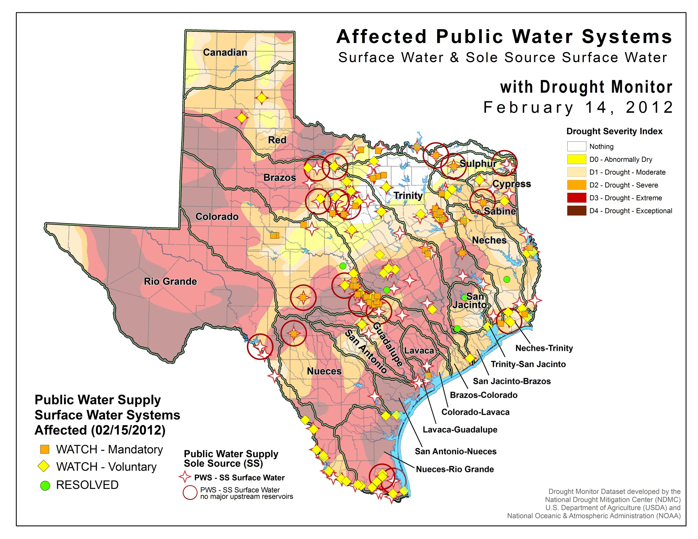

Slide 15
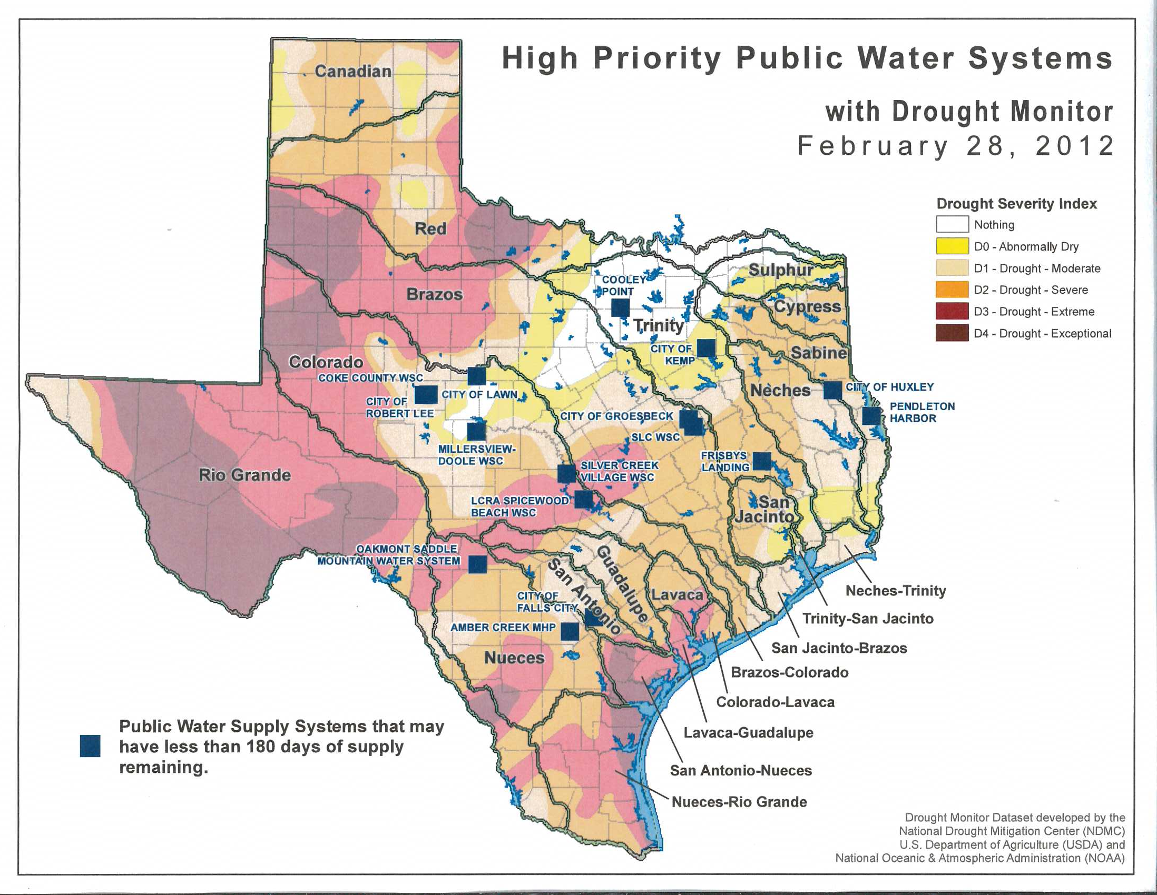

Slide 16
Public Water Systems - FMT
Financial, Managerial, & Technical (FMT) Assistance
Identifying alternative water sources
Coordination of emergency drinking water planning
Identification of possible funding sources for alternative sources of water

Slide 17
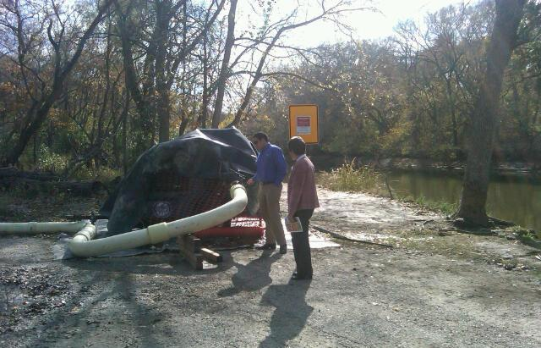

Slide 21
PWS Water Use Restrictions
February 17, 2012:
1,010 public water systems (PWS) with outdoor water restrictions
642 mandatory watering schedule
368 voluntary watering schedule
50 prohibited all outside watering

Slide 22
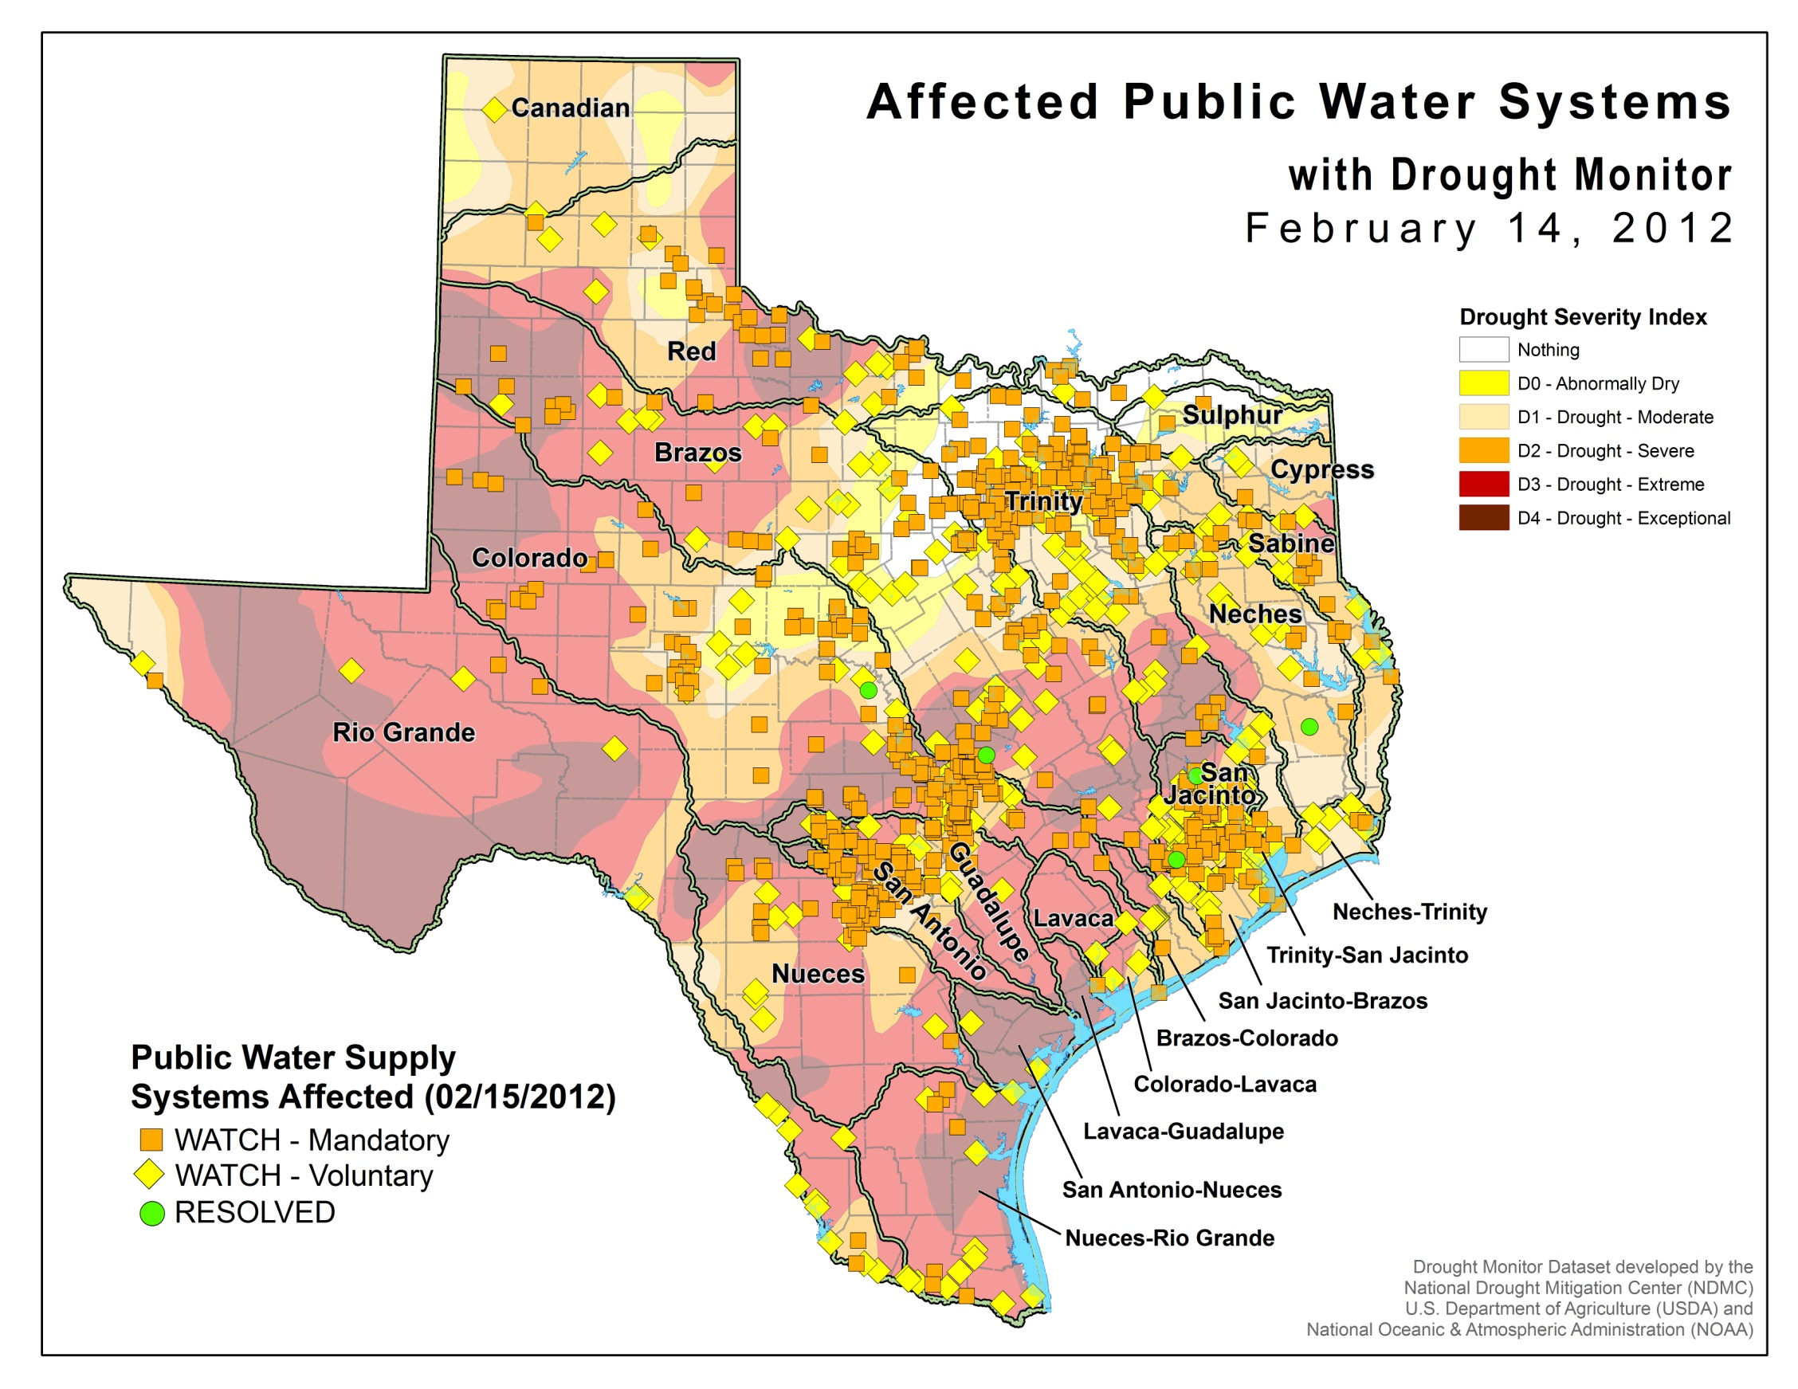

Slide 23
Drought Workshops
TCEQ is sponsoring Drought Workshops at 6 locations state-wide
Attended by state agency partners
Texas Department of Emergency Management
Texas Department of Agriculture
Texas Water Development Board

Slide 24
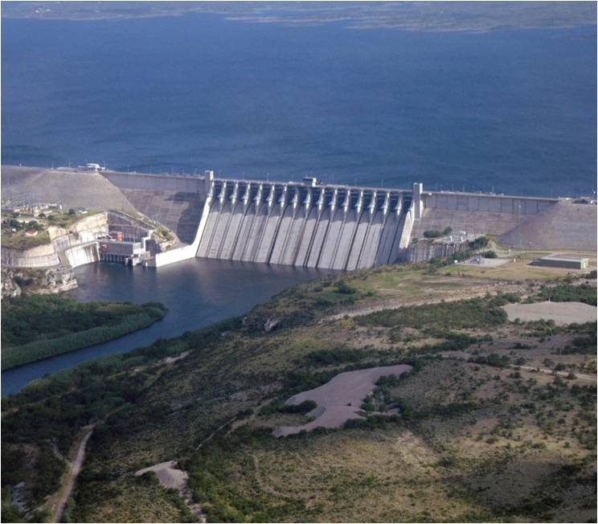
Watermasters
Texas has watermaster programs in areas of the state needing more active management of water rights.

Slide 25
Watermaster Areas

Slide 26
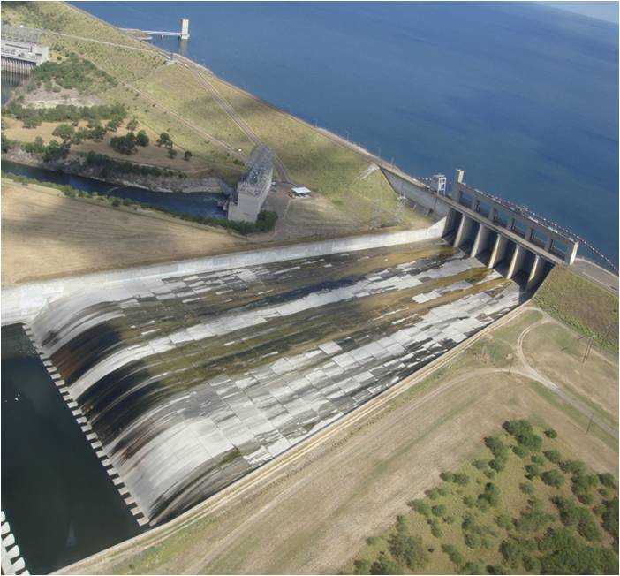
Watermasters in Drought
Watermasters work closely with users to meet water supply needs in times of shortages.

Slide 27
L’Oreal Stepney, P.E.
Deputy Director
TCEQ Office of Water
(512) 239-6696

