Slide 1
Stakeholder Meeting for Proposed Amendment to Concrete Batch Plant Standard Permit

Slide 2
Informal Comments
Email melanie.nelon@tceq.texas.gov
Deadline is November 30

Slide 3
Formal Comments after Proposal
Notice of proposal will be published in the Texas Register and newspapers
Submit formal comments on the proposed amendment in writing or by attending the public meeting.

Slide 4
Email Updates for Air Permitting
https://www.tceq.texas.gov/permitting/air/getupdates.html
Click “Sign up for updates”
Select “email” or “text”
Enter email or phone number
Select “Air Permitting” and “New Source Review Announcements”

Slide 5
Updates to Concrete Batch Plant Standard Permit Webpage

Slide 6
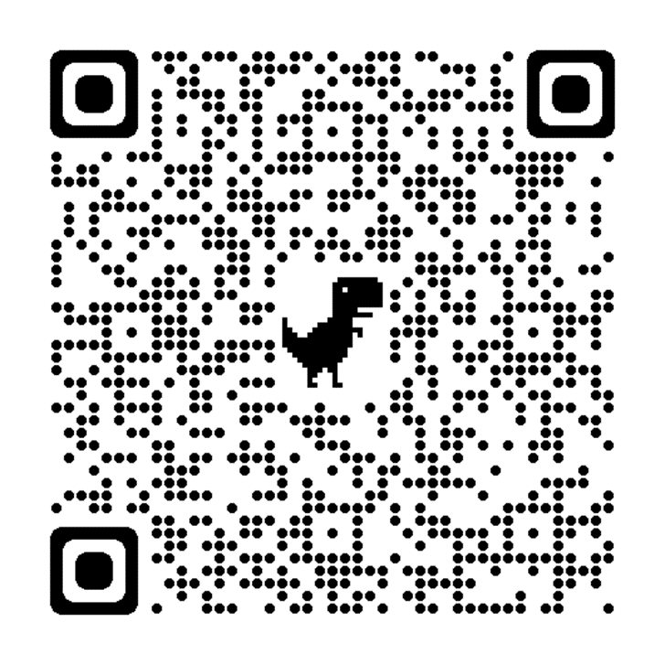
Cómo Participar
Someter comentarios informales antes del 30 de noviembre
Correo electrónico melanie.nelon@tceq.texas.gov
Suscríbase a las actualizaciones por correo electrónico de los permisos de aire
https://www.tceq.texas.gov/permitting/air/getupdates.html
Actualización de la página web del permiso estándar para Plantas Mezcladoras de Concreto

