Slide 1
Texas Pollutant Discharge Elimination System Stormwater Construction General Permit
TCEQ Stormwater Stakeholder Meeting
October 17, 2016
Stormwater & Pretreatment Team
(512) 239-4671

Slide 2
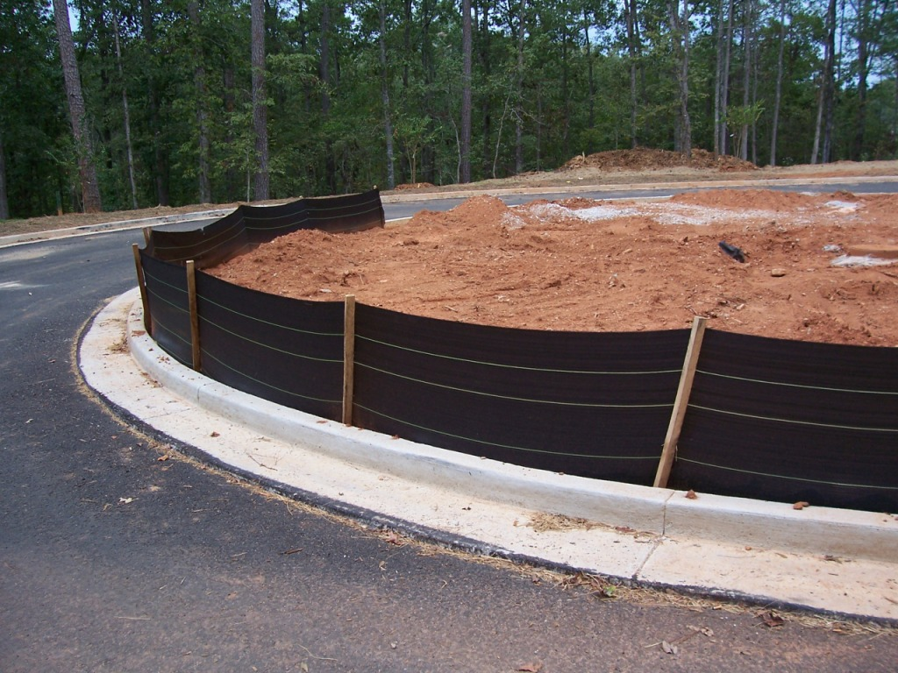
Renewal of TPDES Stormwater Construction General Permit TXR150000
Effective March 5, 2013
The CGP and all issued authorizations expire at midnight on March 4, 2018
Authorizations:
21,200 NOIs
4 Waivers
Notes:
Photograph of a circular driveway with a black silt fence and disturbed soil behind it.

Slide 3
2018 CGP Renewal
Existing permit:
expires March 4, 2018 at midnight
Renewal process began on Sept. 2016
Internal input requested from various TCEQ programs
Stakeholder Meeting - Oct. 17, 2016
Stakeholder comment period ends Nov. 1, 2016
Prepared draft permit and fact sheet Nov. 2016
Briefings
Director, Deputy Director, Executive Director, Commissioners

Slide 4
2018 CGP Renewal
EPA 90-Day Review – Dec. 2016 to Feb. 2017 *
Public Notice – June/July 2017 *
Public Meeting – July/August 2017 *
Agenda for adoption – February 2018
Permit issuance – March 5, 2018
* Tentative dates

Slide 5
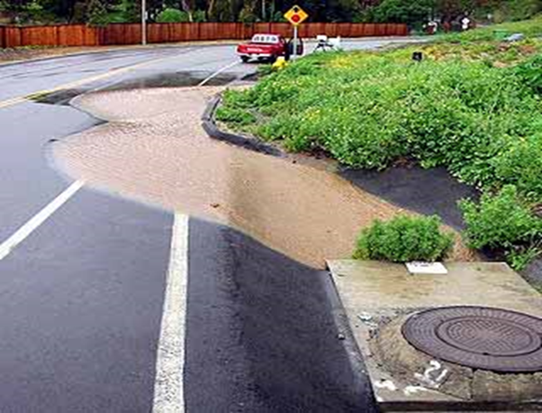
CGP Authorized Discharges
Stormwater Associated with Construction & Support Activities
Certain Non-Stormwater Discharges
Notes:
Discharges of stormwater runoff from small and large construction activities may be authorized under this general permit.
Construction support activities include, but are not limited to, concrete batch plants, rock crushers, asphalt batch plants, equipment staging areas, material storage yards, material borrow areas, and excavated material disposal areas.
Non-Stormwater Discharges
discharges from fire fighting activities
uncontaminated fire hydrant flushings (excluding discharges of hyperchlorinated water, unless the water is first dechlorinated and discharges are not expected to adversely affect aquatic life),
water from the routine external washing of vehicles, the external portion of buildings or structures, and pavement, where detergents and soaps are not used, where spills or leaks of toxic or hazardous materials have not occurred
uncontaminated water used to control dust;
lawn watering and similar irrigation drainage.

Slide 6
Construction Activity Soil Disturbance
Clearing
Grading
Excavation
Demolition
Activities that disturb or expose soil
Notes:
Similar Activities that Disturb / Expose Soil - Infilling Pits, Certain Mining Activities, Borrow Pits, Material or Equipment Storage Pads, etc.
Examples of construction support activities include, but are not limited to, concrete batch plants, rock crushers, asphalt batch plants, equipment staging areas, material storage yards, material borrow areas, and excavated material disposal areas.

Slide 7
What doe the Permit Cover?
Discharges of stormwater from soil disturbances due to construction activity
small construction = 1 acre to less than 5 acres
large construction = 5 acres or more
includes sites less than 1 acre that are part of a larger common plan of development or sale
excludes sites less than 1 acre that are not part of a larger common plan of development or sale
Notes:
Includes Sites of less than 1 Acre and part of a Larger Common Plan of Development – Houses in a Development, Buildings in a Shopping Center, etc.
Excludes Sites of less than 1 Acre that are not part of a Larger Common Plan of Development – Houses, Buildings, etc., that are stand alone projects that are not part of a sub-division, master planned community, shopping center, industrial complex, etc., etc.
Coverage applies only to activities covered by this permit. – Certain oilfield construction activities and oil and natural gas pipeline construction activities are not covered by TPDES permitting and require NPDES permitting that is applied for through the EPA. (EPA 2008 CGP)

Slide 8
Who needs a permit?
Primary Operator –
Person(s) with operational control over construction plans and specifications, including the ability to make changes to those plans and specifications
OR
Person(s) with day-to-day operational control of those activities at a site that are necessary to ensure compliance with a stormwater pollution prevention plan (SWP3)
Notes:
Easier to determine if broken down into individual Questions:
Does this person have operational control over construction plans and specifications? (Yes/No)
Does this person have the ability to make any changes to those plans and specifications? (Yes/No)
Does this person have any overall or day-to-day control of activities to ensure compliance with a SWP3? (Yes/No)
If yes to any or all of these, they are a Primary Operator.

Slide 9
Requirements Under the CGP
SWP3: develop, implement, and maintain a copy on-site (update as necessary)
Implement and maintain appropriate stormwater controls
Conduct required monitoring
Benchmark monitoring for concrete batch plants
Conduct routine inspections
Notes:
The SWP3 indicates the names and permit authorization number(s) for permittees with day-to-day control over activities that ensure compliance with the SWP3.
“Post a Copy of the Primary Operator Site Notice On-site, near the Main Entrance” - If a linear project, post a copy of the site notice close to the main construction activity.

Slide 10
Proposed Changes from Existing Permit
EPA Electronic Reporting Rule (40 CFR Part 127):
Starting December 21, 2020, all Notices Of Intent (NOI), Notices Of Termination (NOT), and Low Rainfall Erosivity Waivers (LREW) must be filed electronically.
Waiver Option will be available for certain reasons, such as; religious beliefs, no internet access, and others.
Final rule available at EPA website:
http://www2.epa.gov/compliance/proposed-npdes- electronic-reporting-rule
Notes:
List of major changes from the existing CGP that we are proposing in the renewal draft permit.

Slide 11
Proposed Changes from Existing Permit
EPA Electronic Reporting Rule:
Add clarification for the use of paper or electronic NOIs, NOTs, and LREWs and a statement of the date when e-filing commences.
TCEQ will require electronic submittal of all NOIs, NOTs, and LREWs as of March 5, 2018.
Notes:
List of major changes from the existing CGP that we are proposing in the renewal draft permit.

Slide 12
Proposed Changes from Existing Permit (con’t.)
Incorporate 2014 & 2015 Amendments to 40 CFR 450 (ELGs) into the CGP
Add the definition of “Infeasible.”
§450.11 (b) - Definition of “infeasible.” (Not technologically possible or economically achievable in light of best industry practices.)
Notes:
List of major changes from the existing CGP that we are proposing in the renewal draft permit.

Slide 13
Proposed Changes from Existing Permit (con’t.)
Incorporate 2014 & 2015 Amendments to 40 CFR 450 (ELGs) into the CGP
§450.21 (a)(1) – (Control volume, velocity, and erosion) Minimize pollutants in discharges.
§450.21 (a)(2) - Minimize channel and streambank erosion and scour in the immediate vicinity of discharge points.
§450.21 (a)(6) - Replace “surface waters” with “Waters of the U.S. (CGP – Surface water in the state); Maximize stormwater infiltration to reduce pollutant discharges, unless infeasible.
Notes:
List of major changes from the existing CGP that we are proposing in the renewal draft permit.

Slide 14
Proposed Changes from Existing Permit (con’t.)
Incorporate 2014 & 2015 Amendments to 40 CFR 450 (ELGs) into the CGP (cont’d).
§450.21 (a)(7) – Minimizing soil compaction not required where the intended function of a specific area dictates that it compacted.
§450.21 (a)(8) – Preserve topsoil, unless infeasible. Preserving topsoil is not required where the intended function of a specific area of a site dictates that the topsoil be disturbed or removed.
Notes:
List of major changes from the existing CGP that we are proposing in the renewal draft permit.

Slide 15
Proposed Changes from Existing Permit (con’t.)
Incorporate 2014 & 2015 Amendments to 40 CFR 450 (ELGs) into the CGP (cont’d).
§450.21 (b) – (Stabilization in arid, semi-arid, and drought-stricken areas) Stabilization must be completed within a period of time as specified by the permitting authority. In limited circumstances, stabilization may not be required if the intended function of a specific area of the site necessitates that it remain disturbed.
Notes:
List of major changes from the existing CGP that we are proposing in the renewal draft permit.

Slide 16
Proposed Changes from Existing Permit (con’t.)
Add the definition of “Low Rainfall Erosivity Waiver (LREW)” form
Revise the definition of Construction Activity to clearly capture “other construction-related activities” (i.e., soil disturbance that can occur from stockpiling of fill material and demolition)
Add clarification that person performing inspections required by the permit are not required to have signatory authority under 30 TAC §305.128. (All other permit requirements still apply.)
Notes:
List of major changes from the existing CGP that we are proposing in the renewal draft permit.

Slide 17
Proposed Changes from Existing Permit (con’t.)
Revise the benchmark monitoring level for Total Suspended Solids (TSS) from 100 milligrams per Liter (mg/L) to 50 mg/l to be consistent with the 2016 Multi-Sector General Permit (TXR050000) and the 2016 Ready Mixed Concrete General Permit (TXG110000).
Revise the limitations for permit coverage for construction activities related to oil and gas production to be consistent with the language in the MSGP permit and revise the title of the paragraph.
Notes:
List of major changes from the existing CGP that we are proposing in the renewal draft permit.

Slide 18
Proposed Changes from Existing Permit (con’t.)
Add clarification that operators of small construction activities must post a copy of a signed and certified Small Construction site notice and how it must be posted.
Add clarification that secondary operators of large construction activities must post a copy of a signed and certified Large Construction site notice and how it must be posted.
Notes:
List of major changes from the existing CGP that we are proposing in the renewal draft permit.

Slide 19
Proposed Changes from Existing Permit (con’t.)
Add clarification that posted small construction site notices may have a redacted signature as long as there is an original copy of a signed and certified site notice with a viewable signature located in a secure location at the site.
Reorganize the Waivers section to provide clarity regarding the requirements for discharge and disposal of non-stormwater when under a Low Rainfall Erosivity Waiver.

Slide 20
Proposed Changes from Existing Permit (con’t.)
Add footnote to the benchmark monitoring table for Concrete Batch plants to clarify that that analytical results for certain pollutants must to be obtained from a NELAP certified laboratory [30 TAC §25.4 (a)]
Add requirements for implementing controls to minimize the exposure of building materials containing polychlorinated biphenyls (PCBs) to precipitation and stormwater during demolition.

Slide 21
Proposed Changes from Existing Permit (con’t.)
Revise to clarify that an applicant who owns or operates a facility classified as an “unsatisfactory performer” is entitled to a hearing before the Commission prior to denial or suspension of authorization (Oct. 23, 2013 Commissioner’s Order on the Livestock Manure Composting General Permit, WQG200000).
Add clarification language in the permit to reference not only the 303 (d) List of Impaired Waterbodies, but also the Texas Integrated Report Index of Water Quality Standards for CWA Sections 305(b) and 303(d).

Slide 22
Proposed Changes from Existing Permit (con’t.)
Add requirements for minimizing the exposure of waste materials by keeping waste container lids closed when not in use.
Add new numbering system for master general permit, moving to TXR160000

Slide 23
Changes to Federal Regulations
March 6, 2014 – EPA published a Federal Register notice indicating that they had amended 40 CFR 450 as follows:
§450.11 by adding paragraph (b);
§450.21 by revising paragraphs (a) (1), (a)(2), (a)(6), and (a)(7); adding paragraph (a)(8); revising paragraph (b); revising paragraph (d)(2);
§450.22 by removing and reserving paragraphs (a) and (b).
Notes:
Since this Presentation was developed the EPA has postponed the Numeric Turbidity Limit - On August 13, 2010 motion the EPA filed with a federal court of appeals asking it to declare that its numeric turbidity limit is void and to send that limit back to the agency for reconsideration and review. The EPA plans to re-examine its numeric turbidity limit through a "narrowly-tailored notice-and-comment rulemaking” and revise the limit if necessary. The courts allowed the EPA to keep the rule but the EPA will work on revising the numerical limit for turbidity and issue that number at a later date.

Slide 24
Changes to Federal Regulations (cont’d)
May 4, 2015 – EPA published a Federal Register notice indicating that they had amended 40 CFR 450 as follows:
§450.22 [Corrected] by lifting the indefinite stay on paragraphs (a) and (b); and removing and reserving paragraphs (a) and (b).

Slide 25
EPA’s National CGP
EPA is renewing its CGP for 2017
EPA’s CGP for 2017 includes
The amended Construction and Development ELGs
The EPA Reporting Rule
Other changes

Slide 26
Stakeholder Meeting
Any issues with existing permit?
Any suggestions for the new permit?
Any questions for staff?

Slide 27
TXR150000 Renewal
Stakeholder Comments and Input?
Please e-mail: SWGP@tceq.texas.gov
Subject Line: “2018 CGP Renewal”

Slide 28
Web Links
Stormwater Home Page:
https://www.tceq.texas.gov/permitting/stormwater/
Stormwater Stakeholders Group (SWSG) Web Page:
http://www.tceq.texas.gov/permitting/Stormwater/stormwater_stakeholders_group.html#construction
EPA 2017 Construction General Permit Web Page:
https://www.epa.gov/npdes/stormwater-discharges-construction-activities#overview
EPA SWP3 Guidance:
https://www3.epa.gov/npdes/pubs/industrial_swppp_guide.pdf
EPA National Menu of BMPs:
https://www.epa.gov/npdes/national-menu-best-management-practices-bmps-Stormwater#edu
Click on link for “Construction”

Slide 29
TPDES Stormwater Program Contacts
Rebecca L. Villalba, Team Leader
Lindsay Garza, Work Leader
Hanne Lehman Nielsen
Gordon Cooper
Dan Siebeneicher
Elizabeth Dickenson
Kent Trede
Austin office (512) 239-4671
SWGP@tceq.texas.gov

