Slide 1
§106.359. Planned Maintenance, Startup, and Shutdown (MSS) at Oil and Gas Handling and Production Facilities.

Slide 2
Overview
MSS Schedule in 30 TAC § 101.222(h) January 5, 2012
SB 1134 moved the deadline for Oil and Gas to January 5, 2014
Must meet 30 TAC § 106.4

Slide 3
PBR 106.359
(1) engine, compressor, turbine, and other combustion facilities maintenance;
(2) repair, adjustment, calibration, lubrication, and cleaning of site process equipment;
(3) replacement of piping components, pneumatic controllers, boiler refractories, wet and dry seals, meters, instruments, analyzers, screens, and filters;
(4) turbine or engine component swaps;
(5) piping used to bypass a facility during maintenance;
(6) planned MSS activities with the same character and quantity of emissions as those listed in paragraphs(1-5) of this subsection;

Slide 4
PBR 106.359
(7) pigging and purging of piping;
(8) blowdowns;
(9) emptying, purging, degassing, or refilling of process equipment, storage tanks and vessels (except landing floating roof tanks for convenience purposes), if subparagraphs (A) - (C) of this paragraph are met.
(10) abrasive blasting, surface preparation, and surface coating of facilities and structures used at the site in oil and gas handling and production.

Slide 5
MSS PBR Timeline
March 15-April 15, 2013 Comment Period
July 26, 2013
Adoption
September 10, 2013
Effective Date
January 5, 2014
O&G Authorizes Planned MSS

Slide 6
MSS Authorization Options

Slide 7
106.352 (i)-Planned Maintenance, Startups and Shutdowns
Options:
Counties required to be registered under 106.352(a-k) must use (i)
Counties voluntarily registered under 106.352(a-k) have an option to revise to 106.352 (l).
Registering/Representing MSS-January 5, 2014

Slide 8
106.359-Planned MSS at O&G Handling & Production Facilities
Applicability
No superseding of existing authorization
Planned MSS Activities
PBR does not require registration
Best management practices
Keep records

Slide 9
106.359 Construction Authorizations (Title V, NSR, Standard Permit)

Slide 10
Title V
106.359 required for permit
Minor revision
OP-NOTIFY

Slide 11
NSR (New Source Review)
106.359 used to increase specific activities
Activities must be in compliance with rules
106.359 may not be used to remove existing special conditions

Slide 12
Standard Permits
106.359 not incorporated §116.620
Referenced at renewal
No hourly emission requirements

Slide 13
MSS Options-Barnett Shale
30 TAC §106.352(a)-(k)
Authorized under §106.352(i)
Non-Rule Standard Permit
Authorized under Section (i)
Painting and Blasting authorized under §106.263
Painting and Blasting authorized under §106.263

Slide 14
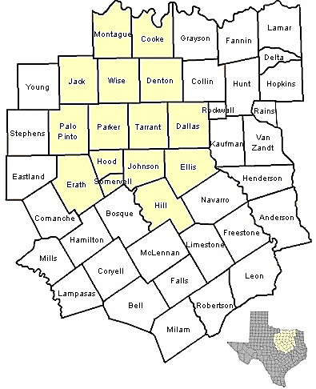
Barnett Shale Counties

Slide 15
What is the difference between Scheduled Maintenance, Planned Maintenance, and Upsets?

Slide 16
What is the difference between Scheduled Maintenance, Planned Maintenance, and Upsets?
• Scheduled maintenance, startup, or shutdown activities are routine and predictable and are scheduled using time constraints.
• These activities should be included in the company’s maintenance program.

Slide 17
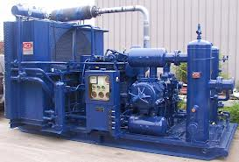
What is the difference between Scheduled Maintenance, Planned Maintenance, and Upsets?
Engine oil will be changed every three months.

Slide 18
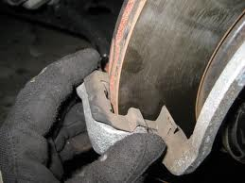
What is the difference between Scheduled Maintenance, Planned Maintenance, and Upsets?
Planned activities are routine and predictable, similar to scheduled maintenance, but planned maintenance is not necessarily scheduled for a specific date in the future.
For example: The brake pads on the car will be changed when the thickness is less than 1/8 inch.

Slide 19
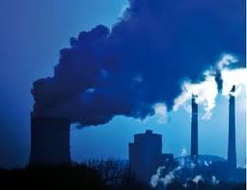
What is the difference between Scheduled Maintenance, Planned Maintenance, and Upsets?
Planned maintenance can be performed on an accelerated timeframe when a facility is shut down due to an emissions event.

Slide 20
What is the difference between Scheduled Maintenance, Planned Maintenance, and Upsets?
For example:
Emission event causes the engine shut down.
While engine is down, planned maintenance is performed.
Emissions during maintenance and the subsequent startup of the facility may be claimed as planned maintenance.
Emissions from the initial emission event that caused the engine shutdown cannot be claimed as planned maintenance

Slide 21
What is the difference between Scheduled Maintenance, Planned Maintenance, and Upsets?
Unplanned and unavoidable
This PBR does not authorize emissions associated with emissions events, malfunctions, upsets, unplanned startup, unplanned shutdown, or unplanned maintenance activities that require immediate corrective action.

Slide 22
MSS Examples

Slide 23
Lily Site
Compressor
Sales
Gas
Gas
VRU
Flare
Separator
Crude
Tank 1
Tank 2
Incoming Product
Crude Pipeline

Slide 24
MSS Example 1
Gas to atmosphere
Closed
for
Repairs
Compressor
Sales
Gas
Gas
Best management practice would be to route the emissions to the flare as a control, if the control can handle the gas and if it can be routed to the flare.
VRU
Flare
Separator
Crude
Tank 1
Tank 2
Incoming Product
Crude Pipeline

Slide 25
MSS Example 2
Compressor
Sales
Gas
Gas
Closed
for
Repairs
VRU
Flare
Gas
Separator
Crude
Tank 1
Tank 2
Incoming Product
Crude Pipeline

Slide 26
MSS Example 3
Compressor
Sales
Gas
Gas
VRU
Flare
Closed
for
Repairs
Separator
Degassing
Crude
Tank 1
Tank 2
Incoming Product
Crude Pipeline

Slide 27
Summary
Compressor
Sales
Gas
Gas
VRU
Flare
Separator
Crude
Tank 1
Tank 2
Incoming Product
Crude Pipeline

Slide 28
Calculation of Emissions from MSS Activities at Oil & Gas Production Facilities

Slide 29
Calculation Programs
TCEQ is aware of two programs that can do MSS emissions calculations.
TCEQ Oil and Gas Emissions Calculations Spreadsheets
Tanks ESP

Slide 30
MSS Default Values for Miscellaneous Activities
Spreadsheet contains the default value of a total of 0.25 tons per year for all activities authorized by 106.359(b)(1)- 106.359(b)(6).
No calculations necessary!
The spreadsheet also allows more customized estimates of emissions for applicants choosing not to accept default values.

Slide 31
MSS Default Values for Miscellaneous Activities
The emissions in activities (b)(1)-(b)(6) may seem small, but they do add up over time. All default values are conservative.
Ex: (b)(1) Engine Oil changes / Filter changes. -Number of activities per year is 10 (Number of oil changes per engine per year) -Number of Engines is set at 10 -Allows for 100 oil changes per year

Slide 32
MSS Default Values for Miscellaneous Activities
Customization of the default spreadsheet is possible.
Ex: A Glycol Dehydration and Amine unit are not present. -Emissions not used for these Units can be used for other activities.

Slide 33
MSS Default Values for Miscellaneous Activities
Best option? Use the default values.
It is as easy as selecting “Yes” at the top of the Spreadsheet page.
Can help with record keeping
Equations located at the bottom of the spreadsheet page.
MSS Default Values for Miscellaneous Activities

Slide 34
TCEQ Oil and Gas Emissions Calculations Spreadsheet
Blowdowns
MSS pigging
MSS Floating Roof Tank Landing Losses
MSS Tank Non Forced Ventilation Degassing
MSS Tank Forced Ventilation Degassing http://www.tceq.texas.gov/assets/public/permitting/air/NewSourceReview/oilgas/spreadsheet-revisions.pdf

Slide 35

Equations: Located on bottom of each Spreadsheet
Blowdowns and MSS Pigging and Piping Components: -Emission estimates based on Ideal Gas Law PV=nRT. -VOC result = ((Pressure of Gas Inside the Unit Before Venting) * (Actual Volume of the Vented Unit)) / (Frequency of events) * (Molecular Weight) * VOC wt%
Engine Oil change/Filter change Two components to Emissions: -Losses from emptying of oil into an open pan can be estimated using AP-42 Loading Equation: $LL=12.46 \frac{SPM}{T}$ -Evaporation Losses from open pan:$L_{E }^{}=4.14 ∗{10}^{−5}{US}_{}^{0.78}PV$M_{W}^{0.67} A_{p}^{0.94} t
Changing Solution in Glycol Dehydration Units and Amine Units -AP-42 Loading Equation:$LL=12.46 \frac{SPM}{T}$ -AP-42 Clingage Loss Equation: $\text{L}\text{SL} \text{max}\text{ = 0.60 (}\text{PVv}\text{ / }\text{RT}\text{) }\text{Mv}$

Slide 36
Equations: Located on bottom of each Spreadsheet
Changing Engine Rod Packings and Wet/Dry Seals and Heater Treaters: -Emissions result from the evaporation of the lubricant adhered to the rod packing and seal casings. -AP-42 clingage equation: $\text{L}\text{SL} \text{max}\text{ = 0.60 (}\text{PVv}\text{ / }\text{RT}\text{) }\text{Mv}$
Aerosol Lubricants: Emissions from the use of aerosol lubricants such as WD-40 can be estimated by assuming that 50% of the contents of a 16 oz can are volatile hydrocarbons that will volatilize.
Calibration: Emissions resulting from the use of calibration gases can be estimated by weighing the calibration gas cylinder every time it is used.

Slide 37
Painting and Sandblasting
Air Permit Technical Guidance for Coatings Sources: Surface Coating Operations.
Small Business and Local Government Assistance
Surface Coating Facilities: Emissions Calculation Spreadsheet http://www.tceq.texas.gov/assistance/industry/sc/coating-emissions-calc.html
TCEQ Technical Guidance : Abrasive Blast Cleaning
Emissions from Aerosol Cans (paints, paint removers, rust inhibitors, etc.) Assume that 90% of the can contents evaporate

Slide 38
Where to Find More Information
Air Permits Main Line : (512) 239-1250
airog@tceq.texas.gov
www.texasoilandgashelp.org

