Slide 1
Direct Assistance Guidance Demonstration: Electronic Modeling Evaluation Workbook (EMEW)
Chad Dumas Modeling Assessment Specialist
Air Permits Division
Autumn Environmental Conference October 8, 2019

Slide 2
Overview
Brief Introduction
Updates in EMEW Version 2.3
Frequently Asked Questions
Common Issues & Recommendations
Other Air Dispersion Modeling Updates

Slide 3
Brief Introduction
Advantages:
Directs applicant to provide exactly what is needed
Minimizes deficiencies and common mistakes
Promotes consistent data for internal processing
Implementation Path:
Available: October 2018
Required: June 1, 2019
Last Revised: October 2019
Modeling audit review time improvement
Notes:
All minor projects utilizing modeling to complete an impacts analysis must include an EMEW with the application submittal. Beginning June 1, 2019, we are currently accepting the March 2019 version (also referred to as Version 2.0) and forward of the EMEWs.
The next version of the EMEW will be version 2.3 and we hope to release it later this month.
We’re seeing these advantages come to life as modeling audit review times have decreased by 40% compared to non-EMEW projects.

Slide 4
Updates in EMEW Version 2.3
Notes:
Image attribution:
https://texashillcountry.com/next-red-meat-emu-farming/

Slide 5
EMEW Version 2.3 will include:
Secondary Formation of PM_{2.5} sheet
Updated with finalized EPA MERP guidance (April 30, 2019)
Updated with latest Toxicology ESL list
Notes:
These updates apply to both the Non-SCREEN3 and SCREEN3 EMEWs.
The MERPs Demonstration Tool for Calculating Secondary PM_{2.5} Impacts still functions the same way. It will include the finalized MERPs guidance released by the EPA on April 30, 2019.
The finalized EPA MERPs guidance can be found here: https://www3.epa.gov/ttn/scram/guidance/guide/EPA-454_R-19-003.pdf
PM = particulate matter
MERP = modeled emission rates for precursors

Slide 6
Monitor Calculations sheet includes out of state option
Street Address and City: | 2320 N. Jefferson St., Hobbs, Lea County, New Mexico
County: | Other State: fill in full address in cell above
Notes:
The EMEW will include the option to report the use of a monitor outside of Texas. Select “Other State” from the County dropdown list and report the full address in the Street Address and City cell above.
Table Description:
This represents the cells on the Monitor Calculations sheet where the applicant will select from a drop-down list the county of the selected background monitor and enter in its full address.

Slide 7
Expanded source input sheets in the Non-SCREEN3 version
The Non-SCREEN3 EMEW will include:
1000 point source parameter entries
200 area source parameter entries
350 volume source parameter/calculation entries
1500 point + flare emission rate entries
750 area source emission rate entries
750 volume source emission rate entries
Notes:
This update only applies to the Non-SCREEN3 EMEW. It is not expected that a SCREEN3 analysis would require this amount of source input space.
The Non-SCREEN3 EMEW will include:
-1000 point source parameter entries
-200 area source parameter entries
-350 volume source parameter & calculation entries
-1500 point + flare emission rate entries
-750 area source emission rate entries
-750 volume source emission rate entries

Slide 8
Frequently Asked Questions (FAQ)
“It isn’t a Texas emu without a cowboy hat.”
-imgur user
Notes:
Image attribution:
https://imgur.com/gallery/A3GAG0U

Slide 9
There is not a place to report “____” in the EMEW, what should I do?
“Other Attachments Provide a list below of additional attachments….”
Notes:
In a situation where there is not a designated place to report information in the EMEW, it is acceptable to provide the information as an attachment. All attachments should be listed on the General worksheet under “Other Attachments”.
Some common examples of other attachments are line source parameters and emission rates, source group descriptions, and MERA Step 3 post-processing calculations.

Slide 10
Not enough source input space
I have more sources than what will fit on the source parameter and emission rate sheets. What should I do?
Notes:
Hopefully the newly expanded source input sheets will alleviate the need for this; however, in the case where all source input information will not fit on one EMEW, submit two EMEWs (or as many needed):
First EMEW will contain all project information with source parameter and emission rate sheets maxed out
Second EMEW will contain only information related to the source input information
Note the source parameter information should correlate with the emission rate information entered in each EMEW.
If you still find yourself running out of room to report source input information, contact us.

Slide 11
Where do I report off-property source information?
Source Description
Notes:
Each modeling analysis is conducted on a case-by-case basis. If off-property sources are evaluated in a minor modeling demonstration, off-property source parameters and emission rates should be reported in the EMEW. An additional attachment should be provided that details source information, such as:
EPN and model ID cross reference table (if needed)
Associated Permit No.
Associated RN
Name of supporting permit document and location of where information was found within document
Justification for supplementing any source parameters and/or emission rates

Slide 12
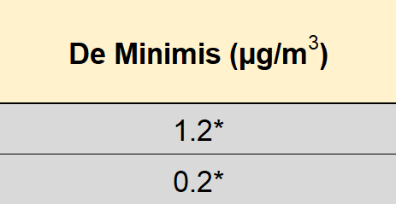
What if I want to use an annual PM_{2.5} SIL of 0.3 µg/m³?
Notes:
Currently, the EMEW is set up to utilize the recommended annual PM_{2.5} SIL of 0.2 µg/m³. Applicants may still use the annual PM_{2.5} SIL of 0.3 µg/m³.
SIL = Significance Impact Level

Slide 13
Annual PM_{2.5} SIL of 0.3 µg/m³
Where do I provide the necessary SIL justification?
Yes!
Notes:
When using an annual PM_{2.5} SIL of 0.3 µg/m³ , the applicant should provide the necessary SIL justification following guidance found in the AQMG. This justification can be provided as an attachment with the EMEW.
Using an annual SIL of 0.3 µg/m³ can affect the secondary formation of PM_{2.5} analysis. The applicant should account for this when conducting the analysis. Be sure to document this as an attachment with the EMEW.
The AQMG can be found here: https://www.tceq.texas.gov/assets/public/permitting/air/Modeling/guidance/airquality-mod-guidelines6232.pdf

Slide 14
On the Background Justification sheet, there are certain cells grayed out under the Monitor Justification Data table, why?
Monitor Justification Data
Notes:
Depending on the location of the project site and selected monitor, the EMEW will filter for reasonable justification data. In this example, both the project site and monitor are located in Harris County. Therefore, comparing county emissions data, county population data, and considering regional aspects of both locations would not be reasonable justification.
Tip: when clicking on the individual cells of this sheet, a small box will appear with guidance pertaining to that cell.

Slide 15
Using a non-Texas monitor in EMEW version 2.2
Additional Information
How are off-property sources accounted for?
Monitoring data set year(s)/Additional Justification:
County:
Notes:
In EMEW version 2.3, when selecting a monitor outside of Texas, the Monitor Justification Data table will filter for reasonable justification data accordingly.
However, if using a monitor outside of Texas in version 2.2 (or an earlier version of 2), leave the county cell blank and report it in the Additional Justification cell on the Background Justification sheet. Even though no county is entered, the Monitor Justification Table will filter for reasonable justification data based on the distance of the monitor to the project site.
Table Description:
Simulation of the Additional Information section on the Background Justification sheet of the EMEW.

Slide 16
On the Secondary Formation of PM_{2.5} sheet, the calculator is not functioning, why?
Notes:
When the MERP calculator is not properly filled out, it will not calculate a MERP value nor the resulting total secondary value. This is an example of what the calculator looks like when the instructions are not followed. As one can see, the project increases and source selection inputs are filled in, but no result is calculated.
tpy = tons per year

Slide 17
Using the Secondary Formation of PM_{2.5} sheet:
Precursor | Project Increases (tpy) | Source Selection
Nitrogen Oxide (NO_{x})
Sulfur Dioxide (SO₂)
Notes:
The instructions for using the MERP calculator are at the top of the sheet in the EMEW and are listed in a step-by-step fashion. Follow the instructions to avoid errors when using the MERP calculator:
1) Project Increases (tpy): Enter the total proposed project emission increases in tons per year (tpy) for NO_{x} and SO₂. If the project does not have any NO_{x} or SO₂ increases, enter 0 tpy. Note if one of the precursor pollutants are not entered, this will cause the calculator to not function.
2) Source Selection: Select the site-specific source or worst-case MERP from the drop down.
NO_{x} = nitrogen oxide
SO₂ = sulfur dioxide
Table Description:
Simulation of an empty MERPs calculator on the Secondary Formation of PM_{2.5} sheet of the EMEW. The two precursor pollutants in the table are NO_{x} and SO₂. Both of the project increases and source selection cells are empty.

Slide 18
Using the Secondary Formation of PM_{2.5} sheet continued: (Selection of Variables)
 | Selection of Variables
Source Selection | Emission Rate (tpy) | Height (m)
20_Harris | 500 | L
20_Harris | 500 | L
Notes:
Using the Secondary Formation of PM_{2.5} sheet continued:
3) Emission Rate (tpy): If not utilizing worst-case MERPs, select an emission rate in tpy that is representative of the corresponding precursor project increases from the drop down.
4) Height (m): If not utilizing worst-case MERPs, select the release height that is most representative of the corresponding precursor release height from the drop down.
Table Description:
Continuation of a simulation of MERPs calculator on the Secondary Formation of PM_{2.5} sheet. For both precursors, the 20_Harris County source, 500 tpy emission rate, and L (low) release height variables are selected.

Slide 19
Using the Secondary Formation of PM_{2.5} sheet continued: (MERP Values)
 | Selection of Variables |  | MERP Values
Source Selection | Emission Rate (tpy) | Height (m) | 24-hr | Annual
worst-case
20_Harris | 500 | L | 384 | 2590
Notes:
Using the Secondary Formation of PM_{2.5} sheet continued:
Continuing with the example from the previous slide, if an emission rate and/or release height is entered and the source selection is then changed to the worst-case source, the calculator will not function properly. Be sure the Selection of Variables cells are empty when using the worst-case source selection.
Tip: whenever cells are grayed out when they shouldn’t be or are not calculating results, be sure that you followed the EMEW instructions. If a selection in a drop down list is changed, the following cells will not automatically refresh. Be sure to update the following information accordingly. Also, if information was not entered correctly on earlier sheets, this could cause cells to gray out later in the EMEW.
Table Description:
Continuation of a simulation of MERPs calculator on the Secondary Formation of PM_{2.5} sheet. The NO_{x} precursor source selection was switched from “20_Harris” to “worst-case”, which caused the Selection of Variables cells to gray out. However, the cells weren’t cleared before switching to “worst-case”, causing the MERP Values cells to be empty. The SO₂ precursor is still using the 20_Harris source, 500 tpy, and L (low) release height which equate to a 24-hr MERP value of 384 and an annual MERP value of 2590.

Slide 20
How much of the EMEW should be filled out when submitting modeling information with the permit application submittal?
Completely filled out!
Notes:
The EMEW should be completely filled out except for the modeled results sections. While not required, it is recommended to submit modeling files with the permit application. Modeling information submitted with the permit application should include information for the proposed model (AERMOD, SCREEN3, etc.).
ADMT highly recommends submitting an updated initial EMEW if significant changes are made to the modeling methodologies initially submitted with the permit application.

Slide 21
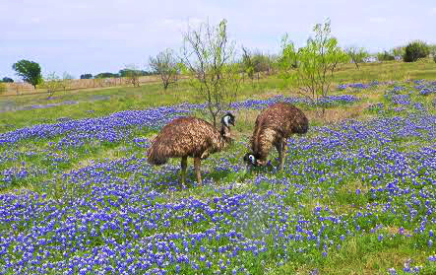
Common Issues & Recommendations
Notes:
Image attribution:
https://freerangequest.wordpress.com/2014/04/23/the-willow-grove-emu-farm/
Photo courtesy of Dave Shriner

Slide 22
Using the Modeling Scenario column
Modeling Scenario | Scenario Description
Routine
MSS_A
MSS_B
MSS_C
EPN | Model ID | Modeling Scenario
FLARE-1 | FL01 | Routine
FLARE-1 | FL01MSSA | MSS_A
FLARE-1 | FL01MSSB | MSS_B
FLARE-1 | FL01MSSC | MSS_C
Notes:
The intent of the modeling scenario column is to distinguish sources that have unique parameters for things like operational scenarios. If a source’s parameters do not change, leave this column blank. Information pertaining to modeled source groups should be provided as a supplemental attachment.
In this example, a flare can operate in several different MSS modes, each with a unique effective stack diameter. When entering this information into the EMEW, each flare will be entered with a unique model ID and corresponding modeling scenario name. The scenario is then described on the Modeling Scenarios sheet. The modeling scenarios will be pre-populated based on the scenarios entered on the source parameter sheets earlier in the EMEW.
Table Descriptions:
“Flare Table”: Simulation of the Flare Source Parameters sheet of the EMEW. This example lists FLARE-1 for all EPNs with a unique Model ID and Modeling Scenario: Model IDs FL01, FL01MSSA, FL01MSSB, and FL01MSSC and scenarios Routine, MSS_A, MSS_B, and MSS_C, respectively.
“Modeling Scenarios Table”: Simulation of the Modeling Scenarios sheet of the EMEW. The modeling scenarios listed are pre-populated based on the scenarios entered earlier in the EMEW (Routine, MSS_A, MSS_B, and MSS_C). The simulation shows the area where the applicant would enter a description of the scenario.

Slide 23
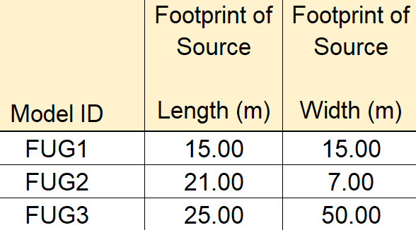
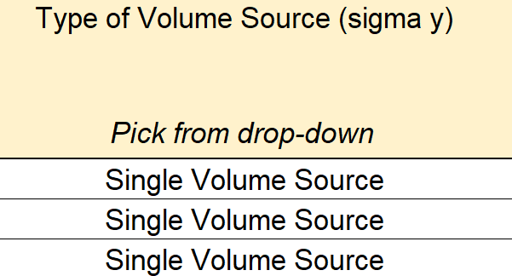
Calculating the Sigma Y value on the Volume Source Calculations sheet
Notes:
Regarding the sigma Y volume source calculations, we have seen multiple EMEWs where the footprint of the volume source is representative of multiple volume sources; however, the single volume source option is modeled.

Slide 24
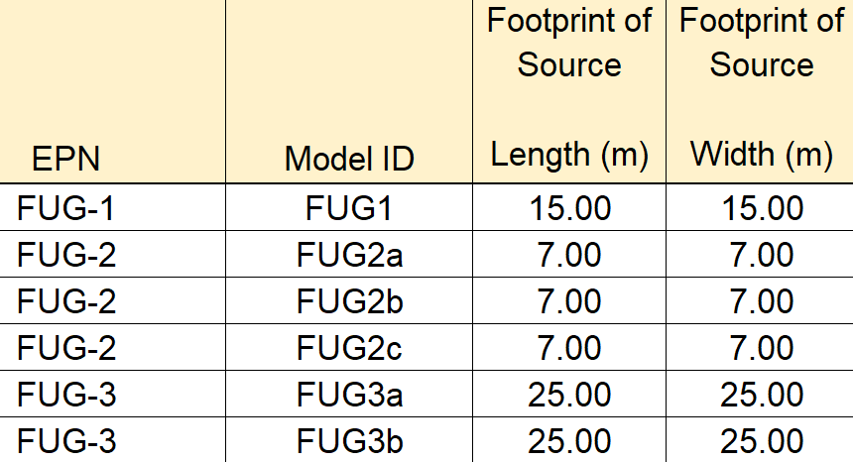
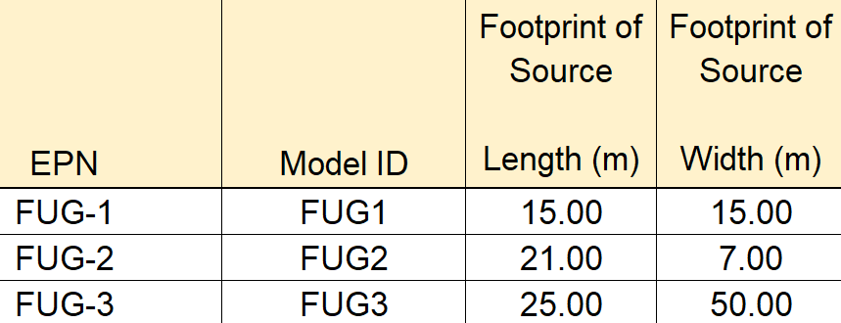
Calculating the Sigma Y value on the Volume Source Calculations sheet continued
Notes:
As a reminder, applicants can still utilize the multiple volumes approach when calculating the sigma y value with the EMEW. When the length and width footprint of the source is at a 2:1, 3:1, 4:1, etc. ratio, this is best represented using the multiple volume source approach.
Adjusting the example from the previous slide, EPNs FUG-2 and FUG-3 are now correctly entered as multiple volume sources based off its footprint.

Slide 25
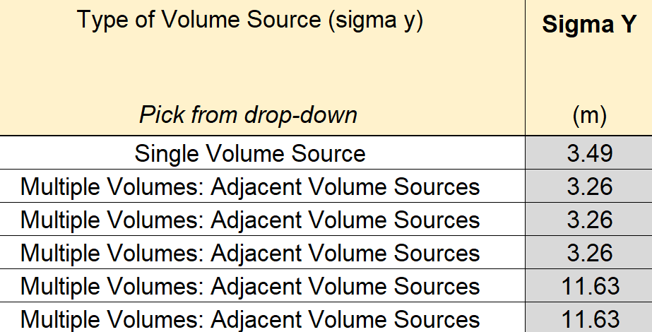
Calculating the Sigma Y value on the Volume Source Calculations sheet continued (Type of Volume Source)
Notes:
Expanded example of volume source calculations sheet filled in using the multiple volume source option.

Slide 26
Fill out General sheet accurately
Processed Met Data Information section
Additional Attachments (as applicable): Note: These are just a few examples of attachments that may need to be included. There may be others depending on the scope of the modeling analysis. |  | Select an X from the dropdown menu if included:
Processed Met Data Information
Excel spreadsheet of processed meteorology data. | Choose an item | Choose an item
Meteorological Files (all input and outputs). | Choose an item | Choose an item
Notes:
The Processed Met Data Information section only applies when an applicant does not utilize TCEQ preprocessed meteorological data. Additional attachments for this section should only be submitted if the applicant is processing their own meteorological data.
The EMEW should be correctly filled out to avoid potential questions from the ADMT and aid in a speedy review process.
Table Description:
A simulation of the Processed Met Data Information section on the General sheet of the EMEW. This section of the EMEW prompts the user to select an X from the dropdown menu if including the listed additional attachments. This specific table prompts the user to select an X from the dropdown menu if submitting 1) an excel spreadsheet of processed meteorology data, and/or 2) Meteorological Files (all input and outputs).

Slide 27
Fill out Model Options sheet accurately
Receptor Grid
Describe any other receptor grid designs (over water, GLC_{ni}, SPLD, etc.):
Notes:
The EMEW has a designated space on the Model Options sheet for applicants to document cases of special receptor grids. We have received multiple EMEWs where a special receptor grid was modeled but was not documented in the EMEW. The slide includes an example of the type of information that should be documented here.
The EMEW should be correctly filled out to avoid potential questions from the ADMT and aid in a speedy review process.
SPLD = single property line designation
Table Description:
A simulation of the Receptor Grid section of the Model Options sheet on the EMEW. The screenshot shows a blank cell where the user would describe any other receptor grid designs (over water, GLC_{ni}, SPLD, etc.).

Slide 28
Fill in the acknowledgement statement selection
General Information
Acknowledgement: | Select from the drop down:
I acknowledge that I am submitting an authorized TCEQ Electronic Modeling Evaluation Workbook and any necessary attachments. Except for inputting the requested data, I have not changed the TCEQ Electronic Modeling Evaluation Workbook in any way, including but not limited to changing formulas, formatting, content, or protections. | Choose an item
Notes:
It is extremely important that applicants fill in the acknowledgement statement of the EMEW. This can be found at the top of the General sheet. If an applicant submits an EMEW without filling out the acknowledgement statement, it will not be accepted.
Table Description:
Simulation of acknowledgement statement in EMEW: I acknowledge that I am submitting an authorized TCEQ Electronic Modeling Evaluation Workbook and any necessary attachments. Except for inputting the requested data, I have not changed the TCEQ Electronic Modeling Evaluation Workbook in any way, including but not limited to changing formulas, formatting, content, or protections. The applicant is required to select an item from the drop down menu.

Slide 29
Common Issues & Recommendations (1 of 3)
A .pdf version of the EMEW is not required for ADMT review. Only the excel EMEW is required.
Delete all internal comments prior to submittal.
Incorporate comments from initial EMEW review into final modeling submittal.
Notes:
Whether for the permit application submittal or final modeling submittal, a .pdf version of the EMEW alone does not satisfy the submittal requirements.
ADMT review needs:
Electronic (excel) version of EMEW
Any supporting attachments
Modeling files (recommended for application submittal but not required)
All internal comments should be deleted prior to submittal. The ADMT will not accept an EMEW with internal comments.
To avoid potential questions from the ADMT and aid in a speedy review, incorporate comments from the initial EMEW review into the final modeling submittal.

Slide 30
Common Issues & Recommendations (2 of 3)
Read all instructions, tips, notes, and warnings.
Review examples for how to fill it in.
Fill out in order of sheet and do not skip around.

Slide 31
Common Issues & Recommendations (3 of 3)
Fill out the EMEW before finalizing modeling.
Use the latest version.
Watch EMEW YouTube Guidance videos.
Notes:
A link to the EMEW YouTube Guidance videos can be found later in the presentation.

Slide 32
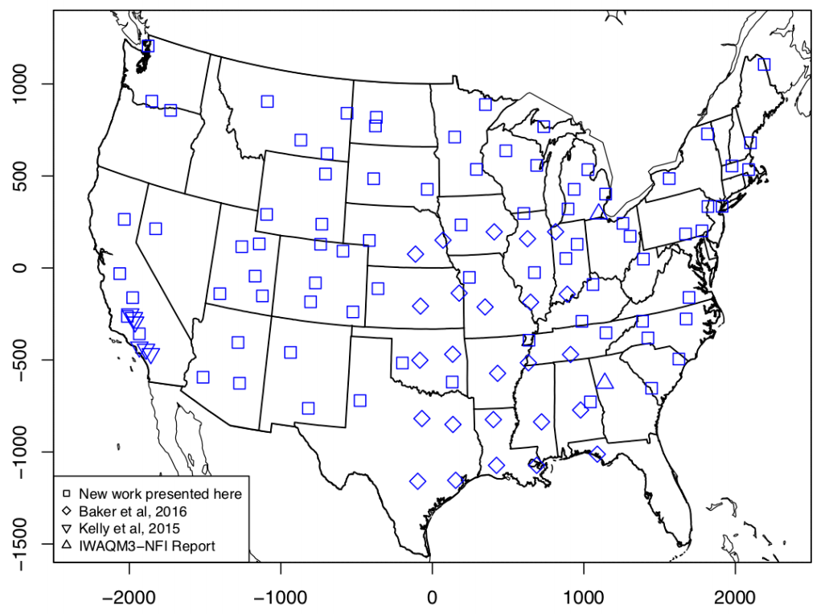
Other Air Dispersion Modeling Updates
Notes:
Image attribution:
https://www3.epa.gov/ttn/scram/guidance/guide/EPA-454_R-19-003.pdf
Image edited with emu (animal) graphics at the locations of hypothetical sources in Texas.

Slide 33
Other Air Dispersion Modeling Updates (1 of 2)
Updated Appendix Q & R of AQMG
New version of AERMOD (19191) - August 21, 2019
TCEQ pre-processed met data still compatible.
Notes:
Current met data on our website should work with latest AERMOD version. Contact us if you experience any issues.

Slide 34
Other Air Dispersion Modeling Updates (2 of 2)
Terrain data for AERMOD/AERSCREEN
https://www.epa.gov/scram/interim-access-and-process-use-1992-nlcd-and-ned
SO₂ SIP designations: 24-hr and annual analyses still required for PSD increment
Notes:
The Multi-Resolution Land Cover Characteristics (MRLC) Consortium website is no longer providing the terrain data that can be used in AERMOD/AERSCREEN modeling analyses. The EPA has an interim solution for retrieving terrain data until a more permanent solution can be developed. Follow the link above for information on the interim solution that includes step-by-step instructions on retrieving terrain data. Be aware, the data will not be in *tiff format. However, the EPA webpage has instructions on how to convert the data into tiff format for input into AERMAP.
Even though the 24-hr and annual SO₂ primary standards have been revoked for most counties in Texas, the PSD increment requirement is still in effect for all counties in Texas.

Slide 35
Coming Soon
Coming Soon
New TCEQ pre-processed met data
New version of AERSURFACE
EPA Guidance
Revised Guidance for PM_{2.5} Permit Modeling – any day now…

Slide 36
Take Home Points (1 of 2)
Modeling review times decreased when using an EMEW
Watch EMEW YouTube Guidance videos
Notes:
A link to the EMEW YouTube Guidance videos can be found later in the presentation.

Slide 37
Take Home Points (2 of 2)
Presentation after this, How Modeling and NSR Permitting Interact
1:15 p.m. to 2:00 p.m. (in this room)
Contact us with EMEW feedback/questions
ADMod@tceq.Texas.gov
Notes:
The How Modeling and NSR Permitting Interact presentation focuses on how the EMEW is incorporated within the NSR permitting process.
We highly encourage EMEW feedback! Whether good or bad, it is important we hear from applicants and consultants.

Slide 38
Websites
NSR Application Tools:
https://www.tceq.texas.gov/ permitting/air/guidance/ newsourcereview/nsrapp-tools.html
EMEW YouTube Guidance videos:
https://www.tceq.texas.gov/ goto/nsrapptools-videos
Gov Delivery Sign Up:
https://public.govdelivery.com/ accounts/TXTCEQ/subscriber/new
Notes:
NSR Application Tools website contains:
The PI-1 workbook;
The EMEWs; and
Industry specific tools.
EMEW YouTube Guidance video website contains links that will open videos on the TCEQ YouTube Channel for the PI-1 General Application and EMEW.

Slide 39
Contact Information
Chad Dumas
Phone: (512) 239-2057
Email: Chad.Dumas@tceq.Texas.gov
Notes:
Image attribution:
https://austinzoo.org/birds/

