Slide 1
Preparing for Severe Weather Events
Presented by:
Paige Ruth-Pritchard

Slide 2
Presentation Outline
Severe weather varieties
Emergency preparedness plans (EPP)
Important to do’s
Critical infrastructure
Preparation

Slide 3
Preparedness Proverb
“If you fail to plan, you are planning to fail”
- Benjamin Franklin

Slide 4
Severe Weather Varieties
Hurricanes
Tornadoes
Straight Line Winds
Hail
Extended cold and freezing
Flooding
Drought
Notes:
Talk about Hail damage in Dallas where they had to do multiple rebuilds of the plant.

Slide 5
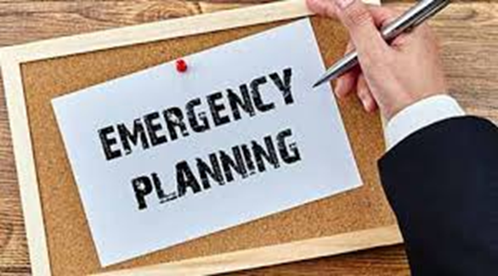
Emergency Preparedness Plan (EPP)
An EPP is a water system’s plan for maintaining a water pressure of 35 or 20 psi throughout the distribution system during an extended period without power (e.g., more than 24 hours)

Slide 6
Who needs an EPP?
As per SB 3, all community water systems and any noncommunity water system that provides overnight accommodations.

Slide 7
Important To Do’s
TXWARN membership
Mutual aid agreement(s)
Critical infrastructure designation
Identify critical customers
Tabletop/emergency preparedness drills
Update plant and distribution maps/schematics
Develop/update plant operation manuals
Develop/implement an asset management program
Develop/implement a preventative maintenance program
Protect critical infrastructure (e.g., winterize, etc.)
Notes:
- identify critical customers – talk about the hospitals during Harvey and them not having water for weeks. The hospital called R10 and asked it they could have water stored onsite at all times in big tanks to prevent this in the future. They also talked about becoming their own PWS. ( one thing is bottled water but in an event like this the roads are not passible and cannot get bottled water or water haulers)
- practice at least once a year a mock natural disaster drill and have all staff involved in it.
- update plant and distribution maps/schematics – example would be you need to figure out where a valve is located but you cannot find it because the maps are out of date. Another examples would be talking to your field guys making sure that when a valve is turned off that is turned back on after the disaster.
Plant operations manuals should include a section for man-made and natural disasters and what the plant is going to do in the even of those happening.
Preventative maintenance – checking generators on a viweekly basis -

Slide 8
Critical Infrastructure
Source water
  Wells
  Intakes
Treatment/booster plants
Pressure tanks
Storage tanks
  Elevated
  Ground/clearwells
Chemical feeding facilities
Treatment plant piping/appurtenances

Slide 9
Critical Infrastructure Cont.
Sensors and monitoring equipment
Control valves (e.g., flow control, altitude, etc.)
Automation (e.g., SCADA)
Generators
Distribution network
  Piping
  Fire hydrants
  Valves (e.g., flush, gate, etc.)
  Meters

Slide 10
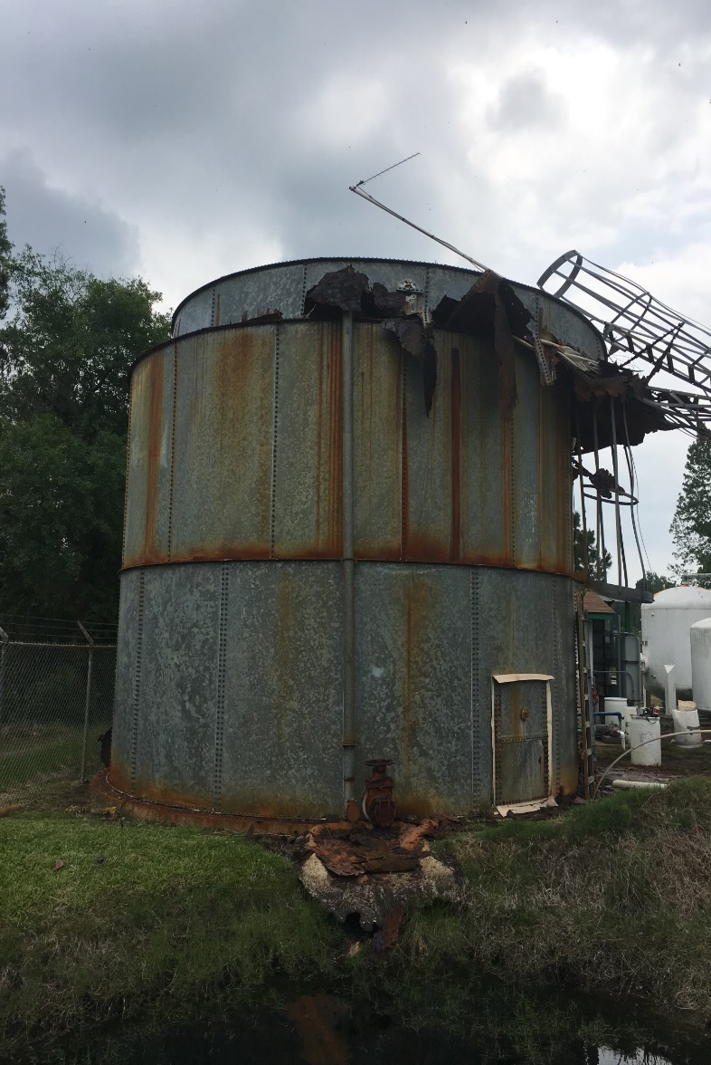
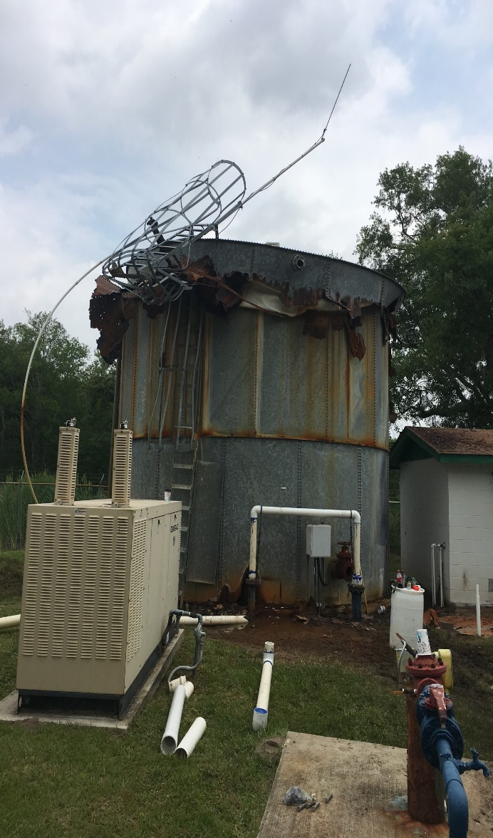
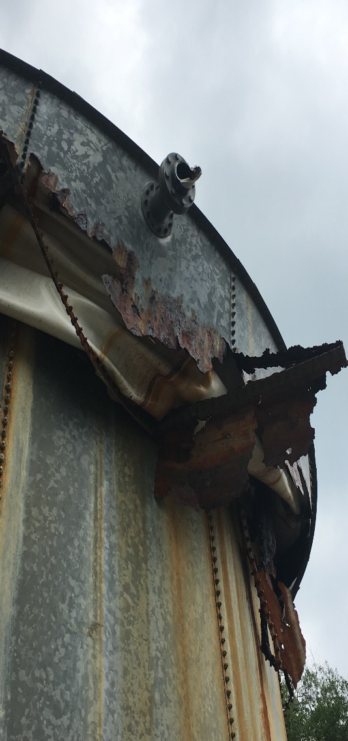
Critical Infrastructure Example
Notes:
- preventative maintenance of critical infrastructure if you see the tank is starting to have significant rust. Budgeting out money or getting in fixed before hurricane season would be best.

Slide 11
Preemptive Checklist
Develop a preemptive plan checklist
Establish deadlines for completion
Define who will be responsible for ensuring checklist(s) is/are completed.
Begin working on the checklist well before severe weather sets in.
Notes:
- have a staff meeting monthly to check up on these issues and see if they are being taken care of. Also, come up with a list together involving everyone not just mayor or city manager. Operators should be included in planning and making list.
Develop a preemptive plan checklist (e.g., winterization, flood protection, etc.)

Slide 12
Fuel/Chemicals
Purchase extra fuel
  Replenish:
  Petroleum storage tanks
  Fuel cans
  Vehicles
Add fuel treatment/additives (e.g., extreme cold, long-term storage, etc.)
Stage fuel cans at remote locations in case road conditions limit access (make sure that they are protected from weather and heat sources)
Ensure that you have at least a 15-day supply of water treatment chemicals (based on the design capacity of the treatment plant).
Notes:
Never go below a 15 day supply of chemicals at all times.
Storing
Stage fuel cans at remote locations in case road conditions limit access (make sure that they are protected from weather and heat sources)
Ensure that you have at least a 15-day supply of water treatment chemicals (based on the design capacity of the treatment plant).

Slide 13
Chemical Storage/Feeders
Tether storage tanks/gas bottles to a secure foundation or wall.
Make sure that chemicals susceptible to freezing are stored in insulated/warmed storage tanks
Ensure that dry chemicals are stored in an area not prone to flooding or busted pipes
Insulate (heat tape, insulation or both):
  Chemical feeder lines
  Motive water lines (e.g., gas chlorine)
  Solenoid valves
Provide non-electrical heating sources:
  Catalytic gas heaters
  Propane heaters
  Wood burning stoves (not common in Texas)
  WARNING: Do not cause a fire hazard or oxygen deficient environment.
Notes:
Alum and caustic are very susceptible to freezing. Additionally, cold weather thickens many chemicals limiting the amount of chemical pumps can deliver.
Be careful not to cause a fire hazard or oxygen deficient environment.

Slide 14
Chemical Storage/Feeders
Cont.
Purchase/stock:
  Standby feeders/pumps
  Check valves
  Quills/stingers
  Solenoids valves
  Feeder lines/pipes
  Fittings/valves
Make sure electrical equipment/components are protected from surges (e.g., rolling blackouts)
Prepare to manually operate feeders if automation is lost (e.g., flow-paced feeders/pumps)

Slide 15
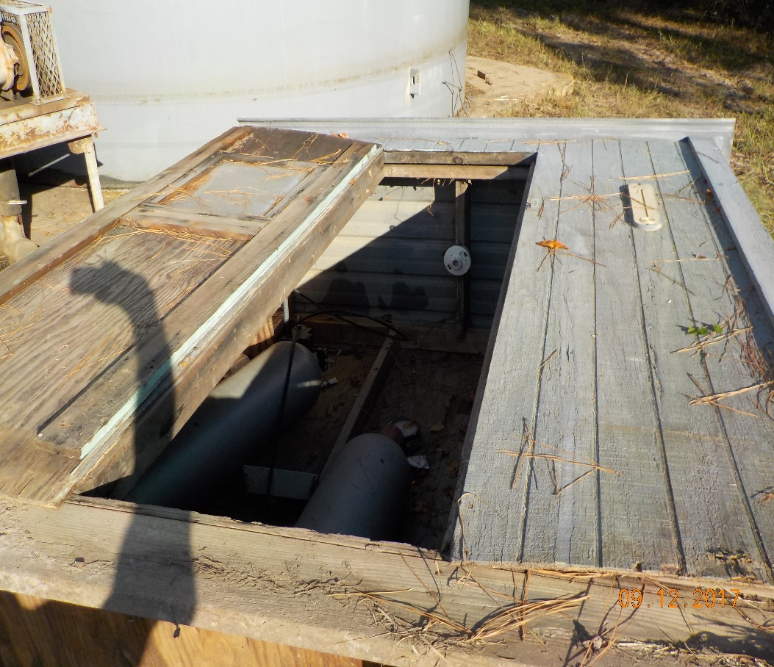
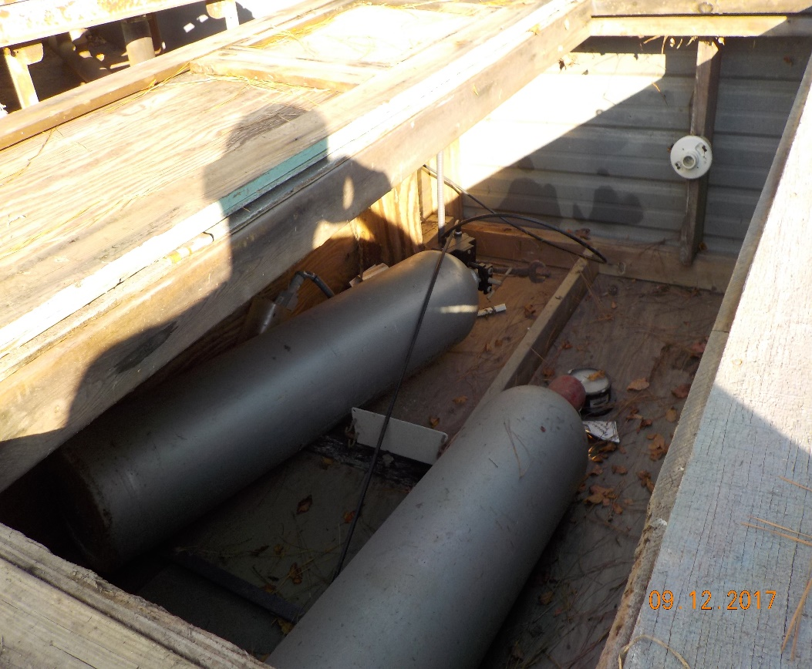
Chemical Storage/ Feeders Example 1

Slide 16
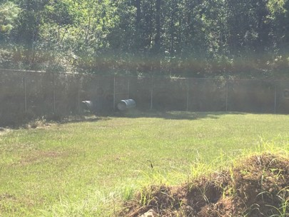
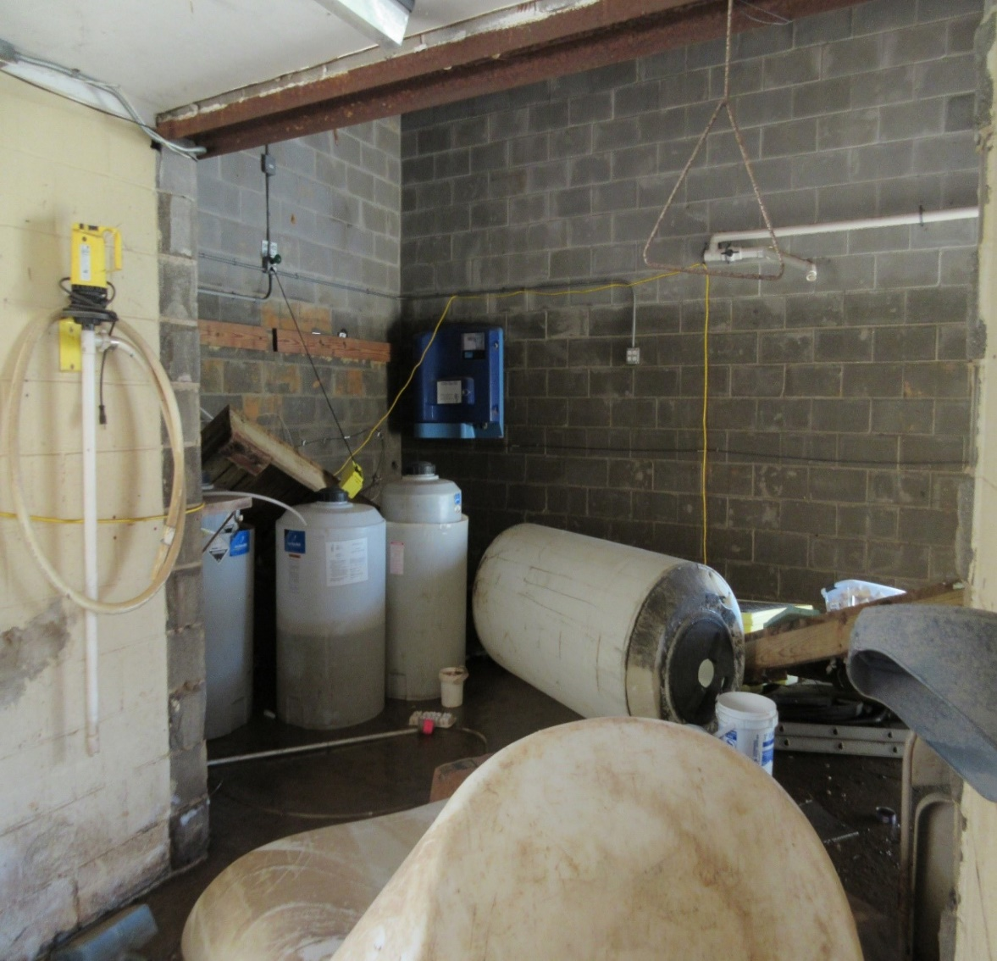
Chemical Storage/ Feeders Example 2

Slide 17
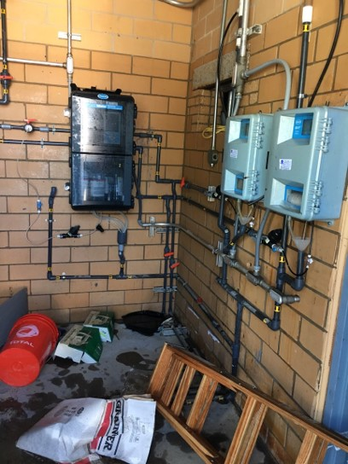
Chemical Storage/ Feeders

Slide 18
Vehicle/Heavy Equip.
4x4 trucks
Side-by-sides
ATVs
Backhoes
Snow-plows
Generators (pull behinds, portables, etc.)
Flatbed trailers

Slide 19
Vehicle/Heavy Equip. cont.
Top-off vehicles
Check fluid levels
Check antifreeze strength
Check batteries
Check tires and pressure
Grease zerk fittings
Add winterization fuel treatments
Store vehicles/machinery in enclosures or under awnings
If vehicles must be kept outside, orient the engine away from the north wind and cover with blankets and tarps

Slide 20
Vehicle Packing List
Snow chains
First aid kit
Flashlights
Tire pressure gauge and portable compressor
Tire plug kit
Warning triangles
Ice scraper
Rope/tie-down straps
Gloves and safety glasses
Tool bags
Fire extinguisher
Snacks and bottled water
Blankets
Snow shovels
Valve/hydrant wrenches
Chainsaw and gas cans
Disinfection residual test kit and reagents

Slide 21
Facility Access Roads
Clear branches away from roadways, fences and treatment plant units
Maintain roads so that you can access your facilities under all weather conditions.
If gated access, make sure that gates are locked.
If gates are electrical, make sure that you can disengage the hydraulic opener.
Salt bridges and roads to water system facilities in preparation for icy conditions.
Warning: Don’t try to cross low water crossings or downed power lines for any reason, it’s not worth losing your life.
Notes:
Tell story about you and Clarie at City of Rose City going down to check on the raw water pump station.

Slide 22
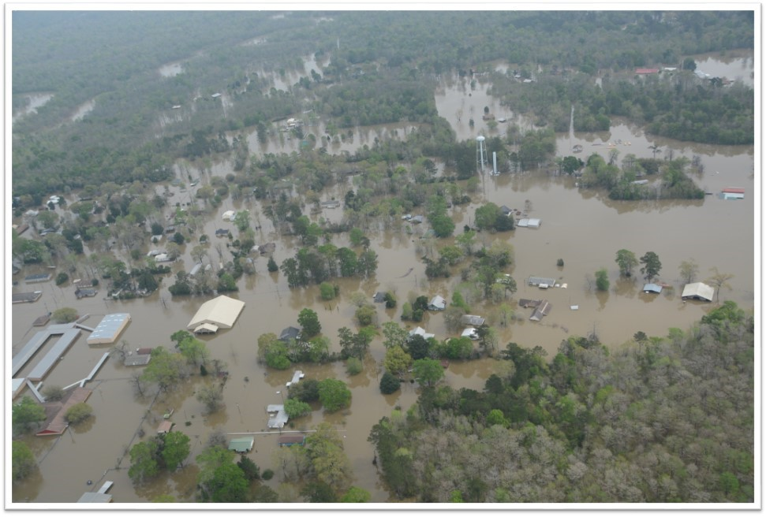
Access Roads Example 1

Slide 23
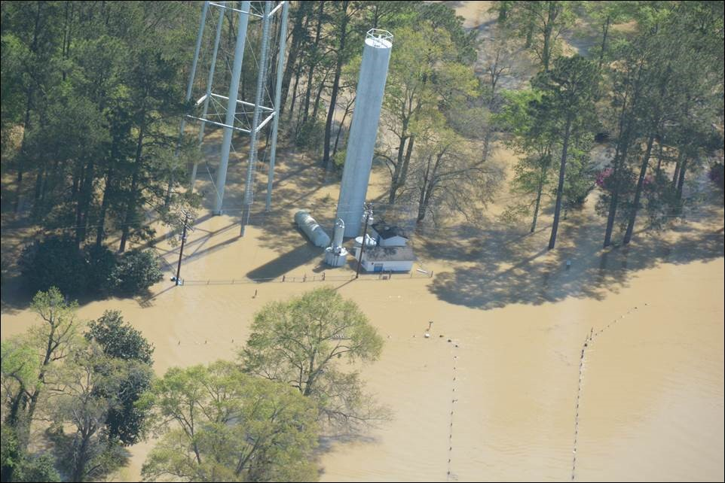
Access Roads Example 2

Slide 24
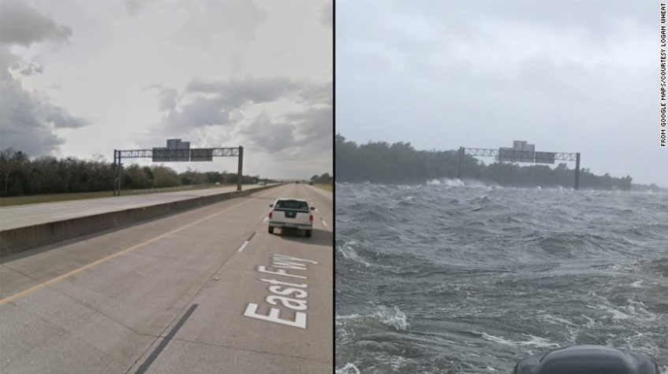
Access Roads Example 3

Slide 25
Electrical Facilities
Ensure:
  Switchgears and transformers are well maintained and operational
  Critical equipment is protected with surge protection and fuses (no pennies)
  Critical monitoring and automation equipment is equipped with uninterruptible power supplies (UPS)
  Develop a plan for re-charging UPS units (e.g., small portable generator)
Notes:
Switchgears and transformers are well maintained and operational
Removing encroaching limbs and vines
Conducting recommended routine maintenance
Exercising circuit breakers (annually)
Long-term service contracts

Slide 26
Electrical Facilities cont.
Ensure:
  Pigtail connections for portable generators are provided, maintained and working properly
  Backup generators and auxiliary equipment are maintained and tested under a load according to manufacturer and NFPA recommendations
  Identify which facilities you can do without during an electricity shortage
  Electrical equipment/components are stored off the ground and in areas not susceptible to flooding from storm water or bursting pipes

Slide 27
Electrical Equipment
Stockpile:
  Fuses
  Breakers
  Wiring
  Electrical Tape
  Digital voltmeter
  Solenoids
  Switches

Slide 28
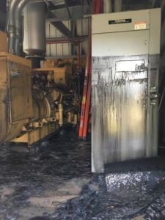
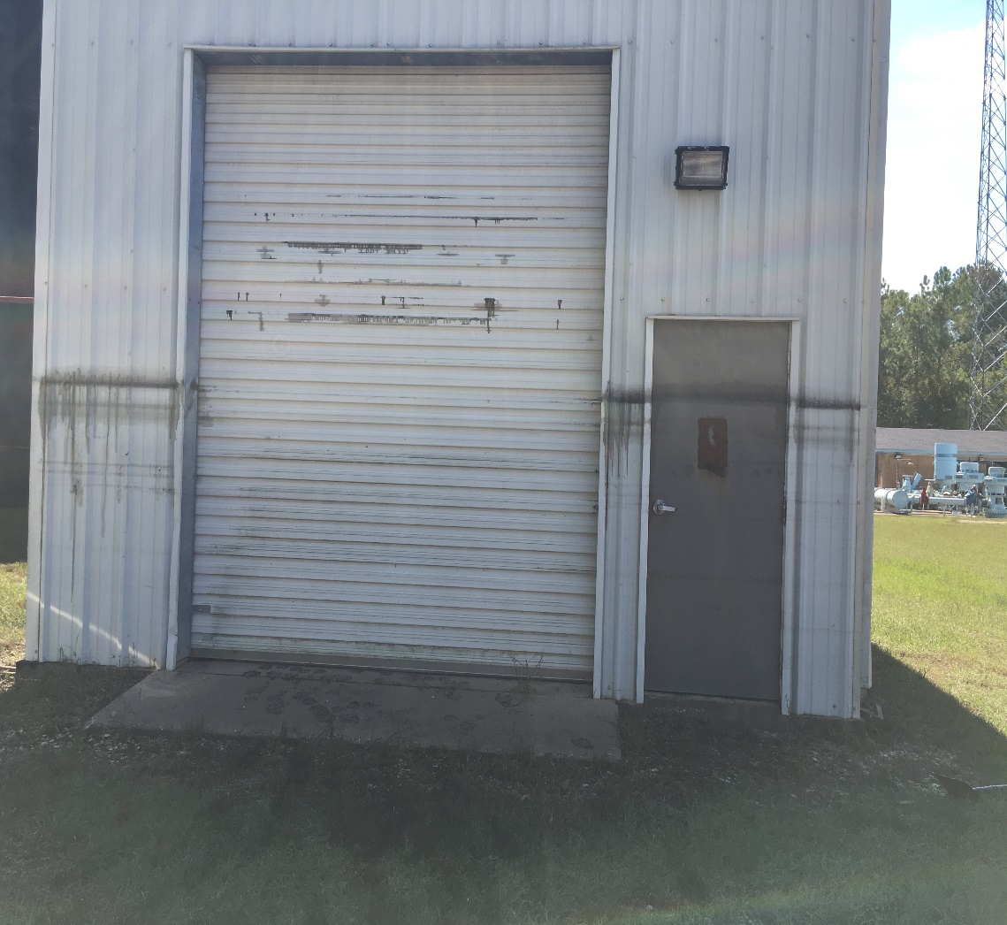
Electrical Equipment Example 1

Slide 29
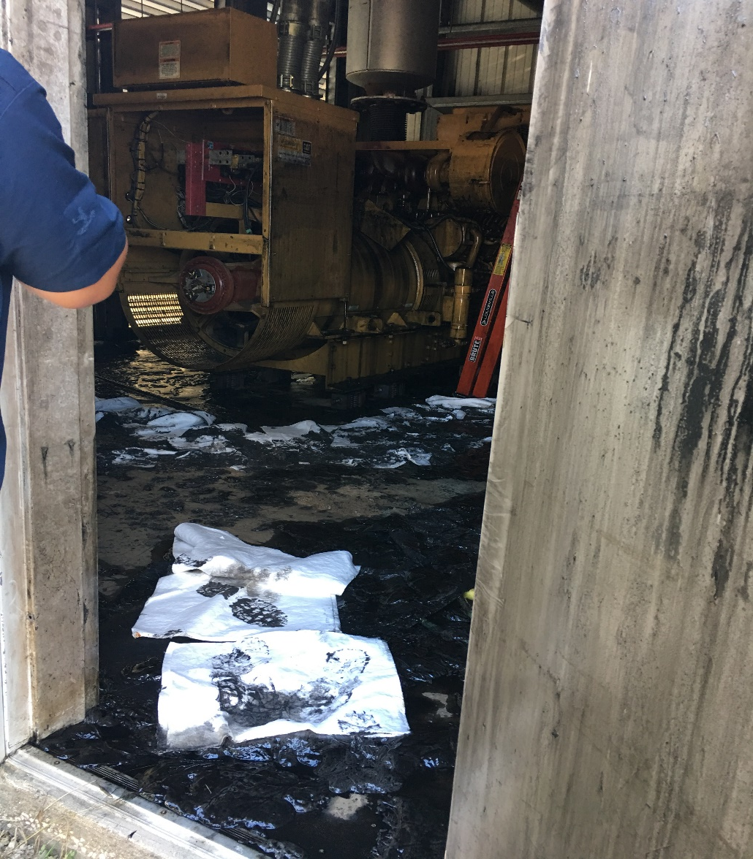
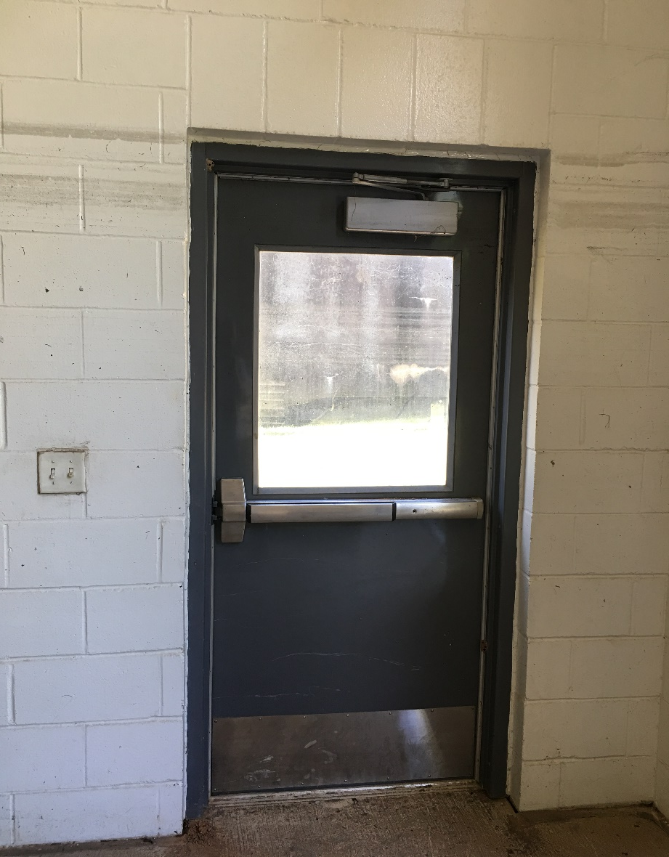
Electrical Equipment Example 2

Slide 30
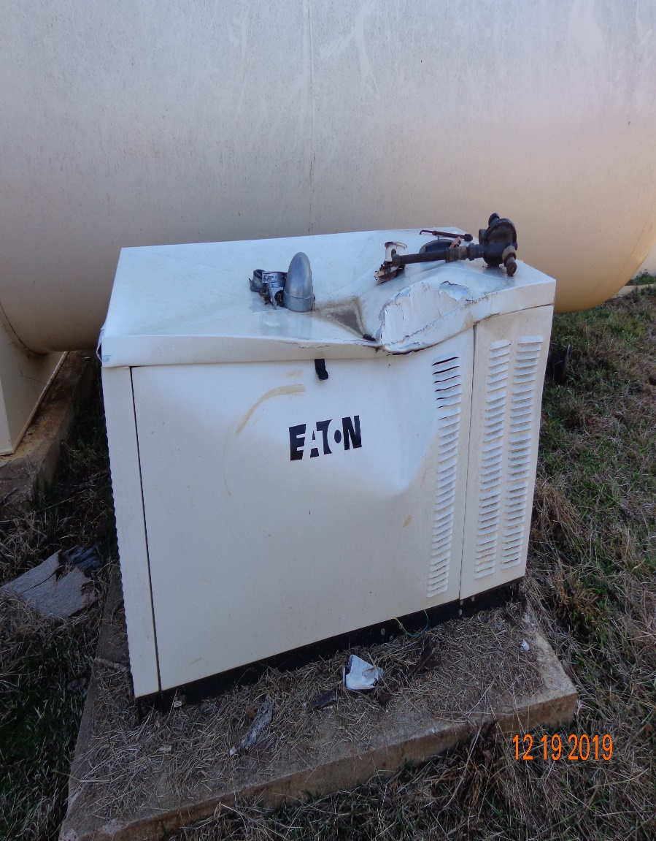
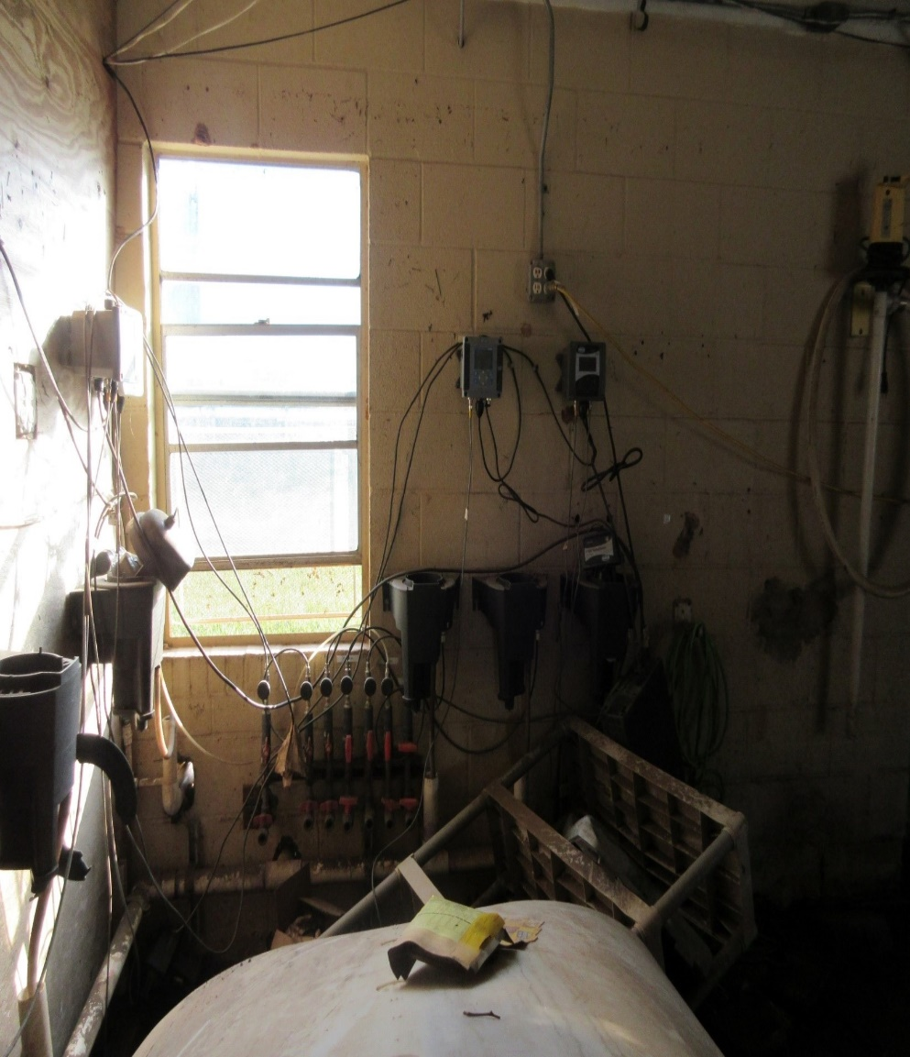
Electrical Equipment Example 3

Slide 31
Wells and Pump Bldgs.
Check heaters and thermostats
Inspect insulation and weather-stripping
Insulate exposed pipes, especially small diameter pipes with low to no flow
Insulate valves, sensors and monitoring equipment
Seal holes to prevent cool air and vermin from entering enclosures
Ensure water leaking from pumps or monitoring equipment is properly draining outside of building or to floor drains
Provide non-electric heating sources
  WARNING: Do not cause a fire hazard or oxygen deficient environment.
Notes:
Please be very careful that space and camping heaters are those that don’t produce carbon monoxide and have safety controls (e.g., catalytic heaters, etc.)
Provide non-electric heating sources
Catalytic gas heater
Propane heater
Wood burning stove (not common in Texas)

Slide 32
Wells and Pump Bldgs Cont.
For those wells/pumps that are outside:
Protect with heat tape and insulation
Insulate check valve casings
Flow meter vaults
When expecting extreme cold weather, block the north wind with temporary walls, dog houses or tarps
  WARNING: Do not cause a fire hazard or oxygen deficient environment.

Slide 33
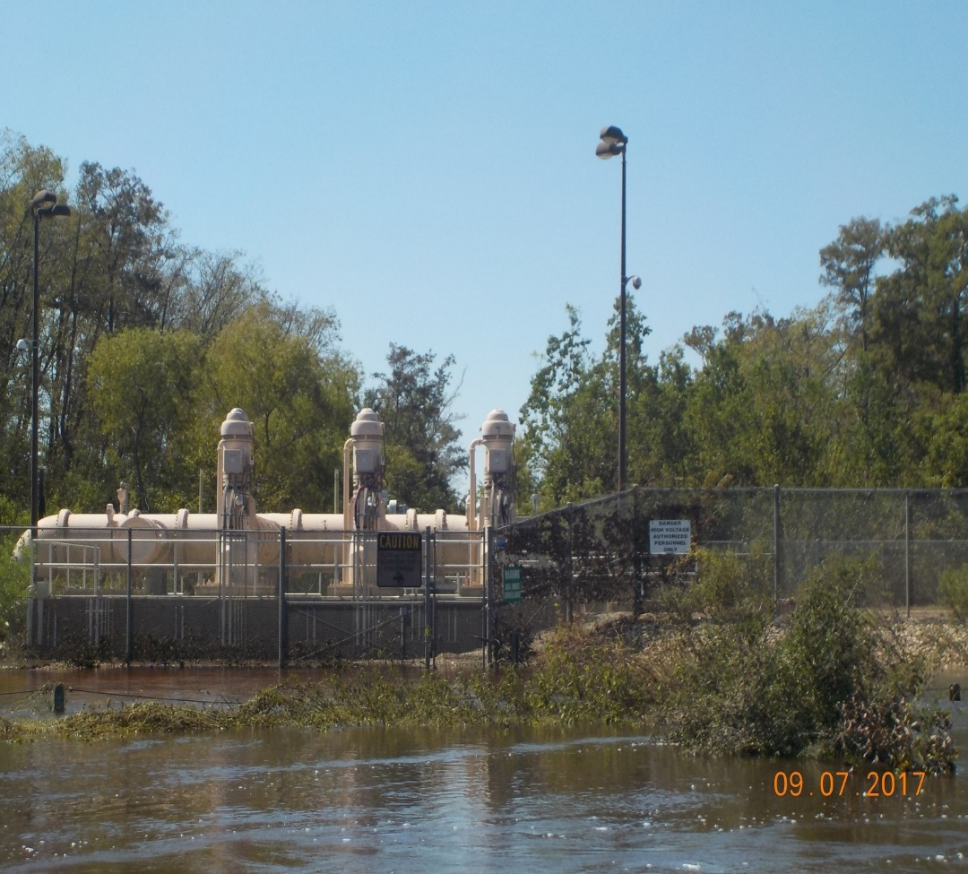
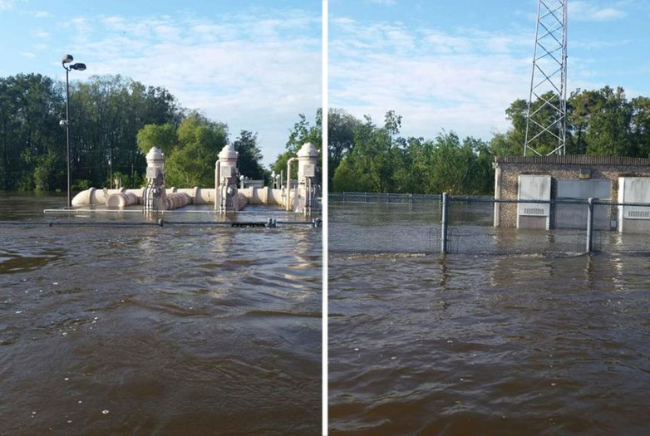
Wells and Pump Example 1

Slide 34
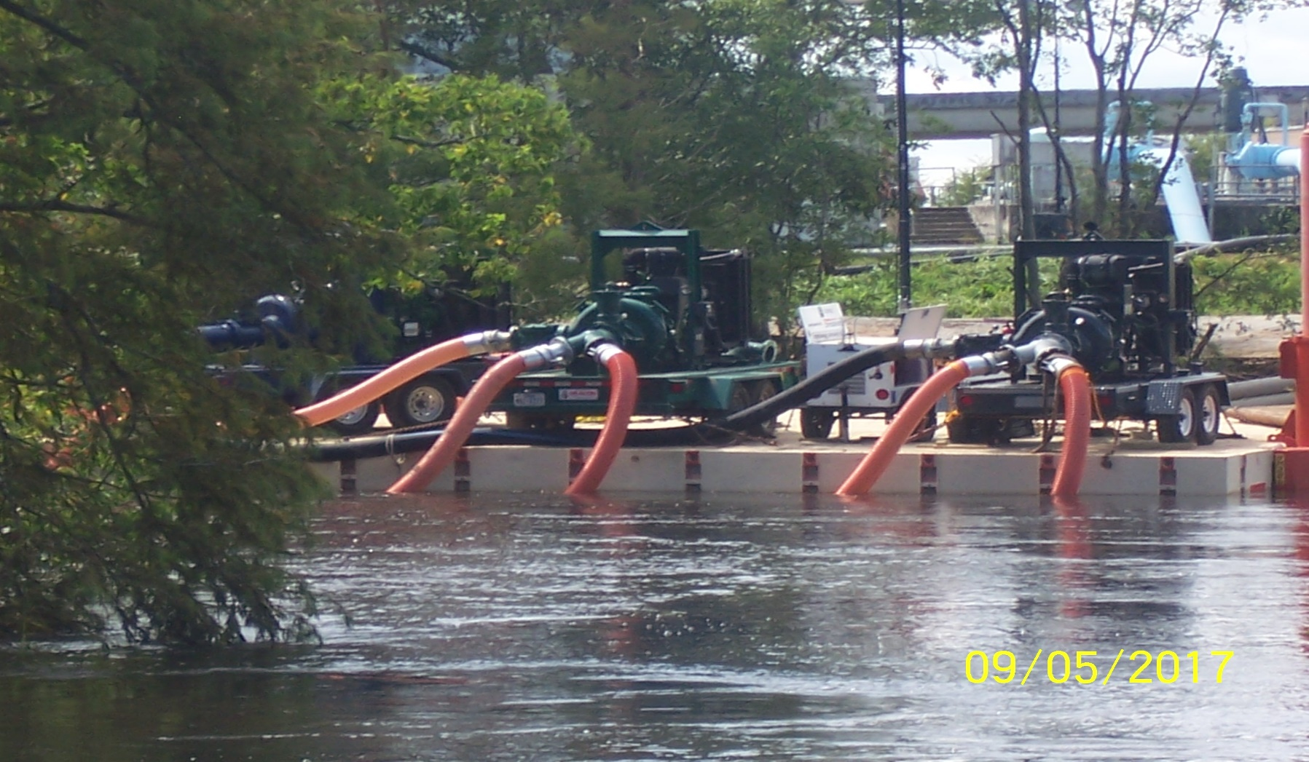
Wells and Pump Example 2

Slide 35
Storage Tanks
Lack of circulation can result in freezing
Smaller tanks are more susceptible because of lower surface area to volume ratio
Adjust pump cycles to ensure more frequent water circulation
Insulate fill and effluent pipes. Use heat tape where practical

Slide 36
Also Consider for Storage Tanks
Insulate small diameter water lines used for sensing equipment (e.g., level indicators, pressure transmitters, etc.)
When altitude valves are used, make sure they are:
  Well-maintained
  Properly insulated
  Protected from adverse weather conditions
Notes:
Protected from adverse weather conditions
For above grade, consider providing an insulated doghouse
For below grade, ensure the pit is dry, insulated and has water/air-tight lid.

Slide 37
Other Considerations for Storage Tanks
Confirm water levels registered by online sensing equipment.
When groundwater and surface water sources are available, consider using groundwater as much as possible, as it’s much warmer.
Consider using recirculation units to keep water fresh and from freezing. Units will need to have an auxiliary source of power during times with no electricity.
Notes:
There are solar powered and air diffusers that can be operated with a compressor running on electricity or small generator.
Confirm water levels registered by online sensing equipment.
For example, floating mechanical level indicators can be used to verify the accuracy of sensors and be used when digital sensing equipment is inoperable.

Slide 38
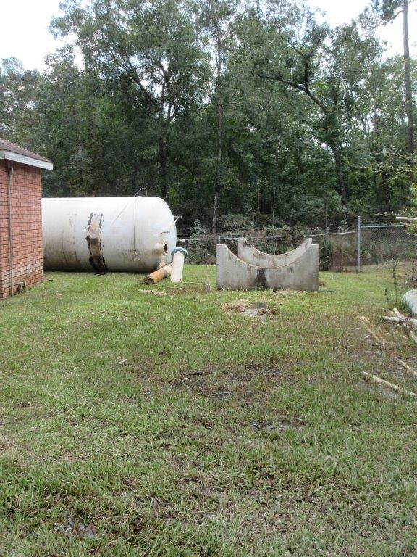
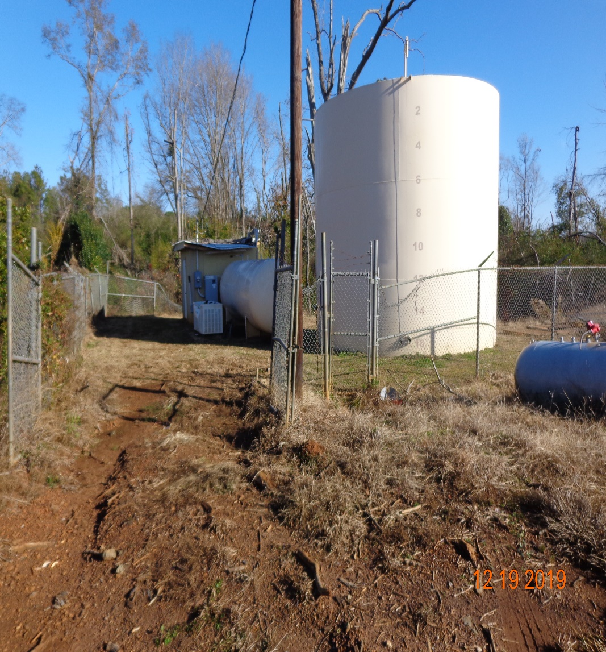
Storage Tanks Example 1

Slide 39
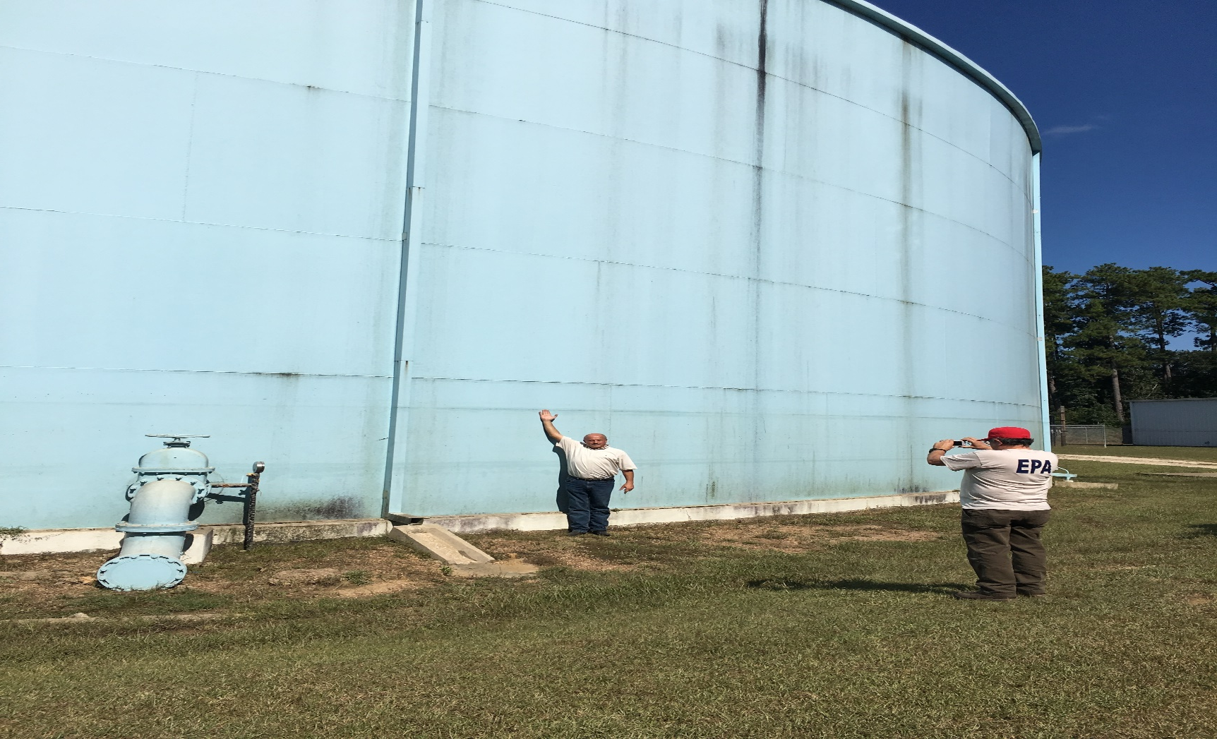
Storage Tanks Example 2

Slide 40
Plant Piping
Insulate exposed piping
Repair/replace damaged insulation
Wrap exposed pipes with heat tape. For more vulnerable pipes, place insulation over the heat tape
Continuously circulate water in small diameter pipes where possible

Slide 41
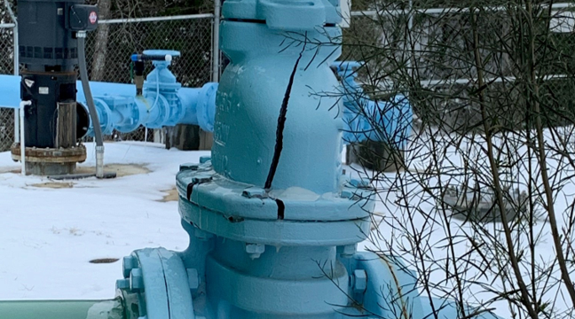
Plant Piping Example

Slide 42
Backflow Assemblies
Make sure that testable assemblies are properly maintained and calibrated
Ensure covers/boxes are air/water-tight
Ensure that wrap insulation is dry and is free of holes
For pit installations, make sure that the pit is dry, insulated and has water/air-tight lid
Notes:
After freeze of 2021 lots of backflow devices were cracked and leaking. Also, need to make sure that during the summer months they are unwrapped so you can make sure they are working properly.

Slide 43
Distribution System
Ensure water lines at bridge and water crossings are properly collared and insulated
Ensure risers are drained on flush valves or properly insulated
Make sure that fire hydrant barrels are drained.
Make sure that park water fountains are drained and the water supply is closed

Slide 44
Distribution System Cont.
Make sure that customers with their own fire lines implement weatherization measures
If emergency interconnection(s) with other system(s), make sure that isolation valves and meters are working and properly insulated
Make sure that automatic valves used to deliver water from a plane pressurized by elevated storage to a plane that is hydropneumatically pressurized are working properly
Notes:
These valves normally keep the planes hydraulically separated until power is lost.

Slide 45
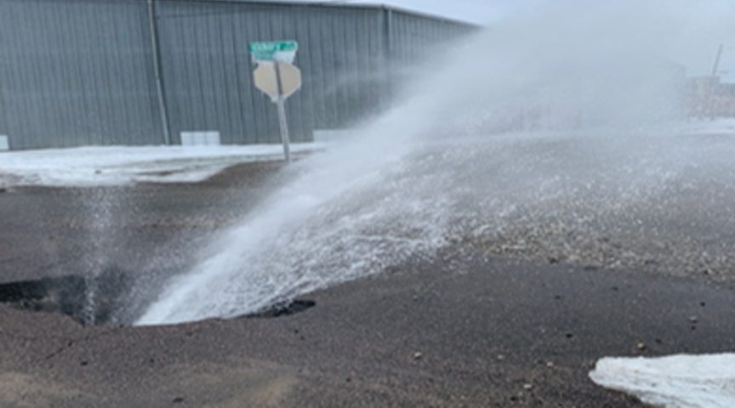
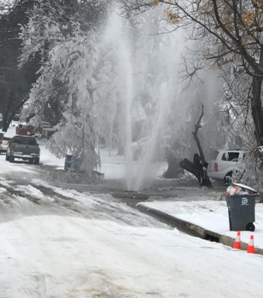
Distribution System Example 1

Slide 46
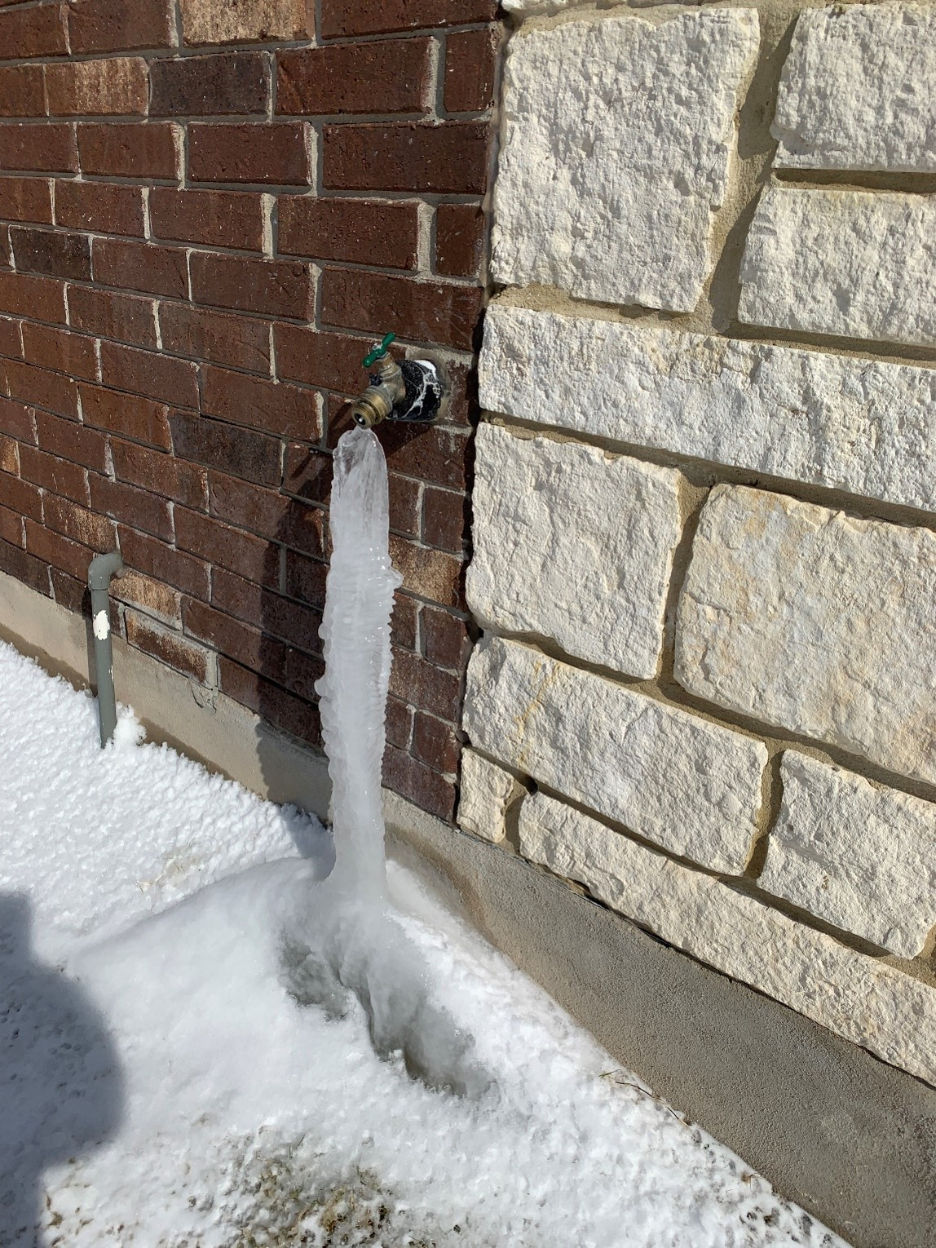
Distribution System Example 2
Notes:
Consider putting out public education before the winter season.

Slide 47
Emergency Repair Items
Stockpile the following:
Repair clamps
MJ sleeves
Compression fittings
Saddles
Rolls of plastic
Valve boxes (tops and bottoms)
Pipe thawing equipment (own, rent or borrow)
Meters
Meter pit insulators
Notes:
You should have a stock pile of extra equipment for when emergencies happen.

Slide 48
Personnel/Staff
Increase staff coverage
Incorporate fatigue management plan to prevent exhaustion and accidents
If not enough staff, consider reaching out to local water systems or volunteers for help
Increase the frequency of facility walkthroughs
Provide safety training for extreme weather and slips, trips and falls
Ensure staff and volunteers have appropriate clothing
Notes:
Local volunteer fire department or maybe other city employees.
Some plants do facility walk throughs daily. Its in their SOP so that they can address any problems immediately.
Good youtube videos on weather slips, trips and falls.

Slide 49
Personnel/Staff Cont.
Treatment plant provisions:
Meals ready to eat (MREs) and non- perishable food items
Cots, blankets and pillows
Bottled water, gatorade and canned sodas
Towels, shampoo and wash rags
Toothpaste
Weather radio
2-way radios
Paper plates, forks and knives
Flashlights and batteries
Notes:
Flower pot with candle for a heater.

Slide 50
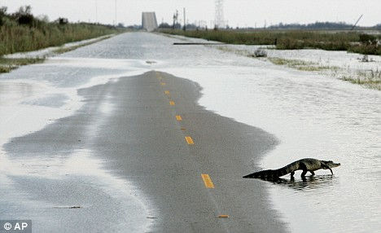
Thank You!
Questions?
Paige Ruth-Pritchard
TCEQ – Texas Optimization Program (TOP)
Paige.ruth-pritchard@tceq.texas.gov

