Slide 1
Air Quality Division Update
Alison Stokes
Air Quality Division
Advanced Air Permitting Seminar 2022

Slide 2
Agenda
Ozone Nonattainment Area Requirements and Classifications
2008 Eight-Hour Ozone National Ambient Air Quality Standards (NAAQS) Updates
2015 Eight-Hour Ozone NAAQS Updates
NAAQS Review Schedule

Slide 3
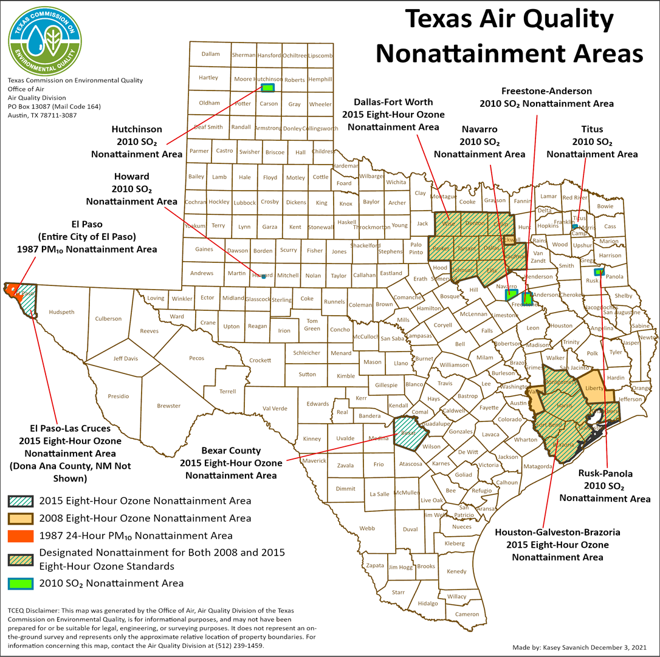
Texas Air Quality Nonattainment Areas

Slide 4
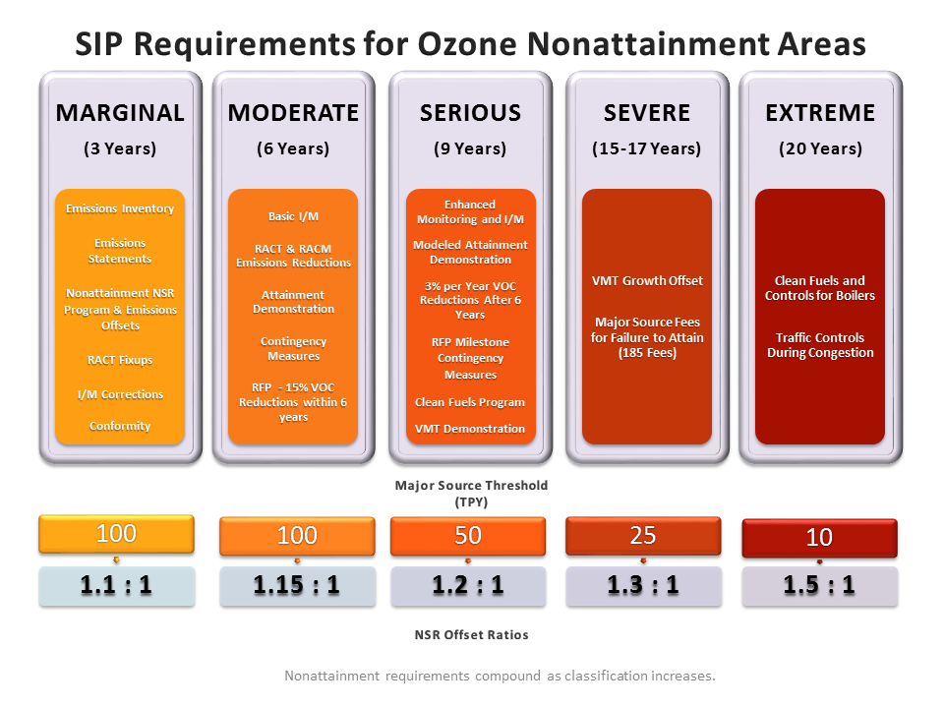
SIP Requirements for Ozone Nonattainment Areas

Slide 5
Designation and SIP Revision Cycle

Slide 6
2008 Eight-Hour Ozone NAAQS
Standard is 0.075 parts per million (ppm).
Design values of 75 parts per billion (ppb) or less are attainment.
EPA finalized designations on May 21, 2012.
Designations were effective by July 20, 2012.
The initial nonattainment designations consist of:
Houston-Galveston-Brazoria (HGB) Marginal Nonattainment Area includes Brazoria, Chambers, Fort Bend, Galveston, Harris, Liberty, Montgomery, and Waller Counties.
Dallas-Fort Worth (DFW) Moderate Nonattainment Area includes Collin, Dallas, Denton, Ellis, Johnson, Kaufman, Parker, Rockwall, Tarrant, and Wise Counties.
HGB Area reclassified to moderate, effective December 14, 2016.

Slide 7
2008 Eight-Hour Ozone NAAQS Serious Reclassifications
DFW and HGB moderate nonattainment areas did not attain by the end of 2017.
EPA published final notice to reclassify both areas to serious on August 23, 2019.
The reclassifications became effective September 23, 2019.
Both areas are currently subject to major source thresholds of 50 tons per year (tpy) and new source review (NSR) offset ratios of 1.2:1.
Serious area attainment date was July 20, 2021, with a 2020 attainment year.
Serious classification SIP revisions were due to EPA by August 3, 2020.

Slide 8
DFW Area Permitting Classification
EPA Action (Effective Dates) | Effective Classification for Permitting (most stringent requirement applies)
One-Hour and 1997 eight-hour ozone NAAQS serious classifications still applied July 20, 2012: DFW area designated as moderate nonattainment for the 2008 eight-hour ozone NAAQS | Serious
December 8, 2016: One-Hour and 1997 Eight-Hour Ozone Redesignation Substitute approved August 3, 2018: DFW area designated as marginal nonattainment for the 2015 eight-hour ozone NAAQS | Moderate
September 23, 2019: DFW 2008 eight-hour ozone nonattainment area reclassified to serious | Serious

Slide 9
HGB Area Permitting Classification
EPA Action (Effective Dates) | Effective Classification for Permitting (most stringent requirement applies)
One-Hour and 1997 eight-hour ozone NAAQS severe classifications still applied July 20, 2012: HGB area designated as marginal nonattainment for the 2008 eight-hour ozone NAAQS November 19, 2015: One-Hour Ozone Redesignation Substitute approved (1997 eight-hour ozone NAAQS severe classification still applied) | Severe
December 8, 2016: 1997 Eight-Hour Ozone Redesignation Substitute approved | Marginal
December 14, 2016: HGB 2008 eight-hour ozone nonattainment area reclassified to moderate August 3, 2018: HGB area designated as marginal nonattainment for the 2015 eight-hour ozone NAAQS | Moderate
September 23, 2019: HGB 2008 eight-hour ozone nonattainment area reclassified to serious | Serious

Slide 10
2008 Eight-Hour Ozone Serious Classification SIP and Rule Revisions
SIP and Rule revisions were adopted on March 4, 2020.
DFW and HGB RFP SIP revision
EPA proposed approval of RFP SIP revision for DFW nonattainment area on October 9, 2020.
EPA published partial final approval of RFP SIP revision for HGB nonattainment area on May 10, 2021.
Attainment Demonstration SIP revisions
Pending EPA action.
Associated rulemakings to address RACT requirements for Wise County.

Slide 11
Additional 2008 Eight-Hour Ozone NAAQS Submittals
On March 25, 2021, the TCEQ submitted a Milestone Compliance Demonstration for the 2020 Calendar Year to meet RFP requirements for the DFW and HGB serious nonattainment areas.
The EPA sent a Letter of Adequacy on July 1, 2021.
On June 30, 2021, the commission adopted a rulemaking to address the EPA’s Oil and Natural Gas Control Techniques Guidelines (CTG).
Implements reasonably available control technology for all volatile organic compounds emissions sources in the EPA’s CTG in the DFW and HGB 2008 ozone nonattainment areas.

Slide 12
What’s Next for 2008 Eight-Hour Ozone Serious Nonattainment Areas?
DFW and HGB serious nonattainment areas did not attain by the end of 2020.
On April 6, 2021, the TCEQ submitted a one-year attainment date extension request for the HGB area.
On April 13, 2022, the EPA proposed to reclassify the DFW and HGB areas to severe.
The EPA is proposing 18 months after reclassification to submit federally required severe classification SIP revisions.
Attainment would be required by the end of 2026 to meet a July 20, 2027 attainment date.
Final action was signed by the EPA on September 15, 2022.

Slide 13
Permitting Requirements for Severe Nonattainment Areas
The effective date of the severe reclassification is anticipated in October/November 2022.
The major source thresholds for the DFW and HGB areas will change from 50 to 25 tpy.
NSR offset ratios will change from 1.2:1 to 1.3:1.

Slide 14
2015 Eight-Hour Ozone NAAQS Designations
Standard is 0.070 ppm.
Design values of 70 ppb or less are attainment.
DFW marginal nonattainment area includes:
Collin, Dallas, Denton, Ellis, Johnson, Kaufman, Parker, Tarrant, and Wise Counties (Rockwall County removed).
Area designation was effective on August 3, 2018.
Six-county HGB marginal nonattainment area includes:
Brazoria, Chambers, Fort Bend, Galveston, Harris, and Montgomery Counties (Liberty and Waller Counties removed).
Area designation was effective on August 3, 2018.
Bexar County designated as a marginal nonattainment area.
Area designation was effective on September 24, 2018.

Slide 15
2015 Eight-Hour Ozone NAAQS Emission Inventory (EI) SIP Revision
Due two years after the effective date of designations.
HGB and DFW EI SIP revisions due by August 3, 2020.
Bexar County EI SIP revision due by September 24, 2020.
One SIP revision for all three areas:
Establishes 2017 base year inventory;
Submitted to EPA on June 24, 2020; and
EPA published final approval on June 29, 2021.

Slide 16
Revised Designation for El Paso County
Effective December 30, 2021, the EPA designated El Paso County as marginal nonattainment for the 2015 ozone NAAQS.
The EPA expanded the Sunland Park, New Mexico nonattainment area to include all of El Paso County.
The area was renamed the “El Paso-Las Cruces, Texas-New Mexico nonattainment area.”
El Paso County is tied retroactively to Sunland Park’s August 3, 2021 marginal attainment date.
The area is currently subject to a major source threshold of 100 tpy and NSR offset ratio of 1.1:1.
The existing NO_{X} waiver for the revoked one-hour ozone standard does not apply to the 2015 ozone nonattainment area.

Slide 17
El Paso County 2015 Ozone EI SIP Revision
Due to the EPA by December 30, 2022.
Proposed on June 15, 2022 with anticipated adoption on November 16, 2022.
Provides current and comprehensive data on emissions of ozone precursors contributing to nonattainment in El Paso County.
Establishes a 2017 Base Year Inventory for the nonattainment area.

Slide 18
FCAA, Section 179B Demonstration
Demonstrates that an area could attain the NAAQS by the attainment date “but for” emissions emanating from outside the U.S.
Submittal is optional.
Not restricted to areas adjoining international borders.
EPA approval of a §179B Demonstration for a nonattainment area that fails to attain:
An area would remain nonattainment but would not be bumped-up to a higher classification.
Nonattainment area requirements under the existing classification would continue to apply until the area is redesignated to attainment.

Slide 19
Bexar County 2015 Eight-Hour Ozone §179B Demonstration SIP Revision
Commission developed §179B Demonstration SIP revision for Bexar County:
Proposed: January 15, 2020.
Adopted: July 1, 2020.
Submitted to EPA: July 13, 2020.
EPA issued draft §179B guidance on January 9, 2020, after SIP development.
The EPA proposed disapproval of this SIP revision as part of the 2015 ozone NAAQS reclassification action.

Slide 20
El Paso 2015 Eight-Hour Ozone §179B Demonstration
The TCEQ submitted a retrospective FCAA, §179B demonstration on February 28, 2022.
New Mexico submitted a §179B demonstration for the Sunland Park 2015 eight-hour ozone nonattainment area to the EPA on June 3, 2021.
Both demonstrations are pending EPA action.

Slide 21
What’s Next for 2015 Eight Hour Ozone Marginal Nonattainment Areas?
The attainment year for 2015 eight-hour ozone marginal nonattainment areas was 2020.
The DFW, HGB, Bexar County, and El Paso marginal areas did not attain by the end of 2020.
On April 13, 2022, the EPA proposed to reclassify DFW, HGB, and Bexar County to moderate nonattainment.
The EPA has proposed a January 1, 2023 deadline to submit federally required moderate classification SIP revisions.
Attainment would be required by the end of 2023 to meet an August 3, 2024 attainment date.
Final action was signed by the EPA on September 15, 2022.

Slide 22
Permitting Requirements for Moderate Areas
The effective date of the moderate reclassification is anticipated in October/November 2022.
For the Bexar County moderate nonattainment area:
The major source threshold will remain at 100 tpy; and
The NSR offset ratio will change from 1.1:1 to 1.15:1.
The more stringent 2008 eight-hour ozone NAAQS permitting requirements still apply for the DFW and HGB areas.

Slide 23
Permian Basin Ozone NAAQS Status
All Permian Basin counties were designated attainment/unclassifiable for the 2015 eight-hour ozone NAAQS.
The EPA is considering a discretionary redesignation to nonattainment.
On June 27, 2022, Governor Abbott sent a letter to President Biden stating that the EPA’s discretionary action would jeopardize oil production in Texas.
On July 27, 2022, EPA Administrator Michael Regan sent a response letter stating that the EPA is still considering nonattainment redesignations for the Permian Basin.
On August 23, 2022, Governor Abbott responded with a letter restating disagreement with the EPA’s position.

Slide 24
NAAQS Review Schedule
 | Ozone | Lead | Primary NO₂ | Primary SO₂ | Secondary NO₂, SO₂, PM¹ | PM² | CO
Last Review Completed (final rule signed) | Dec 2020 | Sept 2016 | April 2018 | Feb 2019 | March 2012 | Dec 2020 | Aug 2011
Recent or Upcoming Major Milestone(s) | End of 2023 EPA’s target to complete reconsideration of the 2020 decision to retain the 2015 ozone NAAQS | July 2020 Call for information | TBD | TBD | 2021 Draft Policy Assessment with Risk and Exposure Assessment appendices | Summer 2022 Proposed reconsideration of the decision to retain the existing PM NAAQS Spring 2023 Final Rule | TBD

Slide 25
Contact Information
Alison Stokes
Team Lead, SIP Team, Air Quality Planning Section
512-239-4902
alison.stokes@tceq.texas.gov
To join the SIP/Air Quality update e-mail list go to: www.tceq.texas.gov/airquality/sip/sipcontact.html

