Slide 1

Case-by-Case Permits:
Common Issues and Updates
Brandon Marsh, P.E.
Technical Specialist, NSR Chemical Section
Phone: (512) 239-1280
Email: brandon.marsh@tceq.texas.gov

Slide 2
NSR Permitting Process
Admin Review (including Notice)
Technical Review Process
Best Available Control Technology (BACT) Review
Emission Calculations
Federal Applicability (PSD/NNSR)
Draft Permit Review
Including Impacts and Modeling
NSR Updates
Notes:
Today we will be discussing common errors and solutions throughout the case-by-case permitting process. Our goal is to work with you, the applicants and consultants-to ensure that the NSR permitting process is as smooth and as timely as possible.
The primary goal of this presentation is to highlight potential friction points and avoidable delays during the following:
Application submittal process
Technical reviews
Impacts and modeling
Permit condition negotiations
By identifying common pitfalls, we hope to help applicants streamline their submittals, reduce back-and-forth, and ultimately achieve faster permit issuance timeframes.

Slide 3
Permitting Steps - Overview
Administrative Process and 1st Notice (NORI)
Technical Review/
Federal Review
Draft Permit and Modeling
2nd
Notice
(NAPD)
Issue Permit
Notes:
This is a brief overview of the permitting process and a general outline of today’s presentation. Items to note:
Today’s presentation will be largely focused on the first two steps in the process, but we’ll highlight a few items related to the draft permit, modeling, and NAPD process as well.
Please note that, in many cases, the draft permit negotiations and modeling occur simultaneously. We have grouped them together but will be discussing separate issues today.
Many of the items that will be discussed in the administrative process and NORI may also apply to the NAPD process.
NORI = Notice of Receipt of Application and Intent to Obtain a Permit
NAPD = Notice of Application and Preliminary Decision

Slide 4
Permitting Steps - NORI
Administrative Process and
1st Notice
(NORI)
Technical Review/
Federal Review
Draft Permit and modeling
2nd
Notice
(NAPD)
Issue Permit
Notes:
Notice of Receipt of Application and Intent to Obtain a Permit (“NORI”)
Notice of Application and Preliminary Decision (“NAPD”)
The focus of the first part of the presentation is to discuss the administrative process once an application has been submitted to TCEQ.
NORI: Required for initial applications, renewal applications, and some amendments (including amendment projects with project increases above the public notice thresholds and/or the addition of a new pollutant, etc.).
We will cover items that can help ensure the application is processed timely, the NORI is issued accurately, and the handoff to the permit reviewer occurs with as few errors as possible.

Slide 5
Administrative Process with APIRT
Review Submitted Application Files
Generate Notice of Receipt and Intent to Obtain a Permit (NORI)
Review Plain Language Summary
Declare Project Administratively Complete
Executive summary or application supplement
PI-1, Fugitive, and EMEW workbook review
Transfer to Technical Staff
Notes:
The first step in the overall process is completed by the Air Permits Initial Review Team, “APIRT”. This generally occurs before the project even reaches the technical staff.
Working with APIRT to ensure the items on this slide are correct is the first step in ensuring a smooth and streamlined permitting process.
The overall process with APIRT includes the following:
Review of the submitted application and files
Creation of the NORI document, if applicable
Review and upload of the plain language summary, if applicable
Declaring the project administratively complete
Transfer to the technical staff.
The following slides will highlight the review of the submitted application files, as well as the creation and review of the NORI.

Slide 6
Administrative Information and Files
Consistency in information and contacts
  PI-1 and CORE Data Form
  Contacts are current
Workbooks Required at Submittal
  PI-1 Workbook required for all case-by-case submittals
  Fugitive Workbook required for fugitive emissions or consolidation
  Electronic Modeling Evaluation Workbook (EMEW) required for all minor modeling analyses
Response Timelines
Notes:
The initial project review is completed by the Air Permits Initial Review Team, “APIRT”. APIRT’s review includes the following:
APIRT verifies that the correct versions of the workbooks have been used and that all applicable workbooks have been submitted.
If the APIRT reviewer notices that something is incorrect or missing, they will reach out request corrections prior to deeming it “administratively complete.”
Please ensure that company contacts are up to date so that our reviewers can contact you with questions.
We ask that you respond in a timely manner, or the project may not be accepted.
A few items we wanted to highlight on this slide are:
PI-1 information matches the CORE Data Form.
The current PI-1 Workbook is required for all CBC submittals. The current version is 7.0.
The current Fugitive Workbook, Version 3.1, is required for projects that have fugitive emission increases or consolidations.
PI-1 UT-ER matches the MAERT.
Emission increases are included in impacts with the appropriate EMEW.
Company contacts are up to date.

Slide 7
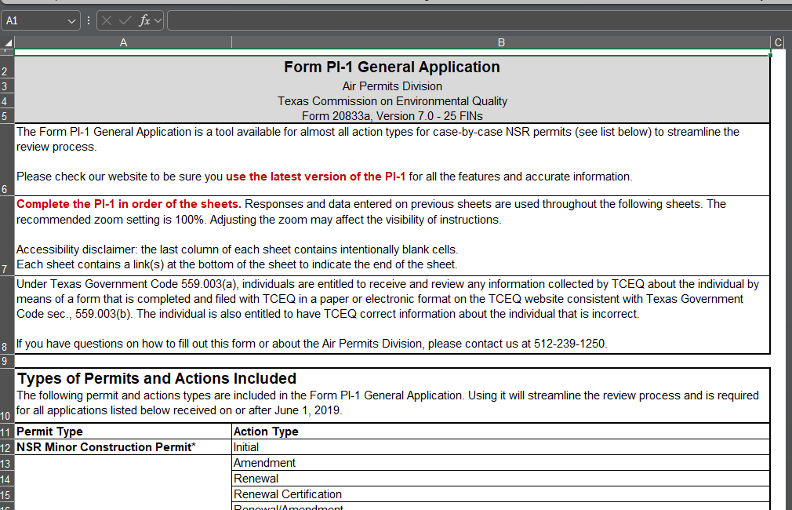
PI-1 Workbook v7.0
Notes:
Just a reminder here to use the most recent version of the PI-1 Workbook…
[Insert snip or screenshot of the “easiest” way to determine which workbook version you are using.]
If resubmitting a workbook as part of an NOD, and a new PI-1 has been issued, the newest workbook should be used.

Slide 8
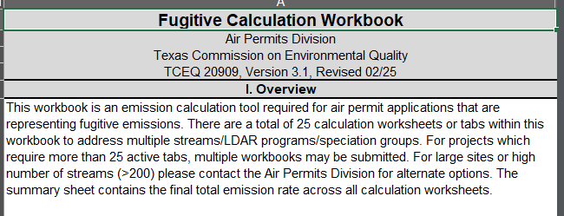
Fugitive Workbook v3.1
Notes:
Same as before, a reminder to use the most current version of the Fugitive Emission Workbook.
If there are fugitive emission consolidations or changes, an updated workbook is required. Ideally, the update will be comprehensive and include all components in the fugitive EPN.

Slide 9
NORI Tips to Avoid Pitfalls – Part 1
Coordinate with APIRT before finalizing NORI
  Review documents within 2 days of receipt
Key Items to Check
  Is the notice location correct?
  Is the site location link correct?
  Is the project type correct?
  Are the pollutants correct and accurate?
Newspaper Consistency
  Must meet general circulation requirements in 30 TAC Chapter §39.603(e)
Notes:
We want to cover and highlight a couple of areas that we have seen that have required either amended notice documents to be sent or the republication of notice documents. There is a presentation after the lunch break that is focused more on public notice and public participation in both the NSR and Title V review process.
NORI: Required for initial applications, renewal applications, and some amendments.
Please note that it is the applicant's responsibility to review the draft NORI that APIRT sends to ensure that it is correct.
Many of these same items apply to the issuance of the NAPD. If we have a correct and accurate NORI, it streamlines the NORI process and helps streamline the NAPD process.

Slide 10
NORI Tips to Avoid Pitfalls – Part 2
Include hazardous air pollutants (HAPs) in notices
  NG combustion = HAPs
Publish NORI and NAPD in the same newspaper
  Publish as sent by TCEQ
Submit timely affidavits and accurate verification forms
  If notice ends on a weekend or holiday, the comment period ends on the next weekday as specified in 30 TAC §1.7
Notes:
Please ensure HAPs is listed in the PI-1, Public Notice tab, Row 41. Specifically, HAPs should be listed in all Energy projects and most Chemical projects.
Even if HAPs are included in the VOC or Particulate matter (PM) emissions and are not speciated on the MAERT, they should be included in the pollutant list for the NORI and NAPD.
As a reminder, although the NORI and NAPD documents are finalized by APD, they are sent out by the Office of the Chief Clerk (OCC). Any deviation from the finalized documents may require republication. Any requested changes must be communicated to APD so that an amended notice document can be issued.
Review the NORI documents and coordinate with the APIRT reviewer. Addresses issues quickly to prevent delays in publishing or re-publishing.
Review NAPD documents and coordinate with permit reviewer.
Notice Periods and dates are calculated in accordance with 30 TAC §1.7. The period shall begin on the day after the act, event, or default in question and shall conclude on the last day of the designated period, unless that day is a Saturday, Sunday, or legal holiday on which the Office of the Chief Clerk is closed. In that event, the period runs until the end of the next day that is neither a Saturday, Sunday, nor a legal holiday on which the Office of the Chief Clerk is closed.

Slide 11
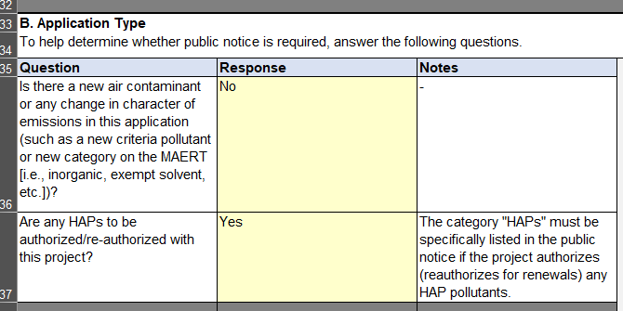
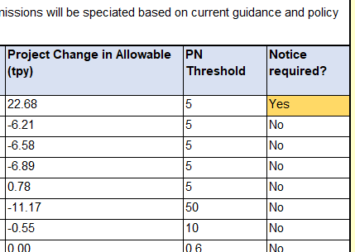
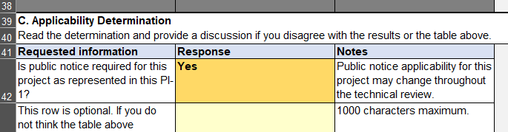
Key Cells on PI-1 Public Notice Tab
Notes:
The PI-1 workbook Public Notice (PN) tab has logic built in to determine if public notice is required.
This logic includes public notice thresholds, new contaminants, change in character of emissions, and authorization or reauthorization of HAPs.
Note that if HAPs have not been “to notice” in a prior permitting action, it may trigger the NORI based on HAPs being a new pollutant to the permit.

Slide 12
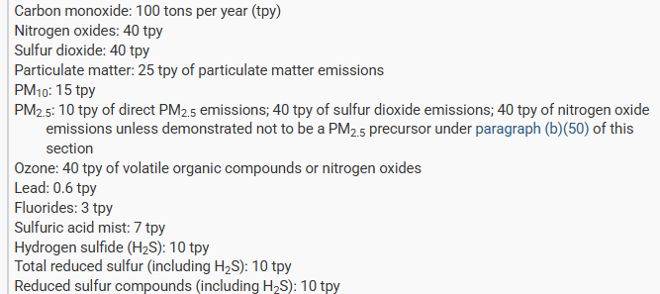
Required Pollutants
30 TAC §39.411(e)(10)
40 CFR Part 52, Subpart A, §52.21(b)(23)
Notes:
Public notice requirements are dictated by 30 TAC Chapters 39, 55, and 116.
Based on 30 TAC Chapter 39, criteria pollutants regulated under NAAQS or state regulations are required to be included in the notice document.
111: visible emissions, opacity
112: sulfur compounds
113: HAPs
115: VOC
117: NOx and CO
Additionally, we have included the list of PSD pollutants, which also includes lead, fluorides, and sulfuric acid mist.
Please note, that the applicant can request that the pollutants list be more specific (i.e., ammonia, inorganics, hydrogen chloride).
Additional pollutants would be those in counties that have air pollutant watch list chemicals.

Slide 13
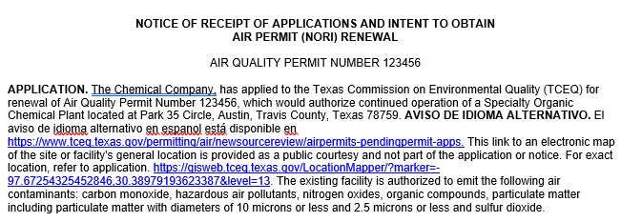
NORI Review: Renewal
Notes:
In this example, we have included a basic renewal NORI document.
For NSR permit renewals, the public comment and notice period is 15 days.
Key Items:
Renewal language
Site/facility type
Physical location
Map link
Pollutants list

Slide 14
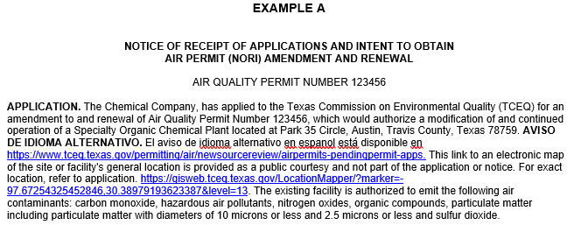
NORI Review: Renewal and Amendment
Notes:
In this example, we have included a renewal and amendment with notice.
For NSR permit initial applications and amendments that require notice, the public comment and notice period is 30 days. This also applies to the NAPD, which mentioned later in the presentation.
Key Items:
Renewal and amendment language
Note that a major modification will include the pollutants that are emitted in significant amounts
Site/facility type
Physical location
Map link
Pollutants list

Slide 15
NORI (and NAPD) Pitfalls and Errors
Published notice is inconsistent with approved notice
  Bold text or contact details have been changed
  Pollutants have been added or deleted
Alternative language requirements (30 TAC §39.426)
Newspapers (30 TAC §39.603)
  Do not meet general circulation requirements
  NORI and NAPD published in different newspapers
Permit documents not available at viewing location
  Administratively and technically complete documents
Notes:
Closing reminders on the notice documents. And just another reminder that Joe Nicosia and Rhyan Stone will be covering additional public notice issues with a focus on public participation and involvement after lunch.
Final reminders:
Ensure that the approved notice documents and the published notice documents match.
Is publication in an alternative language required? 30 TAC Chapter 39.426. If a bilingual education program is required, the alternative language notice is generally required. If there is no alternative language
Ensure that the newspaper meets the general circulation requirements in 30 TAC Chapter 39.603. If there is a question on the newspaper, please check early.
Applicants are required to make the permit documents and application documents available for public viewing at the location listed in the notice document. Note that the administratively and technically complete documents will be made available on the TCEQ website through the new Permit Search Portal. We have a few slides on the updates portal at the end of this presentation.
Failure to meet these requirements can result in either extensions of the comment period OR the requirement to re-notice a permit.

Slide 16
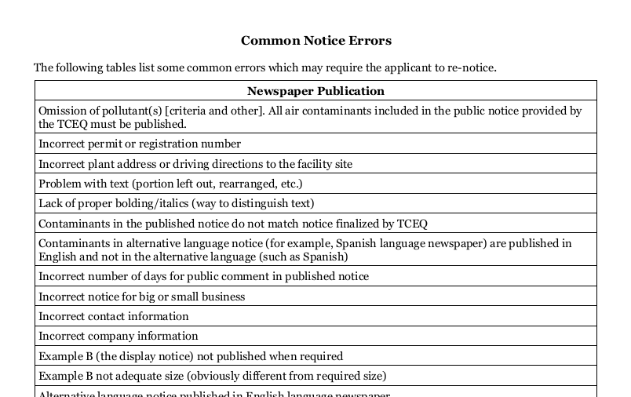
NORI (and NAPD) Common Notice Errors
Notes:
We have a helpful document APDG 6277 that lists the common notice errors.
TCEQ-External PN Common Notice Errors

Slide 17
Permitting Steps –
Technical Review/Federal Review
Technical Review/
Federal Review
Administrative Process and 1st notice (NORI)
Draft Permit and modeling
2nd
Notice
(NAPD)
Issue Permit
Notes:
The next phase in the NSR Permit review process is the Technical Review.
The Technical Review includes:
Federal review
Emission methodology and calculation verification
BACT review

Slide 18
Technical Review Process
Project Scope and Overview
PBR and SP Incorporation
Maintenance, Startup, and Shutdown (MSS)
Best Available Control Technology (BACT) Review
Federal Applicability (PSD/NNSR)
Including Retrospective
Emissions Calculations
Notes:
In this portion of the presentation, we will cover the following, starting with project scope.
Several of the topics covered here blend together, but we will generally separate them into the following:
Project Scope and Overview
PBR and SP Incorporation
Maintenance, Startup, and Shutdown (MSS)
Best Available Control Technology (BACT) Review
Federal Applicability (PSD/NNSR)
Including Retrospective
Emission Calculations

Slide 19
Public Notice (NORI / NAPD) Management
Project Scope and Overview
Permit Action / Requested Change | Amendment (116.116(b)) | Alteration (116.116(c))
Increase in actual or allowable emission rates | Required | Prohibited
This change will require BACT review | Required | Prohibited
Change of stack height or updated impacts | Applicable | Applicable
Add referenced PBR, SP, AMOC, federal subpart | Applicable | Applicable
Updates to reflect current boilerplate | Applicable | Applicable
Addition of speciated VOCs or limit relaxation | Required | Prohibited
Change in control method or facility replacement | Required | Prohibited
Reduction in permit allowable emission rates | N/A | Applicable
Notes:
A common issue that we see often is Alterations being submitted when an Amendment is the correct permitting mechanism. The examples are too many to add, but we wanted to highlight a few. Note that any time an alteration is applicable, and amendment may be submitted instead.
When deciding if a project is an alteration, please remember these checks:
Is there an actual or allowable increase in emissions? This is usually one of the first NOD questions asked or one of the first items we try to address when reviewing alteration projects. If there is an increase in emissions, either allowable or actual, an amendment is the correct project type.
Will the requested change require a BACT analysis? If so, an amendment is the proper project type.
If there is a change in stack height, or a potential impacts review associated, an alteration may be used depending on the results of the impacts analysis. If no emission rates are changing, and the source parameters have an equal or better impacts result, an alteration may be used.
Add a referenced PBR, Standard Permit, or Alternative Methods of Control (AMOC) may be accommodated in an alteration. Consolidation of a PBR, SP, and some AMOCs generally require an amendment.
Requested updates to permit conditions to reflect current boilerplate conditions may be accommodated with an alteration.
This next item is two separate items, but both the addition of speciated VOCs or the relaxation of a permit limit, including monitoring, would require an amendment.
Again, these are two separate items. Changes in the method of control or a facility replacement would be an amendment. New facilities are not authorized in an alteration.
A reduction in the permit allowable emission may be accommodated using an alteration. This could be removal of EPNs, reductions in throughputs or hours of operations, or other updates that would not require a BACT review.

Slide 20
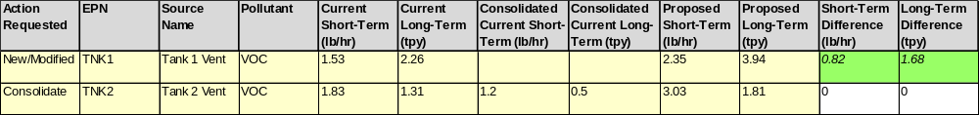
Project Scope and Overview
The PI-1 and application representations match
UT-ER tab matches the Executive Summary
  New/modified, consolidated, and/or removed EPNs in the UT-ER tab are clearly outlined and discussed
Example
Notes:
In general, everything represented in the PI-1 should match the project representations. This includes the project description matching the application supplemental information, EPN names matching, incorporation of PBRs and SPs by reference and consolidation etc.
It is also very important that the Units Type Emission Rate (UTER) tab matches all representations throughout the rest of the permit application.
New/Modified, Consolidated, and/or Removed EPNs in the UTER tab should always be clearly outlined and discussed in the project description.
In the example above, are the following items adequately addressed in the application representations?
Description of the PTE increase for TNK1 and TNK2 (i.e., for TNK2, the description should indicate that the increase in emissions is from the PBR consolidation).
PBR representations addressing consolidated emissions for TNK2.
Impacts and modeling addressing emission increases for TNK1 and TNK2.
BACT for tanks.
Federal applicability determination.
Emphasize that the PI-1 is a tool, but it is also required. Supporting documentation provides the justification for the information in the PI-1 workbook.

Slide 21
Scope Changes During Review
Will require management approval
Updates because of NOD questions
  May be accommodated during the review process
Project timeline and remaining project steps will be considered
Scope changes may require project withdrawal or void or the submittal of an additional project.
Notes:
Scope Changes are another item that we wanted to highlight.
If a scope change is requested during the review process, this will be routed for management consideration and decision. Questions that are evaluated with a scope change include:
Where are we in the review process,
Does this impact calculations,
Will it require an update to the BACT review and/or impacts,
Have drafts been agreed to, is modeling audit underway, etc.?
Note that depending on the scope change, we may request that the project be withdrawn or voided. Alternatively, we may request that a separate project be submitted. In either case, the resubmittal or new project requires would need to address any questions being asked or address any outstanding items.

Slide 22
PBR and SP Incorporation
Renewals
  PBRs must be referenced or consolidated in a renewal
  2006 PBR Incorporation Memo
Initial Authorizations
  Standard Permits must be consolidated in an initial authorization
  PBRs must also be consolidated in an initial authorization
  This includes Maintenance, Startup, and Shutdown (MSS) activities
Notes:
30 TAC §116.116(d)(2)
Permit by Rules (PBRs) and Standard Permit (SPs) must be incorporated into the associated NSR permit by reference or consolidation at the next amendment and at the latest, by the next renewal.
Consolidation requires emission calculations, BACT analysis, and impacts to be submitted. The PBR will be consolidated into the NSR which means that the emissions/sources will be added to the MAERT and representations included in the Conditions. The PBR will be voided upon issuance of the NSR project. (Please note that it’s highly recommended that Pollution Control Standard Permits (PCPs) be consolidated unless a valid reason is provided.)
Reference: The PBR remains active/retained. A Special Condition will be added listing the PBR(s) that are referenced and what the PBR authorizes.

Slide 23
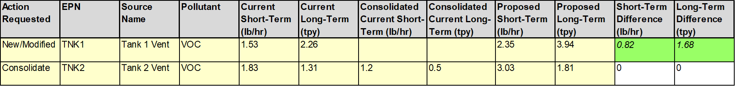
PBR and SP Example
General Tab
  Is incorporation by consolidation included?
Application Representations
  Supporting emission calculations were provided for PBR and emission increase for TNK2
  BACT for TNK2 was addressed
  Impacts associated with the consolidated emissions were included
Notes:
In this slide we will revisit the example from earlier.
TNK2’s proposed allowable emissions are increasing due to the consolidation of a PBR. Therefore, the project should include the supporting/updated emission calculations and BACT analysis for TNK2. In addition, the increase in emissions from the PBR consolidated should be included in the impacts analysis. (Please note that the consolidated emissions must match what was authorized in the PBR.)

Slide 24
Maintenance, Startup, and Shutdown (MSS)
How is MSS authorized?
  Current NSR Permit
  Site-wide MSS permit or other NSR permit
  PBR 106.263
All planned MSS must be included in the initial NSR Permit.
  PBRs and SPs may not be used in conjunction with an initial permit
  30 TAC §116.111(a)(2)
Is MSS changing with this project?
Notes:
In the executive summary please ensure that MSS is addressed. This is also a required entry in the PI-1 workbook on the General Tab, Rows 64 and 65 for initial, renewal, and amendment projects.
MSS emissions must be addressed for initial, renewal, and amendment projects.
Is planned MSS authorized in the current NSR permit, another NSR permit, or via PBR 106.263.
We have seen an increased number of initial projects recently. For these projects, planned MSS operations must be included and accounted for in the initial permit.
PBRs may not be used in addressing MSS. Overall, PBRs and SPs related to the process may not be used in conjunction with an initial permit.
30 TAC §116.111(a)(2) is an example of a citation that requires all emissions from the facility, including MSS, be included in the NSR permit application.
Is MSS changing in the project? i.e., are there updates to MSS activities including the number of events and/or duration that MSS occurs?

Slide 25
Best Available Control Technology (BACT)
Air Pollution Control
  How to Conduct a Pollution Control Evaluation
    APDG 6110
TCEQ Tiered Process
  Tier I: Compare to published BACT and recently issued permits in the same process or industry
  Tier II: If no established Tier I, consider similar streams in a different process or industry
  Tier III: If no technology is identified above, provide detailed economic and technical feasibility
EPA Top-Down Process
Notes:
As part of the Technical Review process, a Best Available Control Technology (BACT) analysis may be required. Specifically, a BACT analysis is required for the following:
Consolidation of Permit-by-Rule and/or Standard Permit
Modifications to facilities and BACT
Federal (PSD, NNSR) Permits and BACT
A few reminders, specifically related to guidance and the overall expectation for BACT reviews:
External long-form guidance is in APDG 6110
https://www.tceq.texas.gov/assets/public/permitting/air/Guidance/NewSourceReview/airpoll_guidance.pdf
TCEQ employs a 3-tiered BACT review process.
The EPA’s 5 step top-down process may also be used.
Identify all possible options
Exclude technically infeasible
Rank remaining by control efficiency
Evaluate adverse or secondary impacts
Select BACT
The end result should be the same regardless of which process is used.
Reminder that permit conditions and boilerplate conditions are written to ensure compliance with represented BACT for each facility.

Slide 26
Modifications to Facilities and BACT
30 TAC §116.10(9) Modification of Existing Facility: Any physical change in, or change in the method of operation of, a facility that causes an emissions increase for any federally regulated NSR pollutant (with exceptions)
APDG 5881: A facility does not need to be physically “touched” for a modification to occur.
  Relaxation of enforceable emission rate
  Relaxation of permit condition or other restriction
30 TAC §116.160(c)(2)(C): incorporates 40 CFR §52.21(r)(4) by reference
Notes:
For modifications to facilities, we look at two main determining factors.
30 TAC §116.10(9) in the definitions.
We also look at APDG 5881, which is the Major NSR Applicability Determination Document.
Air Permit Reviewer Reference Guide – Major New Source Review – Applicability Determination
https://www.tceq.texas.gov/assets/public/permitting/air/Guidance/NewSourceReview/fnsr_app_determ.pdf
30 TAC §116.160(c)(2)(C) is specific to relaxations of enforceable limitations, which incorporates 40 CFR §52.21(r)(4) by reference.
Also as a reminder, §52.21(r)(4) is specific to source obligation and that a relaxation of an enforceable limitation is treated as a modification.

Slide 27
Relaxation Example
SO₂ emission rate was based on AP-42 fuel sulfur content of 2,000 grains total sulfur per 1,000,000 dry standard cubic feet of natural gas. (0.2 gr S/100 dscf).
Applicant requests to update SO₂ calculations based on BACT limit of 5 grains sulfur per 100 dscf of natural gas.
Relaxation, but Retrospective or “Prospective”?
  If this is a correction to a mistake, this would be a retrospective change since there is no process change.
  If this is to reflect the actual concentration from an operational or process change, this would be considered prospective.
Notes:
For modifications to facilities, we look at two main determining factors.
30 TAC §116.10(9) in the definitions.
We also look at APDG 5881, which is the Major NSR Applicability Determination Document.
30 TAC §116.160(c)(2)(C) is specific to relaxations of enforceable limitations, which incorporates 40 CFR §52.21(r)(4) by reference.

Slide 28
Federal (PSD/NNSR) Permits and BACT
Tier I BACT or LAER Determinations
  Published information
  Recently issued permits
RACT/BACT/LAER Clearinghouse (RBLC) Search
  Summarize results to defend BACT or LAER determination
NNSR Lowest Achievable Emission Rate (LAER)
  30 TAC §116.12(17): Reflected by the most stringent emission limit in any approved SIP
Notes:
An additional few reminders, specific to PSD and NNSR reviews.
When a project triggers NNSR, LAER is required for the triggered pollutants.
When a project triggers PSD, BACT review is required.
For all projects that trigger PSD and/or NNSR a summary of the research/findings in the RBLC should be included in the application.

Slide 29
Emission CAPS and BACT
Multiple facilities under one emission limit are considered a cap.
  Restrictive CAP: The sum of the PTE of individual facilities is greater than the CAP (CAP < sum).
  Non-Restrictive CAP: There is no established PTE for individual facilities, but all are subject to a single emission CAP.
BACT for Emission CAPS
  Increasing the CAP effectively modifies every facility included in the CAP; BACT is required.
  Removing a facility requires reducing the cap equal to the original CAP contribution of the facility. If no reduction occurs, BACT is required.
Notes:
We have a couple of examples here, specific to emission caps. It is common to have permits with various emission caps.
An emission cap is a total emission limit that applies to a group of facilities or emission points. These are most commonly applied at sites where there are multiple of the same facility or unit type. Instead of having an individual limit, may sites will group the similar facilities together under a single limit.
When an emission CAP is created or modified (i.e., sources are added or removed from a cap) the cap is considered modified and BACT review is required for all sources under the cap.

Slide 30
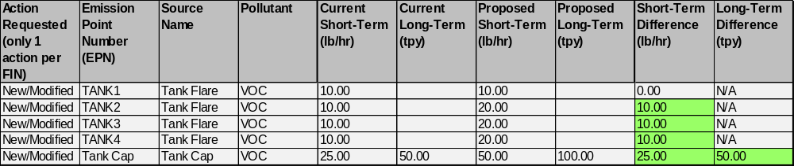
CAPS and BACT – Example 1
Short-term emissions are increasing for all but Tank 1.
There are no individual annual emission limits on any tanks.
The annual emission cap is increasing.
BACT is required to be evaluated for all facilities since each may have an emissions increase in this example.
Notes:
In this example, we have a non-restrictive emission cap.
The tanks are limited to 300 tpy annual emissions.
There is no individual annual emission limit for each tank.
Each tank may emit up to the total for the tank cap as the most conservative scenario.
All facilities in this example may increase their annual emissions based on the increase of the cap since there are no individual annual emissions.
BACT is required for all facilities, even TANK1, in this case since the annual emissions may increase for each tank depending on how they are operated.

Slide 31
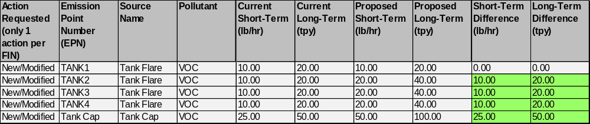
CAPS and BACT – Example 2
Short-term emissions are increasing for all but Tank 1.
The annual emission cap is increasing.
Annual emission rates for Tanks 2, 3, and 4 are increasing
BACT is required to be evaluated for Tanks 2, 3, and 4.
Tank 1 has no changes even though it is part of the cap.
Notes:
In this example, we have a restrictive emission cap.
The tanks are currently limited to 200 tpy annual emissions.
The sum of the individual tank emissions is 250 tpy, so the cap is less than the sum.
If each tank emits up to the individual limit, the cap will be exceeded for the year.
In the proposed project:
TANK1 has no changes authorized as part of this project. It is not modified even though the cap has increased. The cap contribution of TANK1 is still limited to 40tpy.
BACT is required to be evaluated for the other 3 tanks since they have all be modified with an individual emission increase.
The cap is still considered restrictive since the sum of the annual limits for the 4 tanks is 280tpy but the cap is limited to 210tpy.

Slide 32
PI-1 Workbook and BACT Analysis
All new/modified EPNs must be addressed and included for BACT.
  Includes EPNs or facilities with relaxations
  Includes throughput increases, temperature changes, and VP increases.
If Tier I BACT is met, respond “yes” on the PI-1 tab and include specifics.
If Tier I BACT is not met, respond “no” on the PI-1 tab and include supplemental information in the supplemental application file or Executive Summary.
Notes:
This is a reminder slide to re-iterate the expectation that the PI-1 workbook and supplemental application materials match.
All EPNs listed as New/Modified on the PI-1 Unit Types and Emission Rates tab must adequately address BACT.
If Tier I BACT is met, a “yes” response with the corresponding specifics in the Additional Notes cell is expected. If BACT is not addressed adequately in the PI-1 workbook nor in the supplemental application, this will be a Notice of Deficiency item.
If Tier I BACT is not met, please indicate “no” and provide supplemental information in the PI-1 workbook. The supplemental application files should also explain, in detail, the reason that Tier 1 BACT is not met and provide the appropriate justification for the proposed BACT determination.
More information is preferred here and reduces the back and forth between the permit reviewer and applicant/consultant in the technical review process.

Slide 33
Federal Applicability
Federal Programs for Major Sources
  Prevention of Significant Deterioration (PSD)
  Nonattainment New Source Review (NNSR)
2-Step Process
  Project Emission Increase
  Netting
Retrospective Reviews
Notes:
In the past, we have had an entire presentation dedicated to federal applicability. This year, we wanted to highlight a few reminders about federal applicability expectations for projects.
We will have a quick review of the two federal programs as well as the associated major source and major modification thresholds associated with each.
After that, we will highlight the 2-step process for completing a federal applicability analysis and finish with a brief discussion of retrospective reviews.

Slide 34
PSD Major Source Thresholds
Source Category | Regulated Pollutant | Major Source (TPY)
Named | All | 100
Un-Named | All | 250
APDG 5881: Major New Source Review – Applicability Determination
Notes:
This slide is fairly self-explanatory. Fugitive emissions are considered in Named Sources.
The slide note have a list of all the named sources, and additional information may be found in APDG 5881.
https://www.tceq.texas.gov/assets/public/permitting/air/Guidance/NewSourceReview/fnsr_app_determ.pdf
The following are considered named sources:
Coal cleaning plants (with thermal dryers); Kraft pulp mills; Portland cement plants; Primary zinc smelters; Iron and steel mills; Primary aluminum ore reduction plants; Primary copper smelters; Municipal incinerators capable of charging more than 250 tons of refuse per day; Hydrofluoric, sulfuric, or nitric acid plants; Petroleum refineries; Lime plants; Phosphate rock processing plants; Coke oven batteries; Sulfur recovery plants; Carbon black plants (furnace process); rimary lead smelters; Fuel conversion plants; Sintering plants; Secondary metal production plants; Chemical process plants (Not including facilities that produce ethanol by natural fermentation included in the North American Industry Classification System codes 325193 or 312140); Fossil-fuel boilers (or combinations thereof) totaling greater than 250 million British thermal units (BTUs) per hour of heat input; Petroleum storage and transfer units with total storage capacity above 300,000 barrels; Taconite ore processing plants; Glass fiber processing plants; Charcoal production plants; and Fossil fuel-fired steam electric plants greater than 250 million BTUs per hour of heat input.

Slide 35
PSD Major Modification Thresholds
Regulated Pollutant | Major Modification (TPY)
CO | 100
VOC / NO_{x} / SO₂ | 40
PM / PM₁₀ / PM_{2.5} | 25 / 15 / 10 respectively.
Pb | 0.6
TRS (includes H₂S) | 10
H₂SO₄ | 7
Fluoride (excludes HF) | 3
Greenhouse Gases * | GHG > 0 and CO₂e ≥ 75,000
Notes:
Once a source/site exceeds the major source thresholds on the previous slide for any pollutant, the above major modification threshold apply for PSD.
As a reminder, once a site is a major source or exceeds the PSD major source threshold for one pollutant, the site is considered major for all. In this case, the above major modification thresholds or significant emission rates apply.
*Greenhouse Gases are only subject to PSD review for existing major sources that have triggered PSD for a non-GHG pollutant. These are also called PSD Anyway sources.

Slide 36
Nonattainment Ozone Thresholds
Classification | Major Source (TPY) | Major Modification (TPY) | Netting Threshold | Texas Area(s)
Extreme | 10 | 10 | -- | N/A
Severe | 25 | 25 | 5 | HGB/DFW
Serious | 50 | 25 | 5 | Bexar
Moderate | 100 | 40 | 40 | N/A
Marginal | 100 | 40 | 40 | N/A
Notes:
In contrast to PSD, Nonattainment New Source Review (NNSR) applies only in areas that do not meet the NAAQS for a particular pollutant.
While there are a few additional non-attainment areas in Texas specific to PM or SO2, the slide shown is specific to the areas in Texas that are designated as nonattainment for ozone. The ozone precursors NOx and VOC are evaluated against the above thresholds in these areas in determining the major source status or whether a project is considered a major modification or requires netting.

Slide 37
Federal Applicability Analysis
Required for New Sources
Required for Existing Minor and Major Sources
Modification for Existing sources
  Increase in PTE is a modification.
  Increase in throughput without a PTE increase is a modification.
  Relaxation of an enforceable rate or restriction is a modification.
  Affected facilities up or downstream.
Notes:
The conservative approach is to include a federal applicability analysis for all case-by-case permitting projects.
If the site is an existing minor source and will remain a minor source after the project, the analysis can stop there.
If the site is an existing minor source but will exceed the previously mentioned major source thresholds after a project, a federal applicability analysis is required.
New major sources require an analysis.
Changes at existing major sources require an analysis.
As previously discussed in the BACT section, modifications will trigger a federal applicability analysis.
Affected facilities that are upstream or downstream of the modification should also be included in the federal analysis.
The next slide outlines the simplified expectation for the 2-step federal applicability analysis.

Slide 38
2-Step Federal Applicability Process
Step 1: Calculate Project Emission Increase
  Table 2F
    New Sources or facilities (PTE – 0)
    Existing sources or facilities (PTE – BAE or PAE – BAE – CHA)
    Decreases for units being shut down and other project decreases
    Compare to PSD or NNSR netting threshold
Step 2: Perform Netting Exercise if Needed
  Table 3F
    Compare netting exercise to major modification threshold
Notes:
This is a very general and high-level overview of the 2-step process to be completed in a federal applicability analysis.
Step 1 is to calculate the Project Emission Increase (PEI)
Step 2 is to perform the netting exercise. For “step 2” netting, the contemporaneous period is defined in 30 TAC 116.12(12) as the period from five years prior to the start of construction through the start of operation date.
Again, for each project submitted federal applicability should be addressed. Please ensure that the PI-1 workbook federal applicability tab and supporting application materials match.
Potential to Emit (PTE)
Baseline Actual Emissions (BAE)
Projected Actual Emissions (PAE)
Could Have Accommodated (CHA)

Slide 39


Federal Applicability Process
Pollutant
*For NA, replace Major Mod. with netting thresholds
Attainment / Nonattainment
Step 1*
PEI ≥ Major Mod.
Netting
Greenfield/
Existing
Minor Source
Existing
Major Source
Step 2
PEI < Major Source
PEI ≥ Major Source
PEI < Major Mod.
NEI < Major Mod.
NEI ≥ Major Mod.
No Federal Permitting
Federal Permitting
No Federal Permitting
No Federal Permitting
Federal Permitting
Notes:
For the visual learners, this is a review of the Federal Applicability Process.
PEI = Project Emissions Increase
NEI = Net Emissions Increase
Major Modification Thresholds = Significant Emission Increase for PSD
As previously discussed, a federal applicability analysis is required for greenfield sites, existing minor sources, and existing major sources. The image above shows the 2-step process for existing major sources.
We should note that this slide is a simplified overview of the process. In the case of an existing major source for a single pollutant, for instance, the PEI should also be compared to the significant emission rates for other PSD pollutants.

Slide 40
Retrospective Reviews
Apply to existing minor or major sources
Correct previous representations
  Final unit design or operation differs from original design
  Changes were not reflected in original application
  Newly identified emission source not previously authorized
Does not authorize new modifications or representations
Evaluated based on thresholds at time of original project
Evaluated based on current BACT, modeling, and offset ratios
Notes:
Some examples of retrospective projects include corrections related to:
Omitted pollutants.
Vent flow rate to control device.
Stream composition.
Equipment capacity/specifications.
Fugitive component count.
Tank fitting types/counts.
Stack parameters.

Slide 41
Retrospective Review Process
Did the original project trigger major NSR for the pollutant?
Do original emissions plus new/increased emissions trigger major NSR for the pollutant?
Process changes as a minor project. Update impacts analysis as necessary.
No
No
Yes
Yes
Process all emissions as a major NSR project with current BACT/LAER, current modeling/met data, and current offsets as needed.
Do new and increased emissions exceed significance levels for the pollutant*?
Process as a minor project. Include federal level BACT/LAER, update AQA, acquire any additional offsets.
No
Yes
*Increases from new and modified units should be based on allowable emissions (PTE) for the unit(s).
If new/modified units result in increased utilization of an affected unit, the affected unit may be evaluated based on PTE or based on worst-case increases if the new/modified units were to operate at maximum permitted capacity.
Process updates as a major modification project. Include current BACT/LAER, update AQA, acquire any additional offsets.
Notes:
This slide provides a visual representation of the retrospective review process.

Slide 42
Federal Analysis
Submit appropriate forms
  Tables 1F, 2F, 3F, and 4F for retrospective project component
  Tables 1F, 2F, 3F, and 4F for current project component
Clearly describe and separate retrospective and current modifications or updates
It is possible to trigger federal permitting both retrospectively and with a current project, depending on the scope of each analysis.
Notes:
In the case where a project has both retrospective and prospective/current changes, a combined analysis may be required. Tips for this analysis include:
Submission of a retrospective federal analysis for that project component.
A corresponding federal analysis for the current project.
Clearly state which analysis is being represented in the PI-1 workbook on the federal applicability tab.
For clarity, it is best to clearly describe each analysis including the modifications associated with the retrospective review and current project.
It is possible, depending on the scope of each project, to trigger federal review both retrospectively AND with a current project.

Slide 43
Emission Calculations
Provide sample calculations with application supplement
  Include for each calculation type
  Include for each pollutant
Use actual input parameters
More detail is preferred over minimal or insufficient information
Notes:
The goal of the emission calculations is to allow the permit reviewer to duplicate the calculations and verify the emissions.
If the applicant has an Excel file with their calculations and is willing to provide it with the application, this helps speed up this process.

Slide 44
Guidance and Sources
Use the most recent EPA or TCEQ guidance
  TCEQ Fugitive Workbook
  EPA AP-42 Chapter 7, June 2026, for storage tanks
Vendor or Manufacturer Data
  Provide specification or design data, if possible
Stack Test, CEMS, or CMS basis
  Provide stack test summary sheets
  Provide a summary of CMS data and justification for the request
Notes:
Please remember, if you are using a vendor emission factor or an emission factor from a stack test, the vendor data sheet and/or the stack test must be submitted with the application.
If the vendor or manufacturer data is being used, ensure that the vendor/manufacturer data sheet is included in the project submittal.
If emission factors from a stack test are being used, ensure that the stack test report is included in the project submittal.
Continuous Emission Monitoring System (CEMS): If factors or emission rates are based on CEMS data, please provide the relevant data and supporting justification for the request.
Continuous Monitoring System (CMS): If monitored parameters are requested to be updated for emission factors or other justification, please provide the relevant data and supporting justification for the request.

Slide 45
Other Calculation Considerations
Calculations must reflect application BACT determinations.
“Safety” factors
Excel vs. PDF
Confidential vs. non-confidential
Notes:
The calculations must reflect BACT, i.e., control efficiency, concentration, etc. The calculations and representations will be used for both MAERT emission limits as well as permit special conditions.
If a “safety” factor is being requested/integrated into the emissions calculations, please explain/justify the need for the “safety” factor so we can determine if this is acceptable. Safety factors that are greater than 5-10% require robust justification.

Slide 46
Inside the Technical Review Process
Project assignment made after Administrative Review
Assigned reviewer will begin technical review process
First NOD will be sent within 90 days
  Typical requested response time is 30 days
  Confirm receipt
Extension Requests
  Reviewed by management
Additional NODs
  Typical requested response time is 15 days
Notes:
This slide is intended to give you an inside look at the technical review process.
NOD response times are based on the number of questions and type of questions being asked.
If more time is needed to respond, please send an extension request to the permit reviewer. Include the proposed new due date and why an extension is needed in the extension request. Note, an extension is not automatically granted, it is considered by management and may be approved, adjusted, or denied.

Slide 47
Common NOD Items
Storage tank calculations
  Vapor pressure information
  Older EPA methods
Inconsistent calculations
  Calculated emissions do not match PI-1
  Hours per year if not authorized for 8,760 hours/year
Insufficient justification for condition changes
Impacts review not included or incomplete
Notes:
Examples of NOD items:
For renewal projects, if it’s not noted in the application summary, we will ask if the tanks’ emissions have been updated to the latest AP-42 and our guidance. If there are increases, updated calculations and impacts are required. If they have been updated, we will ask for the project number.
When using vendor emissions factor or stack test-based emissions factor, please include the source of the factor in the application materials. If the vendor data sheet or stack test is not provided, we will ask for this information as part of an NOD.

Slide 48
Permitting Steps – Draft Permit and Modeling
Draft Permit and Modeling
Administrative Process and 1st notice (NORI)
Technical Review/
Federal Review
2nd
Notice
(NAPD)
Issue Permit
Notes:
Before wrapping up, we’ll cover a few items in the draft permit and modeling review process.
As mentioned previously, draft permit negotiations and modeling are separate steps that generally occur simultaneously in the permit review process.
Consistent with the theme of the prior slides, we will highlight a few areas where additional coordination will help with the overall permit review process.

Slide 49
Draft Permit Review Process
Boilerplate language is the starting point for negotiations.
  Will be updated for modified EPNs or facilities.
  Will be added for new EPNs.
Proposed Condition Changes
  Include justification or basis.
Scope Changes During Draft Review
  Include requested change and justification.
  These are sent to management for review and approval.
Notes:
Once the technical review process is complete, the permit reviewer will update the permit documents and send a draft for review.
Special Conditions will be updated consistent with application representations.
Boilerplate conditions are the starting point for most condition updates.
Sufficient justification is expected in application materials for special condition changes.
Maximum Allowable Emission Rate Table (MAERT) updates will be based on the PI-1 workbook submittal.
One common item we see during this stage, is to request changes to special conditions that may not have been part of the application as submitted.
These changes may be viewed as a project scope change and prompt additional NODs or Requests for Information.
If there are change requests, please include sufficient justification with the requested change.
Changes that are determined to be outside of the scope of the originally submitted project will require management approval.

Slide 50
Impacts and Modeling
Impacts review and modeling are required for permit applications with emission increases.
  Refined modeling audits and reviews are conducted by the ADMT.
  SCREEN3 modeling reviews are conducted by the permit reviewer.
A “yes” answer in the Electronic Modeling Evaluation Workbook (EMEW) indicates modeling files are included.
Submittal of refined modeling separately may be accepted via TCEQ Send to the APIRT reviewer.
Notes:
Once the technical review process is complete, “final” modeling is typically requested and runs concurrent with the draft permit review. We wanted to highlight a few slides with modeling reminders and items that APD, specifically the Air Dispersion Modeling Team (ADMT) has been seeing in submittals.
Impacts review and modeling are required for projects with emission increases.
This includes increases in a VOC species to address impacts via the Modeling Effects and Review Applicability (MERA) guidance.
Related to the submitting modeling with the permit application, we wanted to highlight a few reminders.
Applicants have been selecting “Yes” in the EMEW indicating modeling files were submitted with the permit application. Unfortunately, in many cases, the modeling files are not submitted, requiring staff to contact the applicant to obtain them.
Submitting modeling files with the application is recommended but optional. If an applicant wishes to submit them, they should be submitted to APIRT via TCEQ Send on the same day the permit application is submitted.

Slide 51
PSD-Specific Impacts and Modeling
PSD modeling protocol must be submitted instead of an impacts review for PSD projects.
  PSD pollutants must be included in the in the AQA.
  Pollutants not triggering PSD may be included in the EMEW or may be included in the AQA for PSD projects.
EPA intermittent guidance requires sufficient justification.
Selection of background monitors must include justification.
Notes:
A couple of reminders specific to projects that trigger PSD or are a PSD major modification:
PSD modeling protocol must be submitted instead of impacts review for PSD projects.
PSD pollutants must be included in the AQA.
Pollutants not triggering PSD may be included in the EMEW, but optionally they can include all pollutants in the AQA for PSD projects.
APD’s preference is to include an EMEW for those pollutants not triggering PSD.
We are seeing an increase in additional PSD modeling protocol reviews. This delays the technical review. Common causes for revised protocols include:
Incomplete source characterization and operational scenario documentation. Applicants must fully document all operational scenarios, including MSS, and demonstrate how the worst-case operating scenario was determined. This issue has become especially common for power generation projects with turbines and engines.
EPA intermittent guidance. Applicants have not been providing sufficient justification to support its use and have been applying it to situations that clearly do not meet the intent of the guidance. Similar to the item above, this issue has become especially common for power generation projects. Additionally, this issue spans beyond initial modeling submittals; it is a general issue as well.
Insufficient documentation, justification, and methodology for NOx-to-NO₂ Tier III analyses. This includes model inputs, such as meteorological data, monitoring data, and in-stack ratio (ISR) justifications.
Insufficient justification for background monitor selections. Note this issue spans beyond initial modeling submittals; it is a general issue as well.

Slide 52
Impacts and Modeling Pitfalls
Initial modeling review items are clearly addressed.
  Include line-by-line response in final modeling submittal.
Retrospective projects are expected to be clearly outlined:
  What part of the project is retrospective?
  How are the retrospective impacts being evaluated?
Modeling Effects and Review Applicability (MERA) Analysis
  At what step do pollutants satisfy the MERA?
Single Property Line Designation (SPLD)
  All applicable emissions from SPLD tenants must be included in site-wide modeling.
Notes:
A few other items to consider for a streamlined a quick impacts and modeling review.
Please ensure that all deficient items in the initial EMEW/modeling review are clearly addressed when final modeling is requested.
For retrospective projects, the AQA needs to clearly indicate that the project is retrospective as well as how the retrospective emissions are being evaluated.
As mentioned above related to increases of emissions, including individual species, clearly communicating in the AQA at which step (step 0, 1, 2) a pollutant “fell out” of the analysis helps to ensure a streamlined review process.
Regulated entities co-located at the project site need to be documented and the relationship to the applicant should be fully explained. Additionally, it should be clear whether their emissions need to be included in the modeling analysis and whether the site is considered ambient air relative to the applicant.
Not all files are included in the final modeling submittal. Missing modeling files prompt ADMT to conduct additional internal analysis or make requests for information from the applicant, both of which delay the review.
For sites with a Single Property Line Designation (SPLD), All applicable emissions from SPLD tenants must be included in site-wide modeling.

Slide 53
Permitting Steps - NAPD
2nd
Notice
(NAPD)
Administrative Process and 1st notice (NORI)
Technical Review/
Federal Review
Draft Permit and modeling
Issue Permit
Notes:
Much like this presentation, the permitting process is long…
Congratulations! We are almost to the end of both, and you’ve made it this far.
Notice of Preliminary Decision (“NAPD”)
The last couple of steps in the permitting process include the 2nd notice or NAPD. This is required for all initial projects as well as some amendments.

Slide 54
NAPD Tips to Avoid Pitfalls – Part 1
Coordinate with permit reviewer before finalizing NAPD.
  Review documents within 2 days of receipt.
Key Items to Check
  Is the notice location correct?
  Is the site location link correct?
  Are the pollutants the same as in NORI?
Newspaper Consistency
  Must meet general circulation requirements.
Notes:
If this slide looks familiar, you have been paying attention.
We want to cover and highlight a couple of areas that we have seen that have required either amended notice documents to be sent OR have required a re-publication of notice documents.
NAPD: Required for initial applications some amendments.
Please note that it is the applicant's responsibility to review the draft NAPD that the permit reviewer sends to ensure it is correct.
As a reminder, if we have a correct and accurate NORI, it streamlines the NORI process and helps streamline the NAPD process.

Slide 55
NAPD Tips to Avoid Pitfalls – Part 2
Publish NORI and NAPD in the same newspaper.
  Publish as sent by TCEQ.
Submit timely affidavits and accurate verification forms.
  If notice ends on a weekend or holiday, the comment period ends on the next weekday.
Notes:
Another reminder, please ensure HAPs is listed in the PI-1, Public Notice tab, Row 41.
Review NAPD documents and coordinate with permit reviewer.

Slide 56
Permitting Steps – Issue Permit
Issue Permit
Administrative Process and 1st notice (NORI)
Technical Review/
Federal Review
Draft Permit and modeling
2nd
Notice
(NAPD)
Notes:
The last step is the issuance of your NSR permit.

Slide 57
Permit Issuance
Submit timely affidavits and verification forms.
If there are no public comments, public meetings, or contested case hearings, the permit may issue.
Notes:
As mentioned in the short NAPD discussion, timely submittal of affidavits and public notice verification forms to the Office of the Chief Clerk and the Permit Reviewer helps with a timely issuance.
Public meetings and notice issues will be discussed in a presentation this afternoon as well, primarily focused on the increased public participation that both the Title V and NSR sections have seen.
If a response to comments is not required, if there are no public meetings to be held, no agenda dates or contested case hearings to work around, the next step is the permit issuance.

Slide 58
NSR Updates
Permit Search Portal
Notes:
A few quick updates to start.

Slide 59
Permit Search Portal
Permit documents can now be found via a map search.
  Current documents
  NORI, NAPD, and PLS
  Administratively complete file packages
  Technically complete file packages
Notes:
The permits have moved!

Slide 60
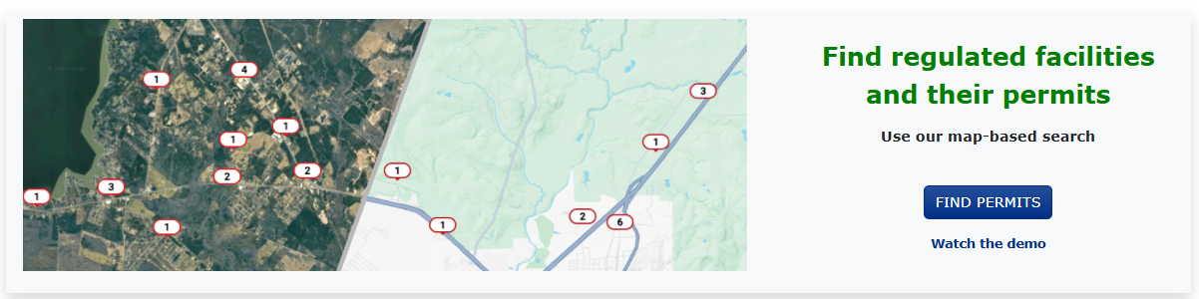
Permit Search Portal Demo
Notes:
TCEQ has recently updated the permit search to be a Permit Search portal.
Using this tool, it is possible to find permit documents for regulated entities.
This tool will is also where notice documents, administratively complete and technically complete application files will be found.

Slide 61
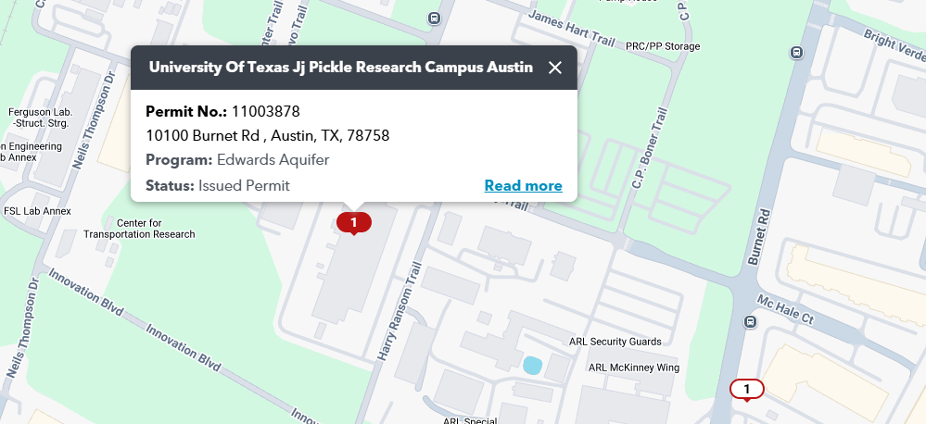
Permit Search Portal Example
Notes:
The portal is searchable by location which could be a specific address including county or zip, near me, or all of Texas.
Options are provided for application types
Options are also available for media: air, water, waste

Slide 62
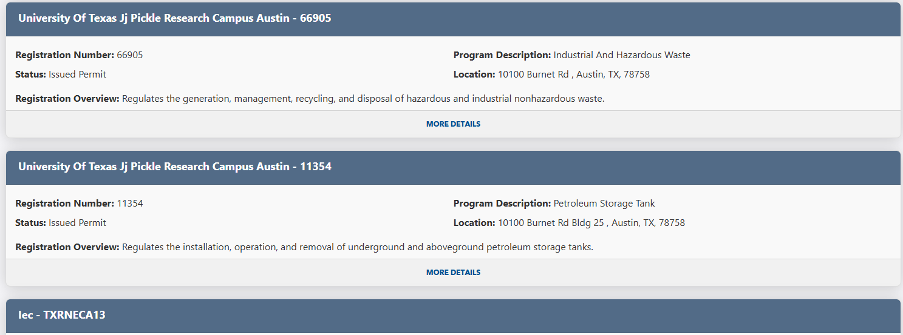
Permit Search Portal Example
(continued)
Notes:
Once you have found the desired area, it is possible to further navigate to the actual permit or registration number.
Selecting more details will provide additional information about the permit including the issuance date, an overview, tracking elements, active projects, etc.

Slide 63

QUESTIONS?
Contact Information:
  Brandon Marsh, P.E.
  Technical Specialist, NSR Chemical Section
  Phone: (512) 239-1280
  Email: brandon.marsh@tceq.texas.gov

