Slide 1
Federal Applicability Netting Options and Retrospective Review
Jean Shaw, P.E. and Lou Malarcher, P.E.
Air Permits Division
Advanced Air Permitting Seminar
Notes:
Welcome to our session on Federal Applicability, Netting Options, and Retrospective Review. My name is Jean Shaw, and I work in the Air Permits Division at TCEQ. I will be presenting the background information for this session. My colleague Lou Malarcher will be going over examples applying the concepts.
Thank you all very much for being here today. I would also like to thank my colleagues who have created and assisted with these slides.
Just as a reminder, this presentation will be available on the TCEQ website.

Slide 2
Outline
Federal NSR Program
PSD/NA Examples
PSD/NA Updates
Federal Applicability
Terminologies
Netting
Federal Applicability Test
Retrospective Review
Notes:
Our presentation today will be in two parts.
Part I will be a very brief overview of federal applicability, since most of you are familiar with the basics and/or attended the presentation at the Environmental Trade Fair. This group of slides will cover PSD and NNSR updates, key terminologies, and the federal applicability test.
Part II will cover retrospective review including basic concept, available guidance, and the nuts and bolts of how we think retrospective review should be applied.

Slide 3
NNSR: Ozone Thresholds
Classification | Major Source (TPY) | Major Modification (TPY) | Netting Threshold (TPY) | Texas Area
Extreme | 10 | 10 | -- | N/A
Severe | 25 | 25 | 5 | HGB / DFW
Serious | 50 | 25 | 5 | Bexar
Moderate | 100 | 40 | 40 | N/A
Marginal | 100 | 40 | 40 | N/A
Ozone regulated through precursors (VOC & NOx).
Notes:
First, Let’s look at the updates from EPA.
On September 15, 2022, EPA finalized the rule to bump up the HGB and DFW areas from serious to severe ozone nonattainment under the 2008 ozone standard.
Bexar County was bumped to serious ozone nonattainment and HGB and DFW areas from moderate to serious under the 2015 ozone standard. Since HGB and DFW are severe for the 2008 standard, the change in the 2015 ozone standard classification does not have an effect on the review process.
The reclassification of HGB and DFW from Serious to Severe results in a lower threshold for major source status (25 tpy). It also means a higher offset ratio (1.30 to 1).
The reclassification of Bexar results in a higher offset ratio as well (1.20 to 1).
Please note nonattainment permit requirements with respect to area classification are based on the date of issuance of the permit (not the date the application is submitted to TCEQ) in accordance with 30 TAC §116.150.
Also, please note that it is possible for a project to trigger both PSD and Nonattainment NSR for NOx.

Slide 4
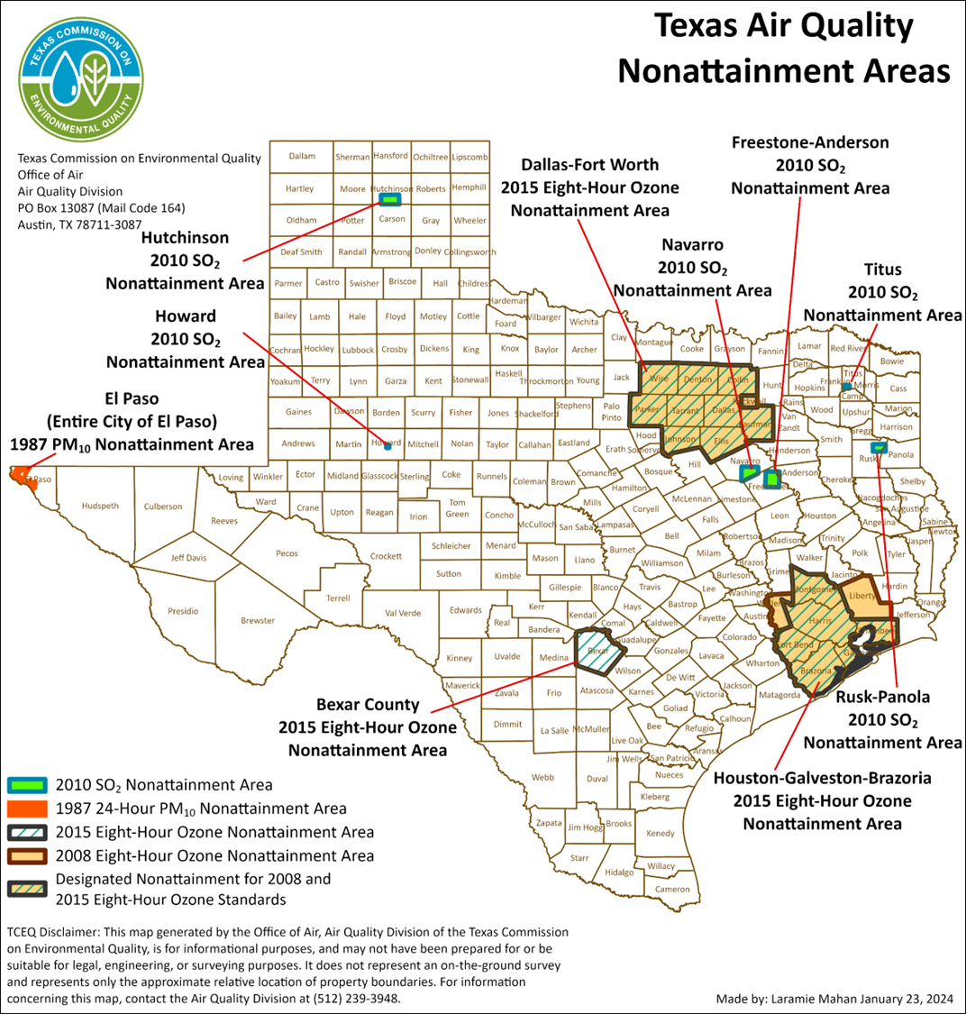
Texas Air Quality Nonattainment Areas
Notes:
This map shows the current nonattainment counties in Texas as of January 2024.

Slide 5
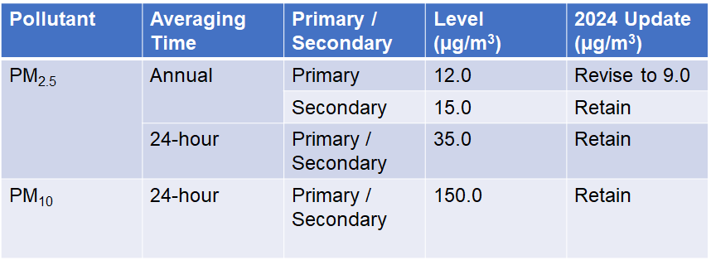
New PM_{2.5} NAAQS
Notes:
Let’s move on to the update on the PM standards.
On February 7, 2024, EPA announced a final rule to strengthen the National Ambient Air Quality Standards (NAAQS) for PM2.5.
The slide shows a summary of previous standards and 2024 standards.
Effective May 6, 2024, EPA lowered the primary annual standard for PM2.5 to from 12 to 9.0 micrograms per cubic meter (µg/m3).

Slide 6
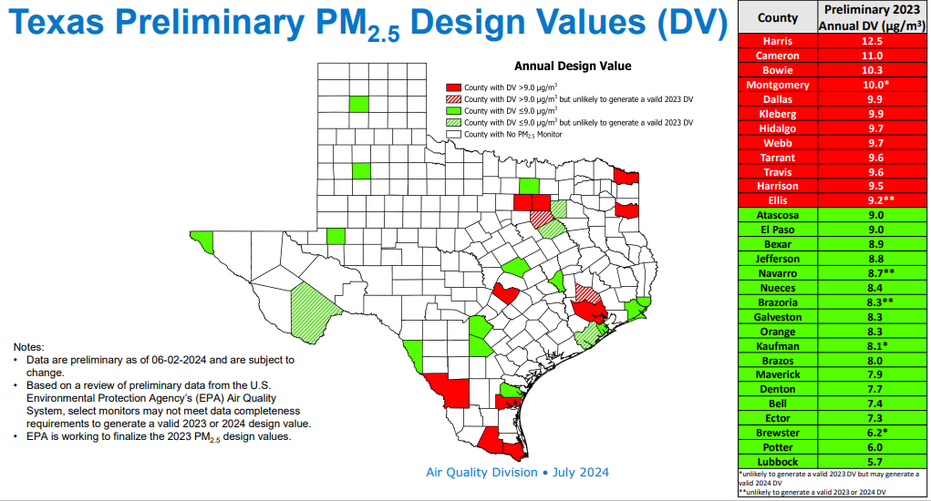
Texas Preliminary PM2.5 Design Values
Notes:
This slide shows the preliminary PM2.5 design values in Texas for counties with PM2.5 monitors.
A design value is a statistic that describes the air quality status of a given location relative to the level of the NAAQS.
TCEQ held an informal comment period from July 30 through August 30, 2024, to gather information for the development of a designation submission related to the 2024 primary annual PM_{2.5} NAAQS.
TCEQ Air Quality Division staff are currently evaluating the available data and potential designations, which will be considered by the commission in December 2024. Once approved by the commission, the designations will be sent to the governor for approval before being submitted to the EPA by February 7, 2025.

Slide 7
Recommended SIL Values for PM_{2.5} NAAQS
PM_{2.5} 24-hour (35 μg/m³) 1.2 μg/m³
PM_{2.5} annual (9 μg/m³ or 15 μg/m³) 0.13 μg/m³
Notes:
Let’s talk about the latest update on the significant impact levels (SIL) for PM2.5.
EPA has lowered both annual PM2.5 standard and SIL.
Annual PM2.5 SIL has been reduced from 0.2 μg/m3 to 0.13 μg/m3, effective May 6, 2024.

Slide 8


Applicability Logic
Pollutant
Attainment / Nonattainment
Step 1
PEI ≥ Netting Threshold
Greenfield/
Existing
Minor Source
Existing
Major Source
Netting
PEI < Major Source
PEI ≥ Major Source
PEI <
Netting Threshold
Step 2
NEI <
Major Mod.
NEI ≥
Major Mod.
No Federal Review
Federal Review
No Federal Review
No Federal Review
Federal Review
Notes:
Let’s move on to the federal applicability determination.
I’m going to take you through a flow chart to determine whether a federal review is applicable.
First, we ask ourselves what the target pollutant is, and then whether the proposed project will be in a nonattainment area or attainment area.
Next, we determine if this is a new site, an existing minor source, or an existing major source.
If at a new site or at an existing minor source, the next question is whether the project increase (or potential to emit) is less than the major source threshold. If below the threshold, no federal review is required. If greater than or equal to the major source threshold, federal review is required.
When we looking at an existing major source, we ask if the project increase is less than the netting threshold. If less than, no federal review is required. If the project increase is greater than or equal to the netting threshold, a netting exercise is required to be conducted, which is Step 2 of the process.
Finally, we ask if the net emissions increase is less than the major modification threshold. If so, no federal review is required. If the net emissions are greater than or equal to the threshold, federal review is required.
Let’s delve into the two steps of the federal applicability review in more detail.

Slide 9
Major NSR
Two Step Applicability Test
Step 2
Significant Net Emissions Increase (NEI) in contemporaneous netting window
Step 1
Significant Project Emissions
Increase (PEI)
New / Existing units:
PEI = PTE – BAE
Existing units:
PEI = PAE – BAE
PEI = PAE – BAE – CHA
  PEI = Project Emissions Increase;
  PTE = Potential To Emit;
  BAE = Baseline Actual Emissions;
  PAE = Projected Actual Emissions (current project);
  CHA = Could Have Accommodated Emissions;
  NEI = Net Emissions Increase.
Notes:
Major NSR permitting involves a two-step applicability test:
The first step is to determine if there is a “significant project emissions increase” of a regulated NSR pollutant from the proposed project.
If there is, the second step is to determine if there is a “significant net emission increase” of that pollutant.

Slide 10
Step 1: Project Emission Increase
New Facility
Existing Facility
  PEI = PTE
  For units that have not begun
  operation the BAE = 0
  PEI = (Proposed – Current) PTE
  For units in operation < 2 years
  BAE = Current PTE
  PEI = PTE – BAE
  PEI = PAE – BAE
  PEI = PAE – BAE – CHA
  PEI = Project Emissions Increase; PTE = Potential To Emit; BAE = Baseline Actual Emissions;
  PAE = Projected Actual Emissions only for current project; CHA = Could Have Accommodated Emissions.
Notes:
Let’s delve into some key terminologies in the federal applicability determination.
The first is the project emission increase.
For new units that have not yet started operating, the BAE are zero, so the PEI is equal to the proposed PTE.
For units in operation for less than 2 years, the BAE are equal to the current PTE, so the PEI is calculated as the proposed PTE minus the current PTE.
For existing facilities, the PEI can be approached using one of three methods:
Potential to emit minus baseline actual emissions.
Projected actual emissions for the current project minus baseline actual emissions.
Projected actual emissions minus baseline emissions and emissions that could have been accommodated during the baseline period.
Please note, projected actual emissions only apply to existing facility.
I will discuss the terminologies of PEI, PAE, BAE, CHA, and NEI in detail to provide clarity and understanding throughout this presentation.

Slide 11
Step 1 - PEI
Includes emissions from all new, modified, and affected facilities associated with the project.
Includes fugitive emissions for PSD named sources; for unnamed sources, include fugitives only in major modification determination.
Table 2F: Represent PEI for each pollutant.
Table 1F: Summarize results.
Update: Include both increases and decreases in emissions.
Notes:
PEI must include emissions from all new, modified, and affected facilities associated with the project.
What are affected facilities?
Typically have actual emission increases due to a modification elsewhere, but there is no increase in allowable emissions.
Example of an affected facility:
New process requires steam from an existing onsite boiler. Boiler actual emissions will increase, but boiler allowable emissions rates will not be exceeded.
Include fugitive emissions in PSD named sources. For unnamed source, only include fugitives in major modification determination.
Step 1 is demonstrated using the TCEQ Table 1F and 2F.
Table 2F is used to represent PEI for each pollutant.
Table 1F is used to summarize the results.
PEI may Include both increases and decreases.
Decrease is allowed in Step 1 as a result of Project Emissions Accounting.

Slide 12
Step 1
Project Emissions Accounting (PEA)
Historically, only emission increases can be considered in the Step 1 of estimating project related emission increases.
Previously known as “Project Netting”.
Adopted by EPA in the FR Notice, effective December 24, 2020.
Adopted by TCEQ in 30 TAC §116.12 (32) (D), effective on July 1, 2021.
EPA clarified Step 1 can now include both increases and decreases in emissions.
Notes:
Let’s move on to the project emissions accounting (PEA) [Refer to slide]
Historically, only emission increases were considered in Step 1 of estimating project related emission increases.
Project Emissions Accounting (PEA) previously known as “Project Netting.”
Adopted by EPA in the FR Notice and effective on December 24, 2020.
Adopted by TCEQ in 30 TAC §116.12 (32) (D) and effective on July 1, 2021.
EPA clarified Step 1 of PEI in major NSR applicability determination can now include both increases and decreases in emissions.

Slide 13
PEA
Not yet State Implementation Plan (SIP) approved.
Oct. 11, 2024, EPA published a supplemental notice of proposed approval.
Applicant can choose whether to use PEA in Step 1.
Notes:
Please keep in mind, PEA is not yet SIP approved and is subject to EPA approval.
Oct. 11, 2024, EPA published a supplemental notice of proposed approval for revisions to the Texas SIP, which updates PSD and NNSR permitting program to incorporate PEA.
Comments are due by November 12, 2024.
EPA is currently in favor of a SIP approval.
Applicant can still choose whether to use PEA in Step 1.

Slide 14
PEA: Reductions
Units must be constructed and operational.
All units must be part of a single project.
Units must be “substantially related” to other units in the project.
Decreases do not need to completely offset increases.
Decreases are not required to be real or enforceable.
Emission reduction example: Shutdown of existing units or add on control.
Notes:
If an Applicant does choose to include decreases or reductions to calculate PEI, the reductions must meet the following:
Units must be constructed and operational.
All units must be part of a single project.
Units must be “substantially related” (technical or economic interconnection between the activities).
Decreases do not have to totally offset increases.
Decreases are not required to be real or enforceable.
Please keep in mind, EPA proposed changes to including decreases in PEA.
On May 3, 2024, the EPA proposed rule regarding PEA stated: “The EPA is also proposing to improve accountability and compliance with this process by requiring that decreases in emissions associated with a project that are included in the significant emissions increase determination be enforceable.”
Emission reduction example: shutdown of existing units or add on-control.

Slide 15
Example 1 – PEI (Step 1)
Project: An existing major source in a severe nonattainment area for ozone. The proposed changes are:
Add (+) one new storage tank (EPN Tank 1).
Control existing tank emissions (EPN Tank 2) (-) and route it to a new Flare (EPN Flare) (+).
Replace existing coal-fired boiler (EPN: Boiler 1) (-) with a new natural gas-fired boiler (EPN: Boiler 2) (+).
Notes:
Let’s look at an example of how to calculate PEI.
For this example, we have an existing major source located in a serious nonattainment area for ozone.
The changes proposed for this project are:
To add one new storage tank;
Control an existing tank and route it to a new flare;
Replace an existing COAL fired boiler with a new natural gas fired boiler.

Slide 16
Example 1 – PEI (Step 1) a
Pollutant: VOC
EPN | Baseline emissions (TPY) | Proposed allowable emissions (TPY) | Project Emissions Increase (PEI) (TPY)
Tank 1 (New) | 0.00 | 18.00 | (+) 18.00
Tank 2 (Routed to control) | 15.00 | 0.00 | (-) 15.00
Flare (New) | 0.00 | 0.50 | (+) 0.50
Boiler 1 (Remove) | 16.00 | 0.00 | (-) 16.00
Boiler 2 (New) | 0.00 | 13.00 | (+) 13.00
 | Step 1: | PEI (Net Increase) | 0.50 TPY
Notes:
In this example, the target pollutant is VOC. We will begin by identifying each EPN in the proposed project. Next , we will determine the baseline and proposed allowable emissions to calculate PEI.
For the new tank, new flare, and new boiler, the baseline emissions are all zero, so the PEI is equal to the proposed allowable emissions, or PTE.
For the existing tank proposed to be controlled, we identify the baseline emissions and represent the proposed allowable emissions as zero, since these emissions will be controlled by the new flare. For this source, the project emissions “increase” is a decrease. So technically there is no increase in VOC from this new flare, but rather a decrease in VOC from the originating facility (in this case, Tank 2) due to the new flare, which meets the definition of a creditable reduction.
For the coal-fired boiler proposed to be removed, we account for the baseline emissions and represent the proposed allowable emissions as zero. Since the source is being removed, the project emissions “increase” also reflects a decrease.
Finally, we sum the project increases from each source, accounting for the decreases, to determine the final Net increase.

Slide 17
Baseline Actual Emissions (BAE)
Emissions, in tons/year, emitted during a consecutive 24-month period out of the previous 10 years (previous 5 years for electric utilities) from the date immediately preceding either the date the owner or operator begins actual construction of the project, or the date a complete permit application is received for a permit.
2015
2022
2023
2024
2025
2018
10-year window for selecting
24-month BAE
Application Submittal
Notes:
It is important to determine the baseline actual emissions in Step 1 of the applicability determination.
[Refer to slide]
Note that the TCEQ interprets the 10-year period as the previous 120 months, rather than the last 10 calendar years.
For instance, if a permit application is expected to be received in 2025, the 10-year window for selecting the 24-consecutive months would fall between 2015 and 2025.
An exception to this timeline applies to electric utility steam generating units, where the baseline period extends back 5 years instead of 10.
Please also note, the 24-month period for determining BAE is not necessarily tied to calendar years.
For new facilities or those in operation for < 2 year, the baseline is assumed to be 0.

Slide 18
BAE
Typically, the highest actual (TPY) average is used for the lowest PEI.
All sources of single pollutant have same 24-month period for a given project.
Different pollutants may have a different 24-month period.
Baseline period can extend back 10 (or 5) years.
Pollutant : VOC
Year | Unit A (TPY)
2023 | 190
2022 | 175
2021 | 180
2020 | 200
2019 | 200
2018 | 190
2017 | 185
2016 | 175
2015 | 166
2014 | 176
Average (BAE)
182.5
177.5
190
200
195
192.5
180
170.5
171
Notes:
- When selecting BAE, the highest actual average baseline emissions are typically used to minimize PEI.
- All sources of a single pollutant must have the same 24-month period for a given project.
- Different pollutants may have a different 24-month period.
Baseline period can extend back 10 years either the date of a complete application is received, or the date construction begins.
Or 5 years for electric utility steam generating units.

Slide 19
Example 2 - BAE
Pollutant: VOC
EPN | 2019 | 2020 | 2021 | 2022 | 2023
Tank1 Vent | 14.70 | 12.70 | 13.30 | 12.30 | 14.60
Tank2 Vent | 16.30 | 14.20 | 10.30 | 14.90 | 15.00
Heater Vent | 9.80 | 7.10 | 6.50 | 9.20 | 8.30
Totals | 40.80 | 34.00 | 30.10 | 36.40 | 37.90
Average |  | 37.40
 |  |  | 32.05
 |  |  |  | 33.25
 |  |  |  |  | 37.15
Notes:
Let’s move on to an example of how to determine BAE.
For simplicity, this example is looking at BAE using Emissions Inventory data based on a calendar year. However, any consecutive 24-month period may be used. This table shows the EI data for three sources which are proposed to be modified in current project. For clarity, this table presents 5 years of data, however, you should go back 10 years, unless you are looking at electric utility steam generating units.
The baseline actual emissions would be the consecutive 24-month average over the 10 years preceding the project. In this case, the highest average is 37.40 tpy.

Slide 20
Projected Actual Emissions
(PAE)
The projected actual emissions are the maximum annual rate, in tons per year, at which an existing facility is projected to emit a federally regulated pollutant in any rolling 12-month period (30 TAC 116.12(31)).
Relevant information used in determining the projected rate should be provided.
Keep records.
A projected actual is not an enforceable limit.
Cannot be used to define contemporaneous increases and decreases.
Notes:
Another important concept in Step 1 of the applicability determination is Projected Actual Emissions. [Refer to slide]
Projected actual emissions represent the maximum annual rate, in tons per year, at which an existing facility is expected to emit a federally regulated pollutant during any rolling 12-month period in five years after resuming regular operation after the project. This period extends to ten years if the project increases the facility’s design capacity or potential to emit.
Relevant information used to determine the projected actual emissions should be provided.
Examples of information: historical operational data, the company's own representations, the company's expected business activity, and the company's highest projections of business activity, the company's filings with the state or federal regulatory authorities.
Emission records must be kept for 5 years, or 10 years if the unit’s capacity or PTE was increased.
Please note, a projected actual only applies to existing sources, and is not an enforceable limit.
PAE cannot be used to define contemporaneous increases and decreases.
Can only be used in Step 1 of the federal applicability determination.

Slide 21
PTE vs. PAE
PTE
PAE
  New and existing units
  Potential to emit to Baseline actual
  No additional recordkeeping / monitoring unless otherwise required
  Delta is higher, most conservative and easy - Enforceable limit
  Existing units
  Projected actual to Baseline actual
  Documentation and recordkeeping - permit condition added to maintain records 30 TAC §116.127
  Delta is less, Not Enforceable limit
Notes:
We discussed using PTE and PAE in Step 1 to calculate PEI.
So, what are the differences between these two?
PTE
Applicable to both new and existing units.
PEI is determined using PTE and BAE.
No additional recordkeeping / monitoring, unless otherwise required
Delta is high, making it a conservative and easy option
Is an enforceable limit
PAE
Applicable to existing units
PEI is determined using PAE and BAE.
Requires Documentation and recordkeeping - permit condition will be added to maintain records in accordance with 30 TAC §116.127.
Delta is less, not an enforceable limit

Slide 22
Could Have Accommodated
(CHA) Considerations
In the estimation of a project’s emission increase, the source owner can exclude emissions that could have been accommodated during the selected baseline period, and that are also unrelated to the particular project. [30 TAC §116.12(32)(A)]
The rule only allows CHA to be used in conjunction with the BAE to PAE test and not with BAE to PTE.
Data must be provided to support accommodation.
Notes:
Another tool available to further refine the PEI is to identify emissions which could have been accommodated.
When calculating the project emission increase in Step 1, the Applicant can exclude emissions that could have been accommodated during the 24-month baseline period.
The rule only allows the CHA exclusion to be used in conjunction with the BAE to PAE approach. It is not allowed if using BAE to PTE.
Data must be provided to show the emissions are unrelated to the proposed project, and to demonstrate compliance with the legal and physical criteria.

Slide 23
Could Have Accommodated
Criteria
The facility must have been legally and physically capable of sustaining the highest production rate during the baseline period.
CHA emissions must be unrelated to the proposed project.
Notes:
The permit application must demonstrate that the facility was legally and physically capable sustaining the higher production rate during the baseline period.
Legal Accommodation - the emission rate and associated operating conditions would have been allowed under the facility’s operating permit or any applicable regulation during the baseline period.
Physical Accommodation - the facility was capable of sustaining the operating conditions associated with the accommodated emission rate during the baseline period.
Additionally, emissions must be unrelated to the proposed project, so project emissions cannot be accommodated.
I will provide an example of how to calculate CHA in the next few slides.

Slide 24
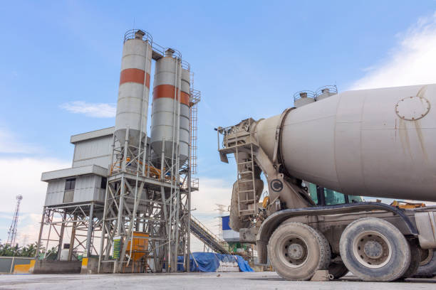
Example 3 - CHA
Notes:
A typical approach is to identify the highest production for a 30-day period during the baseline period. Then calculate the ratio of the highest month’s production divided by the actual production rate during the baseline period. Finally, multiply that ratio by the actual emission rate to determine the CHA emission increment.

Slide 25
Example 3 Background Info
Cement Plant Production Increase:
  PAE (Projected Actual Emissions): 920 tpy
  BAE (Baseline Actual Emissions): 750 tpy (2020-2022)
  Highest 30-Day Annualized Production Rate: 150,000 tons
  Actual Avg 30-Day Annualized Production Rate: 125,000 tons
Notes:
Introduction:
This slide we will discuss how to calculate the could have been accommodated (CHA) for a cement plant for pollutant PM, which is part of evaluating project emission increases and determining if Step 2 netting is needed.
Background Information:
The Projected Actual Emissions (PAE) is 920 tpy.
The Baseline Actual Emissions (BAE) during the period from 2020 to 2022 is 750 tpy. This represents the highest emission recorded in a 24-month period in the last 10 years.
Production Rates:
The highest annualized production rate over 30 days during the baseline period was 150,000 tons.
However, the actual average 30-day annualized production rate is 125,000 tons, which was reduced due to disruption in operations caused by the pandemic.

Slide 26
Example 3 Ratio and CHA Calculation
Ratio Calculation:
  Formula: (Highest 30−Day Annualized Production − Actual Avg 30-Day Annualized Production Rate) / Actual Avg 30-Day Annualized Production Rate
  Calculation: (150,000 − 125,000) / 125,000
  Ratio: 0.2
CHA Calculation:
  Formula: BAE × Ratio
  Calculation: 750 × 0.2
  CHA: 150 tpy
Notes:
Ratio Calculation:
To find the ratio, subtract the actual avg 30-day production rate from the 30-day highest production rate and divide by the actual avg 30-day production rate.
The formula is: (Highest 30−Day Production Rate − Actual Avg 30-Day Annual Production Rate) / Actual Avg 30-Day Annual Production Rate
Substituting the values: (150,000−125,000)/125,000
This gives us a ratio of 0.2.
CHA Increment Calculation:
The could have been accommodated increment (CHA) is calculated by multiplying the BAE by the ratio.
Using the formula: BAE×Ratio
Substituting the values: 750 × 0.2
This results in a CHA increment of 150 tpy.

Slide 27
Example 3 Resulting PEI
PEI (Project Emission Increase):
  Formula: PAE−BAE−CHA
  Calculation: 920−750−150
  PEI: 20 tpy
SER (Significant Emission Rate):
  SER Threshold: 25 tpy
  PEI is less than 25 tpy, so Step 2 netting is not triggered.
Notes:
PEI Calculation:
The Project Emission Increase is the difference between the PEA, BAE, and CHA.
The formula is: PEA−BAE−CHA
Substituting the values: 920−750−150
This gives us a PEI of 20 tpy.
Significant Emission Rate (SER):
The SER threshold for PM is 25 tpy.
Since the PEI of 20 tpy is less than the SER threshold, no netting is triggered for PM.
Conclusion:
Based on the calculations, the increase in emissions is below the threshold for significant emission rates, so the project does not trigger netting for PM.

Slide 28
Don’t forget the Documentation for CHA
Basis for the calculations
How these emissions are not related to the project
Notes:
Documentation must be provided to show the basis for the calculations and the emissions are unrelated to the proposed project.

Slide 29
Step 2
Net Emission Increase (NEI)
Evaluate net emissions increases in the project’s contemporaneous period.
Applies to only existing major sources.
Conducted per pollutant.
Notes:
In Step 1 of the federal applicability determination, if the facility is not an existing major source, then we can conclude whether federal permitting applies.
However, if the facility is an existing major source and the PEI is greater than or equal to the applicable thresholds for PSD or NNSR, then we generally proceed to Step 2, which involves determining NEI.
[Refer to slide.]

Slide 30
Netting
Contemporaneous Window = [5 years prior to Start of Construction (SOC) to Start of Operation (SOO)].
∑ Creditable emissions (increases + decreases) in the contemporaneous window (Table 3F).
NEI ≥ Major Modification Federal permitting applies.
Notes:
This slide summarizes Step 2 of the federal applicability determination.
We will begin by defining the netting window. It is 5 years prior to Start of Construction to Start of Operation.
The purpose of netting is to identify all projects within the window and determine their associated increases and decreases.
We then sum all creditable increases and decreases during the netting window.
If the total, or NEI, is greater than or equal to the major modification threshold, major NSR is triggered. Otherwise, it is not triggered.

Slide 31
Contemporaneous & BAE
Consecutive 24-month
Application Received
SOC
SOO
BAE
2015
2022
2025
2026
2028
10-year BAE
5-year from SOC
to SOO
Contemporaneous Period
Notes:
We have discussed two timeframes or windows when determining federal applicability.
The first is the 24-month BAE window, which we discussed earlier in Step 1.
For example, if the application is expected to be received in 2025, the BAE window would look back 10 years or 120 months from 2025.
The second timeframe is the contemporaneous or netting window in Step 2.
This netting window is defined as five years prior to the proposed start of construction of the current project, extending through to the proposed start of operation.

Slide 32
Creditable Increases and Decreases
During contemporaneous period (Table 3F).
Taken from Emissions Inventory / Permit Compliance Recordkeeping.
Increase
Include planned projects prior to SOO.
Not previously relied upon in issuing major NSR permit.
During contemporaneous period (Table 3F & 4F).
Must be real and enforceable prior to SOO.
Decrease
Not creditable if it is required to meet permit limit / SIP.
Not previously relied upon in issuing major NSR permit or used as an offset.
Notes:
So what are the requirements for creditable increases and decreases?
[Refer to slide.]

Slide 33
Step 2 - Net Emissions Increase (NEI)
NEI
Proposed Project Emissions Increase (PEI)
(Table 2F, Step 1)
=
+
Creditable Contemporaneous Increases
Creditable Contemporaneous Decreases
-
Table 3F, Step 2
Notes:
Here is a visual block diagram showing how to calculate net emission increase in Step 2. [Refer to slide.]
NEI = Project increase + (Creditable Increases - Creditable decreases during 5 years prior to Start of Construction (SOC) to Start of Operation (SOO).
If the NEI ≥ major modification threshold, then major federal review is triggered! Otherwise, it is not triggered.

Slide 34
Example 4 - PEI & NEI
Step 1
Pollutant | PEI (TPY) | PSD Major Mod. | Netting | NEI | PSD review required?
NO_{X} | 70 | 40 | Yes | 76 | Yes
CO | 110 | 100 | Yes | 73 | No
VOC | 52 | 40 | Yes | 67 | Yes
SO₂ | 45 | 40 | Yes | 32 | No
Step 2
Notes:
Let’s take a look at the final example from the first part of the presentation, which covers both Step 1 and Step 2 of the federal applicability determination.
[Refer to slide]
In Step 1, we calculate the PEI as discussed earlier. After determining the PEI, we assess whether Step 2, known as netting, is triggered. In this case, netting is triggered for all four pollutants.
Moving on to Step 2, we calculate the NEI to evaluate whether the PSD is triggered. This involves assessing creditable increases and decreases in emissions during the netting window. The analysis indicates that PSD is triggered for NOx and VOC.

Slide 35
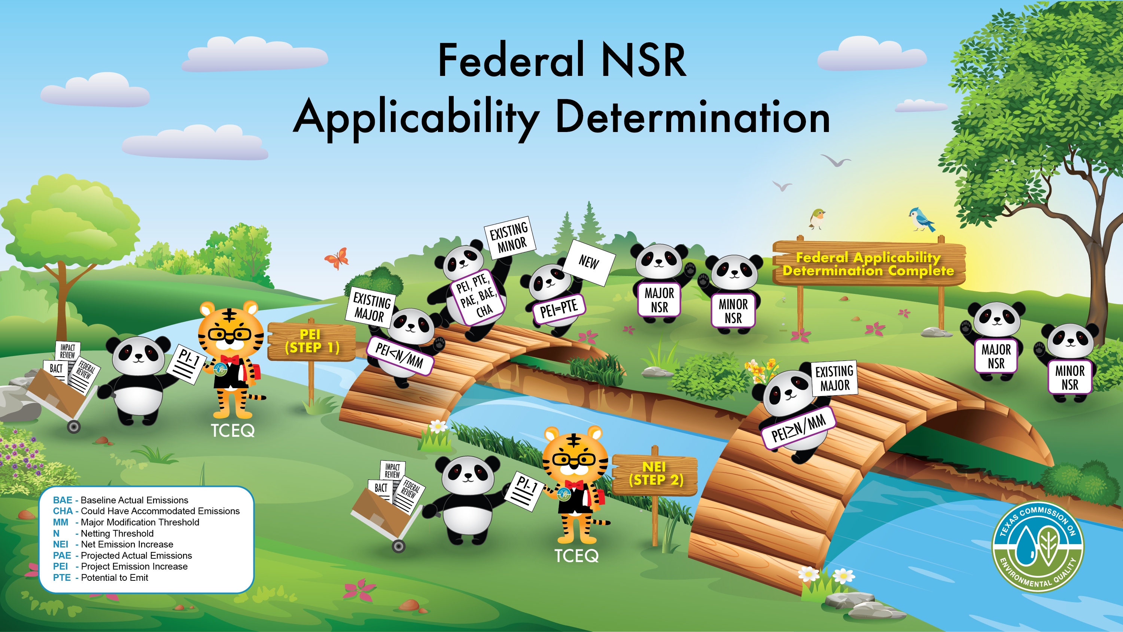
Federal NST Applicability Determination
Notes:
I am getting some help from my trusty panda friends to finish up my portion of the presentation. [Refer to slide]
And with that, I conclude the first part of the session. My colleague, Lou Malarcher, will now take over and guide you through examples related to major NSR permitting and retrospective review.

Slide 36

Major NSR Examples
Notes:
Now let’s take a few minutes to talk about retrospective review.

Slide 37
Example 5
Project: Site C is a major unnamed source of VOC in a severe nonattainment area for ozone. The March 2024 application is seeking authorization of new facilities and modified facilities. The proposed start of construction date is May 2025, and the estimated start of operation date is May 2027.
Will Site C need a federal NSR permit?
Project | Details
Pollutant | VOC
New / Existing | Existing (Major)
Source Category | Unnamed
Classification | Nonattainment (Severe)
Notes:
Let’s look at an example that pulls the concepts together:
We have an existing major unnamed source of VOC.
The area is classified as severe for ozone (Major Source = 25 tpy, Major Mod = 25 tpy, Netting Threshold = 5 tpy).
New and modified facilities are proposed…with milestone dates as shown in the slide.
Will a federal NSR permit be needed? We don’t know yet. Let’s look at Step 1 and Step 2.

Slide 38
Example 5
Step 1 – PEI (VOC)
EPN | Facility | Proposed PTE (B) (TPY) | Baseline (A) (TPY) | Difference (B-A) (TPY)
Tank 1 | New | 10 | 0 | 10
Tank 2 | New | 10 | 0 | 10
Tank 3 | Remove | - | 10 | -10
Boiler 1 | Remove | - | 15 | -15
Boiler 2 | New | 10 | 0 | 10
Flare | Modified | 17 | 10 | 7
 |  |  | PEI | 12
Notes:
In this project we have two new tanks, one new boiler, one modified flare, and one tank and one boiler are being removed.
In Step 1 of this evaluation, the applicant is using the baseline actual (BAs) to potential-to-emit (PTE) approach. In this case baseline actuals correspond to the consecutive 24-month period immediately preceding the change (actual emissions).
We can see that a baseline of zero is used for the new units and existing or modified sources use actual emissions for the baseline. Baseline emissions of 10 tpy were identified for the flare.
In Step 1 of the federal applicability test, the applicant may also utilize emission reductions, which you see for the tank and boiler that are being removed. For this example, these units are considered substantially related to the project.
So the Step 1 Project Emission Increase is 12 tpy VOC. [Next slide…]

Slide 39
Example 5
Step 1
VOC
Severe
Nonattainment
Step 1 | Check
PEI (TPY) | 12
Major Modification Threshold (TPY) | 25
Netting Threshold (TPY) | 5
Major Source for PSD | No
Major Source for NNSR | Yes
Existing Major Source
Deminimis Netting Threshold
= 5 TPY
PEI = 12 TPY
Netting
Notes:
[Refer to slide.]
This slide shows a summary table and a simple flow chart for Step 1 of the Applicability Test.
As a reminder, the netting threshold for a Severe area is 5 tpy.

Slide 40
Example 5
Step 2: NEI (VOC)
Contemporaneous Window | Creditable Increase (TPY) | Creditable Decrease (TPY) | Net Emissions Increase (NEI)
March 2024 (Current Project = PEI) | (+) 12 |  | (+) 12
January 2024 | (+) 18 |  | (+) 18
May 2023 | (+) 7 |  | (+) 7
December 2022 | - | (-) 10 | (-) 10
November 2018* | - | (-) 35
 |  | NEI | (+) 27
*Note: The contemporaneous period goes back in time five years from the proposed start of construction (SOC = May 2025).
Notes:
This slide shows a very broad summary of the netting process for Step 2.
Here we look at all our creditable increases and creditable decreases, going back 5 years prior to the start of construction (May 2025), and going forward to the start of operation (May 2027).
The 35 TPY emission reduction that resulted from the November 2018 project falls outside of the contemporaneous period for the proposed project and is therefore ineligible for inclusion in the netting calculation.

Slide 41
Example 5
Step 2 - NEI
VOC
Severe
Nonattainment
Existing Major Source
Step 1
Step 2
PEI = 12 TPY >
5 TPY
Major Modification of VOC = 25 TPY
Netting
NNSR Required
NEI = 27 TPY
Notes:
So here is a basic flow chart that summarizes Step 2 of the Applicability test.
Our project increase of 12 tpy VOC was above the netting threshold of 5 tpy, so netting was performed.
The result of the netting process yielded a net emission increase of 27 tpy VOC which is above the major mod threshold of 25 tpy.
Therefore, Nonattainment NSR is required for this project.

Slide 42
Example 5
Offsets
EPN | Facility | Proposed PTE (B) (tpy) | Baseline (A) (tpy) | Difference (B-A)* (tpy)
Tank 1 | New | 10 | 0 | 10
Tank 2 | New | 10 | 0 | 10
Tank 3 | Remove | - | 10 | -10
Boiler 1 | Remove | - | 15 | -15
Boiler 2 | New | 10 | 0 | 10
Flare | Modified | 17 | 10 | 7
 |  |  | Total Increases | 37
N/A
*Note that this is not the PEI from Step 1. Project decreases should not be considered while calculating offsets.
Notes:
Now we should consider what emission offsets will be necessary.
Offsets are based on the emission increases…in other words, emission increases from new and modified facilities minus actual emissions.
Please keep in mind that offsets are calculated based on a comparison of PTE minus baseline without consideration of decreases. Any decreases used in determining the project emission increase should be removed from the calculation to determine the offsets.

Slide 43
Example 5
Offset
Pollutant | Classification | Offset Ratio | (PTE-BAE) Increases only (TPY)* | Offset Amount (TPY)
VOC | Severe | 1.3 to 1 | 37 | 1.3 * 37 = 48.1
Emissions Increases only
Classification | Offset Ratio
Extreme | 1.50 to 1
Severe | 1.30 to 1
Serious | 1.20 to 1
Moderate | 1.15 to 1
Marginal | 1.10 to 1
Based on the county classification and pollutant

Slide 44
Retrospective Review is…
Retrospective
Correct previous representations
Final unit design / operation differs from the original preliminary design /operation
Changes in sources not reflected in the original permit application
Proposed Project
Calculate emissions using current methodology / data & use current modeling techniques
Current BACT / LAER
Current Offset requirements as applicable
Not used to authorize changes that constitute a new modification
Notes:
Not used to authorize changes that constitute a new modification, but to correct previous representations.
Generally used to address situations in which the final unit design or operation differs from the original preliminary design or operation upon which a previous air permit application was based and a corresponding permit was issued.
Used to address changes in sources not reflected in the original permit application or issued permit.
Retrospective review is not used to authorize changes from a new modification but is used to correct previous representations and the associated authorization.
A retrospective project can also be for permitted facilities that are not yet constructed or in operation (e.g., a design update).
In addition, a retrospective review can involve an emission source that has been newly identified and was not included in previous authorizations.
These emissions must be properly evaluated, and any applicable permits must be corrected.
Some common names for retrospective review are:
- As-built amendment.
- Clean-up amendment.
- Correction amendment.
Paper change amendment.
Audit privilege amendment.
Some examples of retrospective projects include:
Corrections related to:
- Omitted pollutants.
- Vent flow rate to control device.
- Stream composition.
- Equipment capacity/specifications.
- Fugitive component count.
- Tank fitting types/counts.
- Stack parameters.

Slide 45
Federal Retrospective Review
Proposed Project
Retrospective
Current
Original Project
PSD / NA
Major source / Major Modification / Netting thresholds apply.
Current Project
Current BACT / LAER
Update Modeling & AQA
Acquire any additional offsets based on current offset ratio.
If PSD / NA are triggered retrospectively
Offset ratios if NA is triggered (ratio depends on area classification at the time of new permit issuance as per 30 TAC §116.150(a)).
Notes:
Look back at the federal PSD and/or Nonattainment NSR applicability analyses of a past project or projects to include changes in sources not reflected in the original permit application or issued permit.
PSD and/or Nonattainment NSR applicability thresholds in place at the time of the original project apply. However, if PSD and/or Nonattainment NSR review are triggered retrospectively, current modeling, BACT, LAER, and offset requirements may be applicable.
Please keep in mind modeling for retrospective review will frequently be referred to as AQA in this presentation. Air quality Analysis is specific to PSD permitting. Minor NSR modeling is used for nonattainment permitting.

Slide 46
Retrospective Review
Changes will be processed either as a minor NSR project or as a major modification depending on the increases being authorized.
Notes:
When we have a retrospective project, depending on the magnitude of the emission increases, it will processed either as a minor NSR project or as a major modification.

Slide 47
Retrospective Considerations
For Permit Applications
Retrospective emissions should be separated from new emissions.
Provide separate project increase calculations.
Provide separate Tables 1F and 2F (and 3F and 4F as applicable) with respect to the retrospective time frame.
Notes:
If the permit application contains both a new project and a retrospective project, please evaluate the projects separately.

Slide 48
What Should Be Done?
Retrospective emissions should be evaluated:
Federal applicability is reevaluated for the original project (or newly evaluated for newly discovered, unauthorized units).
Within the context of the project that caused the emissions.
From the start of construction if the emissions cannot be attributed to a specific project.
TCEQ relies on the criteria that defines major source/modification.
Notes:
So now that we’ve discovered the emissions, what is the basic approach?
The emissions should be applied to the original project that caused the emissions in the first place.
If no project can be associated (for example, if an emitting unit is discovered that did not receive authorization), the evaluation is based on the unit’s start of construction.
An evaluation for federal applicability is required. TCEQ relies on the criteria that defines major source and major modification to determine project type required.

Slide 49
Flow Chart for Retrospective Review
Did the original project trigger major NSR for the pollutant?
Do original emissions plus new/increased emissions trigger major NSR for the pollutant?
Process changes as a minor project. Update impacts analysis as necessary.
No
No
Yes
Yes
Process all emissions as a major NSR project with current BACT/LAER, current modeling/met data, and current offsets as needed.
Do new and increased emissions exceed significance levels for the pollutant*?
Process as a minor project. Include federal level BACT/LAER, update AQA, acquire any additional offsets.
No
Yes
*Increases from new and modified units should be based on allowable emissions (PTE) for the unit(s).
If new/modified units result in increased utilization of an affected unit, the affected unit may be evaluated based on PTE or based on worst-case increases if the new/modified units were to operate at maximum permitted capacity.
Process updates as a major modification project. Include current BACT/LAER, update AQA, acquire any additional offsets.
Notes:
Here is a flow chart that gives a general overview of the retrospective review process. Let’s take a minute to look at the possible pathways. The flowchart conveys a process based on TCEQ’s interpretation of how retrospective reviews should be performed and the methods represented in previous projects.
I apologize for the small font size…but please feel free to download the slides from our website for a better view.

Slide 50
Example 6: Retrospective Review
A major source received a permit in November 2021 to authorize installation of two new furnaces and four new tanks.
The area has been classified as serious ozone nonattainment in 2019.
The source is not considered major under the PSD program.
Notes:
Imagine we have a major source under NNSR. The site received a permit in 2021 for two new furnaces and four new tanks. The location is within a serious ozone nonattainment area, and let’s assume that has not changed since 2019. The sitewide emissions are under the PSD major source thresholds for all pollutants.

Slide 51
Example 6
Necessary Corrections
Furnaces - Original furnace capacities were underestimated. The emission correction results in an additional NEI of 1.64 tpy NOx and 0.10 tpy VOC.
Storage Tanks - Original estimated fitting types, fitting counts, and pump capacities were not conservative compared to proposed equipment. The emission corrections resulted in an additional NEI of 2.30 tpy VOC.
Notes:
After construction, the permit holder identified some elements that were underestimated in the original design and permit application. Because the as-built scenario results in higher emissions, a permit application is needed to correct the representations.

Slide 52
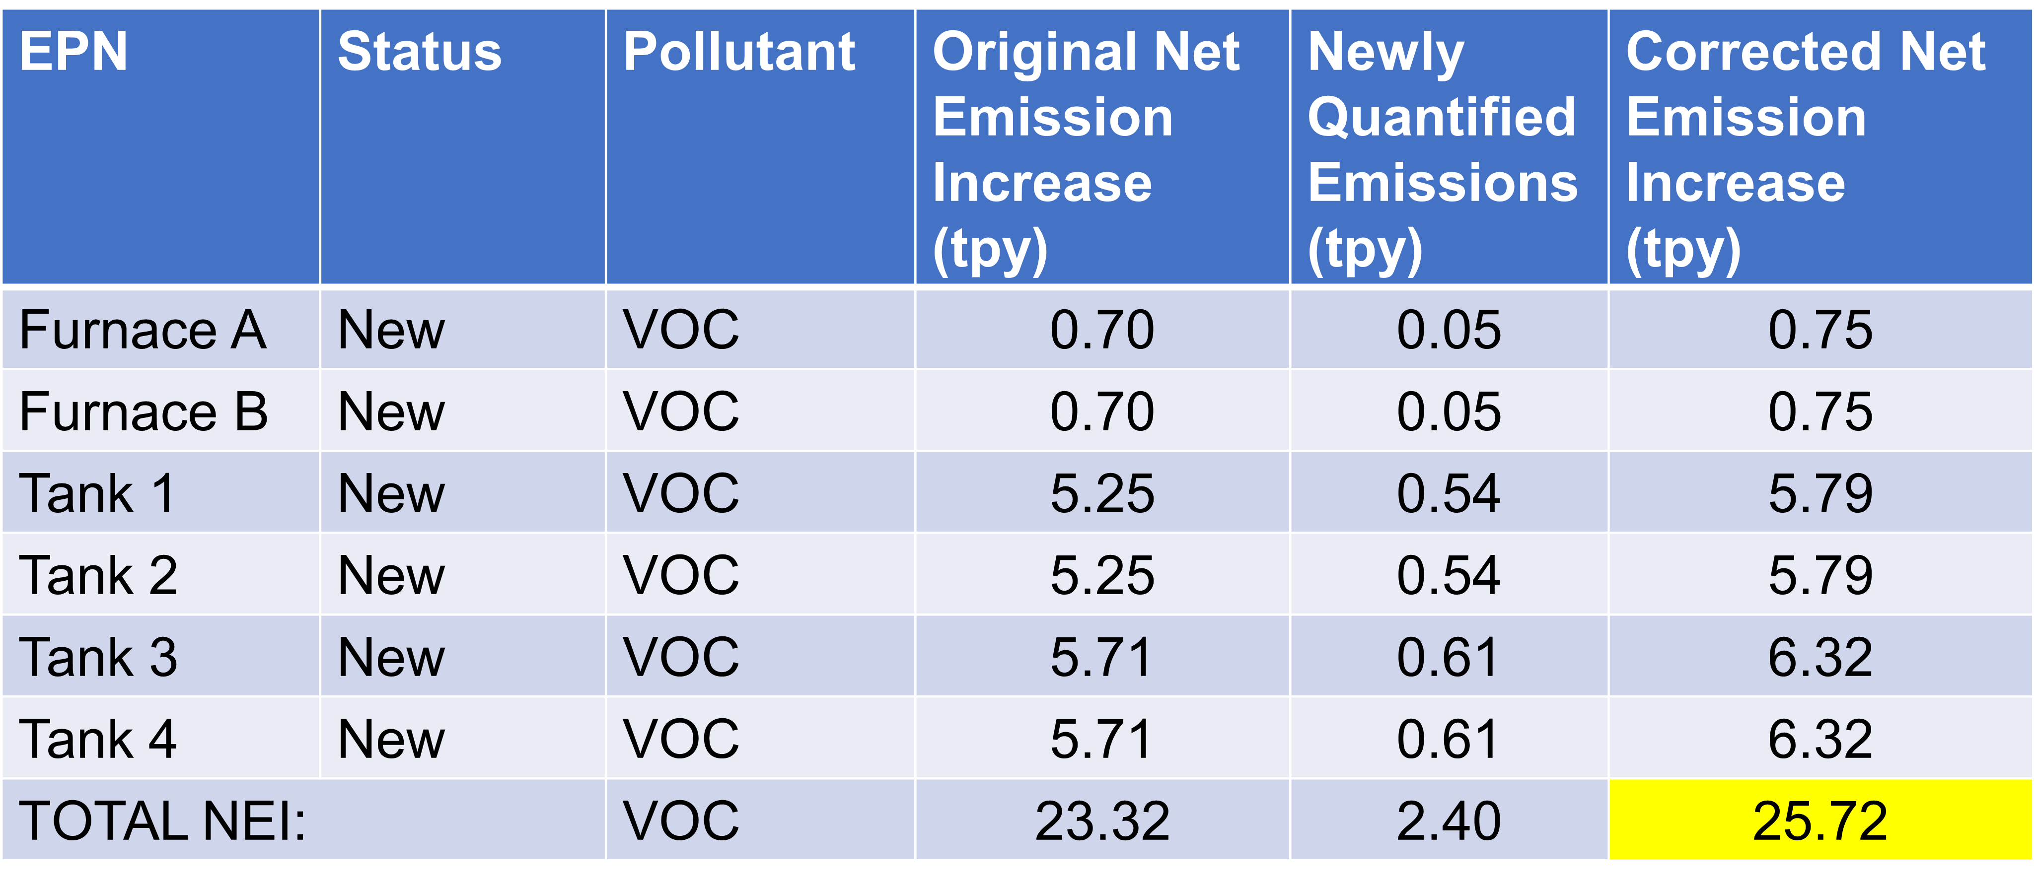
Example 6: Retrospective Review
VOC
*Assuming Netting is triggered in Step 1.
Notes:
This table shows the original net emission increase for VOC, the newly quantified emissions, and the corrected total. You can see that the original project did not trigger nonattainment review based on VOC emissions, but once corrections are applied the retrospective emissions are over 25 tpy.

Slide 53
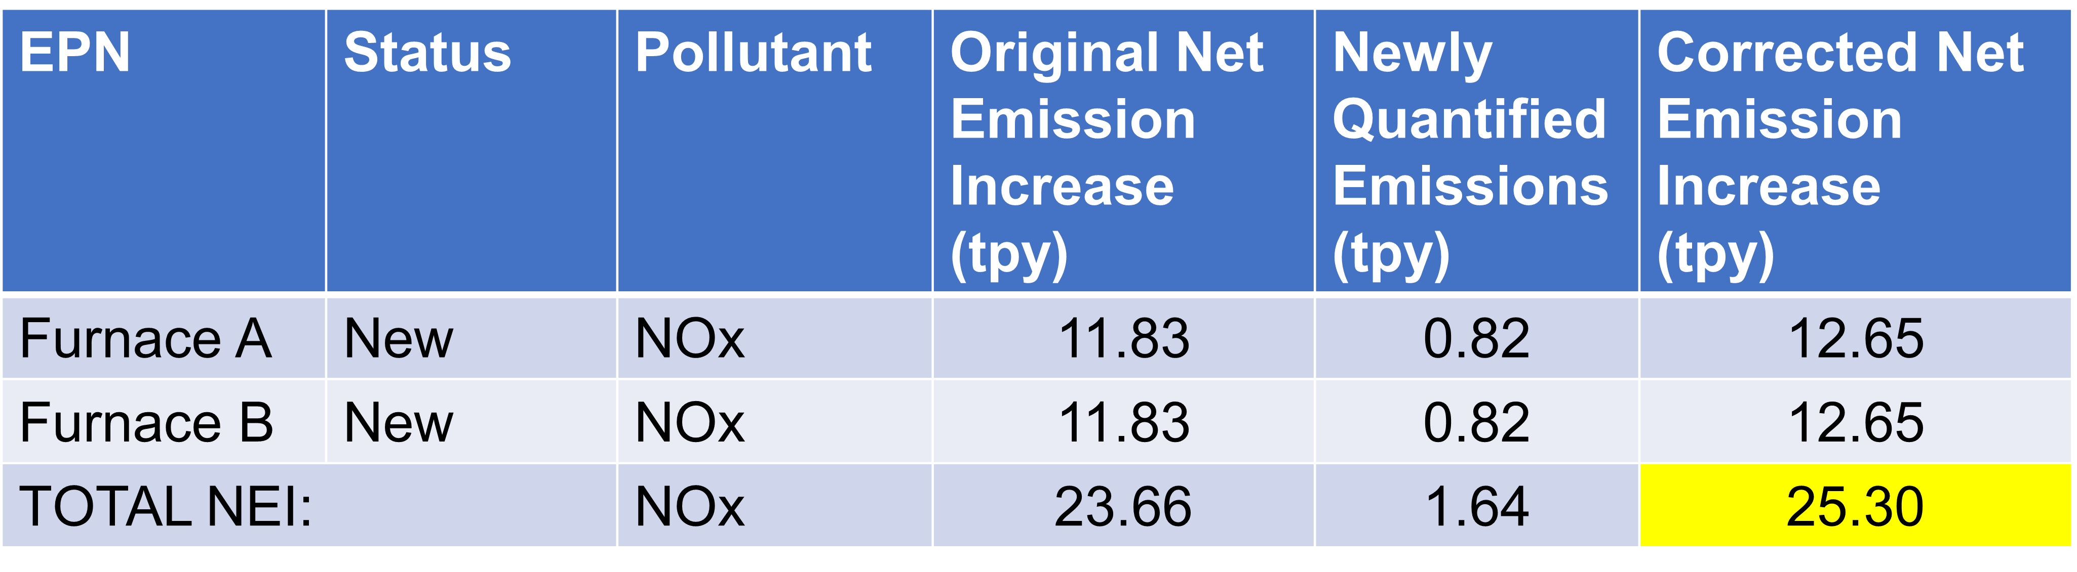
Example 6: Retrospective Review
NOx
*Assuming Netting is triggered in Step 1.
Notes:
This table shows the original net emission increase for NOx, the newly quantified emissions, and the corrected total. The corrected net emission increase for NOx is also over 25 tpy.

Slide 54
Retrospective…
Pollutant | Serious NA Threshold | NEI | NA triggered
VOC | 25 | 25.72 | Yes
NOx | 25 | 25.30 | Yes

Slide 55
Retrospective Review…
Proposed Project
Retrospective
Current
Original Project
Corrected increases of VOC and NOx > Major Modification threshold (25 tpy) for areas in serious nonattainment.
Current Project
▪ LAER analysis for VOC & NOx
▪ AQA current modeling techniques.
▪ Current Emission offsets (1.30 : 1 for Severe NA).
NA review triggered retrospectively
Notes:
Look back at the federal PSD and/or Nonattainment NSR applicability analyses of a past project or projects to include changes in sources not reflected in the original permit application or issued permit.
PSD and/or Nonattainment NSR applicability thresholds in place at the time of the original project apply. However, if PSD and/or Nonattainment NSR review are triggered retrospectively, current modeling, BACT, LAER, and offset requirements may be applicable.
And this slide shows the highlights of the nonattainment permit application, versus a typical case-by-case application:
Lowest Achievable Emission Rate technology, an air quality analysis using current meteorology and background, and emission offsets corresponding to the area classification.

Slide 56

Back to the Archives
Notes:
For more guidance on retrospective projects, let’s travel back in time…deep into the dark and dusty archives of the Texas Natural Resource Conservation Commission (TNRCC)…

Slide 57
Guidance
July 5, 2000 memorandum from Ruben Herrera, P.E. through John Steib (Director, APD,TNRCC):
Retrospective Federal Permit Analyses and Reviews
Related documentation:
EPA 1985 DRAFT memo on “handling changes to sources which have PSD permits…” may be found on the EPA website:
Revised Draft Policy on Permit Modifications and Extensions
Notes:
Current TCEQ guidance for retrospective projects is based on a July 5, 2000 memo by Ruben Herrera, P.E. through John Steib (who was the Air Permits Division Director at the time).
This memo is primarily focused on a scenario where federal review was not triggered in the original project.
There is also a draft EPA policy memo from 1985 which provides some general perspective. Policy appears to have never been adopted.

Slide 58
Herrera/Steib Memo
- By the Numbers
Determine if the site is major using PSD and NA rules in effect at the time.
Calculate emissions using current methodology and data.
Compare the project increase to criteria in effect at the time:
major source, netting, and major modification thresholds.
Use the original baseline and contemporaneous windows.
Notes:
Please note that this memo pertains to situations where previously unknown emissions and/or emission sources are discovered at existing plant sites. If change can be attributed to a specific past project, the project information should be updated to include increases. If the change cannot be attributed to a specific project, use start of construction date.
Emission calculations should use the most recent methods and data.
Major source status, netting thresholds, and project increase thresholds are based on the time of the original project that caused the newly identified emissions.

Slide 59
Herrera/Steib Memo
- By the Numbers
(continued)
If the sum of the corrected project increase and contemporaneous increases/decreases exceed a significance level, then major NSR is triggered.
Notes:
If the combination of the corrected project increase plus contemporaneous increases and decreases exceed the significance thresholds, then major NSR is triggered (PSD or Nonattainment NSR).

Slide 60
Herrera/Steib Memo
- Additional Elements
For retrospective actions that trigger major NSR, use current:
BACT or LAER requirements.
meteorology for impacts analysis.
offset ratios if NA is triggered (ratio depends on area classification at the time of new permit issuance as per 30 TAC §116.150(a)).
Notes:
Even though we use the thresholds for major source status, netting, and major modification in effect at the time of the original project, we use current BACT, LAER, meteorology, and offset ratios for retrospective review.

Slide 61
Retrospective PEI Reminders
Add the existing (newly quantified) emissions to the original project emission increase (PEI) or net emission increase (NEI), as applicable.
Evaluate how the corrected PEI/NEI would have affected the original federal applicability analysis (including netting).
If federal NSR is not triggered, evaluate how the corrected PEI/NEI would have affected any subsequent netting and any permit determinations.
Notes:
Here are a few more reminders:
Add the newly quantified emissions to the original project or net emissions increase.
Evaluate how the corrected total would have affected federal applicability (including netting) in the original project.
If federal NSR is not triggered, evaluate how any subsequent netting and federal applicability determinations would have been affected.

Slide 62

Let’s Look at Another Example
Notes:
Time for another example of the retrospective scenario.

Slide 63
Example 7: Retrospective Review
The Scenario
What if our previous example had required Nonattainment NSR review originally and the retrospective review?
  A major source under Nonattainment NSR received a permit in June 2021 to authorize installation of two new furnaces and four new tanks.
  The area was classified as serious ozone nonattainment in 2021.
  Reclassified to severe in 2022.
  The source is not considered major under the PSD program.
Notes:
Let’s consider Example 5 again. This time, the original project included the storage tank VOC emissions previously found during the retrospective review which resulted in nonattainment review. With this retrospective review, we are going to add additional emissions to the storage tanks keeping in mind that a nonattainment permit was issued with the original project.
Imagine we have a major source under NNSR. The site received a permit in 2021 for two new furnaces and four new tanks.
The sitewide emissions are under the PSD major source thresholds for all pollutants.
Let’s put the site in the HGB area which was classified as serious nonattainment for the 2008 ozone standard in 2019 and severe in 2022. The offset ratio was 1.20 to 1 between 2019 and 2022. It changed to 1.30 to 1 after the reclassification in 2022.

Slide 64
Example 7: Retrospective Review
Necessary Corrections
Upon installation of the new facilities, it was discovered that:
Furnaces - The original furnace capacities were underestimated. The emission correction results in an additional 1.64 tpy NOx and 0.10 tpy VOC.
Storage Tanks - The originally estimated fitting types, fitting counts, and pump capacities were not sufficiently conservative compared to installed equipment. The emission correction results in an additional 2.30 tpy VOC beyond original project calculations.
Notes:
After construction, the permit holder identified some elements that were underestimated in the original design and permit application. Because the as-built scenario results in higher emissions, a permit application is needed to correct the representations.

Slide 65
Example 7: Retrospective Review
VOC
EPN | Status | Pollutant | Original Net Emission Increase (tpy) | Newly Quantified Emissions (tpy) | Corrected Net Emission Increase (tpy)
Furnace A | New | VOC | 0.70 | 0.05 | 0.75
Furnace B | New | VOC | 0.70 | 0.05 | 0.75
Tank 1 | New | VOC | 5.79 | 0.54 | 6.33
Tank 2 | New | VOC | 5.79 | 0.54 | 6.33
Tank 3 | New | VOC | 6.32 | 0.61 | 6.93
Tank 4 | New | VOC | 6.32 | 0.61 | 6.93
Total NEI: |  | VOC | 25.62 | 2.40 | 28.02
Notes:
This table shows the original net emission increase for VOC, the newly quantified emissions, and the corrected total. You can see that the original project did trigger nonattainment review based on VOC emissions over 25 tpy. The original VOC increase was not sufficient, and the original offsets would need to be increased. The additional offsets should be calculated using the same ratio originally used. Please keep in mind that when calculating the offsets, any reductions in emissions included in the Net Emission Increase need to be removed. The offsets should be calculated on all of the increases.

Slide 66
Example 7: Retrospective Review
NOx
Notes:
This table shows the original net emission increase for NOx, the newly quantified emissions, and the corrected total. The corrected net emission increase for NOx is also over 25 tpy.

Slide 67

Example 7: Retrospective Review
The Verdict
The original project exceeded the major modification for VOC. The result of triggering Nonattainment NSR review is not changed.
The corrected increases of NOx exceeded the major modification threshold (25 tpy) for areas in serious nonattainment.
Nonattainment NSR review is triggered for NOx.
Notes:
Since the corrected emission increase for at least one ozone precursor exceeds the major modification threshold (25 tpy), a nonattainment permit review is triggered.
Since the original project included issuance of a new Nonattainment permit and the retrospective project includes both an update and the addition of a new nonattainment pollutant, the project would be a nonattainment major modification and require public notice even if the emission increases in VOC and NOx are less than the public notice threshold.

Slide 68
Example 7: Retrospective Review
The Path Forward
Major modification to the Nonattainment NSR permit is required.
LAER analysis for NOx and VOC to include updated RBLC searches.
Modeling based on current versions of dispersion models using current meteorology and background.
Emission offsets based on original required ratio (1.20 : 1 for serious NA) for VOC.
Emission offset based on current required ratio (1.30 : 1 for severe NA) for NOx.
Notes:
And this slide shows the highlights of the nonattainment permit application, versus a typical case-by-case application:
Lowest Achievable Emission Rate technology, an air quality analysis using current meteorology and background, and emission offsets corresponding to the area classification.

Slide 69
Tables related to Major NSR
Table | Description
Table 1F | Air Quality Application Supplement
Table 2F | Project Emission Increase
Table 3F | Project Contemporaneous Change
Table 4F | Description of Creditable Reductions
Table 4N | Initial Lowest Achievable Emission Rate Determination
Table 6N | Alternate Site Analysis for Texas NNSR
Table 9N | Signature Verification
Notes:
Tables Related to Air Permitting (Nonattainment New Source Review (NNSR) Tables) - Texas Commission on Environmental Quality - www.tceq.texas.gov

Slide 70

Contacts
Sandya Bhaskara, P.E.
Sandya.bhaskara@tceq.texas.gov
512-239-4740
Richard Goertz, P.E.
richard.goertz@tceq.texas.gov
512-239-1294
Jean Shaw, P.E.
jean.shaw@tceq.texas.gov
512-239-1823
Christopher Loughran, P.E.
chris.loughran@tceq.texas.gov
512-239-0838
Louis Malarcher, P.E.
louis.malarcher@tceq.texas.gov
512-239-1151
Notes:
Here are a few people in the Air Permits Division who will be glad to help if you have a question. Please feel free to call or email us at any time.

Slide 71

Thank You!
Notes:
Thank you very much for attending this session, and I hope you enjoy the rest of the seminar. If you have any questions we will stick around for a few minutes, or you can contact us later. Thank you!

