Slide 1
TCEQ Texas Pollutant Discharge Elimination System (TPDES) Pretreatment Stakeholder Meeting
September 15, 2022
The meeting will begin shortly.
Webcast attendees can submit questions to: Outreach@tceq.texas.gov
Notes:
Thank you, Erika. And again, welcome everyone and thank you for joining us for the second stakeholder meeting of 2022. Today we will be providing you with some updates to the TCEQ Pretreatment Program that are likely to impact our CAs. We were able to meet and chat with a lot of you at the Region VI conference last month, but for those of you we didn’t get a chance to talk with I will quickly introduce the team- Bridget Malone, Jessica Alcoser, Dr. Erin Darling, and Amy Golden Leddy. Our newest employee Jo Hunsberger is unable to join us today.

Slide 2
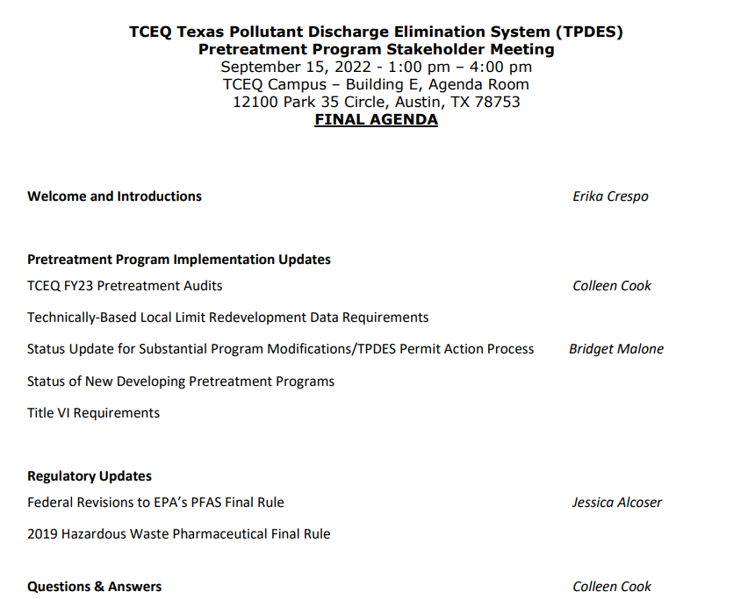
Agenda
Webcast attendees can submit questions to: Outreach@tceq.texas.gov
Notes:
On the screen you can see our agenda for this afternoon, there are also hard copies available if you would like to follow along as we move through the presentation.
We will be going over a couple of different topics - Bridget and I will be reviewing updates to this years Pretreatment Audits as well as other updates to TCEQ’s Program Implementation including TBLL data requirements, the status of our Substantial modification approvals and the permit action process needed for approval, as well as the status of our NDP and some updates to the Title VI requirements that will impact the permit actions needed for substantial modifications. From there we will hand it over to Jessica to review some Regulatory Updates. If you attended the conference last month, you will be hearing some of the same updates, but we will be providing new information, as well.
During our presentation, we will have plenty of time to open up the floor for a question & answer session after each topic. And then after the presentation, we are happy to answer questions on any of the material covered in the presentation, as well as any additional questions on topics you would like to discuss. As always, we encourage questions and hope this can be an open dialogue where we can all learn from each other.
If you are attending the meeting via our live webcast, you can submit questions to outreach@tceq.Texas.gov and we will be addressing as many of those as we can after each topic and during the q and a at the end of the presentation.

Slide 3
TCEQ FY23 PRETREATMENT AUDITS
Notes:
First up, we are going to discuss a few of the common violations we have seen in our audits the last couple of years and then update you on what our Audit process is going to look like moving forward as we move away from the strictly remote audits that we have been conducting since the start of covid in Spring of 2020.

Slide 4
FY2021 & 2022 Audit Recap – Common Violations
Failure to follow the approved program’s Enforcement Response Plan/Guide (ERP/ERG)
Failure to submit modifications to TCEQ
Failure to evaluate SNC for all SIUs as required by 40 CFR §403.8(f)(2)(viii) (A) – (H)
Failure to conduct WWTP influent and effluent monitoring as required by TPDES permit
Failure to review with sufficient care reports and/or chain of custody (COC) forms to identify noncompliances
Failure to ensure all reports submitted by IUs contain the required certification statements and signatures from authorized representatives
Failure to include all applicable effluent limits in the IU permit (categorical standards, local limits, etc.)
Notes:
Let’s get started by reviewing some of the common violations that we discovered during the last two audit years.
#1 – Failure to follow the approved program’s Enforcement Response Plan/Guide (ERP/ERG). As a program, you want to make sure that if a violation is identified you are following the enforcement responses and time frames identified in your ERP and ERG. As you all know, a big component of TCEQ audits are the industrial user file reviews and reviewing violations that were identified to ensure the CA issued the appropriate response as outlined in the ERP.
#2 – Failure to submit modifications to TCEQ. The majority of these violations were for failure to submit the Dental OTCR Form as a nonsub mod. However, any time a change or update to your program is made, a modification should be submitted to TCEQ for review and approval.
#3 - Failure to evaluate SNC for all SIUs as required by 40 CFR §403.8(f)(2)(viii) (A) – (H). Please note the evaluation will need to be done for all criteria A-H and properly documented.
#4 – Failure to conduct WWTP influent and effluent monitoring as required by TPDES permit. For example, we occasionally see missing pollutants from analysis. Please keep in mind that CA’s must keep current with the pollutant list in all regulations as the TPDES permit may have outdated tables if the permit has not been renewed recently. We have also seen instances of CA’s monitoring results not matching the required frequency dictated in their TPDES permit.
#5 – Failure to review with sufficient care reports and/or chain of custody (COC) forms to identify noncompliances. As a CA, you want to ensure that all monitoring results are being reviewed timely (as dictated in your ERP) and efficiently in order to identify noncompliances. Making sure the monitoring report was submitted by the due date is just the first step in review.
#6 - Failure to ensure all reports submitted by IUs contain the required certification statements and signatures from the correct and authorized representative. You will want to check for the certification in all submitted reports as well as confirm the appropriate representative signed the statement.
#7 - Failure to include all applicable effluent limits in the IU permit (categorical standards, local limits, etc.). You want to make sure that any categorical standards in IU permits match the federal regulations for that category as well as ensure that the local limits included match what is in your approved ordinance.

Slide 5
Updates to TCEQ FY23 Audit Process
Hybrid audit schedule: remote & in person portions
Pre-audit electronic IU file requests
In person Initial Interview & Site Visits
Virtual Exit Meeting
Initial Interview location should have internet accessibility for TCEQ staff
Additional TCEQ auditors – please be aware some audits may have additional auditors present to provide training opportunities for newer staff
Notes:
Now let’s move on to what we can expect for this fiscal year’s audits. As most of you know, the last couple of years, we have been conducting required program audits on a strictly remote basis due to the pandemic. There have been positives and negatives to this approach. Taking all of these into account, we will be moving forward with a hybrid audit approach for the 2023 fiscal year. This will take what worked with the remote audits and leave behind what didn’t.
The new hybrid audits will consist of pre-audit electronic industrial user file requests. Pre audit IU file requests allow us to perform file reviews prior to the field audit and increase the scope of the IU universe reviewed. Requests for electronic copies of IU documents will be made prior to the start of the audit.
Additionally, the audit will also consist of in person initial interviews and site visits but implement a virtual exit meeting. Internet accessibility will be required to ensure staff have the ability to research and communicate with staff back in office and continue to access pre-audit files. If no internet accessibility available, please let us know PRIOR to the start of the audit so we can plan accordingly.

Slide 6
TBLL Redevelopment Updates
Notes:
Before we move on, are there any questions pertaining to previous audit violations or what Fiscal Year 23 audits will look like? As a reminder for those that joined the webcast after we got started, you can submit your questions to outreach@tceq.Texas.gov.
Let’s move onto some additional program updates, starting with everyone’s favorite TBLL redevelopment submissions.

Slide 7
TBLL Redevelopment Submissions
Consistent with the 2004 EPA Local Limits Guidance, TCEQ may accept routine monitoring data, in lieu of (or in addition to) conducting a consecutive day sampling event, for TBLL redevelopment calculations
TCEQ has created an initial rubric for determining the criteria for accepting routine data as part of TBLL redevelopment submissions.
If you are considering re-developing and are interested in pursuing using routine monitoring data, please reach out to TCEQ staff to discuss any questions prior to submission.
Notes:
Historically, TCEQ has required that POTWs conduct a 4 – 7 consecutive day sampling event to collect the data that will be used during TBLL redevelopment calculations. However, in response to feedback from programs and to be consistent with the 2004 EPA Local Limits Guidance, TCEQ may now choose to accept routine monitoring data, in lieu of (or in addition to) conducting a seven consecutive day sampling event, for these calculations.
However, this data will have to meet a certain standard in order to be accepted and used for tbll calculations, and the next few slides will go over the criteria TCEQ will use in order to determine if your routine monitoring data will be acceptable to use for redevelopment.
I would also like to take this opportunity to encourage all programs that if you are considering re-developing and are interested in pursuing using routine monitoring data, please reach out to TCEQ staff to discuss prior to submission. We want to make sure CA’s are clear on all of the expectations as we roll out this alternative option.
IF THERE ARE QUESTIONS: Please also keep in mind this is a new initiative that was just recently approved by our division management so we are working very hard to finalize the process and how this will also impact what is submitted in sampling plans. We do not go into those details during this presentation but we are happy to discuss more during the Q and A portion of this session.

Slide 8
TBLL Redevelopment Submissions (1)
The following criteria must be met before utilizing routine monitoring data in the TBLL redevelopment calculations. These include but are not limited to:
The POTW must have conducted a recent (within the last 12 months) initial influent scan to identify their pollutants of concerns (POCs) for the WWTPs.
The POTW must have conducted routine monitoring events at the WWTPs meeting the minimum frequency of routine monitoring outlined in EPA’s 2004 Local Limit Guidance. EPA states that ongoing evaluations of TBLLs (redevelopments) can use sampling data collected at the minimum frequencies in Table 4-2.
At this time, a minimum of eight (8) routine sampling events (data points) for influent and effluent sampling locations must be used. In addition to influent and effluent routine monitoring data, the CA may also use the available TCLP results from the WWTP’s sludge monitoring events. All routine monitoring data to be used must be from within the past three years.
Notes:
Let’s take a look at the criteria that must be met before utilizing routine monitoring data in the TBLL redevelopment calculations. These include:
For #1: The POTW must have conducted a recent (within the last 12 months) initial influent scan to identify their pollutants of concerns (POCs) for the WWTPs. This requirement is not changing and is the same as it’s always been.
For #2: The POTW must have conducted routine monitoring events at the WWTPs meeting the minimum frequency of routine monitoring outlined in EPA’s 2004 Local Limit Guidance. EPA states that ongoing evaluations of TBLLs (redevelopments) can use sampling data collected at the minimum frequencies in Table 4-2. We will take a look at this table in more detail on the next slide.
For #3: At this time, a minimum of eight (8) routine sampling events (data points) for influent and effluent sampling locations must be used. All routine monitoring data to be used must be from within the past three years. For example: a WWTP that performs quarterly influent/effluent monitoring (four sampling events per year), would be required to submit a minimum of two years of routine monitoring data, for a total of eight sampling events.

Slide 9
TBLL Redevelopment Submissions (2)
Notes:
On this slide you can see Table 4-2 that includes the minimum recommended sampling frequency required in order for routine monitoring to be used. This table is pulled straight from EPA’s 2004 Local Limit Guidance. The required frequency is based on the type of pollutant and the size of the plant. As you can see, the type of parameter is listed on the left hand side and the plant flow in MGD is listed along the top.
In order to use routine monitoring for existing local limits, a minimum of quarterly influent/effluent data will be needed, regardless of the size of the plant. However, if a POC is identified in the initial pollutant scan that falls under Table II or Ch. 307, where the organic priority pollutants reside, routine sampling at a minimum of once per year or once per six months may be acceptable.
If routine monitoring data does not provide 8 representative data points for a pollutant of concern then additional sampling may be needed.

Slide 10
TBLL Redevelopment Submissions (3)
Sampling and analytical procedures shall be in accordance with guidelines established in 40 CFR Part 136, as amended; or as suggested in Tables E-1 and E-2 of the Procedures to Implement the Texas Surface Water Quality Standards (RG-194), June 2010, as amended and adopted by the TCEQ.
All routine monitoring data the CA wishes to use for TBLL calculations must have been collected and analyzed in accordance with TBLL data requirements, as outlined in the 2004 EPA Local Limits Guidance.
The CA should ensure that the most representative data of actual/current conditions at the facility are being used for the TBLL calculations. Conditions at the WWTP should have remained consistent throughout the time frame associated with the routine monitoring data being used.
WWTPs will still be required to conduct domestic and commercial sampling events throughout the POTW’s service area, in order to collect the representative background data needed for TBLL calculations.
Notes:
Moving on to criteria #4: the Sampling and analytical procedures shall be in accordance with guidelines established in 40 CFR Part 136, as amended; or as suggested in Tables E-1 and E-2 of the Procedures to Implement the Texas Surface Water Quality Standards (RG-194), June 2010, as amended and adopted by the TCEQ. This is not a new requirement and hopefully isn’t a surprise.
For #5: Similar to #4, all routine monitoring data the CA wishes to use for TBLL calculations must have been collected and analyzed in accordance with TBLL data requirements, as outlined in the 2004 EPA Local Limits Guidance. This means all laboratory reports and associated chain of custody (COC) forms must be submitted for all the routine monitoring events the CA wishes to use in the TBLL calculations. Additionally, the data being proposed for TBLL calculation should be the same results reported in the annual report submissions. If any data is found to be deficient, the TCEQ may require additional monitoring.
Please pay close attention to #6 as this is an important consideration: The CA should ensure that the most representative data of actual/current conditions at the facility are being used for the TBLL calculations. Conditions at the WWTP should have remained consistent throughout the time frame associated with the data being used. In order to utilize routine monitoring data, the CA should certify that the data is still representative of current conditions at the facility and should include a detailed justification for the selection of sampling events used for data. Particularly if the CA wishes to omit a sampling event from within the timeframe being used, an explanation for why that sampling event and results were not representative of typical conditions at the facility will be required. However, please keep in mind there should have been no significant changes at the WWTP or within the POTW from the start of the timeframe associated with the routine monitoring data. If there have been recent changes at the facility, the TCEQ may determine that this routine data collected from previous years may not be representative of the current and future operating conditions at the facility.
And finally #7: WWTPs will still be required to conduct domestic and commercial sampling events throughout the POTW’s service area, in order to obtain the representative background data needed for TBLL calculations.
Before we move on, does anyone have any questions on the TBLL data information presented so far? A reminder, webcast attendees can submit questions to outreach@tceq.Texas.gov.

Slide 11
Update on Substantial Modifications and New Developing Programs
Notes:
Now I will hand it over to Bridget to update us on the status of Substantial Modification and New Developing Program approvals.

Slide 12
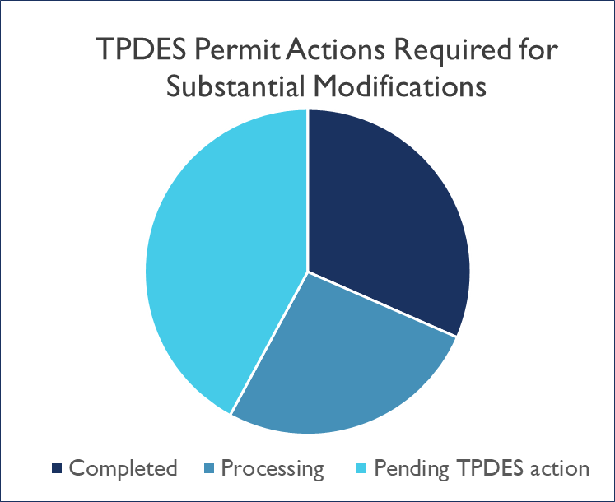
Status of Substantial Modifications Backlog
Successfully completed 50% of the TPDES Permit Action backlog for substantial modifications.
Since the Pretreatment Team started incorporating these sub mods into TPDES permit actions in July 2021, the team has completed:
3 SIAs; 3 Dovetails
The PT is currently processing ongoing TPDES permit actions for:
2 SIA; 3 Dovetails
Additionally, there are currently 8 substantial modifications that have been technically completed that are pending the final TPDES permit action.
Notes:
Thank you, Colleen. As you all know, we are diligently chipping away at our next backlog project: completion and final approval of the pending Substantial Modifications, which will incorporate the technically completed approved programs into the TPDES permit through either a staff-initiated amendment or the dovetail process using a pending permit application already in house.
As discussed during Region VI, you can see on that over half of the modifications have been completed or we are currently processing a TPDES permit action to finalize and complete the modification approval. We started with 19 pending modifications and currently only have 8 remaining that we may need to initiate a permit action for (or incorporate into a dovetail review).
We appreciate your patience as we work on streamlining the permitting process.

Slide 13
Substantial Modifications - TPDES Permit Process
Streamlining internal TPDES permit approval process in order to approve and incorporate pretreatment substantial modifications more efficiently.
UPDATE: the number of hardcopies required to be submitted with final substantial modification package will be reduced from 4 copies to only 2. This will take effect for all modifications technically completed after October 1, 2022.
In addition to the 2 hard copies, we will now be requiring an electronic version of the modified program with the final modification package, as well.
File Transfer Protocol (Secure) site (FTPS) electronic submittal:
Create Account: https://ftps.tceq.texas.gov/help/
Login, Upload, Share: https://ftps.tceq.texas.gov/ut.php
Notes:
As part of streamlining our approval process for substantial modifications we are updating what is required to be submitted with the final package. As you all know, currently we request 4 hardcopies of the final modified program in the tech complete notification. However, moving forward we will only be requesting 2 hardcopies and one electronic copy. This will reduce excess paper usage and postage costs for shipping documents and is beneficial for everyone involved. So again, TWO hardcopies. ONE digital copy.
Additionally, the Pretreatment team has streamlined the TPDES permitting process in order to approve and incorporate these sub mods in a timelier manner. Previously this process averaged approximately 180 days once the permit amendment was initiated, however, our most recent SIA that was initiated is on track to be sent to the Chief Clerk’s Office for mailout of the draft permit package within 60 days of initiation of the permit action. This is more than a 50% improvement on processing time.
As discussed, we will now be requesting a digital copy of the final sub mod submittal. The most efficient and secure way to submit documents electronically is through TCEQ’s FTPS website. This site will also be utilized during our audits for file reviews. The FTPS sharing site is a great place to quickly submit addendums or revisions to your documents and is best used to upload large files that may be too big to send through email, like maybe an entire digital copy of your program, if you have one available. As part of looking at our internal processes, we are also updating and digitizing our internal records. Currently, our process is to scan the hardcopy of the approved program and upload it to our records, however, if any programs out there have a complete digital copy of the program already and would like to submit it to the FTPS, we would appreciate you for saving us some time scanning the documents.
So now let’s hopefully do a quick walkthrough in case anyone is unfamiliar with the FTPS file sharing site.
[FTPS demo, search TCEQ, create account (quick scroll), second link: upload and share EXAMPLE].
So you can see how easy it is to do, once you’ve created an account and done the process a few times. And again, this presentation and links will be posted to the Pretreatment Stakeholders webpage if you would like to refresh your memory on how to use the file sharing site.

Slide 14
New Developing Programs
Now that we have successfully cleared the majority of pending program modifications for our current approved programs, TCEQ will begin reviewing the new developing program submissions.
There are a total of seven (7) developing program submissions that will need to be reviewed.
If a developing program would like to submit updated program documents, please contact the Pretreatment Team for further discussion.
Notes:
At the start of 2022 we had 8 new developing programs (NDP) submittals waiting approval, but one pending developing program has recently been completed and approved for the first time in many years! There are now a total of 7 remaining new developing programs awaiting review and Pretreatment staff have already picked up the next one to begin the technical review.
Staff will be reaching out to the developing program contacts to confirm that we have all of the updated items and elements for the program review on file. During the review, we plan to implement a collaborative process, in which we will schedule either Teams meetings or conference calls to go over any deficiencies, so they can be resolved in real-time. These joint-working sessions reduce the back-and-forth correspondence and provides an opportunity for us to address and resolve any questions or concerns as they arise.
Are there any questions or comments about updates to the submod approvals or new developing program reviews before we move on? Or uploading digital files to the FTPS. Just a reminder that you can email in questions to Outreach@tceq.Texas.gov

Slide 15
TCEQ Title VI Requirements
Notes:
Alrighty so onto the Title VI requirements! Particularly as they relate to the permit actions associated with pretreatment substantial modification approvals

Slide 16
TCEQ Title VI Implementation
On August 2021, TCEQ implemented new rule requirements in Title 30 Texas Administrative Code (TAC) Chapter 39 relating to public notice requirements.
This implementation is the result of the informal resolution with EPA and to meet Title VI requirements.
This implementation impacts all permit applications subject to the Chapter 39 public notice requirements that are administratively complete on or after May 1, 2022.
Notes:
TITLE VI refers to the alternative language requirements for public notice found in Chapter 39 of the Texas Administrative Code. This new implementation procedure is the result of the informal resolution with EPA to meet Title VI requirements. [alternative language at a school in the POTWs service area]
So, how does this effect Pretreatment? Title VI is applicable to the permit actions required to incorporate pretreatment modifications into the approved programs (SIAs and dovetails). How does this affect the CAs?
The newly implemented review process does not add any additional requirements, it simply updates the step in the process where the NAPD translation by the permittee takes place. [NAPD is an acronym and just means Notice of Application and Preliminary Decision and is the public notice required during a permit action.] Now, it will be during the DRAFT PERMIT ACCEPTANCE STAGE of the review, the permittee will be provided with the NAPD and required to provide the translated notice with the acceptance of the draft permit. Most of the language will be translated in the template provided, HOWEVER, specific details related to the WWTP may need to be translated by the permittee. Again, this will be requested during the permittee’s review of the draft permit language and the permittee is required to submit BACK to the TCEQ, a translated version of the NAPD, along with any comments on the draft permit package.
Does anyone have any questions or comments about Title VI requirements for pretreatment permit actions? Thank you and now Heeeeeeeeeeere’s Jessica!

Slide 17
Regulatory Updates
Notes:
Thank you Bridget for those updates on our Pretreatment Program. Now we will discuss a few regulatory updates. Starting with PFAS….

Slide 18
Regulatory Updates: PFAS
EPA’s PFAS Strategic Roadmap
October 2021 EPA PFAS Roadmap: established Office of Water Key Action Items
Effluent Limit Guidelines program to establish regulatory limits on nine industrial categories
Utilize NPDES permitting program to reduce PFAS discharges to waterways
Publish analytical methods to enable PFAS to be monitored in 8 different environmental matrices, including wastewater
Publish final recommended ambient water quality criteria for PFAS for aquatic life and human health to help states implement rule
https://www.epa.gov/system/files/documents/2021-10/pfas-roadmap_final-508.pdf
Notes:
In October 2021, EPA announced the Agency’s PFAS Strategic Roadmap – laying out a whole agency approach to addressing PFAS. The roadmap included numerous action items for the Office of Water, four of which directly affect wastewater.
These are the four items are listed on the screen.
EPA has already taken action on a few of these items which we will discuss in the next few slides.

Slide 19
Regulatory Updates: PFAS (1)
Restrict PFAS discharges from industrial sources through the ELG program
Rulemaking Revisions to restrict PFAS discharges from industrial categories where EPA has the data to do so. These include:
Organic Chemicals, Plastics & Synthetic Fibers (OCPSF)
Metal Finishing
Electroplating
Launch detailed studies on facilities where EPA has preliminary data on PFAS discharges, but the data are currently insufficient to support a potential rulemaking. These include:
Electrical & Electronic Components
Textile Mills
Landfills
Initiate data reviews for categories where there is little known information on PFAS discharges, including:
Leather tanning & finishing
Plastics Molding and Forming
Paint Formulating
Notes:
The first item on the EPA’s roadmap will directly affect industrial facilities and pretreatment programs. The EPA plans to:
Undertake rulemaking to restrict PFAS discharges from industrial categories where EPA has the data to do so—including the guidelines for organic chemicals, plastics and synthetic fibers (OCPSF), metal finishing, and electroplating. Proposed rule is expected in Summer 2023 for OCPSF and Summer 2024 for metal finishing and electroplating.
Suggestion to CAs: Identify IUs who manufacture, use or otherwise process PFAS substances. Ensure IUs are aware of PFAS Final Rule and upcoming revisions to categorical standards.
Launch detailed studies on facilities where EPA has preliminary data on PFAS discharges, but the data are currently insufficient to support a potential rulemaking. These include electrical and electronic components, textile mills, and landfills. EPA expects these studies to be complete by Fall 2022 to inform decision making about a future rulemaking by the end of 2022.
The EPA also intends to: Initiate data reviews for industrial categories for which there is little known information on PFAS discharges, including leather tanning and finishing, plastics molding and forming, and paint formulating. EPA expects to complete these data reviews by Winter 2023 to inform whether there are sufficient data to initiate a potential rulemaking.
In addition to the 9 industrial categories identified, the plan includes the Monitoring of industrial categories where the phaseout of PFAS is projected by 2024, including pulp, paper, paperboard, and airports. The results of this monitoring, and whether future regulatory action is needed, will be addressed in the Final ELG Plan 15 in Fall 2022.

Slide 20
Regulatory Updates: PFAS (2)
In April 2022, EPA announced three clean water actions that advance progress under EPA’s PFAS Strategic Roadmap:
A New Testing Method Will Help Detect PFAS
EPA published a new draft method to measure for Adsorbable Organic Fluorine in water samples. This new method, known as draft EPA method 1621, can broadly screen for the presence of chemical substances that contain carbon-fluorine bonds, including PFAS.
Addressing PFAS in National Pollutant Discharge Elimination System (NPDES) Permitting
EPA issued a memo to use NPDES permitting authorities to reduce discharges of PFAS at the source and to obtain more comprehensive monitoring information on potential sources of PFAS. This memo applies to Clean Water Act programs EPA oversees; EPA plans to issue a subsequent memo that provides guidance to state permitting authorities.
https://www.epa.gov/system/files/documents/2022-04/npdes_pfas-memo.pdf
Draft Aquatic Life Criteria for PFOA and PFOS
EPA proposed draft aquatic life criteria for PFAS, focusing on two of the most well-studied chemicals in this group: PFOA and PFOS.
https://www.epa.gov/newsreleases/epa-delivers-three-water-commitments-agencys-pfas-strategic-roadmap
Notes:
In more recent news, EPA has announced progress on three of the action items for the OW:
In addition to EPA Draft Method 1633, EPA is also publishing a new method that can broadly screen for the presence of PFAS in water at the part per billion level. EPA’s Draft Method 1621 has successfully completed single laboratory validation. Multi-laboratory validation will took place this summer and EPA intends to publish an updated version of the method later this year.
EPA has also issued a memo (Addressing PFAS Discharges in EPA-Issued NPDES Permits and Expectations Where EPA is the Pretreatment Control Authority) which provides instructions for monitoring provisions, analytical methods, the use of pollution prevention, and best management practices to address discharges of PFAS. EPA also plans to issue new guidance to state permitting authorities to address PFAS in NPDES permits in a future action.
EPA has proposed the first aquatic life criteria for PFOA and PFOS—two of the most well-studied chemicals in this group. The criteria are intended to protect aquatic life in the United States from short-term and long-term toxic effects of PFOA and PFOS. Following the comment period, EPA intends to issue final PFOA and PFOS recommended criteria, considering public comments and any new toxicity data. States and Tribes may consider adopting the final criteria into their water quality standards or can adopt other scientifically defensible criteria that are based on local or site-specific conditions.

Slide 21
Regulatory Updates: 2019 Hazardous Waste Pharmaceutical Final Rule
As part of the EPA’s Water Reuse Action Plan (WRAP), EPA has recently released two new fact sheets. Both fact sheets provide information about the “sewer ban” that was part of EPA’s 2019 Hazardous Waste Pharmaceuticals Final Rule.
The first fact sheet is an introductory fact sheet that is directed to a general audience, who may be less familiar with the Resource Conservation and Recovery Act (RCRA) regulations.
The second fact sheet is directed to Publicly Owned Treatment Works (POTWs) that receive discharges from industrial users and includes information about who is responsible for enforcing the RCRA sewer ban.
Notes:
The RCRA Hazardous Waste Pharmaceuticals Final Rule, which bans the introduction of hazardous waste pharmaceuticals (HWPs) into the sewer, went into effect on August 21, 2019. The 2019 rule prohibits all healthcare facilities and reverse distributors from disposing of HWPs down the drain in all states, territories, and in Indian Country. In addition to the prohibition, EPA strongly discourages the sewering of any pharmaceutical, with very few exceptions, by residents or by any type of facility.
Two fact sheets on this sewer ban were published by EPA in April of this year. One is an introductory fact sheet aimed at a general audience and the other is directed at POTWs. The introductory fact sheet covers what types of healthcare facilities must comply with the sewer ban, as well as what pharmaceuticals are considered hazardous and subject to the sewer ban.
The SECOND fact sheet for POTWs covers who is responsible for enforcing the sewer prohibition and how control authorities may adapt their pretreatment programs to enforce this rule. Pdf versions of these fact sheets also contain links to additional information and can be accessed from the Final Rule page at epa dot gov. We also have copies of this fact sheet printed if you would like to take a copy with you for reference.

Slide 22
Adjourn
Notes:
In an effort to increase outreach to stakeholders, the Pretreatment Team will be holding public stakeholder meetings semi-annually, so stay tuned for the next one in 2023. You can find updates on the Pretreatment Stakeholder website and if you are not currently on the TCEQ pretreatment stakeholder list to receive correspondence, please email oureach@tceq.texas.gov to be added in order to receive updates about upcoming meetings. Additionally, if you would like to watch a recording of this meeting you can do so via webcast by visiting the link on your screen.
Thank you everyone for joining us today!

Slide 23
Questions?
Notes:
This concludes our stakeholder presentation, and now we would like to open up the floor for your questions and feedback.

