Slide 1
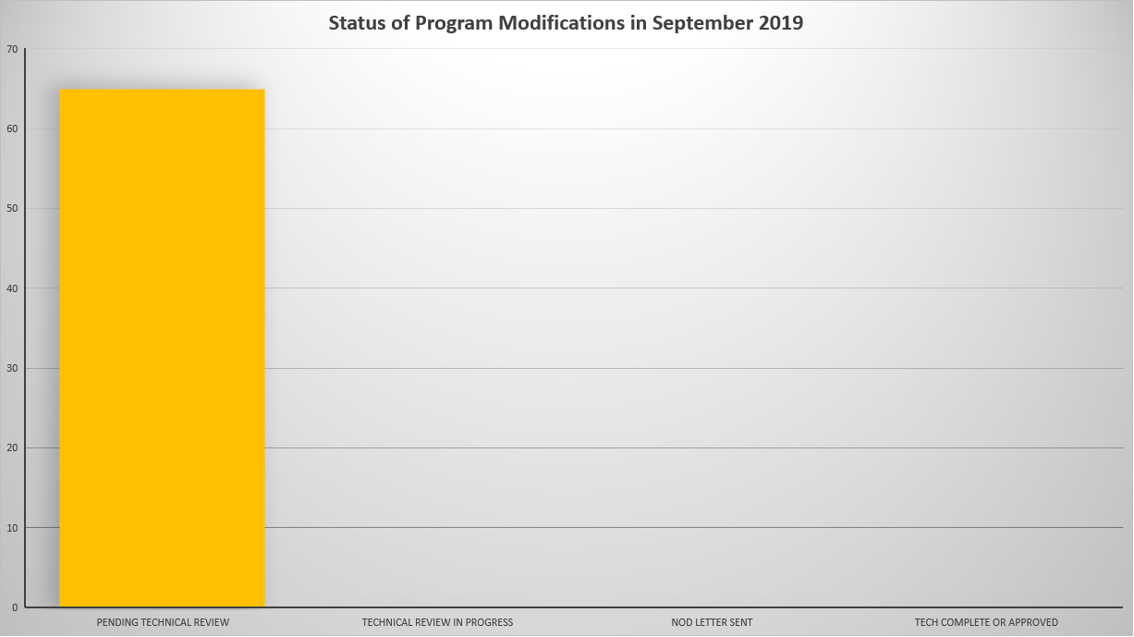
Status of Program Modifications in September 2019

Slide 2
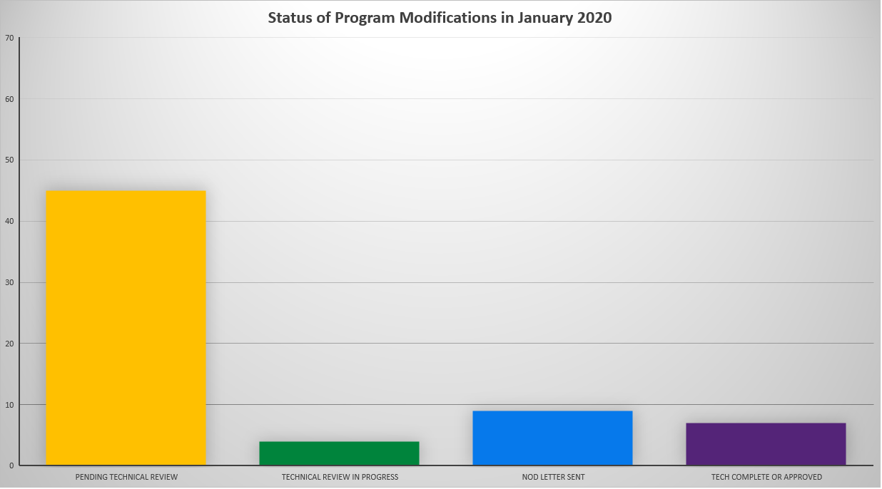
Status of Program Modifications in January 2020

