Slide 1
Status Update and Overview of Changes being made to 30 TAC Chapters 210 and 321 P for SB 1289 Implementation
Erika Crespo
Assistant Deputy Director
Water Quality Division

Slide 2
TCEQ regulations involved in Senate Bill 1289
30 TAC Chapter 210
authorizes producers, providers, and users of reclaimed water
promotes sustainability
protects public health
30 TAC Chapter 321 Subchapter P
authorizes the construction and operation of reclaimed water production facilities
generates reclaimed water that can be used instead of potable or raw water

Slide 3
Current Implementation Status
Legal and Management review

Slide 4
Overview of proposed rule changes to 30 TAC Chapter 210 (subject to change during rulemaking process)
revised the definition of “permit or permitted” in §210.3(20).
added another reference to the list of regulations associated with types of reclaimed water activities in §210.2(b).

Slide 5
Overview of proposed rule changes to 30 TAC Chapter 321 P (subject to change during rulemaking process)
No TPDES / TLAP permit is required for reclaimed water production facilities, except as outlined in §210.5, so long as:
the owner is also the owner of the associated domestic wastewater treatment facility.
OR
the owner has permission or consent from the owner/operator of the associated domestic wastewater.

Slide 6
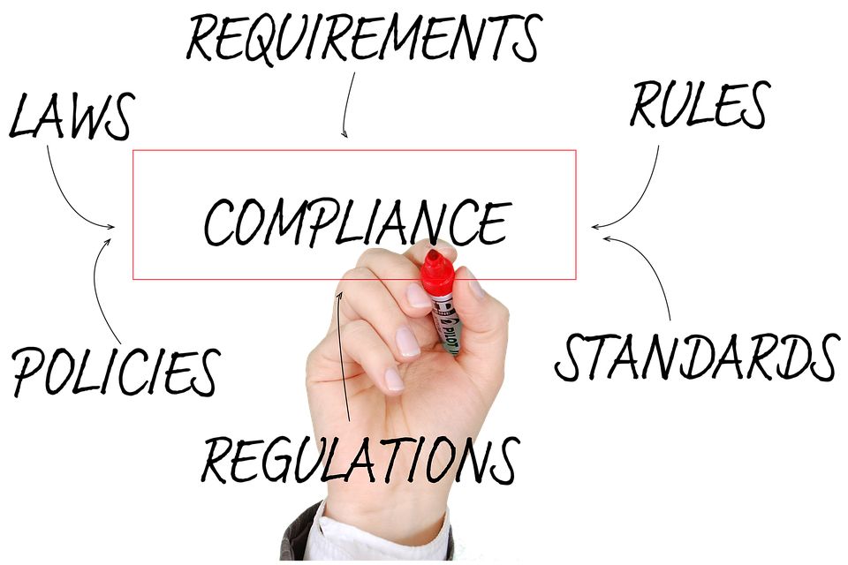
Overview of proposed rule changes to 30 TAC Chapter 321 P (subject to change during rulemaking process)
Authorizations will be automatically cancelled if the TPDES / TLAP permit for the associated domestic wastewater treatment facility expires or is suspended / cancelled / revoked.

Slide 7
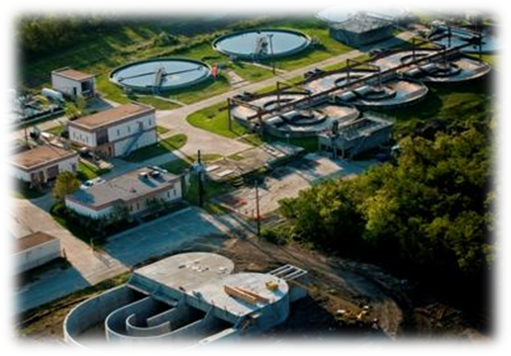
Overview of proposed rule changes to 30 TAC Chapter 321 P (subject to change during rulemaking process)
Definitions are being added for the following:
associated domestic wastewater treatment facility
collection system
permit

Slide 8
Overview of proposed rule changes to 30 TAC Chapter 321 P (subject to change during rulemaking process)
The following three items must be submitted concurrently:
210 beneficial reuse authorization application
321 P reclaimed water production facility application
complete set of engineering design plans and specs

Slide 9
Overview of proposed rule changes to 30 TAC Chapter 321 P (subject to change during rulemaking process)
Reclaimed water production facility authorizations will be terminated if the permission/consent is withdrawn
Reclaimed water production facility owners/operators must notify TCEQ in writing and cease operations within five business days

Slide 10
Process for issuing 321 P authorizations prior to the adoptions of rules
To date, under the SB 1289 statute changes:
one authorization has been issued
one application is currently under review
A reopener clause is being included in issued authorizations.
The statement about automatic termination if associated TDPES / TLAP permit goes away is being revised.

Slide 11
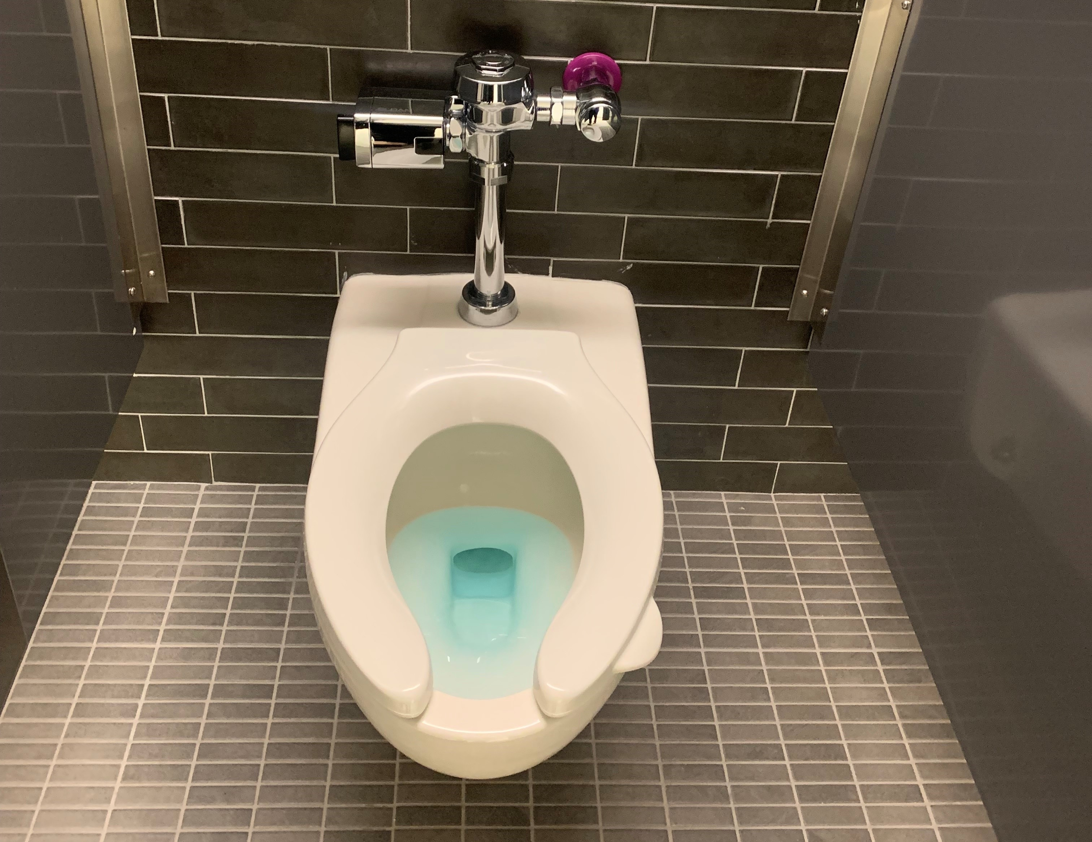
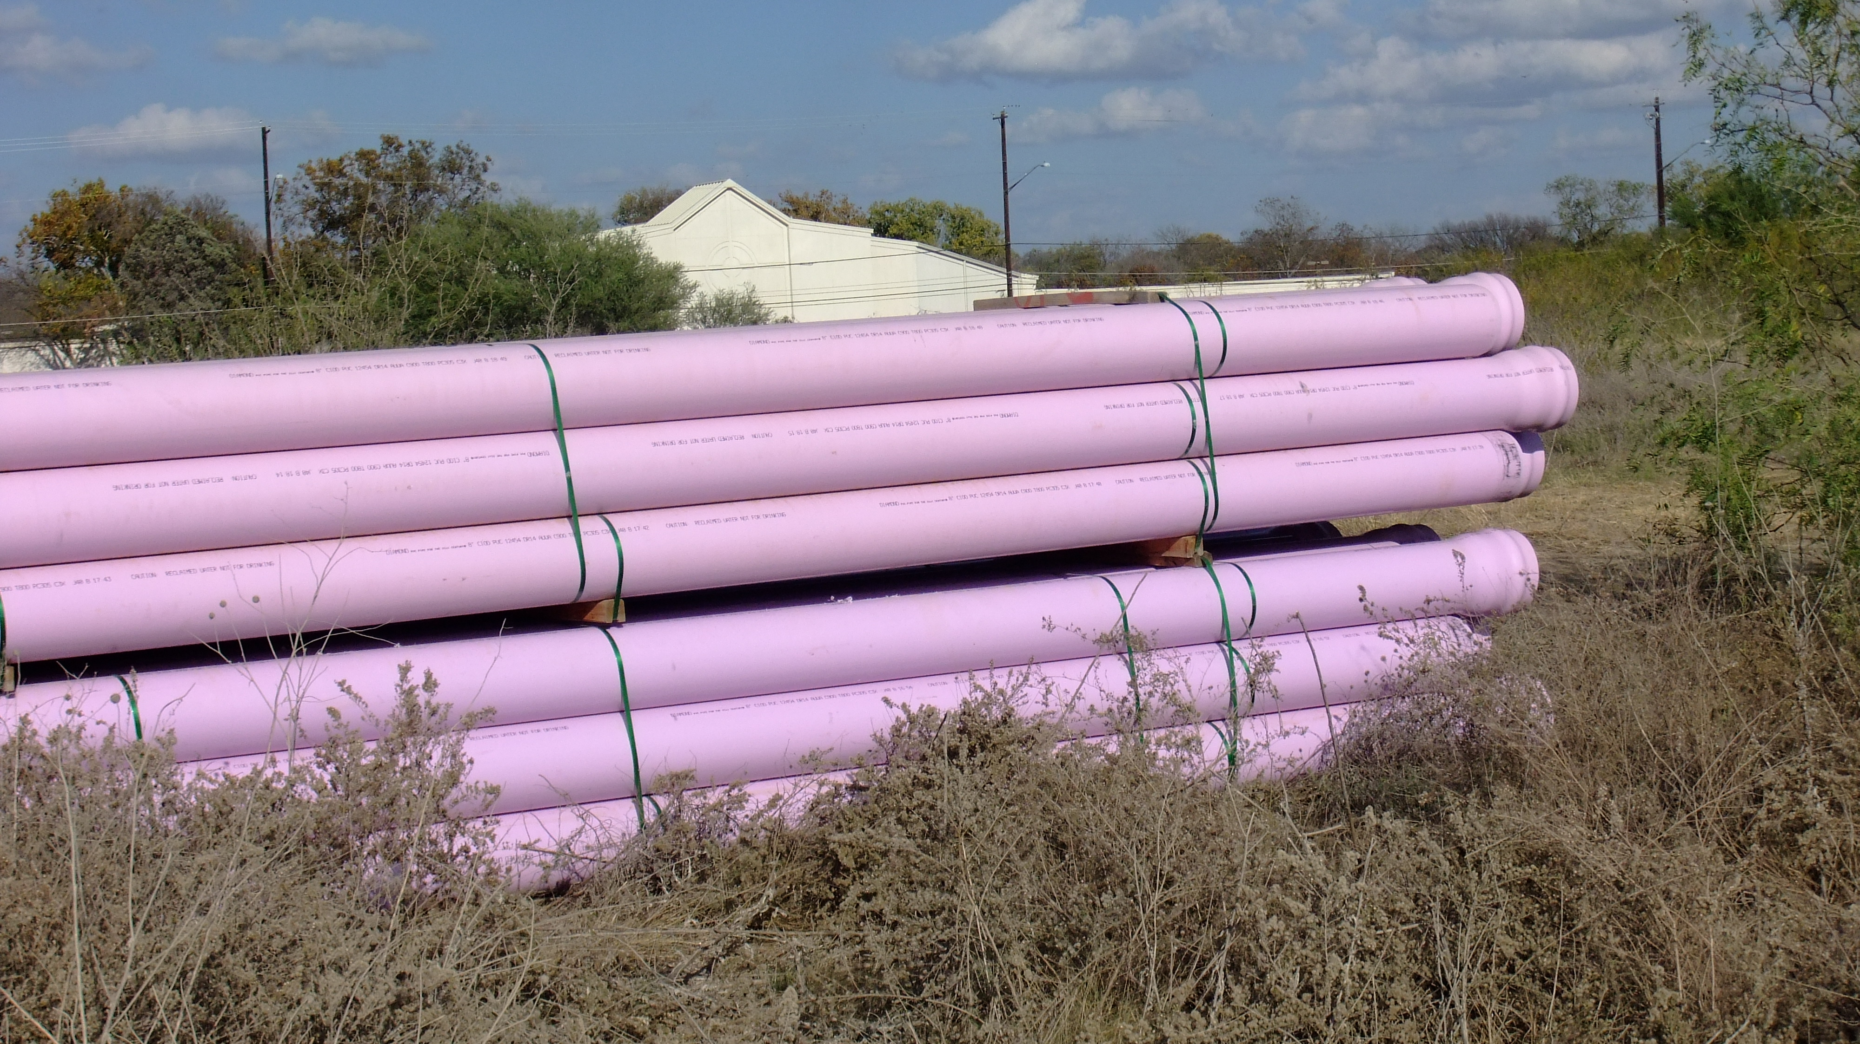
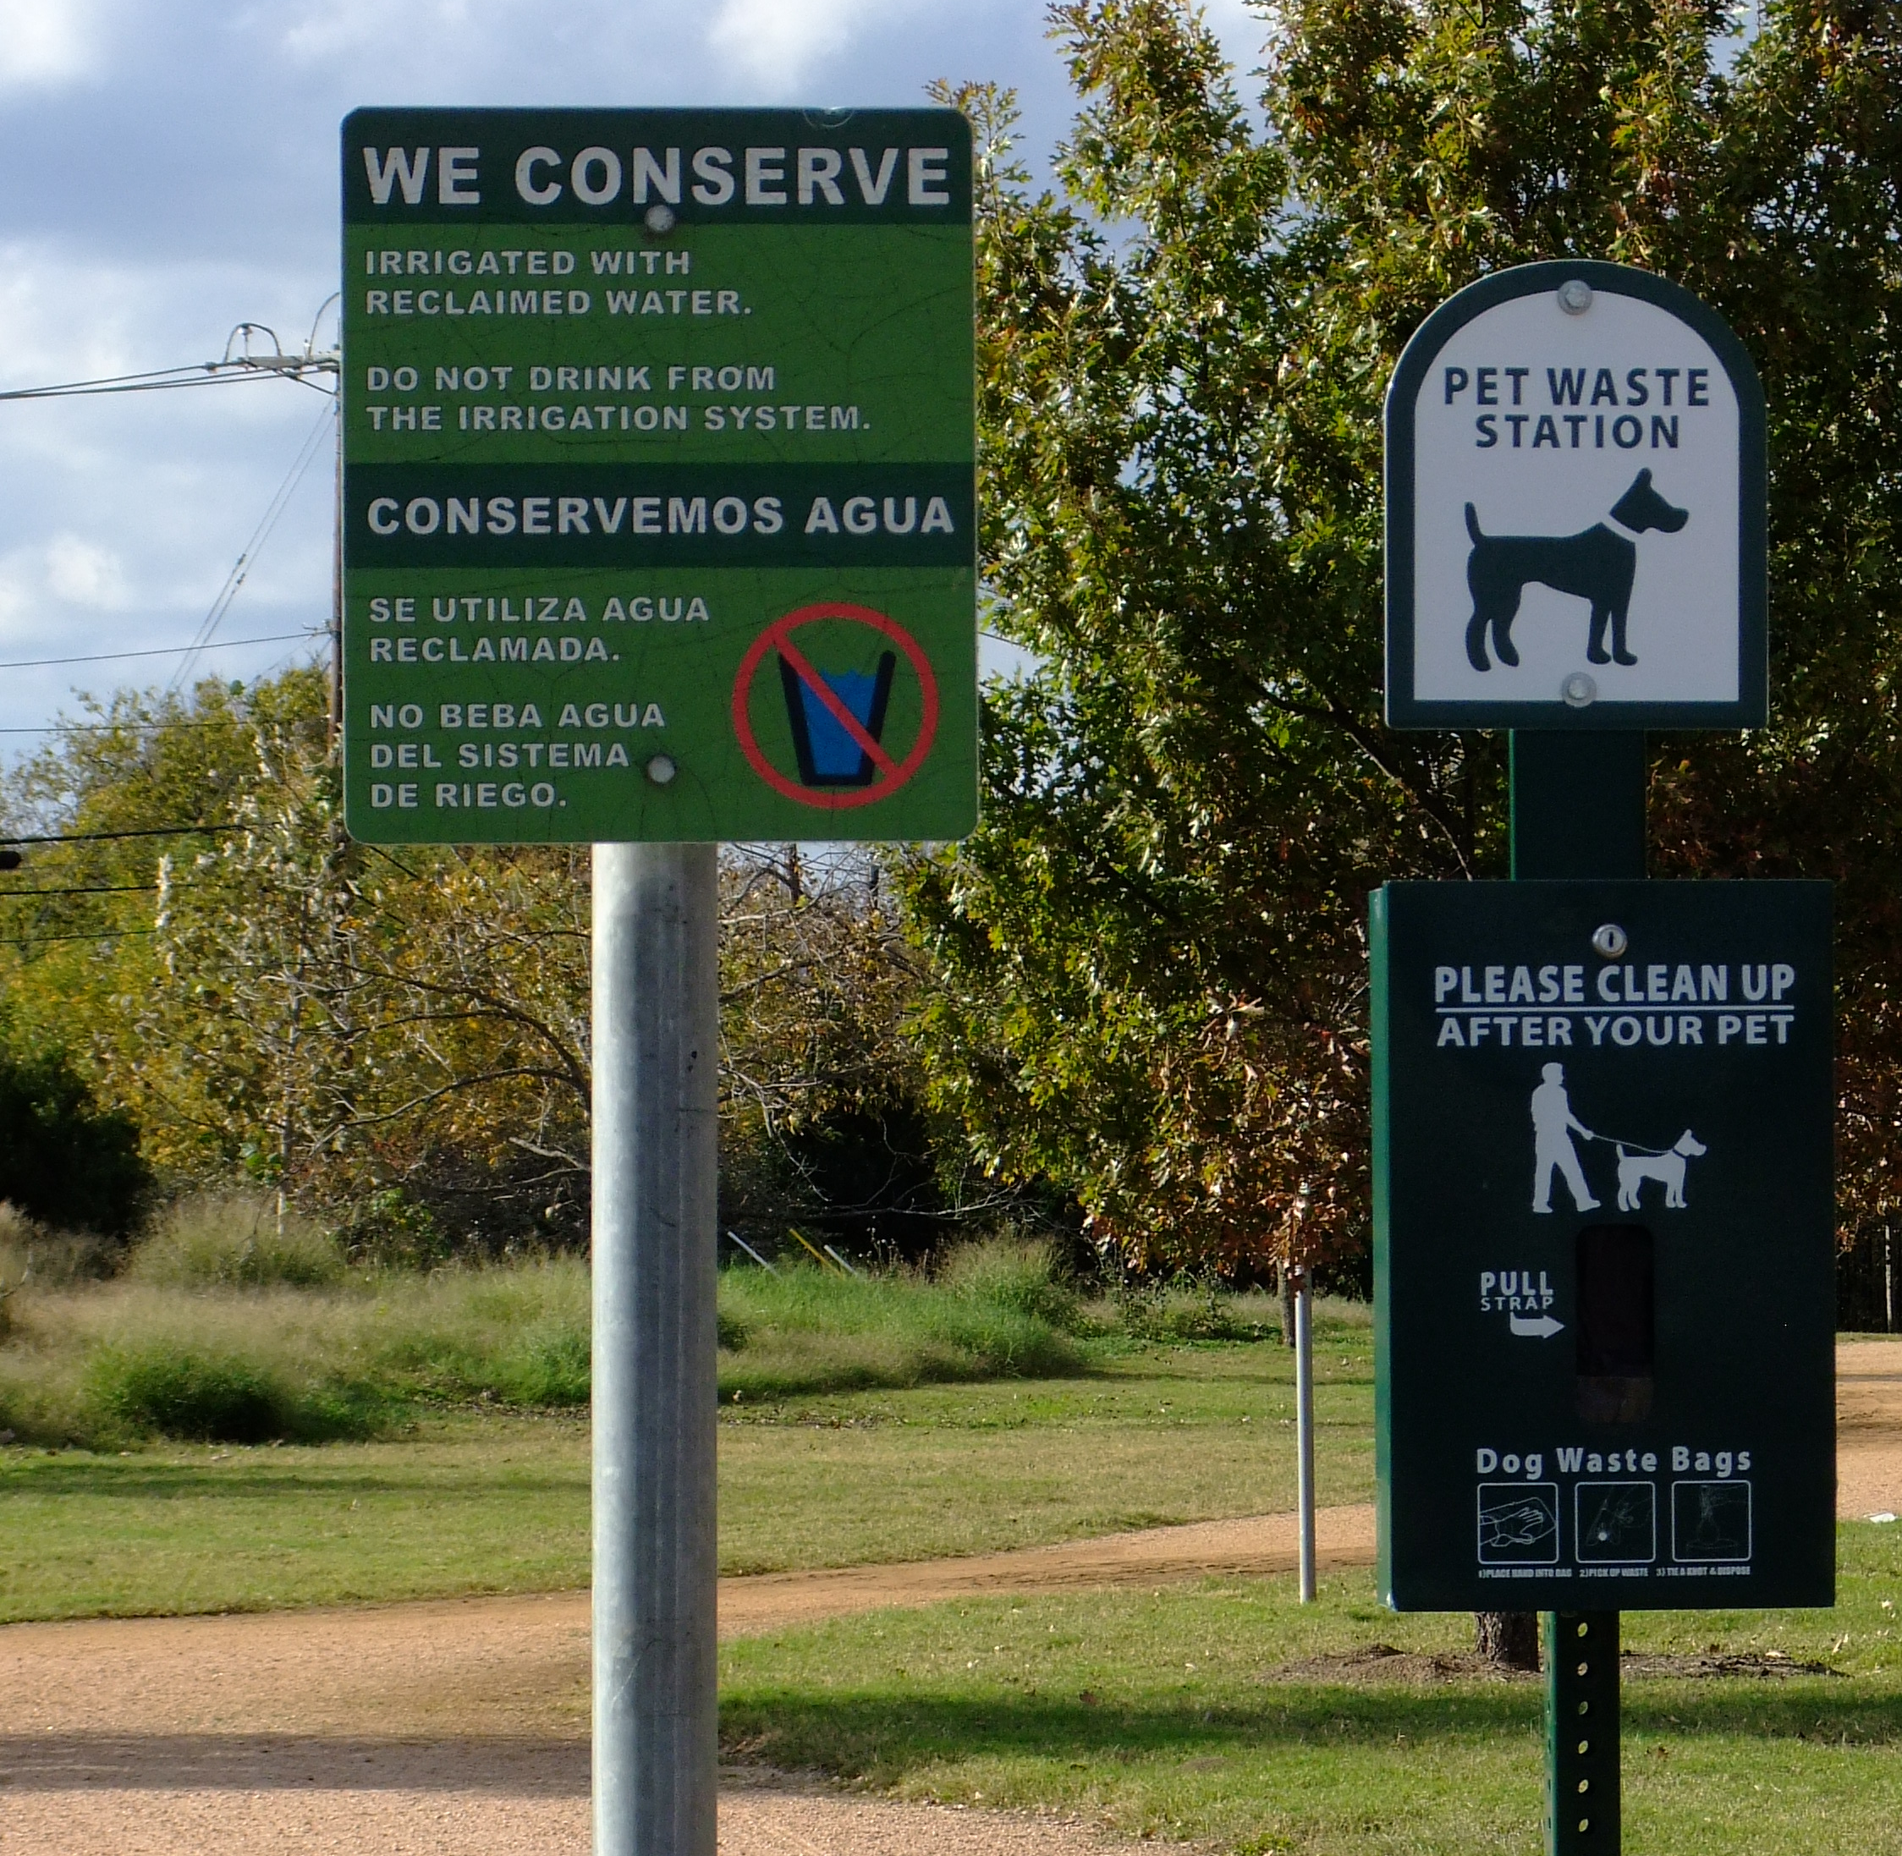
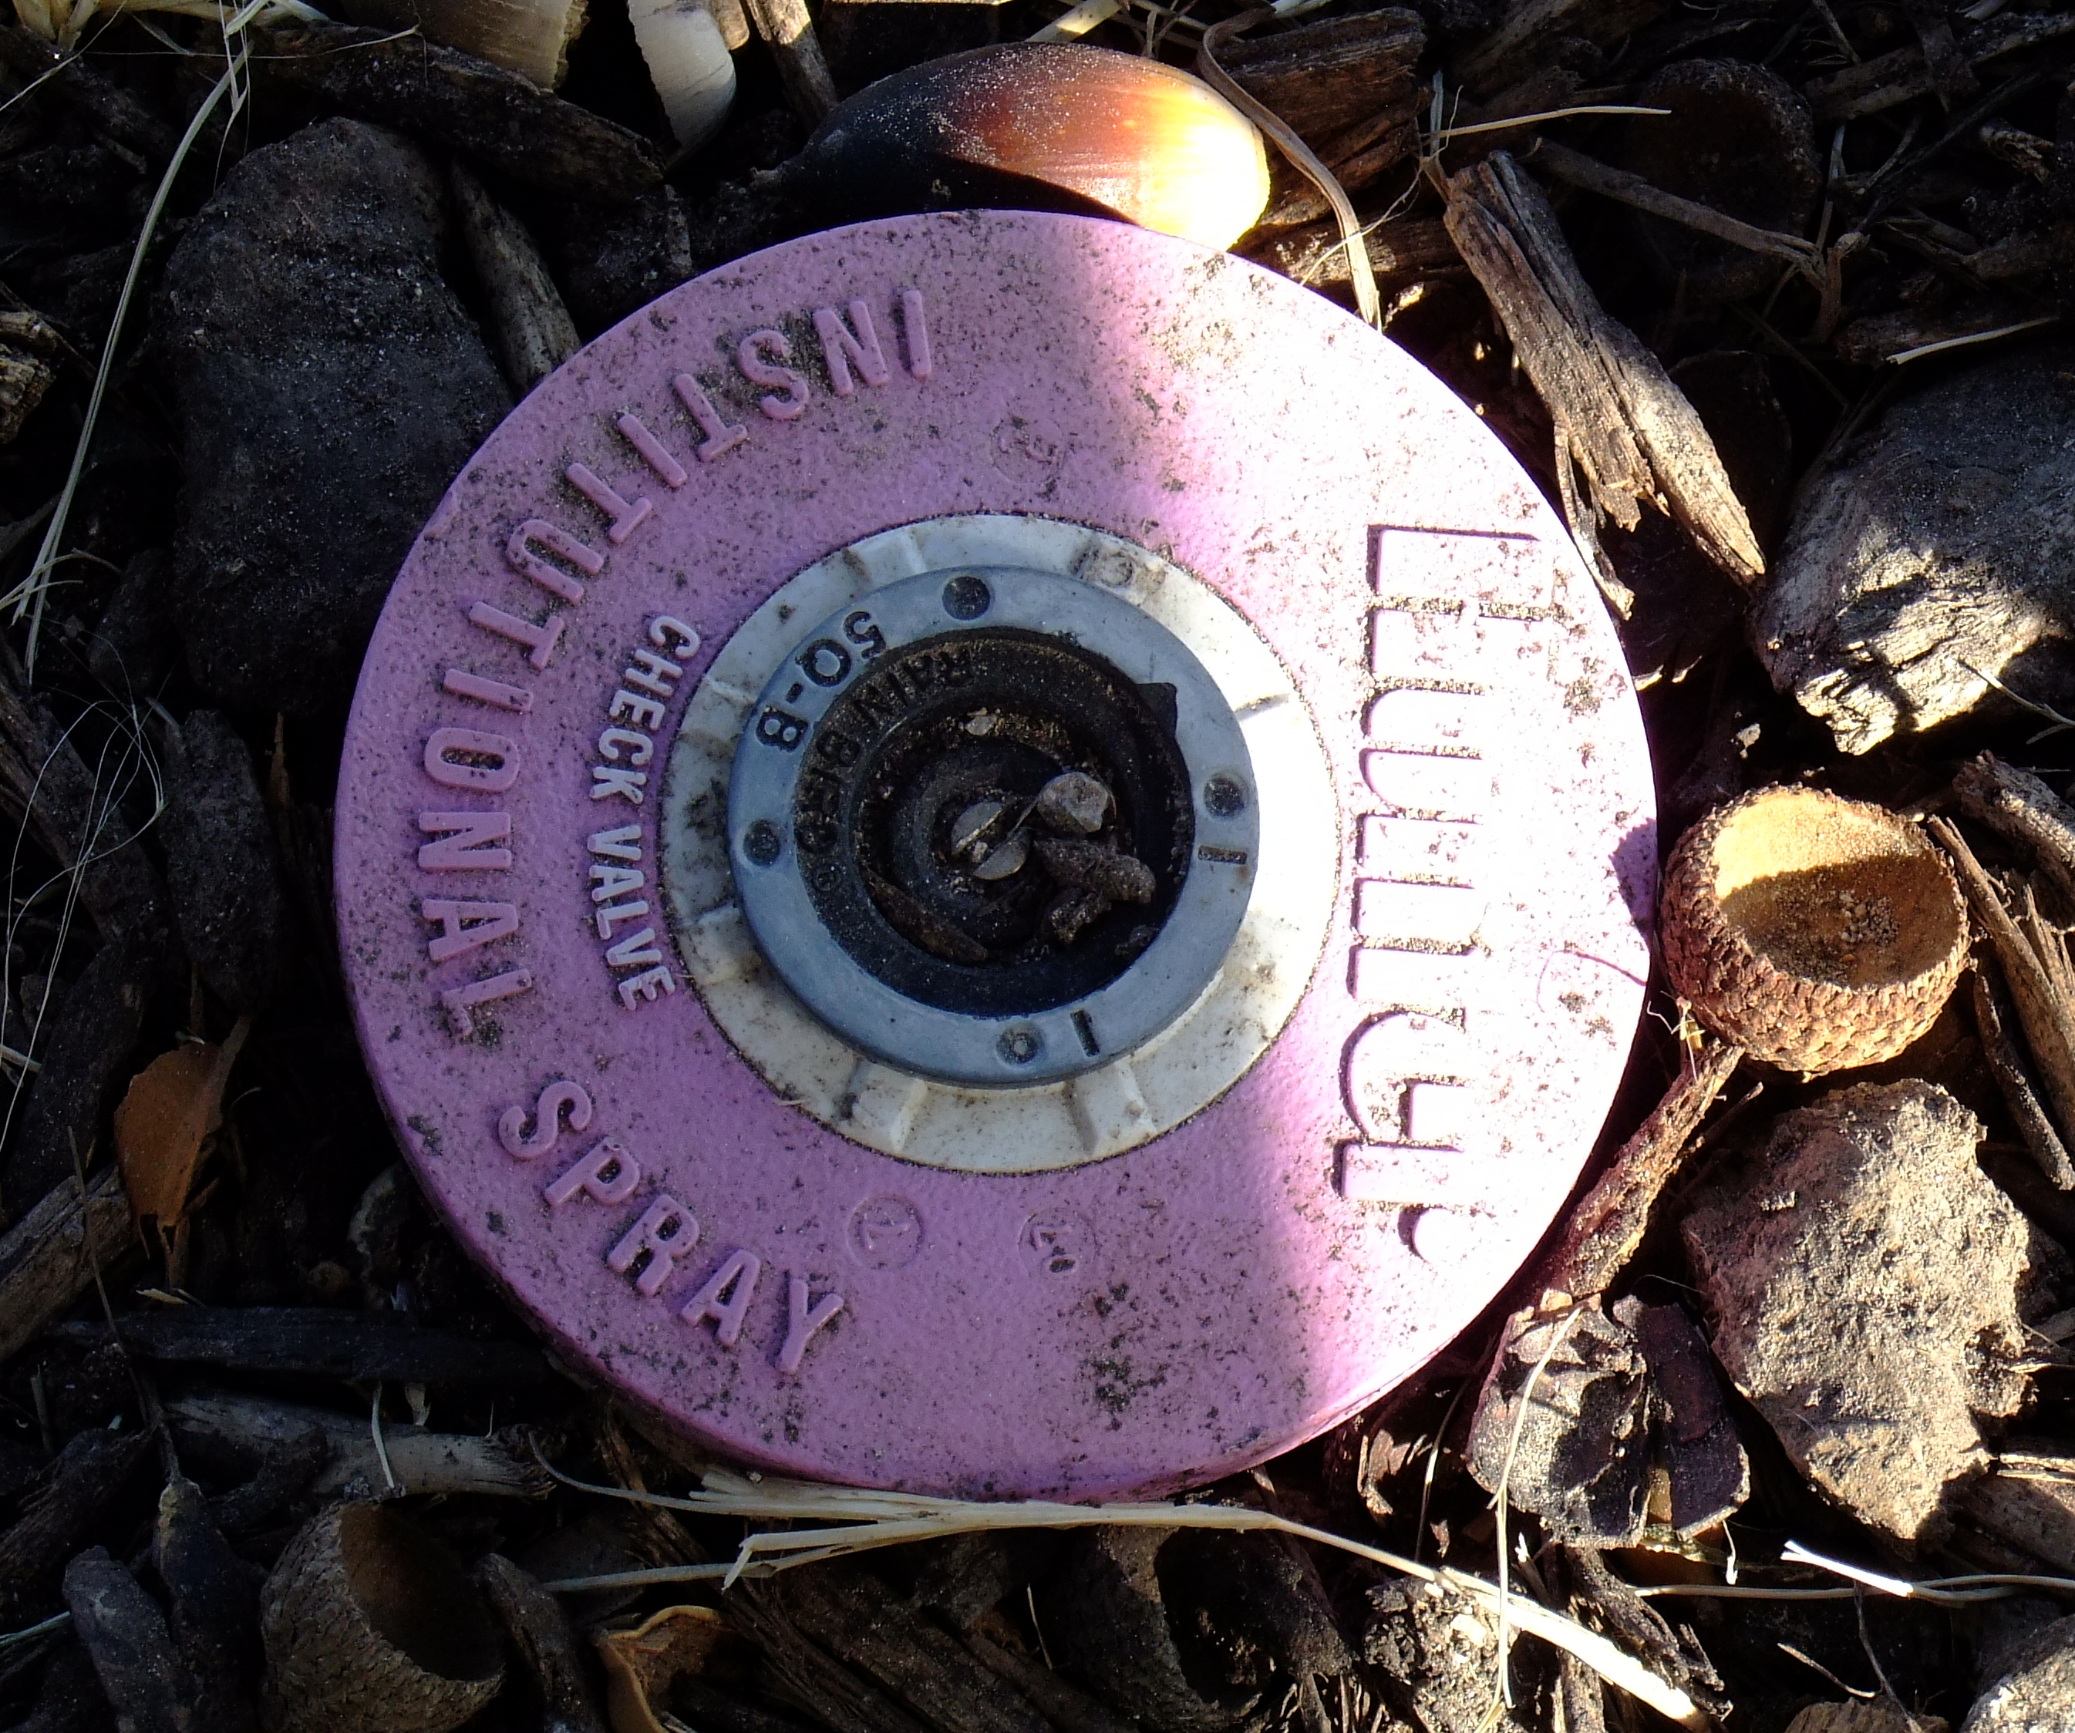
Thank You!
Questions?
Erika Crespo
512-239-1827
erika.crespo@tceq.texas.gov
https://www.tceq.texas.gov/

