Slide 1

Municipal Setting Designation Applications:
Avoiding Common Mistakes
Aaron Correll, P.G.
VCP-CA Section
Remediation Division
Texas Commission on Environmental Quality

Slide 2
What is a Municipal Setting Designation (MSD)?
MSDs prohibit current and future potable use of groundwater within the MSD boundary
A MSD is based on a restriction on groundwater use placed/supported by a municipality
Potable water is defined as water used for drinking, showering, bathing, cooking purposes, or for irrigating crops intended for human consumption
MSD Property
Soil
Contamination
Groundwater Zone 1
Designated Groundwater
Groundwater Zone 2
Groundwater Zone 3

Slide 3
Eligibility Requirements
Proposed MSD must be within the corporate limit or extraterritorial jurisdiction (ETJ) of a municipality
Public water supply must be available to the properties within the MSD boundary and all properties within 0.5 miles of the MSD boundary
ETJ
Municipality
MSD
MSD

Slide 4
What type of sites get a MSD?
MSDs are applied to sites that are in a TCEQ remediation program with documented groundwater contamination
Voluntary Cleanup Program
A MSD
cannot alter or supersede any requirement of a federally authorized environmental program
Corrective Action Program
(non-RCRA permitted sites)

Slide 5
TCEQ Application Requirements
TCEQ Core Data Form
(TCEQ-10400)
Application Form
(TCEQ-20149)
Items 1-12 (Supporting Information)
Application Fee of $1,000
Exhibit B (Affidavit of Eligibility)

Slide 6
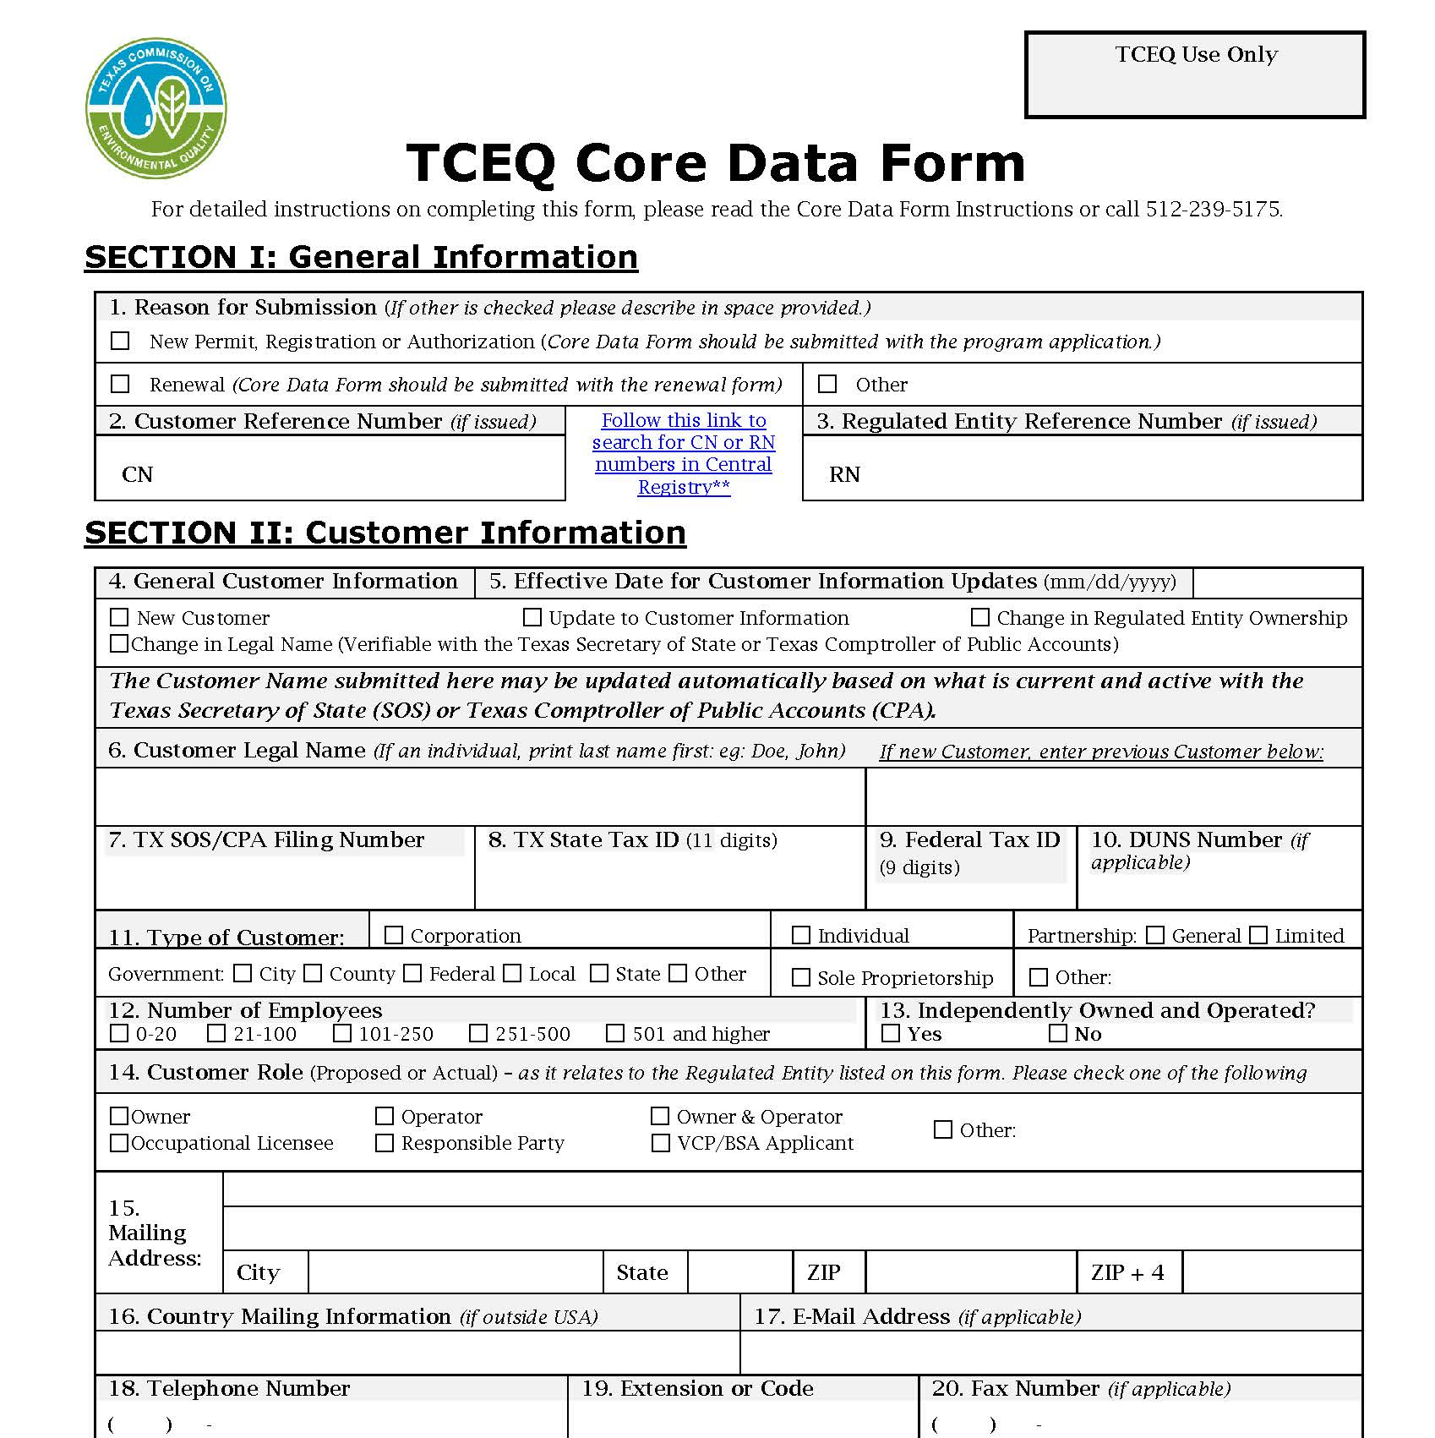
TCEQ Core Data Form
Critical to submit at time of Application
Customer should be the MSD Applicant
Regulated Entity Number (RN) not necessarily the same as the associated remediation site

Slide 7
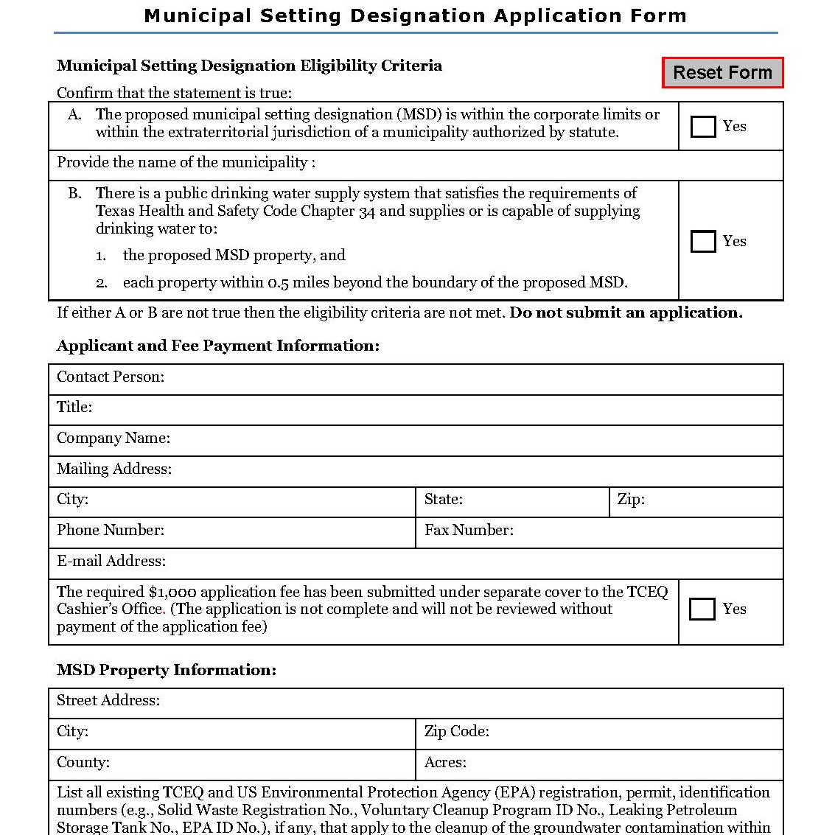
MSD Size and Boundary
MSD size/boundary may differ from the remediation site boundary
Maintain consistency
  Application Form (1st page)
  Legal Description (Item 3)
  Ordinance/Restrictive Covenant (Item 6)
7

Slide 8
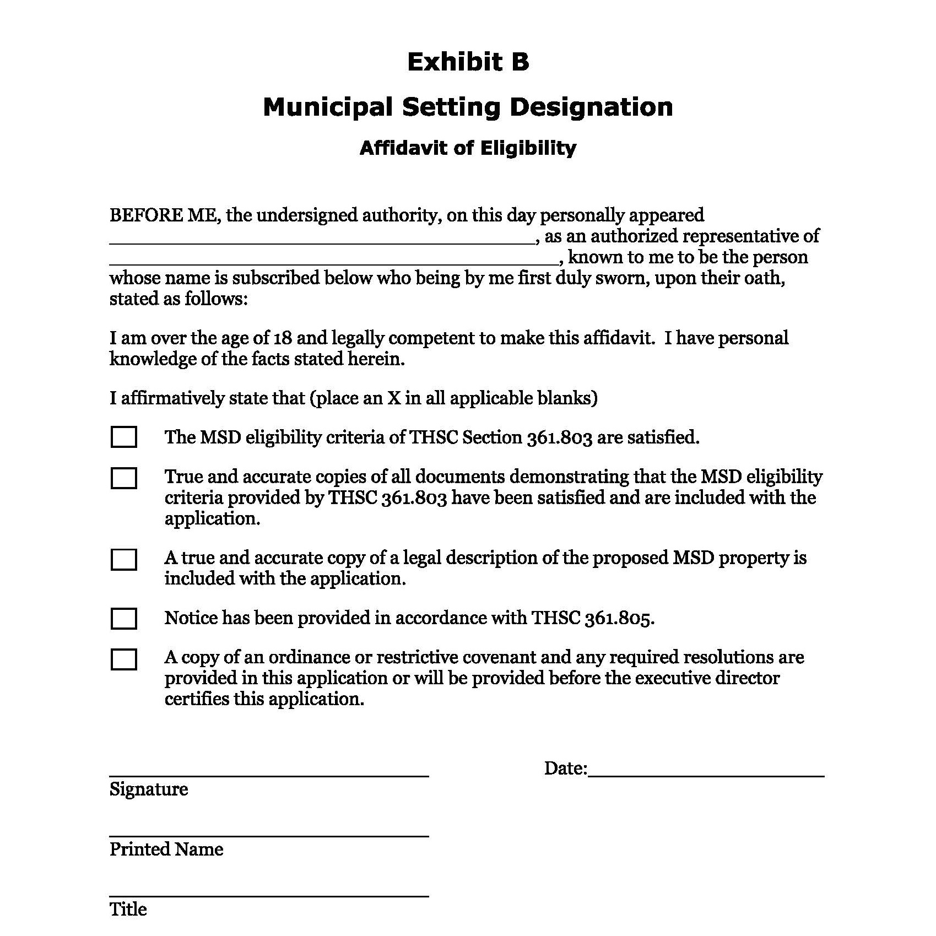
Exhibit B
Consistent with Application
Original signature

Slide 9
Item 1:
Map of Municipality and
Proposed MSD
REQUIREMENTS
COMMON MISTAKES
Include a map of the municipality in which the proposed MSD is located
  Demarcate corporate limits and extraterritorial jurisdictions (ETJs)
  Clearly show proposed MSD boundary
Scale (consider multiple figures)
MSD boundary/shape not depicted
9

Slide 10

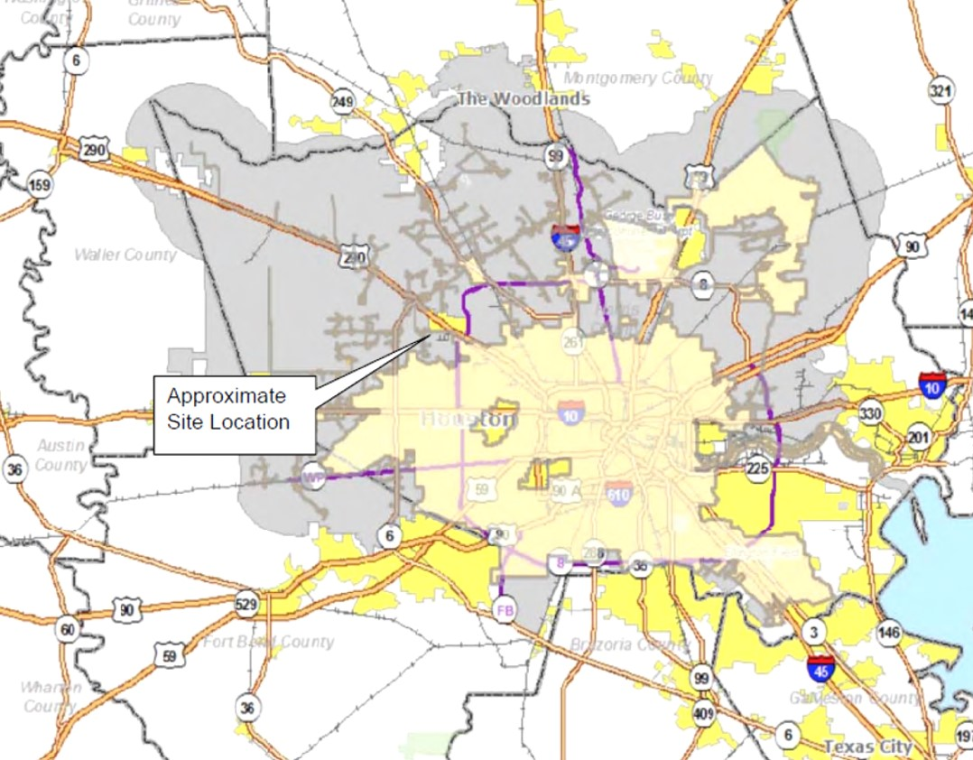
Example 1.1
Figure adequately demarcates the corporate limits of Houston and its ETJ
Approximate location of proposed MSD identified
However, scale is too large for MSD boundary to be clear

Slide 11
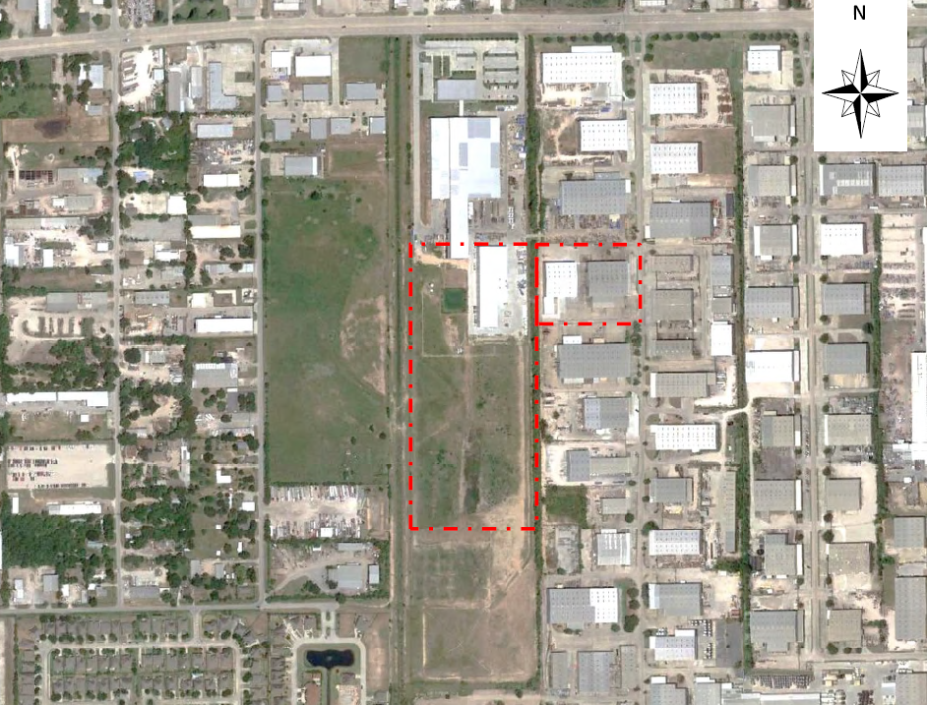
Example 1.2
Figure clearly outlines the proposed MSD boundary
However, the scale is too small to adequately demarcate corporate limits (important if city limits change within 0.5 miles)
Combination of Examples 1.1 and 1.2 would be sufficient for Item 1

Slide 12
Item 2:
Public Water Supply
REQUIREMENTS
COMMON MISTAKES
Ensure public water supply is available:
  For properties within MSD boundary
  For all properties within a ½-mile radius of MSD boundary
Provide map of potable water service lines or statement from appropriate authority
½-mile radius not depicted
Additional public drinking water systems not identified
Statement from the appropriate public drinking water system(s) not provided
12

Slide 13
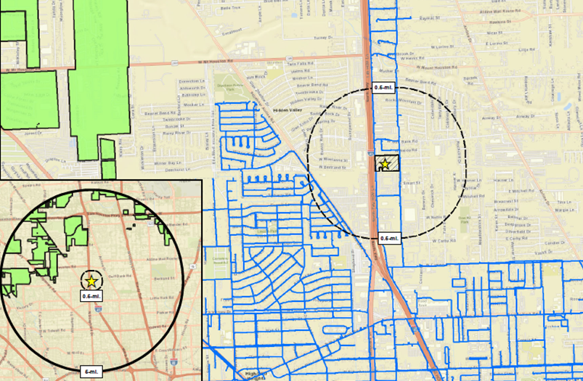
Example 2.1
Figure clearly identifies water service lines
However, water service lines do not appear to be available to all properties within 0.5 miles
Note: Missing water lines may be associated with other public drinking water systems
13

Slide 14
Item 3:
Legal Description of MSD Property
REQUIREMENTS
COMMON MISTAKES
Submit legal description
(outer boundary of MSD)
Metes and bounds survey not signed and sealed by Texas Registered Professional Land Surveyor
Size not consistent with MSD Application Form or Item 6
Lot and Block copied from county appraisal district website
14

Slide 15
Item 4:
Description of Designated Groundwater
REQUIREMENTS
COMMON MISTAKES
Describe the groundwater that is affected and will be restricted
Define upper and lower bounding limits
Provide designated geological formation/unit/member names, if known
Not provided
Bounding limits not defined
Reference to restriction defined in ordinance or restrictive covenant
15

Slide 16
Item 5:
Groundwater Contamination
REQUIREMENTS
COMMON MISTAKES
Provide documentation of verified groundwater contamination
Include table with:
  Contaminant name
  Chemical Abstract System (CAS) number
  Potable water use standard
  On-site concentrations
No verified groundwater contamination
Omitted table requirements (e.g., no CAS numbers)
16

Slide 17
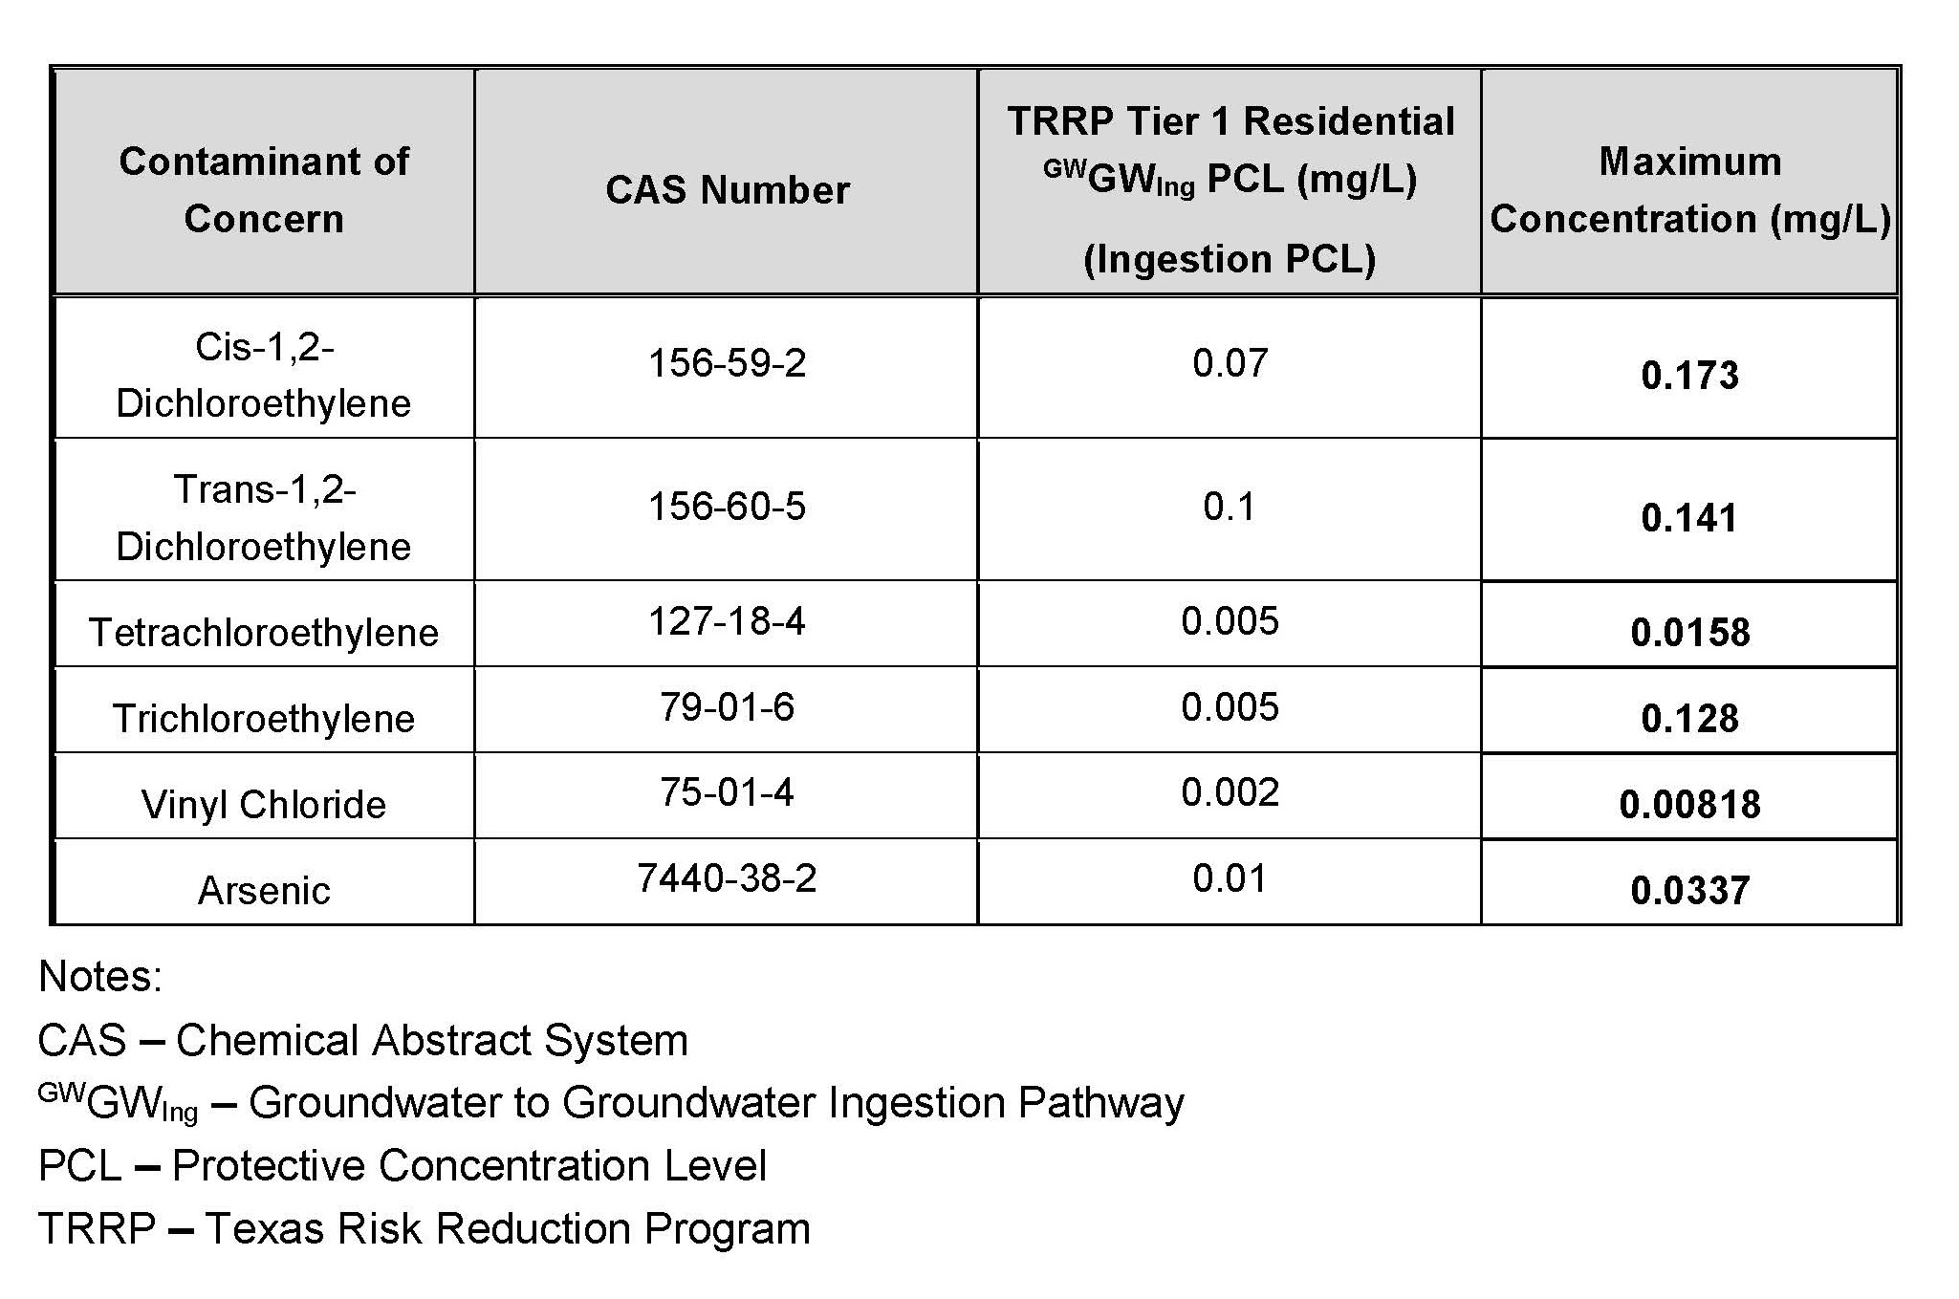
Example 5.1
Table identifies all required information
Note: If contamination was not previously documented to TCEQ, then laboratory documentation is required
17

Slide 18
Item 6:
Groundwater Use Restriction
REQUIREMENTS
COMMON MISTAKES
Provide ordinance or restrictive covenant with resolution of support
Provide additional resolutions of support from:
  All other municipalities within 0.5 miles
  All other municipalities owning or operating wells within 5 miles
  Retail Public Utilities (RPUs) owning or operating wells within 5 miles
Not provided
Resolution of support only; Restrictive covenant not provided
Resolutions of support not signed by city council
18

Slide 19
Item 7:
Municipality, RPU, and Private Water Well Identification
REQUIREMENTS
COMMON MISTAKES
Provide a map that identifies:
  Proposed MSD boundary
  Boundaries of all municipalities and ETJs within 0.5 miles
  Service boundaries for any RPUs within 5 miles
  All private water wells within 5 miles (include unique well ID number)
Provide a copy of the Water Well Report
Scale (consider multiple figures)
Wells listed as non-potable not included on map
Water Well Report not provided
Radii from center point and not outer boundary of proposed MSD
19

Slide 20
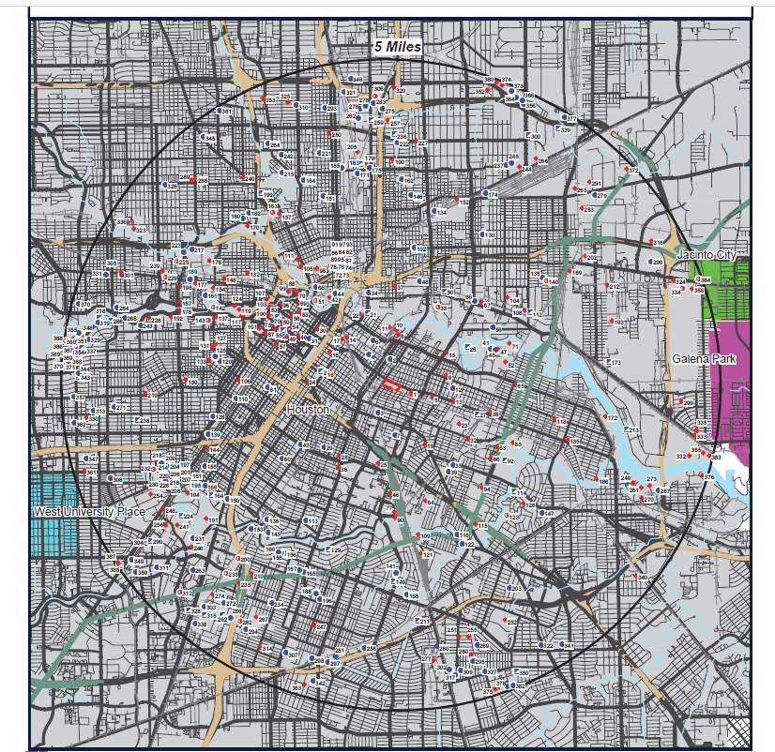
Example 7.1
Figure demarcates proposed MSD boundary and includes locations of water wells within 5 miles
Corporate limits identified
However, RPU service boundaries are absent (include if present)
½-mile radius not included
20

Slide 21
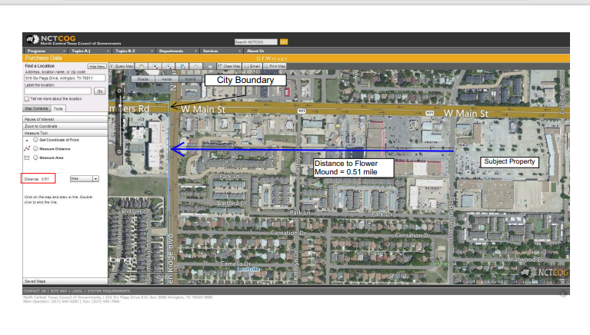
Example 7.2
A more detailed figure might be necessary to clarify distances.
This example shows the City of Flower Mound is 0.51 miles west of the proposed MSD and therefore, would not be required to provide support.
21

Slide 22
Item 8:
Locate Water Wells and Determine Contact Info
REQUIREMENTS
COMMON MISTAKES
Description of actions taken to:
  Locate all private water wells within 5 miles
  Determine well owners and contact information
Not provided (usually, a letter from the company used to locate wells)
Not all databases are searched
22

Slide 23
Item 9:
Table of Water Wells
REQUIREMENTS
COMMON MISTAKES
Provide a table keyed to:
  Unique map ID in Item 7
  State of Texas Well ID number
  Well owner
  Current mailing address
  Notification success ('yes" or "no")
  Page number of signed notification receipt in Item 10
Addresses omitted
Page numbers in Item 10 not provided
23

Slide 24
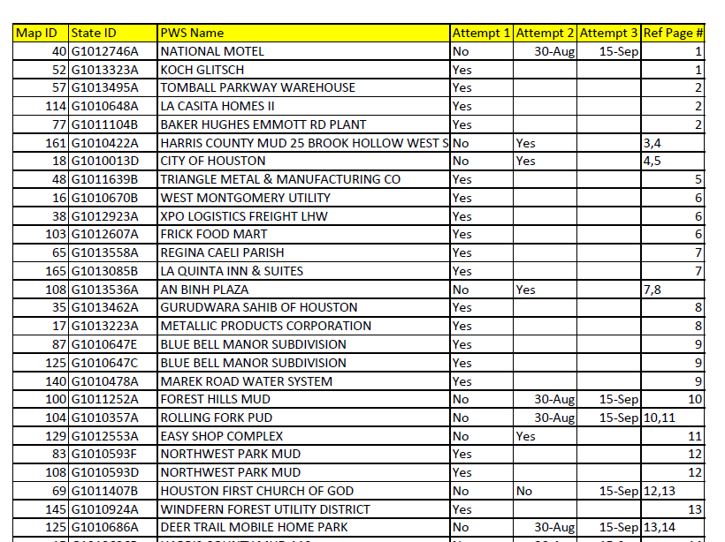
Example 9.1
Table provides most of the required information
However, addresses need be included
Dates provided for notification attempts 2 & 3 insufficient to indicate if notice was successful

Slide 25
EXAMPLE 9.2
Table shows all required information, except notification success
Also includes tracking numbers (not required)
  Note: Providing tracking numbers can be beneficial when cross-referencing with Item 10

Slide 26
Who Receives Notice?
Municipality in which proposed MSD is located
All Other Municipalities
Within ½-mile of proposed MSD boundary
Address to City Secretary
Retail Public Utilities (RPUs)
Address to registered agent, owner, or manager
Each Registered Private Water Well Owner
Address to current owner
Address to City Secretary
Owning or operating water wells within 5 miles of proposed MSD boundary
Owning water wells within 5 miles of proposed MSD boundary
Owning or operating water wells within 5 miles of proposed MSD boundary

Slide 27
Item 10:
Notification
Provide a copy of each notice letter
Provide proof of notification attempts
Number the pages for cross-reference with Item 9
Include each signed delivery receipt

Slide 28
Keys to Successful Notifications
COMPLETE A THOROUGH WATER WELL SEARCH
SEND NOTICE TO CURRENT OWNER
USE TAX APPRAISAL INFORMATION TO ENSURE CORRECT ADDRESS
PROVIDE SIGNED RECEIPTS IN ITEM 10
Signed receipts required per statute as proof owner was notified
Acceptable methods:
  USPS Certified Mail, Return Receipt Requested
  FedEx Direct Signature Required
  Hand delivered with notarized statement

Slide 29
What if signed receipt is not available?
Ensure current correct address is identified
Conduct at least two attempts at obtaining a signature
Third and final attempt can be delivery confirmation
Proof of all three attempts (to the same, correct, current address) can be provided in lieu of a signature

Slide 30
Types of Mail Attempts
Type of Service | 1st Attempt | 2nd Attempt | 3rd Attempt
USPS Certified Mail, Return Receipt Requested | √ | √ | √
FedEx Direct Signature Required | √ | √ | √
USPS Delivery Confirmation Receipt | X | X | √

Slide 31
Notification Confirmation
TCEQ must verify notifications by cross-referencing receipts or proofs of notice in Item 10 with water well owners listed Item 9
Page number(s) where signed receipt or proof of notice is found in Item 10 should correlate with Item 9
Ensure address/tracking numbers provided in Item 9 are verifiable on the signed receipts or proofs of notice provided in Item 10
Item 9 must reference all notification attempts

Slide 32
Item 10
Common Issues
Unsigned receipts
Illegible documentation (smeared, cut off, etc.)
Address on receipt does not match address in Item 9
Signed, but returned to sender
Inconsistent page numbers between Items 9 and 10
Insufficient notification attempts

Slide 33
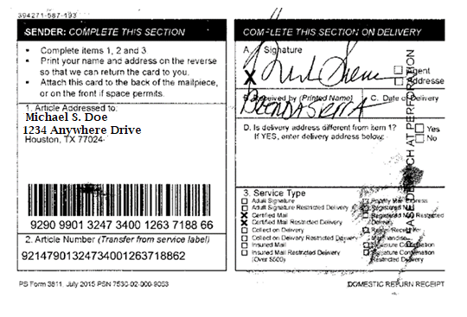

Example 10.1
Signed Receipt
Successful Notice (Signed Receipt)
Successful Certified Notification Attempt (required for minimum 2 attempts)
Successful Delivery Confirmation Attempt (acceptable for 3rd attempt)

Slide 34
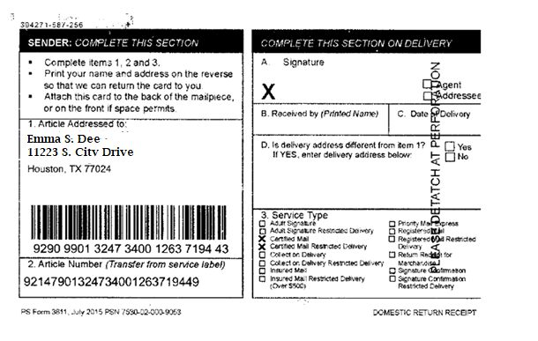

Example 10.2
Unsigned Receipt
Successful Notice (Signed Receipt)
Successful Certified Notification Attempt (required for minimum 2 attempts)
Successful Delivery Confirmation Attempt (acceptable for 3rd attempt)

Slide 35
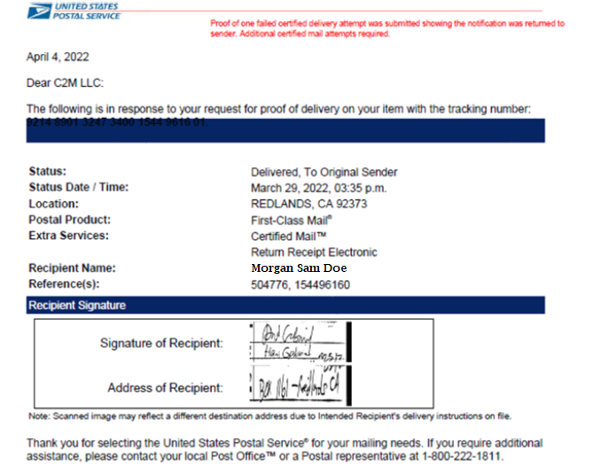
Example 10.3
Electronic Receipt
Returned to Sender
Successful Notice (Signed Receipt)
Successful Certified Notification Attempt (required for minimum 2 attempts)
Successful Delivery Confirmation Attempt (acceptable for 3rd attempt)

Slide 36
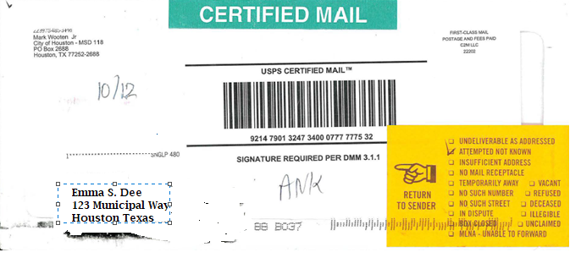
Example 10.4
Certified Attempt
Returned to Sender
Successful Notice (Signed Receipt)
Successful Certified Notification Attempt (required for minimum 2 attempts)
Successful Delivery Confirmation Attempt (acceptable for 3rd attempt)

Slide 37
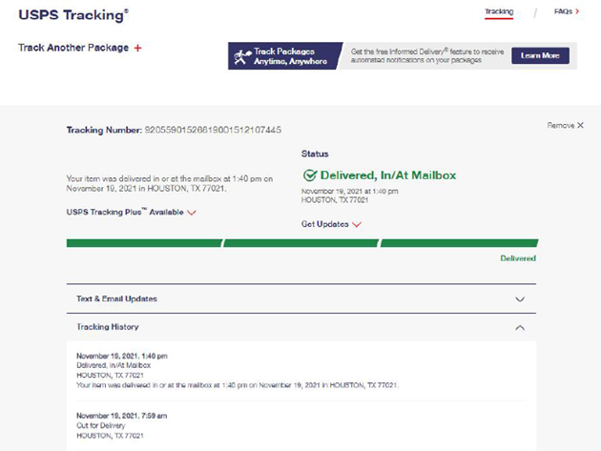
Example 10.5
Delivery Confirmation
Successful Notice (Signed Receipt)
Successful Certified Notification Attempt (required for minimum 2 attempts)
Successful Delivery Confirmation Attempt (acceptable for 3rd attempt)

Slide 38
Item 11: Mailing List
Requirements
Provide contact information for mass mailout notifications
Paper
Electronic (Microsoft Excel® or Word®)
Should contain:
Well Owner Name
Correct Current Address
City
State
Zip code
Remove duplicates

Slide 39
Item 12: Notice to Municipalities/RPUs
If a city or RPU is required to receive notice, contact information must be provided
Municipality contact information must be City Secretary (not the MSD coordinator for the municipality)

Slide 40
Summary
Follow instructions in the MSD Application Form
01
Maintain consistency throughout Application
02
Ensure notification documentation is complete and verifiable
03

Slide 41
Reference and Guidance
Statute: Texas Health and Safety Code Chapter 361 Subchapter W
MSDs: A Guide for Cities
(GI-326)
TCEQ MSD webpage:
https://www.tceq.texas.gov/remediation/msd.html
Contact:
(512) 239-2000
msd@tceq.texas.gov
Questions?

