Slide 1
Industrial Emissions during Enforcement Discretionary Period
Toxicology, Risk Assessment, and Research Division
Updated: 02/23/2021

Slide 2
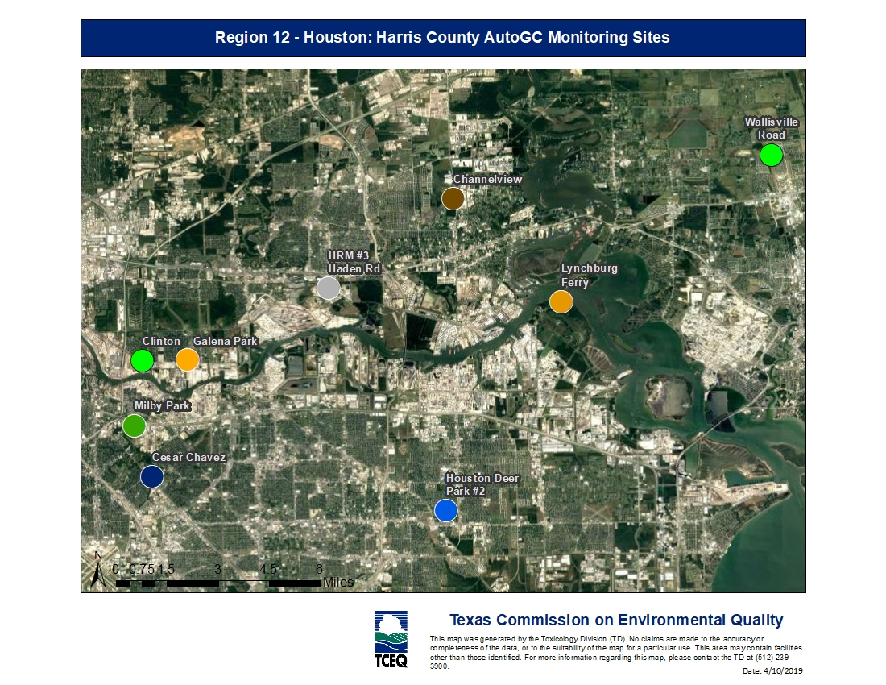
Houston Ship Channel, Region 12

Slide 3
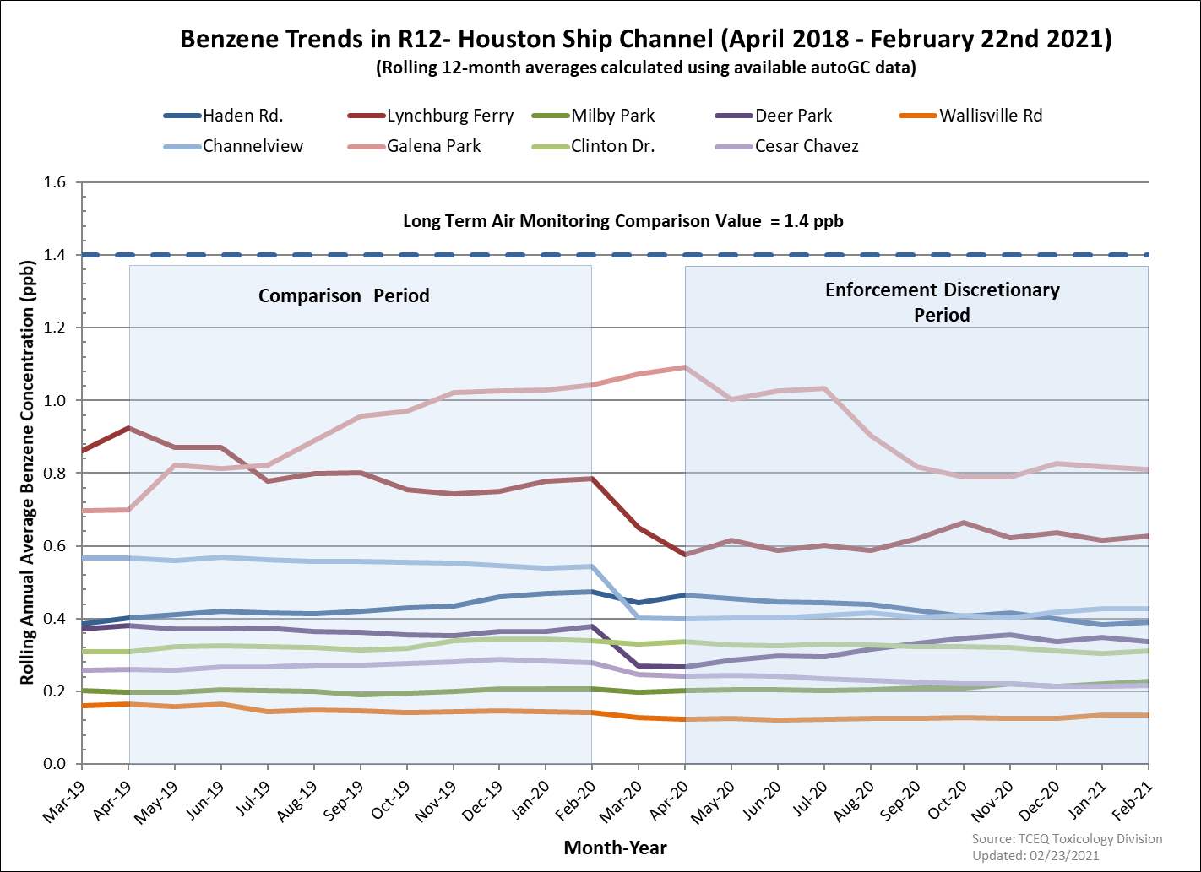

Slide 4
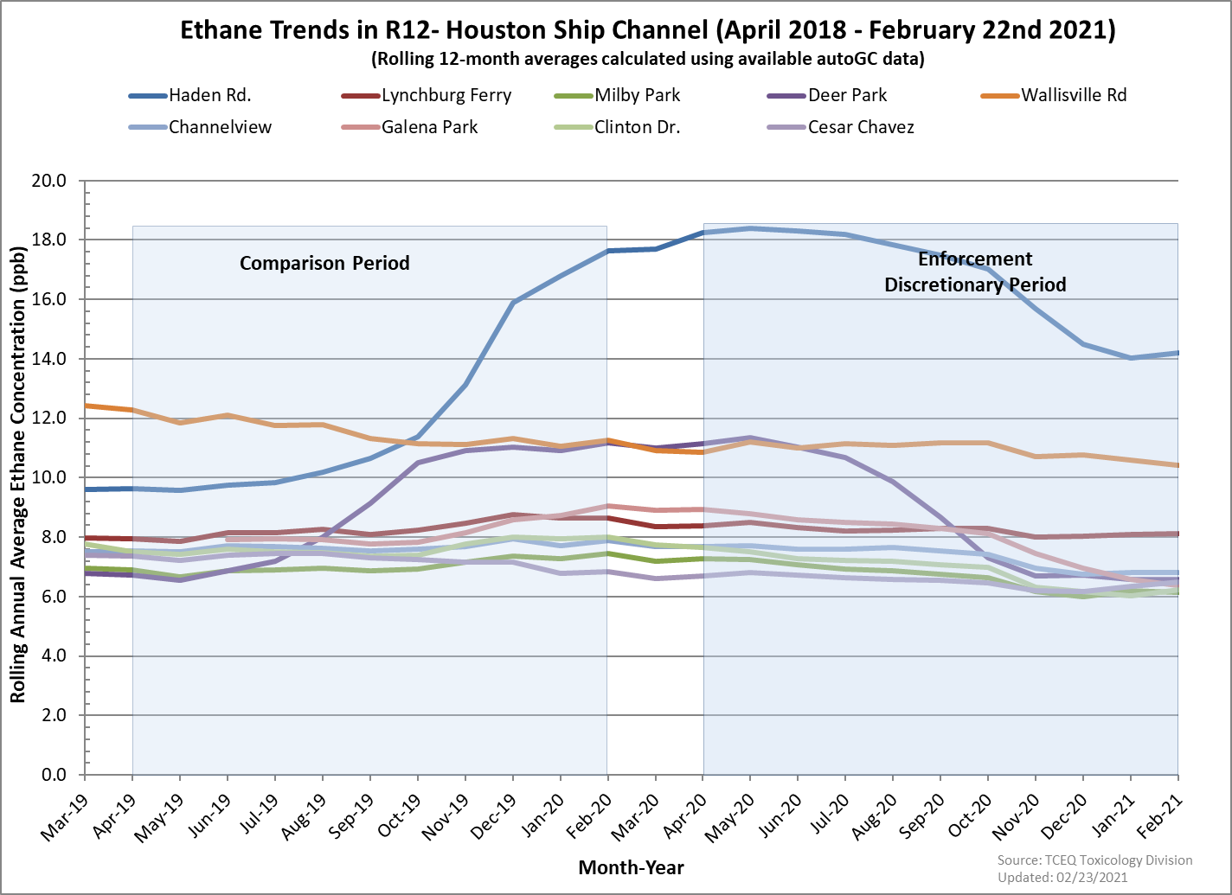

Slide 5
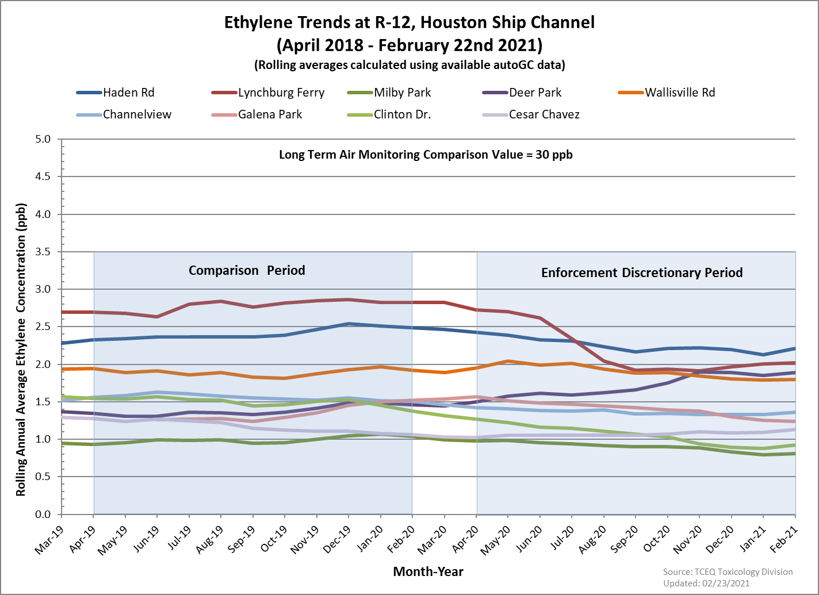

Slide 6
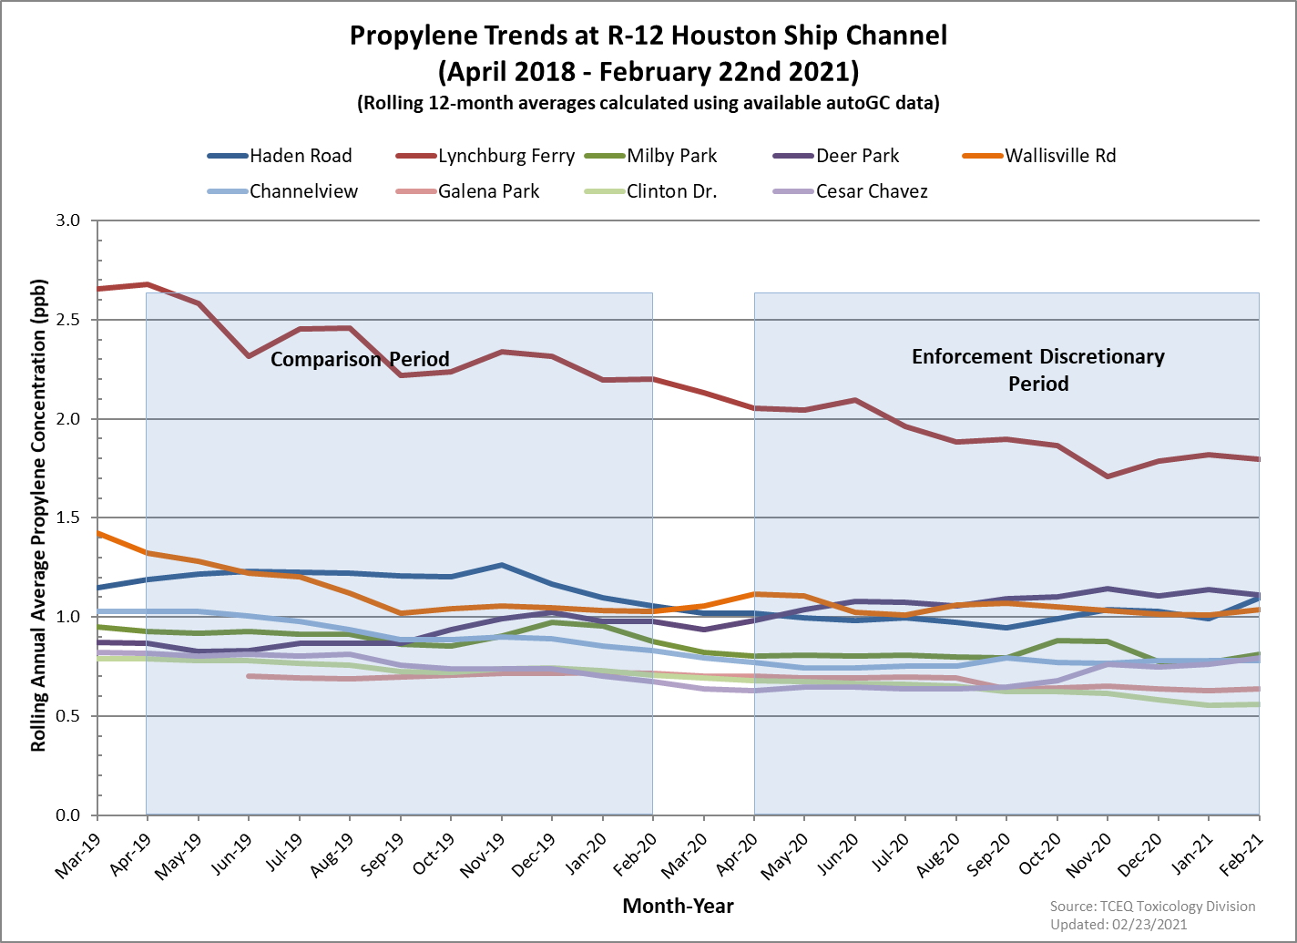

Slide 7
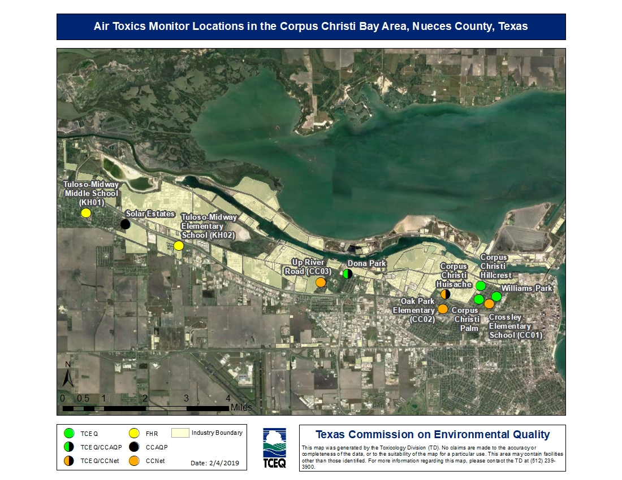
Corpus Christi Bay Area, Region 14

Slide 8
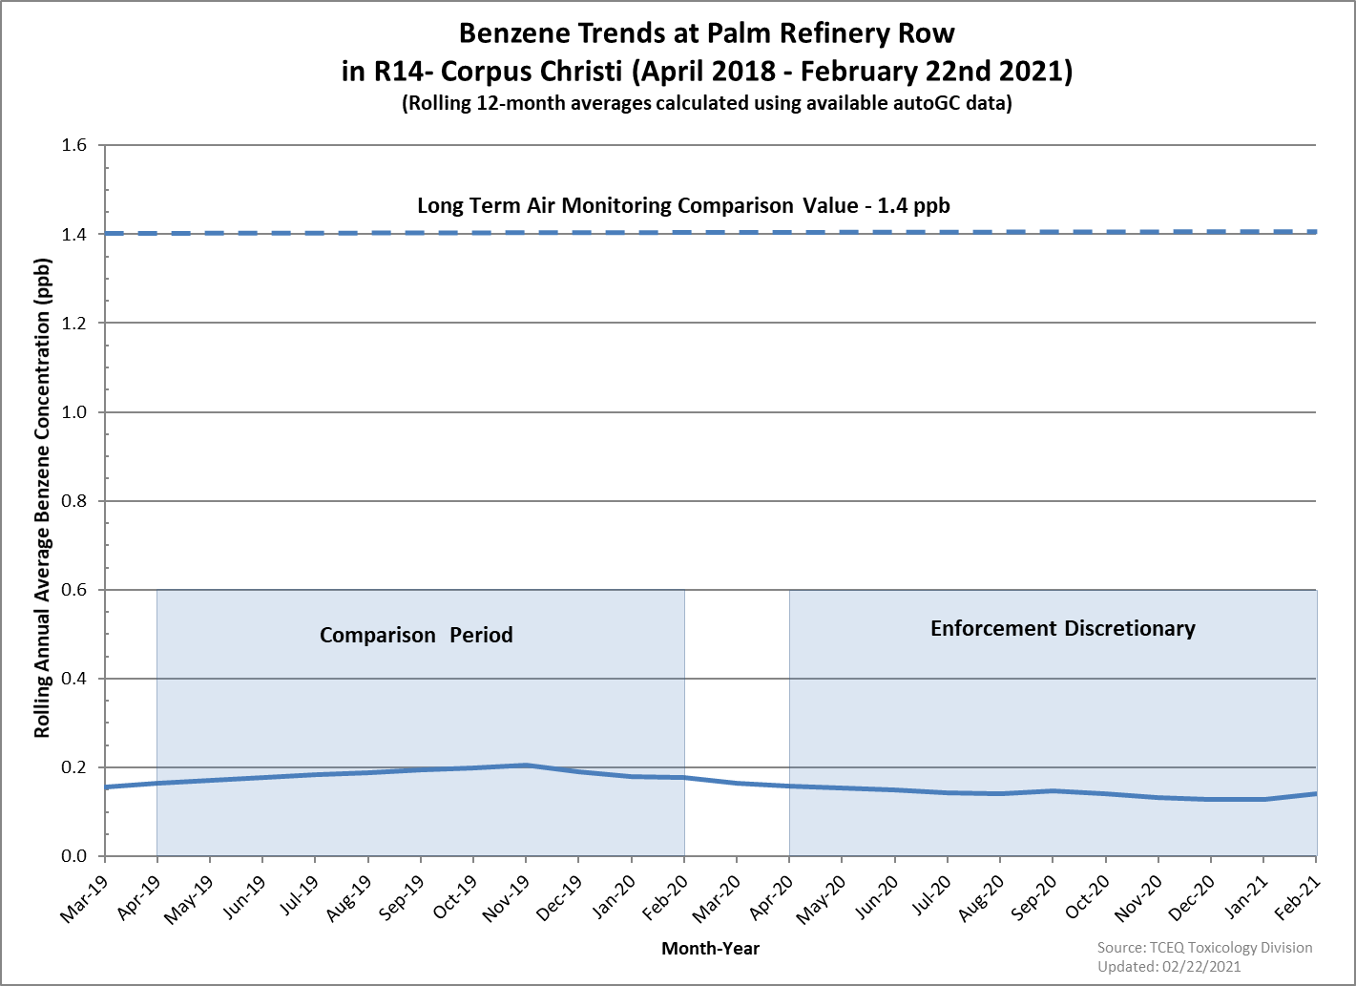

Slide 9
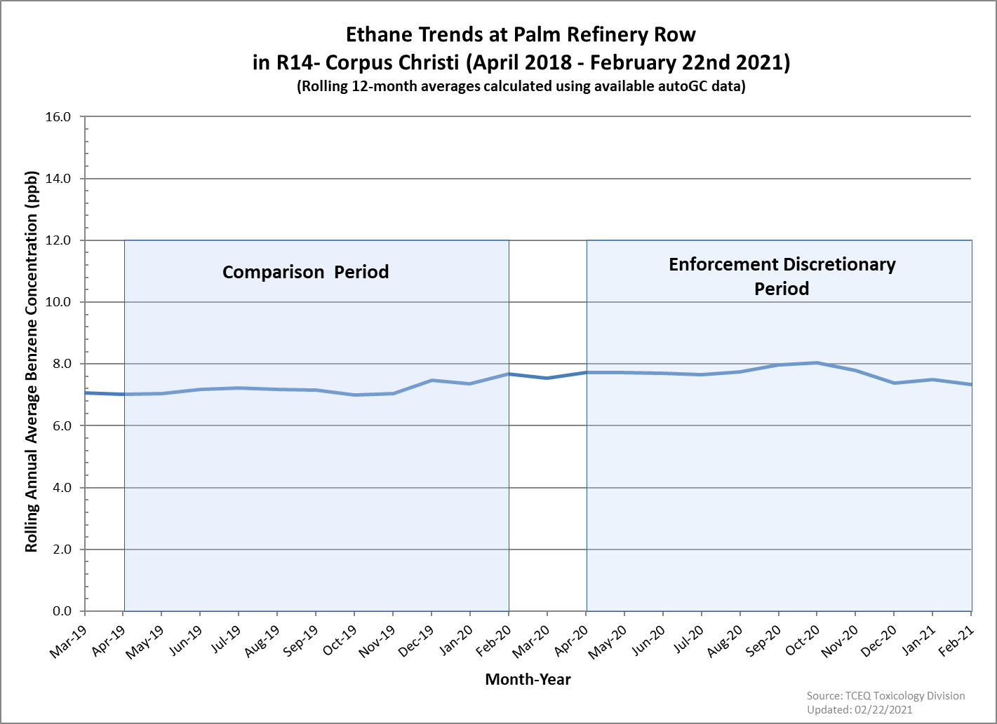

Slide 10
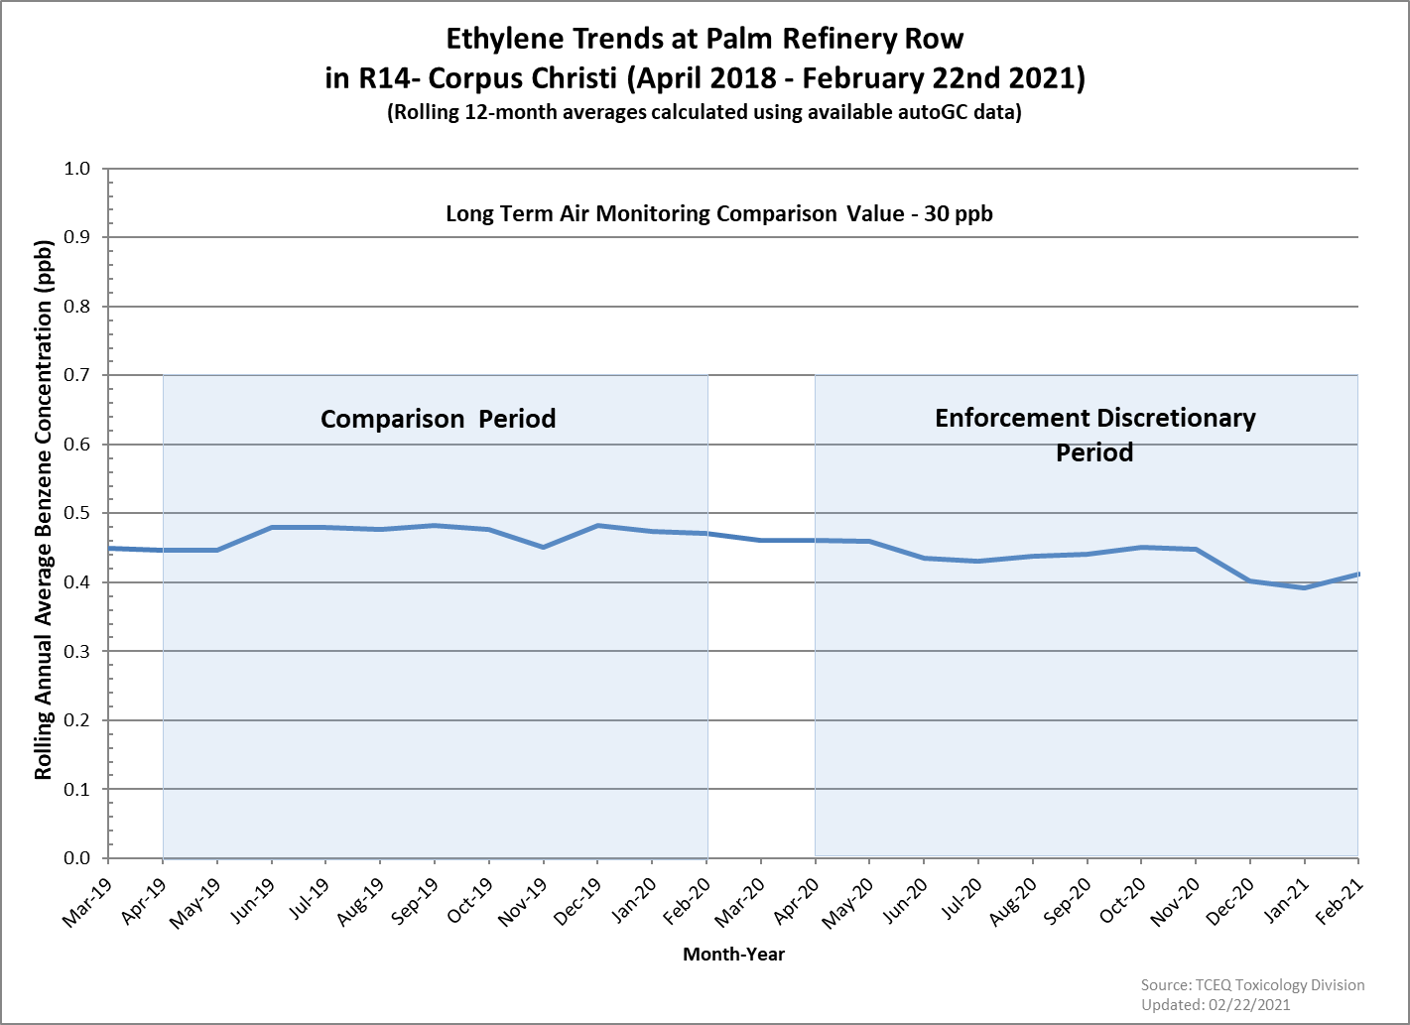

Slide 11
