Slide 1
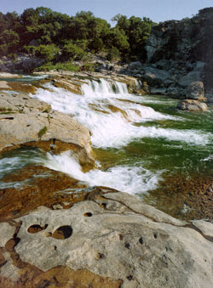
Nutrient Criteria Development Advisory Workgroup
      Welcome
          Moderator
          Director Kelly Holligan
          Water Quality Planning Division
      Water Quality Standards Staff
      Introductions
          Jim Davenport
          Laurie Eng Fisher
          Jason Godeaux
          Joe Martin
          Debbie Miller
Pedernales River
Image by: Texas Water Development Board
Notes:
1

Slide 2
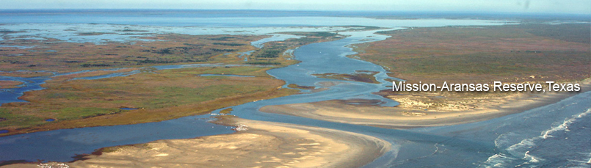
Workgroup Process
          All attendees can participate
          Handouts and other info will be posted
          Email communication
          Written comments
          standards@tceq.texas.gov
Notes:
2

Slide 3
Workgroup Purpose and Goals
Input to develop potential options for Numeric Nutrient Criteria (NNC)
Review and suggestion analysis
For this meeting
          Current developments in NNC
          Update on Texas status and plans
          Discussion
Notes:
3

Slide 4
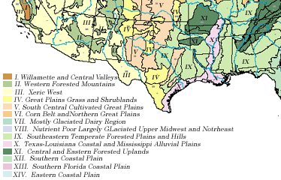
Nutrient Criteria: EPA Guidance
      EPA and Numerical Nutrient Criteria
          1998 mandate: NNC by 2004
          Allowed state development plans and schedules – current plan from 2006
          National guidance criteria
            Separate for lakes,
            streams, reservoirs
            Pooled for large,
            aggregate nutrient
            ecoregions
            Based on historical
            data for TP and TN
            25th percentile or
            75th for unimpacted
            sites

Slide 5
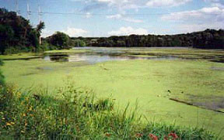
Nutrient Criteria: Recent Guidance
        Nutrient Innovations Task Group Report (August 2009)
        Empirical Approaches for Nutrient Criteria Derivations – SAB Draft (August 2009)
        SAB review (April 2010)
        Using Stressor-response Relationships to derive NNC (November 2010)
        Nutrients in Estuaries (November 2010)
Pond covered in Green Algae

Slide 6
Nutrient Criteria: EPA
          EPA “Speed Up” memo (Ben Grumbles) (May 2007)
Lawsuits Florida (July 2008), Wisconsin (Nov. 2009), Kansas (June 2010), possibly more
“Go Faster”- EPA Inspector General (August 2009)
EPA promulgated NNC for Florida rivers & lakes (November 2010)
EPA letter (Tinka Hyde, Region 5) to Illinois (January 2011)
EPA response letter (Nancy Stoner) to New England states affirmed NNC must have TP and TN criteria (March 2011)
EPA memo (Nancy Stoner) Working in Partnership
Memo (March 2011)

Slide 7

EPA Nutrient Criteria: Florida
Lawsuit from Florida Wildlife Fed. & others in 2008
Consent decree with EPA in 2009
EPA promulgated criteria for Florida lakes & streams in Nov 2010 - in effect Mar 2012
EPA estuary criteria - propose in Nov 2011; final
Aug 2012
Lake Lyndon B. Johnson
Image by: Lake Property of Texas

Slide 8
Nutrient Criteria: Florida Lakes & Streams
Grouped lakes by color and alkalinity
          Chlorophyll a (20 – 6 µg/L)
          Based on Chl a for oligotrophic, mesotrophic
          TP (0.01-0.05 mg/L); TN (0.51-1.27 mg/L)
Grouped streams in regions
          TP (0.06-0.49 mg/L); TN (0.67-1.87 mg/L)
          Based on reference streams (90th percentile)
Stream criteria must protect downstream lakes
Down Stream Protection Values
EPA allows site-specific adjustments
of criteria

Slide 9
Nutrient Criteria: Florida Response
Recent countersuits:
          Florida municipalities and utility districts
          Florida Fertilizer and Agrichemical Association
          Florida Agriculture Commissioner
        Florida DEP: http://www.dep.state.fl.us/water/wqssp/nutrients/
          Petitioned withdrawal – April 22
          Public meetings – June 14 & 16

Slide 10

Nutrient Criteria: State/National Efforts
Other states NNC
          Alabama – Chl a → Site specific by Lake
          Arizona – Chl a, TN, TKN, TP, Secchi → Lake
          category
          Minnesota – TP, Chl a, Secchi → Lake grouping
          Oregon – Chl a → Natural lakes, reservoirs, rivers
          and estuaries
          Wisconsin – TP →Grouping lake & river
Image by: MyManatee.org

Slide 11
Why Are Nutrient Criteria Difficult?
Lack of clear “use-based” thresholds for uses such as recreation & aesthetics, aquatic life propagation, drinking water sources
Responses to nutrients are highly variable – e.g., effect of TN and TP on Chl a
No consensus on how to derive criteria
Independent criteria or “weight-of evidence”?
Insufficiencies in historical monitoring data
Initial EPA guidance criteria were problematic
High concern about regulatory impacts

Slide 12
Nutrient Criteria In General
Monitoring & research is increasing
Potential approaches are becoming defined:
            Stressor-response evaluations – of what levels of TP, TN cause a significant response in Chl a, algal cover, dissolved oxygen swings, fish & invertebrate communities.
            Defining reference conditions – basing criteria on historical ambient concentrations of nutrients in relatively unimpacted water bodies.

Slide 13
Status of Nutrient Criteria in Texas
      Development Plan
      2010 Adoption of reservoir criteria
      2010 Nutrient Implementation Procedures
      EPA review
      EPA framework for state nutrient reductions

Slide 14
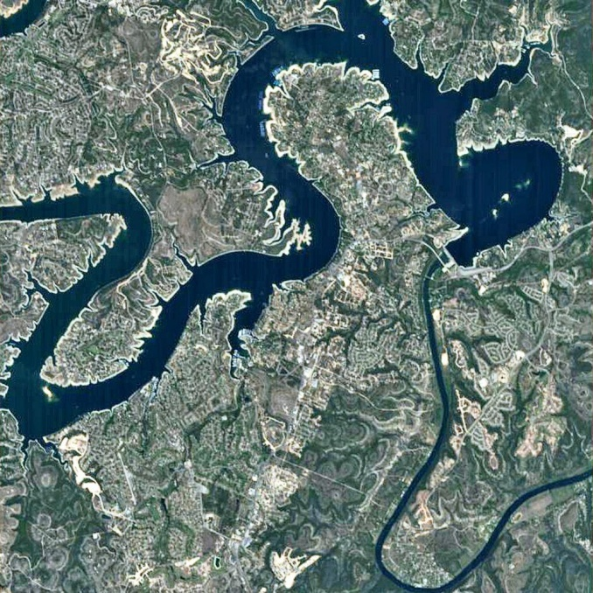
TCEQ Nutrient Criteria: Development
      Submitted plans to EPA in 2001, 2006
      Reservoirs, then streams & estuaries
      Convened advisory workgroup
      Separately for each reservoir
      Set on historical conditions
      Proposed for 93 reservoirs
      - Stand-alone Chl a criteria
      - Chl a criteria, + screening levels:
      TP, transparency
      New permitting procedures for nutrients

Slide 15
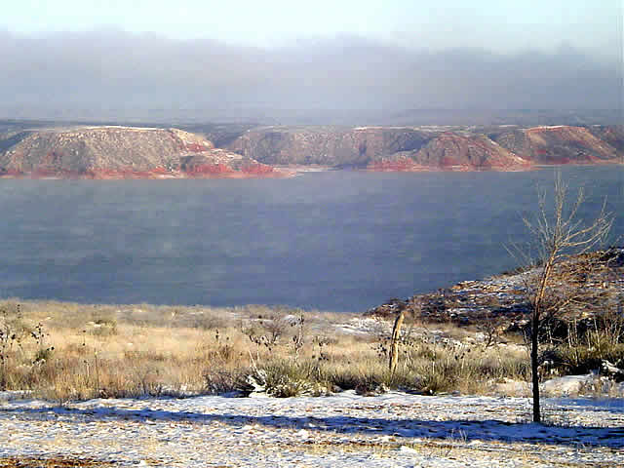
Reservoir Nutrient Criteria - Assumptions
Included reservoirs with > 30 sampling dates
Data from 1990-2008, older data if needed
Criteria = upper prediction interval
Outliers = > 1.5 interquartile range (boxplot)
Values < detection limit = ½ detection limit
Assumes normality of untransformed data
Minimum criterion = 5 µg/L Chl a
Lake Meredith
Image by: Brent Shirley

Slide 16
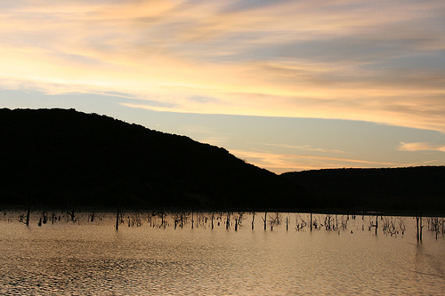
Reservoir Nutrient Criteria - Options
Assessed as median Chl a, >10 sampling dates
Assessed at main pool station or comparable
Option 1: Confirm with TP, Transparency values
- Calculated same as Chl a criteria
- Impaired if Chl a criterion plus one of the screening criteria are exceeded
Option 2: Stand-alone Chl a criteria
Adopted: Option 2 for 75 reservoirs
Lake Palo Pinto
Image by: ThisIsBryanOk

Slide 17
Nutrient Criteria: Examples
Reservoir | Chl a (µg/L) Stand-alone | TP (mg/L) Not adopted | Transparency (meters) Not adopted
Eagle Mtn | 25.4 | 0.07 | 0.80
Cedar Creek | 30.4 | 0.07 | 0.80
Livingston | 23.0 | 0.16 | 0.67
Lewisville | 18.5 | 0.06 | 0.60
[Houston – not adopted] | [12.4] | 0.18 | 0.28
Travis | 3.7 | 0.03 | 3.13
Table that shows an example of nutrient criteria that was proposed in the 2010 Water Quality Standards:
Reservoir - Eagle Mtn; Chl a Stand-alone - 25.4 micrograms per liter; TP Not adopted - 0.07 milligrams per liter; Transparency Not adopted - 0.80 meters
Reservoir - Cedar Creek; Chl a Stand-alone - 30.4 micrograms per liter; TP Not adopted - 0.07 milligrams per liter; Transparency Not adopted - 0.80 meters
Reservoir - Livingston; Chl a Stand-alone - 23.0 micrograms per liter; TP Not adopted - 0.16 milligrams per liter; Transparency Not adopted - 0.67 meters
Reservoir - Lewisville; Chl a Stand-alone – 18.5 micrograms per liter; TP Not adopted - 0.06 milligrams per liter; Transparency Not adopted - 0.60 meters
Reservoir - Houston not adopted; Chl a Stand-alone – 12.4 micrograms per liter; TP Not adopted - 0.18 milligrams per liter; Transparency Not adopted - 0.28 meters
Reservoir - Travis; Chl a Stand-alone – 3.7 micrograms per liter; TP Not adopted - 0.03 milligrams per liter; Transparency Not adopted – 3.13 meters
Notes:
Examples of Proposed Nutrient Criteria for 6 better known Texas Reservoirs.
-Eagle Mountain Lake has a Stand Alone Chl-a criteria of 25.4 µg/L, Cedar Creek Lake 30.4 µg/L, Livingston Lake 23.0 µg/L, Lewisville Lake 18.5 µg/L, Houston Lake (Not yet adopted) 12.4 µg/L, and Lake Travis 3.7 µg/L. Criteria for Total Phosphorous and Transparency have not yet been adopted, but TP ranged from 0.03 to 0.18 mg/L and transparency from 0.28 to 3.13 meters.

Slide 18
2010 Nutrient Implementation Procedures
In 2010 Standards Implementation Procedures
Applied to increases in domestic discharges
Sets framework for nutrient (TP) effluent limits
Reservoirs – predict effects on “main pool”
Reservoirs – assess local impacts
- Apply site-specific screening factors
- Level of concern – low, moderate, or high
- Assess “weight-of-evidence”
Streams – assess local impacts (as for reservoirs)

Slide 19
Nutrient Screening: Local Factors for Reservoirs
- Size of discharge (quantitative)
- Distance from reservoir (quantitative)
- Sensitivity: water clarity (quantitative or qualitative)
- Sensitivity: observed vegetation responses
- Sensitivity: shading by brush and trees
- Consistency with similar permits (qualitative)
- Local dispersion, mixing (quantitative or qualitative)
- Impact on main pool (quantitative)
- Listed as a nutrient concern in WQ inventory?
Local factors for streams are similar
Notes:
19

Slide 20
Nutrient Screening: Local Factors for Streams
- Size of discharge
- Instream dilution
- Sensitivity to attached vegetation – type of bottom
- Sensitivity to attached vegetation – depth
- Sensitivity to nutrient enrichment – clarity
- Sensitivity to aquatic vegetation – observations
- Sensitivity to aquatic vegetation – sunlight, tree shading
- Streamflow sustainability
- Impoundments and pools
- Consistency with other permits
- Listed as a nutrient concern in WQ inventory
Notes:
20

Slide 21
2010 Nutrient Implementation Procedures: Example
Factor for local impacts - water clarity in reservoirs:
Quantitative Concern level Qualitative Secchi (m)
Low Turbid … < 0.75
Moderate … not murky 0.76 to 1.27
High … high transparency > 1.28
Notes:
21

Slide 22

EPA Review
WQ Standards
          Adopted by TCEQ - 6/30/2010
          Additional documentation to EPA - 8/4/2011
          EPA request for more information regarding nutrient criteria - 5/17/2011
Standards Implementation
Procedures
          Approved by TCEQ
          6/30/2010
          Comments from EPA
          12/2/2010 letter
Lake Bridgeport
Image by: TRWD

Slide 23
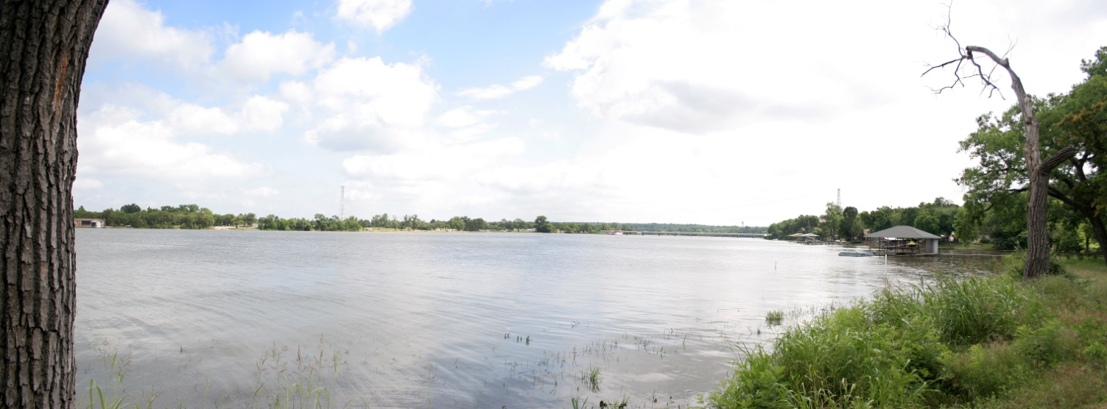
EPA Review of Nutrient Impl. Proc.
      - Should also apply to renewals
      - Lower TP limits than 0.5 mg/L may be needed
      - Include all domestic discharges when evaluating loadings to reservoirs with criteria
      - Is more analysis of cumulative loadings needed?
Lake Worth
Image by: City of Fort Worth

Slide 24
EPA Framework for State Nutrient Reductions
EPA Memo from Nancy Stoner, 3/16/2011
Summarizes key elements needed for state programs to reduce nutrient loadings
Intended as a flexible planning tool
EPA VI has also requested comment and discussion with each state on the framework

Slide 25
EPA Framework for State Nutrient Reductions: Eight Key Elements
Prioritize watersheds on a statewide basis
Set watershed load reduction goals
Ensure effectiveness of point source permits
Agricultural areas
Storm water and septic systems
Accountability and verification measures
Annual public reporting of implementation activities
& biannual reporting of load reductions
Develop work plan, schedule for numeric criteria

Slide 26
Prospects for Developing Additional Nutrient Criteria for Texas
Summary of current plans
Overview of available data and projects
The road ahead: streams and rivers
The road ahead: estuaries

Slide 27
Summary of Current Plans
Develop criteria option for selected rivers and estuaries based on historical conditions
- Individual water bodies
- Reference groupings
Develop criteria option for streams and rivers based on stressor/response analyses
Initiate additional options for estuaries based on ongoing efforts (e.g., stressor/response)
Revisit reservoir criteria
Consider ways to incorporate weight-of-evidence
Develop implementation options

Slide 28
Available Data – Streams and Rivers
30-40 years of data at 100’s of stations, for TP, ~TN, Chl a, Transparency, D.O., etc. plus frequent fish, invertebrate sampling
Data and Research Needs
          Algae Sampling – attached periphyton sampling
          Representative Stations
          More TN data
          Lower TP and TN detection limits
        Recent Projects
          Dr. Beran, Texas Agrilife Research at Stephenville
          Dr. Haggard & Dr. Scott, University of Arkansas
          Dr. Guillen, University Houston Clear Lake
          Additional studies
Notes:
28

Slide 29
Available Data - Estuaries
Long-term monitoring stations with decades of data for TP, ~TN, Chl a, Transparency, D.O., Salinity (~ 72 active stations in 2010)
Numerous research studies
          Marine institutes, national estuary programs,TPWD,
          USGS, TWDB, others
          Nutrient criteria for Mission-Aransas Estuary
          UT Marine Science Institute (Dr. Buskey)
          Nutrient sources/inputs for Galveston Bay, TAMU
          Galveston (Dr. Quigg)
          Loading calculations (USGS)
        Gulf of Mexico Alliance – nutrient team
        TPWD/TCEQ seagrass sampling
        Studies on freshwater inflow effects and needs
Notes:
29

Slide 30
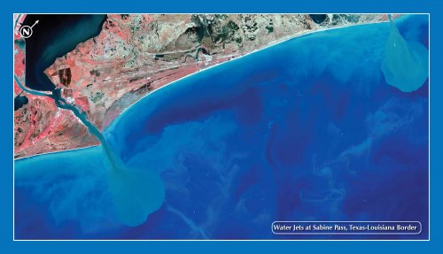
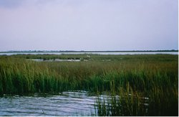
Available Data - Estuaries
Data/research needs
          More TN data
          Lower TP and TN detection limits
          Relationship of TP &TN to Chl a, productivity
          Biological indices for fish, invertebrates
          Biological responses to nutrient loading
          Addressing effects of variations in salinity
Left: Water Jets
Image by: CSTARS
Right: A Texas Estuary
Notes:
30

Slide 31
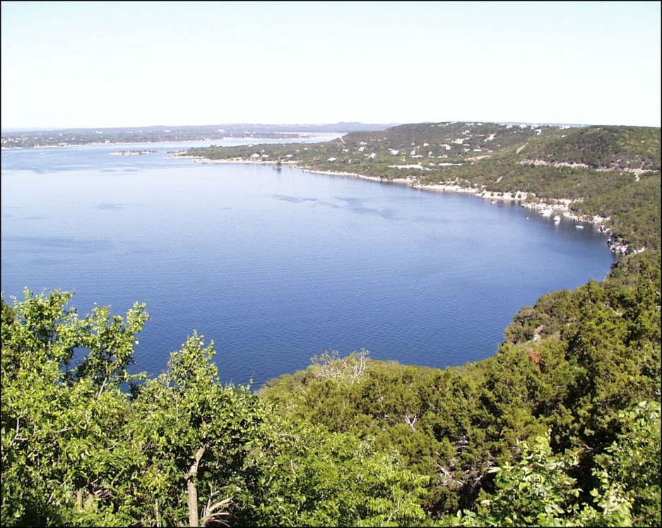
Available Data Reservoirs – again…
Data/research needs
          More TN data
          Lower TP and TN detection limits
          Representative stations
          Relationship of TP & TN to Chl a, productivity
          Biological indices and response
Main Pool of Lake Travis
Notes:
31

Slide 32
The Road Ahead: Streams & Rivers
Categorize and group based on
  Geography?
  Hydrology?
  Chemical similarities?
Option 1: Base criteria on historical levels in reference streams and rivers
Option 2: Stressor/response analyses, relating TN,TP to biological indices, D.O., Chl a (in rivers), attached algae (smaller streams)
Notes:
32

Slide 33
Streams & Rivers: Challenges
Limited data for TN and relative abundance of
attached algae
Extensive geographic, hydrologic, chemical
variability
Ideas on applying these options/additional
options?
Suggestions on how to deal with effluent
dominated streams????
Notes:
33

Slide 34
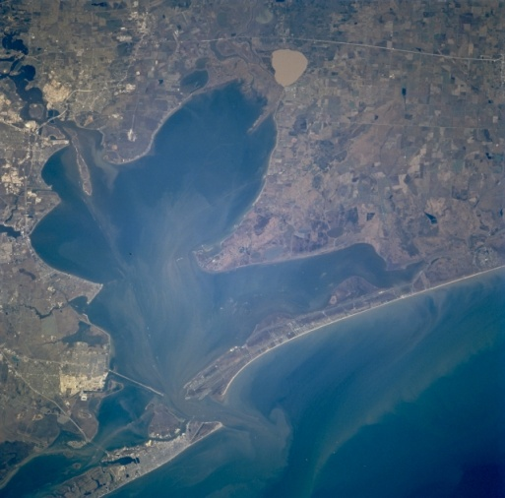
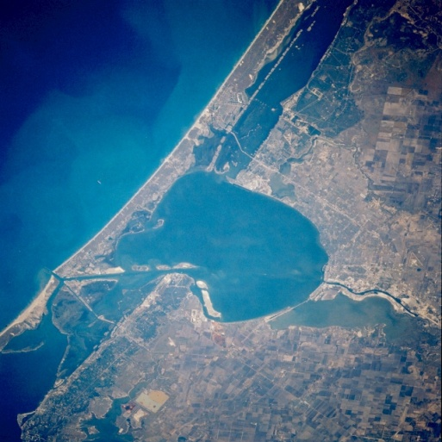
The Road Ahead: Estuaries
Option 1: Base criteria on historical levels of
Chl a, TP, TN, transparency at reference sites
Option 2: Relate TN, TP to observed responses
of parameters such as D.O., Chl a
Option 3: Incorporate models of nutrient
loading/responses (Florida DEP, Chesapeake
Bay)
Left: Galveston Bay
Right: Corpus Christi Bay
Images by: NASA
Notes:
34

Slide 35
Estuaries: Challenges
          What defines normal, healthy nutrient loads and water quality for estuaries?
          Establishing groupings of reference stations difficult
          Examples of criteria development lacking
Remote Sensing of Chlorophyll-a concentrations near Matagorda Bay
Image by: Claire Griffin
Notes:
35

Slide 36
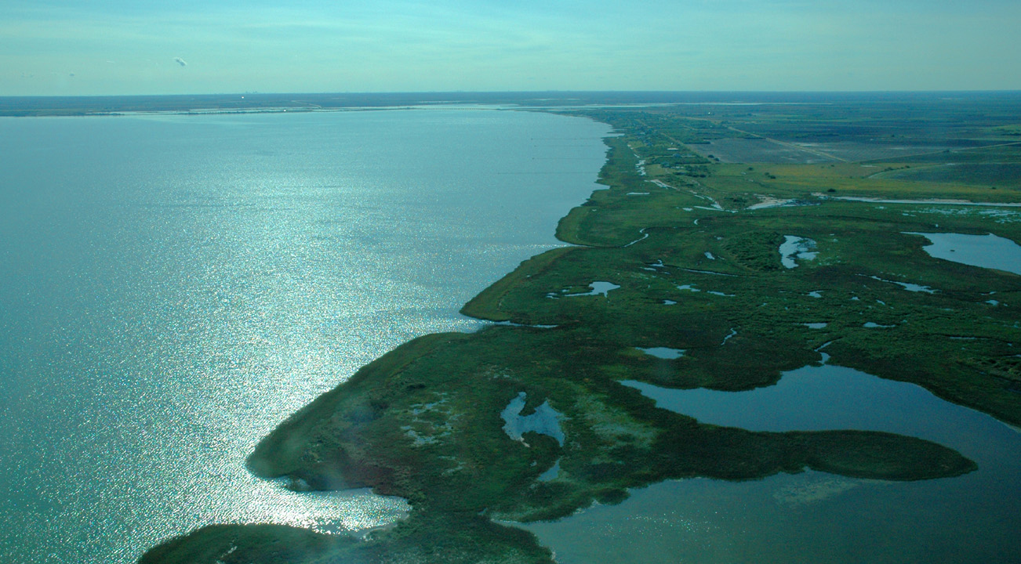
Estuaries: Challenges cont.
Any comments on the nature or resolution of
challenges?
Focus groups needed for any specific individual
estuaries or estuary complexes?
Ideas on applying these options /additional
options?
Texas Mission-Aransas National Estuarine Research Reserve.
Image by: NOAA
Notes:
36

Slide 37
Conclusion
Next Steps and Action Items
Final comments
Next meeting
Webpage
www.tceq.texas.gov/waterquality/standards/stakeholders/nutrient_criteria_group.html
Contact Information
standards@tceq.texas.gov
Notes:
37

