Slide 1
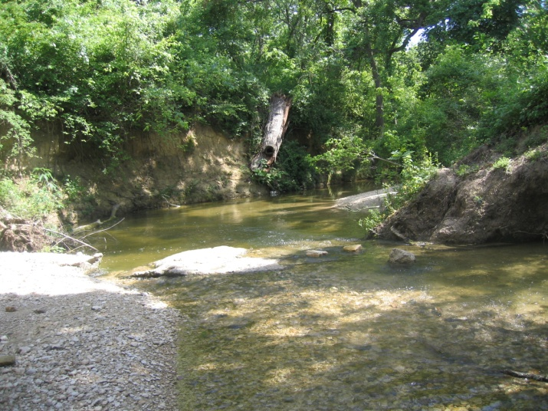
Nutrient Criteria
Criteria (as chlorophyll a ) adopted for 75 reservoirs in 2010, under review by EPA
Review of data for streams and rivers conducted in 2011
Nutrient workgroup met on June 20, 2011 to define next steps
Projects to investigate nutrients in estuaries and further examine other waters are underway for FY 2012 and 2013: These studies will examine
(1) Historical reference nutrient conditions
(2) Data to identify when nutrient effects occur
Walnut Creek
Notes:
TALKING POINTS
In conjunction with overall revisions of the Texas Surface Water Quality Standards (TSWQS), TCEQ adopted numerical criteria (as chlorophyll a concentrations) for 75 reservoirs on June 30, 2010. At the same time, the Commission approved a new framework to evaluate nutrients for wastewater discharge permits – in the Procedures to Implement the Texas Surface Water Quality Standards.
The chlorophyll a criteria are currently under view by EPA. In response to questions from EPA staff, TCEQ sent additional documentation on the nutrient criteria on August 4, 2010. EPA staff requested additional information and analyses on May 17, 2011, and TCEQ has sent an initial response on July 7, 2011. Additional documentation is currently being completed.
TCEQ is continuing to devote major efforts and funding to develop future options for nutrient criteria for streams and estuaries, and to improve and expand criteria for reservoirs.
These efforts include (1) a variety of recent studies to obtain better data on nutrients and attached vegetation in streams, (2) statewide statistical analyses of historical data to identify nutrient effect levels in streams (fy 2011) and in estuaries (fy 2012 and 2013), and (3) an external assessment of available data, approaches taken by other states, and options for Texas (fy 2011).
More information is available on the Standards Webpage www.tceq.texas.gov/waterquality/standards.
NATIONAL INFO
On the national front, EPA promulgated nutrient criteria for Florida streams and reservoirs in November 2010. The final rule was published in the Federal Register on December 6, 2010 and will go into effect on March 6, 2012. EPA plans to propose nutrient criteria for Florida’s estuaries in November 2011. Florida has sued EPA and petitioned to allow the state to develop its own criteria. EPA has indicated in Congressional testimony that they do not intend to promulgate nutrients in other states; However, EPA has recently imposed specific regulatory requirements for nutrient management in several states, such as Illinois and Indiana. EPA has also circulated a suggested process for states to identify and reduce nutrient loadings.

