Slide 1
Proceeding with Reservoirs with Disapproved Chlorophyll a Criteria
Jeremy Walls​
Nutrient Criteria Coordinator | Water Quality Standards Group​
Jeremy.walls@tceq.texas.gov | 512-239-3164

Slide 2
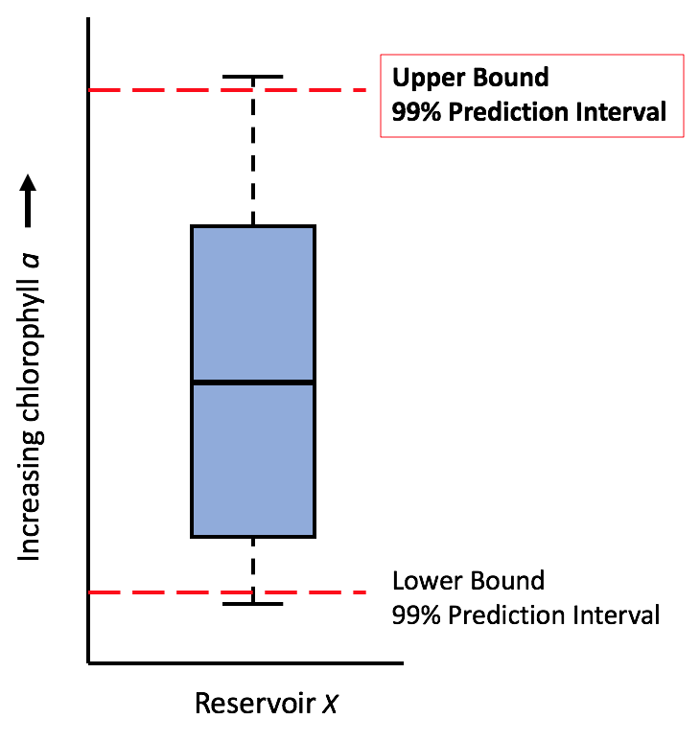
2010 Chlorophyll a Criteria
TCEQ adopted site-specific chlorophyll a criteria for 75 reservoirs
Based on historical conditions
99th percentile of prediction interval
Criteria ranged from 5-55.8 µg/L
Meant to maintain existing water quality and protect long-term existing conditions and uses
Notes:
With the 2010 water quality standards revision, TCEQ adopted site-specific chlorophyll a criteria for 75 reservoirs. The criteria were developed based on historical ambient conditions. The criterion for each reservoir was generated by calculating the upper 99th percentile of a prediction interval of chlorophyll a data spanning from 1990 to 2008, or longer, when necessary, to get at least 30 data points. Here on the right side we can see an example data distribution of chlorophyll a concentrations for a reservoir. A prediction interval set at the 99th percentile of the upper bound of the prediction interval means there is a 99% probability that the values recorded at the same monitoring station in the future (assuming no degradation) will fall below that level. The resulting criteria ranged from 5 µg/L, the historically minimum lab quantifiable chlorophyll a concentration, to 55.8 µg/L. The criteria were meant to be set at a level that not only maintained existing water quality, but protected long-term existing conditions and designated uses.

Slide 3
EPA Action
In 2013, EPA approved chlorophyll a criteria for 39 reservoirs, disapproved the criteria for 36 reservoirs
Disapproval based on EPA’s conclusion that the chlorophyll a criteria are not protective of each reservoir’s designated uses
EPA reviewed and acted on each reservoir-specific chlorophyll a criterion individually
Notes:
EPA approved the criteria for 39 reservoirs, disapproving the criteria for the remaining 36 reservoirs. No chlorophyll a criteria set greater than 20 µg/L were approved. According to EPA, TCEQ’s historical ambient period approach to chlorophyll a criteria development was dependent on the key assumption that the long-term water quality conditions in all 75 reservoirs undergoing criteria development were protective of their designated uses. For the 36 reservoirs in which EPA disapproved the site-specific chlorophyll a criteria, EPA found that the assumption was not satisfied in certain scenarios.

Slide 4
EPA Action
In 2013, EPA approved chlorophyll a criteria for 39 reservoirs, disapproved the criteria for 36 reservoirs
Disapproval based on EPA’s conclusion that the chlorophyll a criteria are not protective of each reservoir’s designated uses
Factors affecting EPA decision on disapproval:
  Reservoir trophic state
  Chlorophyll a values exceeding 30 µg/L
  Trend of increasing chlorophyll a values
  Nutrient concerns in Integrated Reports
Notes:
In general, the scenarios for EPA’s conclusion that TCEQ’s assumption was not satisfied included: hypereutrophic classification, 10% or more of chlorophyll a values in a reservoir’s dataset are equal to or greater than 30 µg/L, or a combination of increasing chlorophyll a trends and nutrient concerns identified in Integrated Report cycles.

Slide 5
Where to go from here…
2014 NCDAWG Meeting Survey
Do you have any suggestions for addressing the disapproved criteria?
What do you feel are the pros or cons of using site specific vs. broad-based criteria?
Is there another criteria development method you would suggest?
Notes:
Following the EPA action letter regarding the 75 reservoirs, TCEQ hosted a nutrient criteria development advisory work group meeting in 2014. Following the meeting, we asked stakeholders for their input on how to address the reservoirs with disapproved criteria. We also asked about using site-specific criteria vs a blanket criteria approach, and whether there were other methods stakeholders suggested.

Slide 6
2014 NCDAWG Survey Response Summary
Stick with site-specific criteria
Needs to be one process for all criteria
  Re-calculate disapproved criteria using old method, but account for trends of degradation (increasing chlorophyll a and nutrient screening concerns)
  Completely re-do the criteria for both approved and disapproved reservoirs such that one method is utilized for all criteria
Use a modeling-based approach to account for variable inflow and other seasonal conditions to develop criteria that are protective of uses and trophic status
Notes:
There were sixteen respondents in total. All respondents to the questions were strongly in favor of continuing to use the site-specific criteria to protect designated uses, given the variability of climate across Texas. Several respondents mentioned that there needs to be one method used for all criteria development, whether we do that by using the old method and adjusting the datasets for the reservoirs with disapproved criteria to account for trends of degradation, or we completely re-do the criteria for all reservoirs using a new method. A modeling approach was also favored by several respondents, in which seasonal conditions and variable inflow rates could be accounted for, and criteria would be set to be protective of the designated uses and/or a set trophic level.

Slide 7
2014 NCDAWG Survey Response Summary
Incorporated into TCEQ Assessment Guidance
Stick with site-specific criteria
Needs to be one process for all criteria
  Re-calculate disapproved criteria using old method, but account for trends of degradation (increasing chlorophyll a and nutrient screening concerns)
  Completely re-do the criteria for both approved and disapproved reservoirs such that one method is utilized for all criteria
Use a modeling-based approach to account for variable inflow and other seasonal conditions to develop criteria that are protective of uses and trophic status
Notes:
TCEQ incorporated the input summarized in these first three bullets into TCEQ assessment guidance, which is still being discussed with EPA. For the last two bullets, regarding re-doing the criteria and using a modeling approach, we'd like the workgroup's input on the preference and viability of these and other potential options.

Slide 8

Additional input?
Notes:
I’d now like to open up the discussion to provide the workgroup an opportunity to provide input on the options from the survey and any other potential options for how we should proceed with the reservoirs with disapproved chlorophyll a criteria.
We'll now take general questions on any of the presentations from today's meeting, including any questions on the periphyton handout.

