Slide 1
TCEQ Nutrient Criteria Development Plan Update
Jeremy Walls​
Nutrient Criteria Coordinator | Water Quality Standards Group​
Jeremy.walls@tceq.texas.gov | 512-239-3164
Notes:
First thing today, I want to give an update on our nutrient criteria development plan and the progress we’ve made since implementing the plan. This presentation will be similar to my presentation given during the May surface water quality standards advisory work group meeting, but lays the foundation for the rest of our talks today.

Slide 2
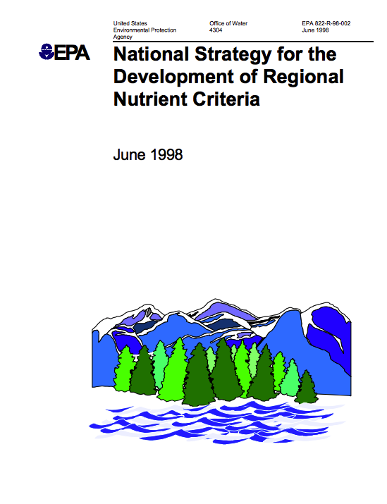
History
Nutrient criteria development plan (NCDP) developed to comply with mandate in 1998 EPA National Nutrient Criteria Strategy
TCEQ submitted plans to EPA in 2001, 2006, 2014​
Notes:
TCEQ’s nutrient criteria development plans (NCDPs) are developed to comply with the 1998 EPA mandate that states should either develop numeric nutrient criteria (NNC) for surface waters by 2004 or submit NCDPs that lay a foundation for how the states will develop criteria in the future. TCEQ submitted NCDPs to EPA in 2001, 2006, and 2014.

Slide 3
2014 Nutrient Criteria Development Plan
Purpose: provide a framework for the continued development of numeric nutrient criteria for Texas
Components of the Plan:
  History of nutrient criteria development
  Nutrient regulations
  Implementation of regulations
  Work to be performed
  Assessment of nutrient criteria
  Options for criteria development
  Ongoing timeline of progress
2014 Nutrient Criteria Development plan:
https://www.tceq.texas.gov/waterquality/standards/WQ_standards_nutrient_criteria.html
Notes:
TCEQ is currently working under the constructs of the 2014 plan, which is still guiding our path for the continued development of numeric nutrient criteria for Texas water bodies.
The 2014 NCDP contains a comprehensive overview of nutrient work in Texas. The plan details the history of nutrient criteria development, nutrient regulations, the implementation of regulations, ongoing studies, and the approach to criteria development for each water body type. An overall timeline of progress is also included with the plan.
The 2014 NCDP can be found on the Nutrient Criteria Development page of our website, or at the link on the slide.

Slide 4
Strategy: 2014 Nutrient Criteria Development Plan
RESERVOIRS
ESTUARIES
RIVERS & STREAMS
WETLANDS
BOUNDARY WATERS
Notes:
In the 2014 NCDP, TCEQ has nutrient criteria development strategies laid out by water body type, including reservoirs, estuaries, and rivers and streams. Wetlands and boundary waters are also included in the plan, but won’t be addressed in much detail during this presentation. Our focus is the other water body classes—reservoirs, estuaries, and rivers & streams.

Slide 5
Schedule: 2014 Nutrient Criteria Development Plan
Water Body Class | Task | Status
Reservoirs | Re-evaluate reservoir criteria disapproved by EPA | Ongoing
Estuaries; Rivers and Streams | Incorporate additional information | Ongoing
Estuaries; Rivers and Streams | Consider expanded narrative criterion and new implementation procedures to address nutrient impacts | Ongoing
Estuaries; Rivers and Streams | Consider numerical nutrient criteria for selected water bodies | Ongoing
Notes:
The 2014 NCDP schedule lays out our next milestones and tasks for nutrient criteria development. There are still several tasks we are actively working to complete, such as those in this table. For reservoirs, we plan to discuss today how to proceed with reservoirs with disapproved chlorophyll a criteria. For estuaries and rivers and streams, we are still actively incorporating additional information and data, as well as taking into consideration new studies that are published among other things. We are also contracting studies that have the potential to be used in the development of numeric nutrient criteria for selected estuaries and rivers and streams. All of this work is ongoing.

Slide 6
Progress: 2014 Nutrient Criteria Development Plan
RESERVOIRS
ESTUARIES
RIVERS & STREAMS
WETLANDS
Notes:
We’ve made significant progress since the submission of our plan to EPA in 2014, so let’s discuss the progress that has been made and ongoing work for each class of water bodies.

Slide 7
Progress: 2014 Nutrient Criteria Development Plan
Updated assessment guidance (2016)
Working with EPA on assessment processes (ongoing)
Developing strategy for addressing reservoirs with disapproved criteria (ongoing)
RESERVOIRS
ESTUARIES
Progress since 2014
RIVERS & STREAMS
WETLANDS
Notes:
For reservoirs, we updated our assessment guidance in 2016 to assess reservoirs with both approved and disapproved criteria. We are still working with the EPA on the assessment implementation. We are also working to develop a strategy for addressing reservoirs with disapproved criteria, which will be discussed later today.

Slide 8
Progress: 2014 Nutrient Criteria Development Plan
Updated assessment guidance (2016)
Working with EPA on assessment processes (ongoing)
Developing strategy for addressing reservoirs with disapproved criteria (ongoing)
RESERVOIRS
ESTUARIES
Coastal Modeling Contract (2017)
Refined Coastal Modeling Contract (ongoing)
Progress since 2014
RIVERS & STREAMS
WETLANDS
Notes:
For estuaries, we have completed one contract through Texas A&M Galveston, and another is underway right now. Our contractor will touch more on these projects later today.

Slide 9
Progress: 2014 Nutrient Criteria Development Plan
Updated assessment guidance (2016)
Working with EPA on assessment processes (ongoing)
Developing strategy for addressing reservoirs with disapproved criteria (ongoing)
RESERVOIRS
ESTUARIES
Coastal Modeling Contract (2017)
Refined Coastal Modeling Contract (ongoing)
Progress since 2014
RIVERS & STREAMS
Database Analysis (2015)
Phase I Periphyton Contract (2017)
Phase II Periphyton Contract (2019)
WETLANDS
Notes:
We have completed three contracts in support of nutrient criteria development for rivers and streams since 2014. We contracted with University of Arkansas to perform a database analysis, looking for statistical stressor-response relationships and thresholds for nutrients. We also contracted with Texas Institute for Applied Environmental Research (TIAER) to look at potential stressor-response relationships among nutrients and periphyton in streams, and thresholds for impacts. The summary of the second phase of that study is provided as a handout today.

Slide 10
Progress: 2014 Nutrient Criteria Development Plan
Updated assessment guidance (2016)
Working with EPA on assessment processes (ongoing)
Developing strategy for addressing reservoirs with disapproved criteria (ongoing)
RESERVOIRS
ESTUARIES
Coastal Modeling Contract (2017)
Refined Coastal Modeling Contract (ongoing)
Progress since 2014
RIVERS & STREAMS
Database Analysis (2015)
Phase I Periphyton Contract (2017)
Phase II Periphyton Contract (2019)
WETLANDS
National Wetlands Condition Assessment (2016)
Notes:
Lastly we have wetlands. The majority of our efforts have been focused towards the other water body classes. However, we did participate in the 2011 National Wetlands Condition Assessment, and the final report was made available in 2016.

Slide 11

Moving Forward
Core tenants of 2014 NCDP still relevant
Continue multi-faceted approach to numeric nutrient criteria development for each major category of water body
Integrate and consider new data, information, and guidance
Notes:
As we saw earlier, the goals of the 2014 plan were laid out in broad terms, and continue to be relevant today. Therefore, as we look to the future, we plan to continue to use a multi-faceted approach toward nutrient criteria development for the various classes of water bodies, including through the use of in-house analyses and contracted studies. We will also continue to consider new data, information, and guidance as it becomes available.

