Slide 1
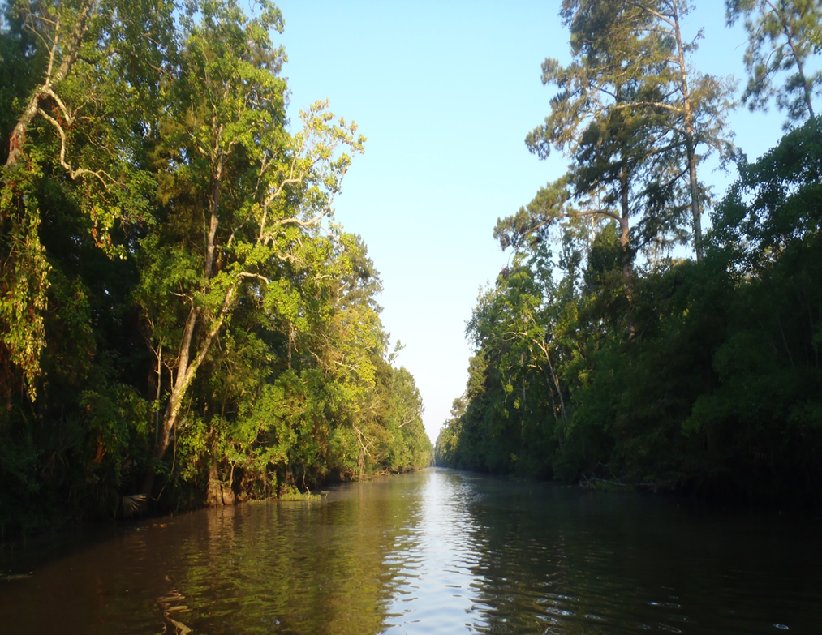
Texas Surface Water Quality Standards (TSWQS) Update
Debbie Miller
Water Quality Standards Group

Slide 2
Water Quality Standards
The Texas Surface Water Quality Standards (TSWQS) (Title 30, Chapter 307 of the Texas Administrative Code) describe the chemical, physical, and biological conditions to be attained in the surface waters of Texas.
Authority for adopting and revising water quality standards is contained in §26.023 of the Texas Water Code (TWC), and in §303(c) of the Federal Clean Water Act.
Notes:
The Water Quality Standards (WQS) are a rule found in 30 TAC, Chapter 307. Texas has had WQS since 1967, so they predate the Clean Water Act.
The goal of the WQS is to maintain the biological integrity of aquatic systems and to make sure they are safe for human uses such as recreation and fish/water consumption.
WQS set the baseline used to establish water quality-based effluent limits. WQS are used to asses the general health of waters of the state in the Integrated Report, including the 303(d) list, which describes what waterbodies aren’t meeting standards, and are used as the targets for the TMDL program and watershed protection plans. Therefore, the WQS impact many water programs both in and outside of the TCEQ.
The WQS also set up the framework for how they are to be applied in permitting and for assessment purposes.

Slide 3
Triennial Revision Process
Preliminary comments
Work group meetings
Proposal rule package with preamble
Fiscal note
Public comment period
Public hearing
Adoption rule package
Response to comments
Notes:
In accordance with the Clean Water Act, the WQS are re-evaluated every three years, or on a triennial basis, to see if any updates or changes are needed based on recently conducted studies or changes to federal rules or guidance. During the triennial review process, we first ask the public for preliminary comments. We then organize work group meetings to discuss possible changes, write the proposal package, and bring it before the commissioners for permission to propose the revisions to the public for a formal public comment period, which ends with a public hearing here at the TCEQ campus. Finally, we bring the proposed changes with response to all comments back to the commissioners for permission to adopt the revisions as the newly revised WQS. The WQS must be approved by the EPA before being used for Clean Water Act purposes.

Slide 4
Types of Actions by EPA
Approved - available for use in all Clean Water Act (CWA) activities – permitting, assessment, TMDL
Disapproved - not available for use in CWA activities
No action - not considered water quality standards under the CWA
Under review
Notes:
EPA communicates their actions taken on revisions of the WQS via action letters. Prior to the 2000 triennial revision, EPA would typically send a single letter that would act on all revisions to the rule. However, when the 2000 revisions were submitted, EPA started issuing letters that only took action on portions of the WQS revisions instead of acting on all of the revisions at once. For the 2000 WQS, it took a total of 11 letters to act on all of the revisions, with the first letter coming in 2004 and the last letter received in 2008. These letters outlined what was approved/disapproved and what portions of the WQS were still under EPA review.
“No action” started in 2010. Basically what EPA is saying with “no action” is that there are portions of the WQS, like references to guidance documents, that EPA now no longer see as water quality standards as defined in the CWA - even though much of this language had been approved by EPA in previous triennial revisions. EPA isn’t saying that these “no action” portions of the rule should be removed. Instead they are simply noting that these are not standards as defined in the CWA. Therefore, EPA can neither approve or disapprove these portions of the WQS.
TCEQ is currently still waiting for the EPA to act on portions of the 2010, 2014, and 2018 WQS.

Slide 5
EPA Action
Highlighted 2018 rule indicates status of approval
Action letters posted on TCEQ Website
EPA Action Letters
November 2, 2018
May 24, 2019
January 6, 2020
Notes:
In order to help everyone understand what is and isn’t approved for CWA purposes, TCEQ has a highlighted version of the rule on our WQS website. All EPA action letters are posted there as well. Since the submission of the 2018 WQS, TCEQ has received three action letters.
EPA’s November 2018 and January 2020 action letters were unique in that they acted on items from multiple revision cycles. The November letter acted on the 2010, 2014, and 2018 revisions, and the January letter acted on the 2014 and 2018 revisions.
None of the letters contained any disapprovals – only approvals.

Slide 6
EPA Approvals – Nov 2018 Letter
2010 TSWQS Revision
Black Cypress Bayou (0410) Temperature Criterion - 90°F
2014 TSWQS Revision
Town Creek (0804L) Intermediate Aquatic Life Use
Notes:
The November 2018 letter approved the temperature criterion for Black Cypress Bayou, which was added to Appendix A during the 2010 revision. The letter also approved the intermediate aquatic life use for Town Creek, which was added to Appendix D during the 2014 revision.

Slide 7
EPA Approvals – Nov 2018 Letter
2018 TSWQS Revision
§307.3. Definitions and Abbreviations
Definition for “Coastal Recreation Waters”
§307.6. Toxic Materials
Table 1 – Biotic ligand footnote
Table 2 – All revised human health criteria, including footnotes
Notes:
The November 2018 letter also approved the addition of a definition for “coastal recreation waters”. This definition was added based on amendments to the CWA by the BEACH Act of 2000.
EPA also approved changes to the existing footnote for biotic ligand models, which are used to develop site-specific aquatic life criteria for copper in freshwater.
Human health criteria for 60 substances were included in this revision cycle and were approved in their entirety.

Slide 8
EPA Approvals – Nov 2018 Letter
§307.7. Site-specific Uses and Criteria
§307.7(b)(1)(B) – revised single sample criterion for Enterococci of 130 CFU/100 mL for coastal recreation waters
§307.9. Determination of Standards Attainment
§307.9(e)(3) – geometric mean criterion and the single sample maximum criterion for Enterococci are each used for determination of standards attainment in coastal recreation waters
Notes:
EPA also approved the revised single sample criterion for enterococci of 130 colony forming units, or CFU, per 100 mL for coastal recreation waters as well as using both the geomean and the single sample max criterion to determine if WQS are being attained. Amendments to the CWA by the BEACH Act of 2000 directed EPA to conduct studies associated with pathogens and human health and to publish new or revised criteria recommendations for pathogens and pathogen indicators based on those studies, which led the EPA to publish new Recreational Water Quality Criteria in 2012 to replace EPA’s 1986 Recreational Water Quality Criteria. These changes were adopted because of recent revisions to EPA’s 2012 Recreational Water Quality Criteria and its tie into the BEACH Act.
The General Land Office is still using 104 CFU/100 mL for Beach Action Values.

Slide 9
EPA Approvals – Nov 2018 Letter
Appendix A – Site-specific Uses and Criteria for Classified Segments
Segment 0902 – Cedar Bayou Above Tidal: removal of public water supply use
Segment 1008 – Spring Creek: site-specific seasonal dissolved oxygen criteria of 4.0 mg/L (24-hour average) and 3.0 mg/L (minimum) from July - September
Appendix B – Sole-source Surface Drinking Water Supplies
All revisions approved
Notes:
EPA also approved the site-specific WQS listed here for Appendix A and Appendix B.

Slide 10
EPA Approvals – Nov 2018 Letter
Appendix C – Segment Boundary Descriptions
Segment 1225 – Waco Lake
Segment 1226 – North Bosque River
Segment 0513 – Big Cow Creek
Segment 0701 – Taylor Bayou Above Tidal
Segment 1259 – Leon River Above Belton Lake
Segment 1424 – Middle Concho/South Concho River
Notes:
EPA approved the listed changes to Appendix C.

Slide 11
EPA Approvals – Nov 2018 Letter
Appendix G – Secondary Contact Recreation 1
Dixon Creek (0101)
Buffalo Creek (0214)
Paradise Creek (0230)
Nichols Creek (0502)
Allens Creek (1202)
Duck Creek (1209)
Shepherd Creek (1209)
Duncan Creek (1222)
Indian Creek (1226)
Simms Creek (1226)
Alarm Creek (1226)
Little Green Creek (1226)
Cottonwood Branch (1242)
Campbells Creek (1242)
Willis Creek (1247)
Unnamed tributary of Scarborough Creek (1255)
Dry Branch (1255)
Gum Tree Branch (1302)
Aransas Creek (2004)
Notes:
EPA approved the listed site-specific contact recreation use for the listed water bodies. These water bodies had been presumed to support primary contact recreation with a numeric criterion of 126 colonies E coli per 100 ml, but recreational use-attainability studies showed that these water bodies were instead supporting a secondary contact recreation 1 use. Numeric criterion for these water bodies is now 630 colonies E coli per 100 ml.

Slide 12
EPA Approvals – Nov 2018 Letter
Appendix G – Secondary Contact Recreation 2
Armstrong Creek (1223)
Goose Branch (1255)
Scarborough Creek (1255)
Unnamed tributary of Goose Branch (1255)
North Fork Upper North Bosque River (1255)
Woodhollow Branch (1255)
Notes:
EPA approved the listed site-specific contact recreation use for the listed water bodies. These water bodies had been presumed to support primary contact recreation with a numeric criterion of 126 colonies E coli per 100 ml, but recreational use-attainability studies showed that these water bodies were instead supporting a secondary contact recreation 2 use. Numeric criterion for these water bodies is now 1030 colonies E coli per 100 ml.

Slide 13
EPA Approvals – May 2019 Letter
Appendix E
Approved Copper WER for MarkWest Javelina Co.
Permit issuance delayed for several years
Public participation occurred with 2018 triennial as opposed to TPDES permitting process
Action letter not issued until May 2019 in order to fully understand proposed changes at the plant
Notes:
It’s unusual to get an EPA action letter on a triennial revision for Appendix E because Water-Effect Ratio (WER) results are usually approved via the permitting public participation process, so WER studies are typically already EPA approved when they are added to Appendix E.
This approval occurred this route instead of through the usual permitting route because of the timing associated with the triennial revision and the reissuance of the MarkWest Texas Pollutant Discharge Elimination System (TPDES) permit (including public participation). The reissuance of the TPDES permit was delayed for a couple of years because of some complicated issues at the plant. The public participation occurred through the 2018 triennial revision of the WQS before it occurred in the TPDES permitting process. In addition, EPA waited to approve the site-specific copper WER results until the TPDES permit was proposed in the spring of 2019. Up until that moment, it was unclear to the EPA what the proposed changes at the plant (such as possibly moving an outfall) were, which could have altered EPA’s review of the WER results under the Endangered Species Act. Once the proposed permit was reviewed by the EPA and they understood that the permit changes would not impact their current review of the study under the Endangered Species Act, EPA approved the addition of this copper WER to Appendix E through the rule revision process instead of the using the usual TPDES process.

Slide 14
EPA Approvals – Jan 2020 Letter
Appendices A and C
Segment 2485 – Oso Bay
Approved segment description (Appendix C)
Approved site-specific dissolved oxygen criteria (Appendix A)
Segment 2486 – Blind Oso Bay
Approved segment description (Appendix C)
Approved site-specific dissolved oxygen criteria (Appendix A), including seasonal criteria
Notes:
EPA approved the listed changes to Appendices A and C.
Site-specific DO criteria were assigned to Oso Bay in the 2014 revision, and EPA approved those DO criteria. In the 2018 revision, Blind Oso Bay was created from a portion of Oso Bay and given site-specific DO criteria similar to Oso Bay, but Blind Oso Bay was also assigned lower seasonal DO criteria from March 15 through October 15. EPA approved this new segment and its associated criteria. EPA also approved the revised description for Oso Bay and the new description for Blind Oso Bay in Appendix C.
Now that we have covered what the last three action letters approved, let’s go over what is still pending EPA review from the 2010, 2014, and 2018 WQS.

Slide 15
2010 TSWQS Pending Action
Revised temperature criteria for two classified segments
Revised dissolved minerals criteria for 19 classified segments
Notes:
Temperature criteria for portions of the Upper San Marcos and Comal Rivers are still pending. These revisions are to lower the temperatures at headwaters of these spring-fed segments to 78 degrees Fahrenheit.
Revised dissolved minerals criteria for 19 classified segments are still pending EPA review. When the 2010 Standards were submitted to EPA Region 6, EPA Headquarters had begun re-evaluating the way states and tribes calculate dissolved minerals criteria. Until EPA Headquarters makes a decision on how they want these numeric criteria calculated, all dissolved minerals criteria will remain under EPA review.

Slide 16
2014 TSWQS Pending Action
Primary Contact Recreation 2
Aquatic life use/dissolved oxygen criteria for eight classified segments
Dissolved minerals criteria for eight classified segments
pH criteria for three classified segments
Boundary description for eight classified segments
Aquatic life use/dissolved oxygen criteria for nine unclassified water bodies
Recreational use changes on three unclassified water bodies
Notes:
The following items listed here are pending EPA approval.

Slide 17
2018 TSWQS Pending Action
Temporary standards revised language
Aquatic life criteria
Acrolein and Carbaryl
Revised language stating nutrient assessment will be based on multiple uses
Boundary descriptions for three classified segments
Aquatic life use/dissolved oxygen criteria for eight unclassified water bodies
Recreational use changes for one segment and 26 unclassified water bodies
Notes:
The following items listed here are pending EPA approval as well.

Slide 18
2021 TSWQS Revision – Tentative Dates
March 2019 – 30 day preliminary public comment period
Workgroup meetings planned for spring of 2020
Agenda date for proposal in April 2021
Public hearing in June 2021
Agenda date for adoption in September 2021
Notes:
We’ve already had the preliminary comment period for this triennial revision, but if there is an additional topic you would like to suggest for consideration for our next workgroup meeting or for this triennial revision, please let us know.
The second work group meeting is planned for late May. We’ll be discussing more site-specific changes to aquatic life and dissolved oxygen criteria, an update on contracts recently completed regarding nutrient criteria development, and a presentation on the results from a contracted study which evaluated a qPCR method for measuring bacteria on the Texas coast among other topics. We’ll send out a “save the date” email to the stakeholders when the date is finalized and let stakeholders know when the agenda is posted on the web (likely about two weeks prior to the May 20th meeting date).

Slide 19
Questions?
Debbie Miller
debbie.miller@tceq.texas.gov
(512) 239-1703
Notes:
This is my contact information.
To receive Work group webpage updates, please sign up to listserv for notices.

