Slide 1
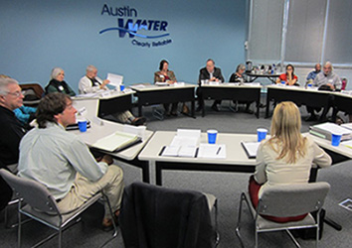


Working Together for
Clean Water
Watershed Maps for the Improving
Austin Streams Project
2022
Stakeholder Update
to the
TMDL I-Plan
September 2021

Slide 2
Disclaimer
These maps were generated by the Total Maximum Daily Load Program of the Texas Commission on Environmental Quality in September 2021. The maps are for informational purposes only and are not suitable for legal, engineering, or surveying purposes. They do not represent on-the-ground surveys; they represent only approximate locations.
For more information concerning these maps, contact the Water Quality Planning Division at 512-239-6682 or email tmdl@tceq.texas.gov.

Slide 3
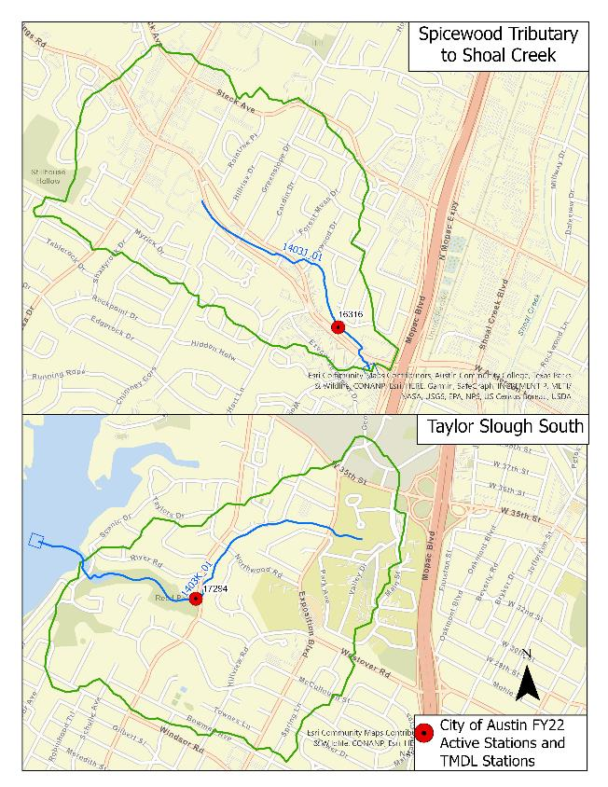
Spicewood Tributary to Shoal Creek Watershed and
Taylor Slough South Watershed

Slide 4
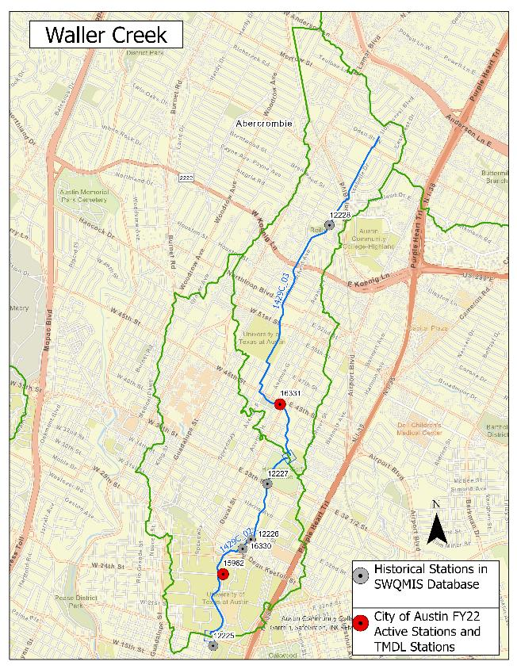
Waller Creek Watershed

Slide 5
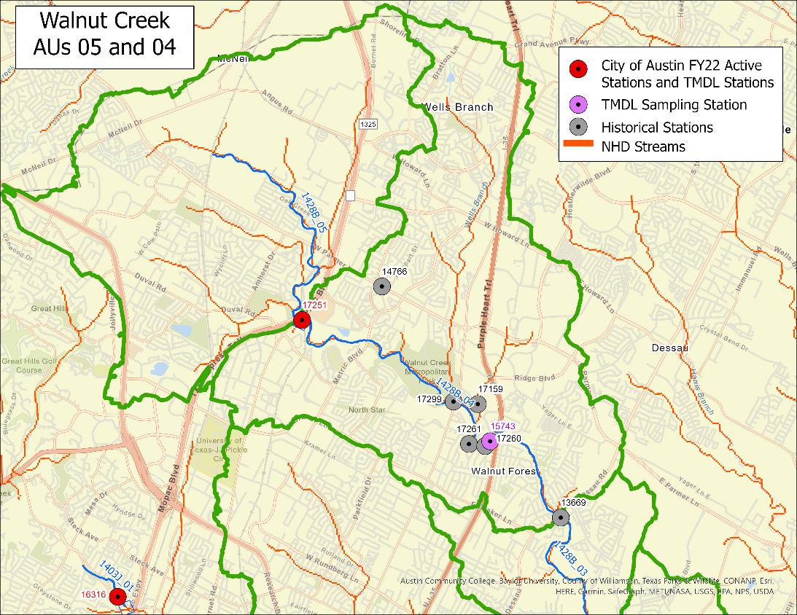
Upper Walnut Creek Watershed (AUs 04, 05)

Slide 6
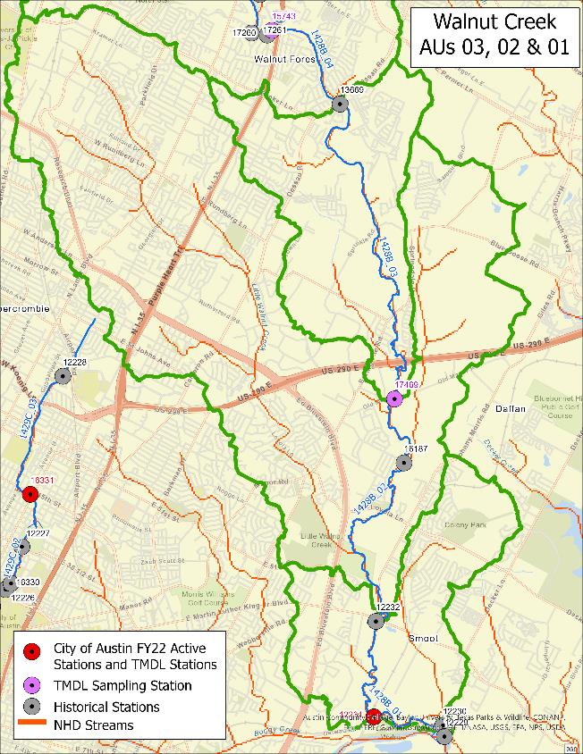
Lower Walnut Creek Watershed
(AUs 02, 03, 04)

